Slide 1
Python Exception handling

Slide 2
Python Errors and Exceptions
Encountering errors and exceptions can be very frustrating at times, and can make coding feel like a hopeless endeavor.
However, understanding what the different types of errors are and when you are likely to encounter them can help a lot.
Python Errors can be of three types:
Compile time errors (Syntax errors)
Runtime errors (Exceptions)
Logical errors

Slide 3
Compile time errors (Syntax errors)
Errors caused by not following the proper structure (syntax) of the language are called syntax or parsing errors.
Runtime errors (Exceptions)
Exceptions occur during run-time.
Your code may be syntactically correct but it may happen that during run-time Python encounters something which it can't handle , then it raises an exception.

Slide 4
Logical errors
Logical errors are the most difficult to fix.
They occur when the program runs without crashing, but produces an incorrect result.
The error is caused by a mistake in the program's logic .
You won't get an error message, because no syntax or runtime error has occurred.

Slide 5
Python Exception Handling
The try block lets you test a block of code for errors.
The except block lets you handle the error.
The finally block lets you execute code, regardless of the result of the try- and except blocks.
When an error occurs, or exception as we call it, Python will normally stop and generate an error message.

Slide 6
Python Exception Handling
These exceptions can be handled using the try statement:
Example
The try block will generate an exception, because x is not defined:
try: print(x) except: print("An exception occurred")

Slide 7
Since the try block raises an error, the except block will be executed.
Without the try block, the program will crash and raise an error:
Example
This statement will raise an error, because x is not defined:
print(x)

Slide 8
Example:
try:
a = int(input("First number: "))
b = int(input("Second number: "))
result = a / b
print("Result =", result)
except ZeroDivisionError:
print("Division by zero is not allowed")
else:
print("Successful division")
Output
First Number:10
Second number:0
Division by zero

Slide 9
Except clause with multiple exceptions
try:
a = int(input("First Number: "))
b = int(input("Second Number: "))
a="10"
result = a / b
print("Result =", result)
except (ZeroDivisionError, TypeError, ValueError):
print("Error occurred")
else:
print("Successful Division")Output
First Number:10
Second Number:0
Error occured

Slide 10
try......finally
A finally block can be used with a try block
The code placed in the finally block is executed no matter Exception is caused or caught
Syntax:
try:
suite;
finally:
finally_suite # Executed always after the try block

Slide 11
Example:
try:
a = int(input("First Number: "))
b = int(input("Second number: "))
result = a / b
print("Result =", result)
finally:
print("Executed always")
Output
First Number:20
Second number:0
Executed always
Traceback (most recent call last):
File “main.py”, line 5, in <module>
result=a/b
ZeroDivisionError: integer division or modulo by zero

Slide 12
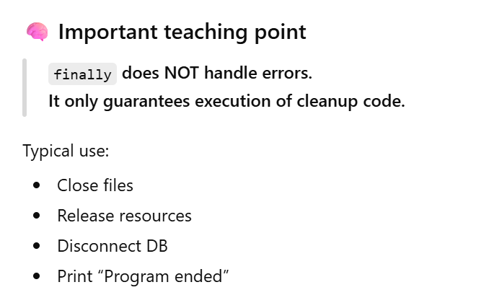

Slide 13
except NameError: Example
try:
print(x) # x is not defined
except NameError:
print("Caught: Variable name is not defined")

Slide 14
except FileNotFoundError: Example
try:
f = open("no_such_file.txt", "r")
print(f.read())
except FileNotFoundError:
print("Caught: File does not exist")

Slide 15
if–else vs try–except
Point | if–else (Check Before) | try–except (Handle After)
Purpose | Check condition first | Handle error after it occurs
When to use | Problem is predictable | Problem is unpredictable
Program crash? | ❌ No | ❌ No (if handled)
User input | ⚠️ Simple checks only | ✅ Safe for wrong input
Runtime errors | ❌ No | ✅ Yes
Example | Check if zero | Non-numeric input
Code | if x == 0: | try: x = int(input())
Meaning | Prevent error | Recover from error
Beginner tip | Use for rules/ranges | Use for input/files

Slide 16
a) Cannot divide by 0 Terminate b) Cannot divide by 0 c) Cannot divide by 0 Inside except block Terminate d) Cannot divide by 0 Inside except block
data = 50
try:
data = data/0
except ZeroDivisionError:
print('Cannot divide by 0 ', end = '')
else:
print('Division successful ', end = '')
try:
data = data/5
except:
print('Inside except block ', end = '')
else:
print(‘Terminate', end = '')
Ans. (a) Explanation: The else block of code is executed only when there occurs no exception in try block.

Slide 17
data = 50
try:
data = data/10
except ZeroDivisionError:
print('Cannot divide by 0 ', end = '')
finally:
print(‘Learning ', end = '')
else:
print('Division successful ', end = '')
a) Runtime error
b) Cannot divide by 0 Learning
c) Learning Division successful
d) Learning
Ans. (a)
Explanation: else block following a finally block is not allowed in python. Python throws syntax error when such format is used.

Slide 18
value = [1, 2, 3, 4]
data = 0
try:
data = value[4]
except IndexError:
print(‘Hello', end = '')
except:
print(‘Let’s start Learning Together', end = '')
a) Let’s start Learning Together b) Hello c) Hello Let’s start Learning Together d) Compilation error
Ans. (b) Explanation: At a time only one exception is caught, even though the throw exception in the try block is likely to belong to multiple exception type.

Slide 19
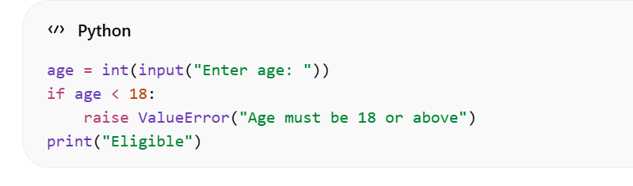
raise keyword (raise an exception manually)
Use: When you want to stop the program with a clear message if an invalid condition happens.

Slide 20
User-defined (Custom) Exceptions Use: When built-in errors aren’t expressive enough for your rule.
class AgeTooSmallError(Exception):
pass
age = int(input("Enter age: "))
if age < 18:
raise AgeTooSmallError("Not eligible for registration")
print("Registered")

Slide 21
Catching the exception message (as e)
Use: To see/log the exact error message for debugging.
try:
x = int("Be loud to your thought")
except ValueError as e:
print("Error message:", e)

Slide 22
What if data.txt not found?
try:
f = open("data.txt", "r")
print(f.read())
except FileNotFoundError:
print("File not found")
finally:
f.close()

Slide 23
What goes wrong?
open("data.txt", "r") raises FileNotFoundError
except runs → prints "File not found"
finally still runs
But f was never created
So f.close() causes another error: 👉 UnboundLocalError:
local variable 'f' referenced before assignment

Slide 24
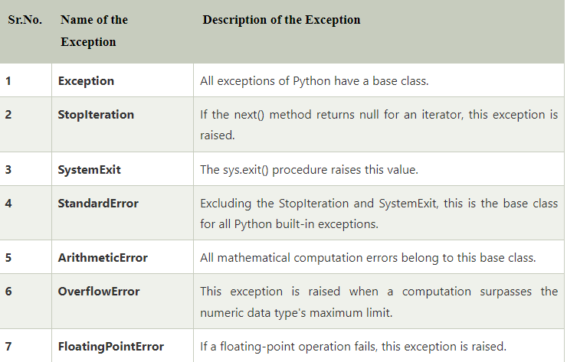

Slide 25
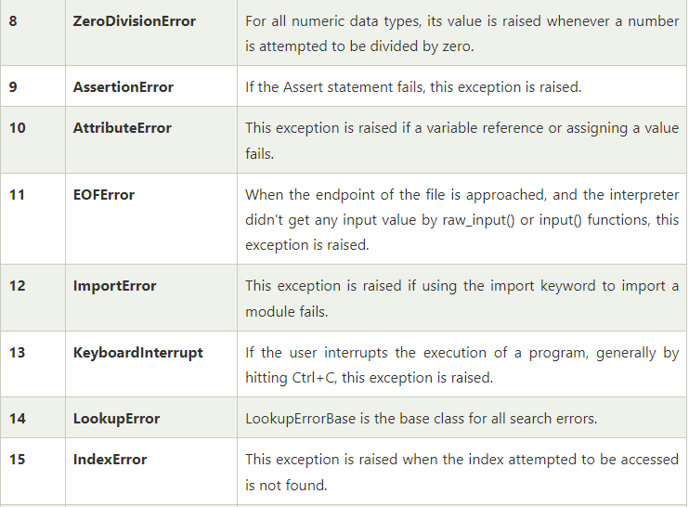

Slide 26
Aaj ka Gyan:
“Don’t fear errors; design for them.”
“Great programmers don’t avoid errors — they handle them gracefully.”
“Bugs test your patience. Exceptions test your design.”

