Slide 1
DICTIONARIES

Slide 2
INTRODUCTION
Dictionaries are called mutable unordered collections with elements in the form of
key : value pairs that associate keys to values.

Slide 3
CHARACTERISTICS/ ADVANTAGES OF DICTIONARY
It is an unordered set.
It is not a sequence.
It is indexed by keys not by numbers.
Keys must be unique and immutable type.
Dictionary supports mutability.
Dictionaries are stored as mapping internally.
It is dynamic in nature.

Slide 4
CREATING DICTIONARY IN PYTHON
In Python, a dictionary can be created in 4 ways they are:
(i) Creating an Empty Dictionary and Add values into it.
(ii) Creating Dictionary with some initial values(I.e. Initializing a Dictionary).
(iii) Creating Nested Dictionary.
(iv) Creating Dictionary from name and value pairs using dict( ).

Slide 5

(i) CREATING AN EMPTY DICTIONARY IN PYTHON
In Python, an empty dictionary can be created by using { } or dict( ).
Syntax:
Variable_Name= { }
(or)
Variable_Name= dict( )
Example:
(OR)

Slide 6
CREATING KEYS AND ASSIGNING VALUES TO THE KEYS OF A DICTIONARY:
After Creating an empty dictionary, then we should create keys and assign some values to the keys.
Before, creating keys and assign values/element to keys, we must follow some rules. They are:
Key must be an Immutable type.(I.e. Keys may be in the form of Numbers or strings, or tuples).
Key must be always unique. I.e. key names/values must not be duplicate or repeat.
Values of the keys may or may not repeat and they may be mutable type.
Example :

Slide 7
(ii) CREATING A DICTIONARY WITH INITIAL VALUES
In Python, we can create a dictionary with some initial key : value pairs.
Syntax:
Variable_Name={ 'Key1' : value1, 'Key2' : value2, 'Key3' : value3 … }
Example:
Key
Value
Key
Value
Key
Value
Key
Value

Slide 8

(iii) CREATING NESTED DICTIONARY
Creating a Dictionary inside another dictionary is called "Nested Dictionary“.
But, in Nested Dictionary we can store dictionary as a value only inside a dictionary.
Example:

Slide 9
(iv) CREATING A DICTIONARY FROM NAME AND VALUE PAIRS USING dict()
Using dict( ) constructor of dictionary initialized from specified set of keys and values.
Syntax:
Variable_Name=dict( key1=value1, key2=value2, key3=value3…)
(or)
Variable_Name=dict( { key1: value1, key2: value2, key3: value3 …} )
(or)
Variable_Name=dict( [key1: value1] , [key2: value2] , [key3: value3] )
(or)
Variable_Name=dict( ( [key1: value1], [key2: value2], [key3: value3] ) )
Note:
Using dict( ) method to create a dictionary takes longer time compared to traditional method of enclosing values in { }. Thus, it should be avoid until it becomes necessity.

Slide 10
Example:
(or)
(or)
(or)
(or)

Slide 11
MEMORY REPRESENTATION OF DICTIONARY
Dictionaries are not like other data types. In other data types each item has separate with index number, But in Dictionary Keys are acts like index or indices.
Example:
keys
'a'
'alpha'
'o'
'omega'
'b'
'beta'
'g'
'gamma'

Slide 12
(i) How to Display all items of a Dictionary?
We can display all items of a dictionary by using Dictionary variable name.
Syntax:
print(Dictionary_variable_name)
Example:

Slide 13


(ii) How to Display specific item of a Dictionary?
We can display only specific item of a dictionary by using the following syntax.
Syntax:
Dictionary_variable_name[key]
Example:

Slide 14
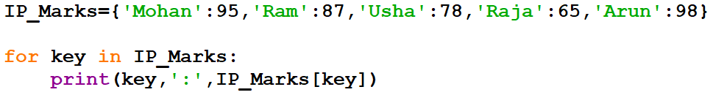
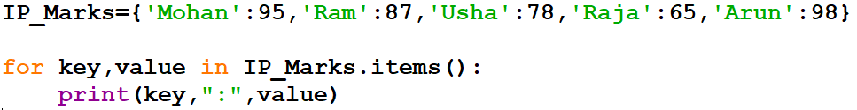
(iii) Traversing through Loop
We can access each item of the dictionary or traverse a dictionary using for loop.
Method 1:
Method 2:

Slide 15
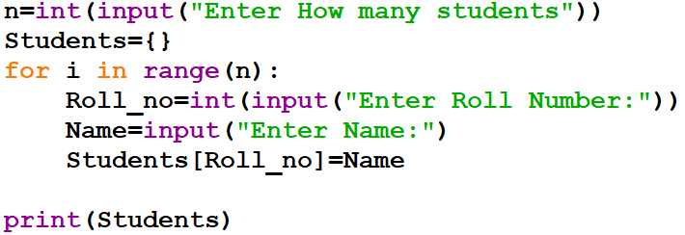
Getting Input from user to create Dictionary
To store user specified value in dictionary during run time, we must create an empty
dictionary.
Using for loop we must get Key name and value for that key from the user.
Example:
Write a Program to create a dictionary containing Roll number of students as keys and their name as values.

Slide 16
ADDING A NEW ITEM INTO A DICTIONARY
We can add new item to the dictionary as shown in the following example:
Example:
Adding a New item

Slide 17
MODIFYING AN EXISTING ITEM OF A DICTIONARY
Dictionaries are mutable which implies that the contents of the dictionary can be Modified after it has been created.
The existing dictionary can be modified by just overwriting the key-value pair.
Example:

Slide 18
DELETING ELEMENTS/ITEMS FROM DICTIONARY
We can delete the elements/items of a Dictionary by using four ways. They are:
(i) Using del keyword.
(ii) Using pop( ) method.
(iii) popitem()
(iv) clear()
Deleting an item using del keyword:
To delete the Dictionary item (or) key-value pair we can use del keyword.
Syntax:
del Dictionary_variable_name['key‘]
Example:

Slide 19

MEBERSHIP OPERATION IN DICTIONARY
The membership operator "in“ checks whether the keys present in the dictionary or not.
If the key is present in the dictionary it returns True, otherwise it returns False.
Example:

Slide 20

DICTIONARY FUNCTIONS AND METHODS
(i) len()
(ii) min()
(iii) max()
(iv) sorted()
(v) del()
(vi) dict()
(vii) d.keys()
(viii) d.values()
(ix) d.items()
(x) d.get()
(xi) d.update()
(xii) d.copy()
(xiii) d.pop()
(xiv) d.popitem()
(xv) d.clear()
(xvi) d.setdefault()
(xvii) d.fromkeys()

Slide 21
(i) len( )
This function returns the length or number of key: value pairs of the dictionary passed as the argument.
Syntax:
len(Dictionary_variable_name)
Example:

Slide 22



(ii) min()
The max() returns minimum/smallest value of key in dictionary.
Syntax:
min(Dictionary_variable_name)
Example:

Slide 23



(iii) max()
The max() returns maximum/highest value of key in dictionary.
Syntax:
max(Dictionary_variable_name)
Example:

Slide 24


(iv) sorted()
The sorted() function returns a sorted sequence of the keys in the dictionary. The sorting is ascending order, does not modify original dictionary.
Sorted() with argument reverse=True created a new list which is sorted in descending order of the elements
Syntax:
sorted(Dictionary_variable_name, reverse=True/False)
Example:

Slide 25
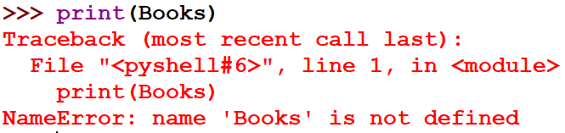
(v) del( )
The del() function is used to delete dictionary from memory.
After this process python completely removes dictionary structure from its memory.
Syntax:
del(Dictionary_variable_Name)
Example:
# Before Deleting
# After Deleting. Python removed entire structure from
Memory.

Slide 26

(vi) dict()
The dict() function used to create an empty dictionary and Creates a dictionary from a sequence of key-value pairs.
Syntax:
(i) Variable_Name=dict() # Syntax to create an empty dictionary using dict()
(ii) dict(Dictionary_variable_name) # Syntax to creates a dictionary from a sequence.
Example -1:

Slide 27
(vii) d.keys( )
This method is used to returns a list of keys in the dictionary.
The result in the form of Tuple with list.
Syntax:
Dictionary_variable_Name.keys( )
Example -1:
Example -2:

Slide 28
(viii) d.values( )
This method is used to returns a list of values in the dictionary.
The result in the form of Tuple with list.
Syntax:
Dictionary_variable_Name.values( )
Example -1:
Example -2:

Slide 29
(ix) d.items( )
This method is used to returns a list of tuples(key:value) pair.
Syntax:
Dictionary_variable_Name.items( )
Example -1:
Example -2:

Slide 30
(x) d.get( )
The get( ) method used to returns the value corresponding to the key passed as the argument.
If the key is not present in the dictionary it will return None
Syntax:
Dictionary_variable_Name.get( )
Example -1:
Example -2:

Slide 31

(xi) d.update( )
This method merges key:value pairs from the new dictionary into the original dictionary, adding or replacing as needed.
The items in the new dictionary are added to the old one and override any items already there with the same keys.
Syntax:
Dictionary_variable_name.update(existing_dictionary_name)
Example:

Slide 32
(xii) d.copy( )
The copy() method returns a shallow copy of dictionary. It doesn't modify the original dictionary.
This method does not take any arguments.
Syntax:
Dictionary_variable_name.copy( )
Example:

Slide 33
Difference in Using copy() method, and = Operator to Copy Dictionaries:
When copy() method is used, a new dictionary is created with different address which is filled with a copy of the references from the original dictionary.
When = is used , no any new dictionary is created, both variables points to the same dictionary, For example:
Example 1: Using = Operator to Copy Dictionaries:
#Removing all elements from the Fruits.
# Here, when Fruits dictionary is cleared, Costs dictionary is also cleared.

Slide 34
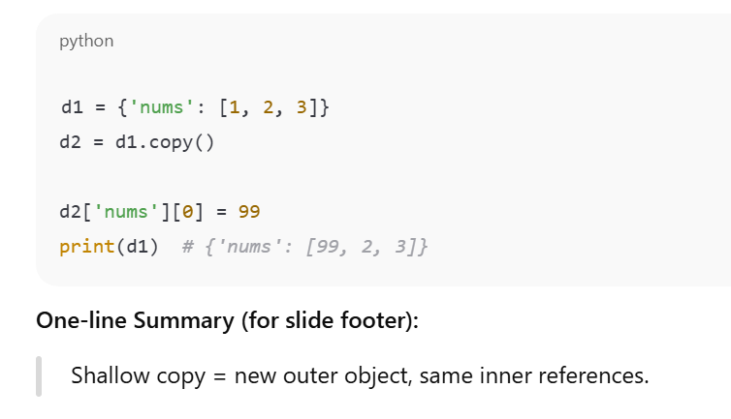

Slide 35
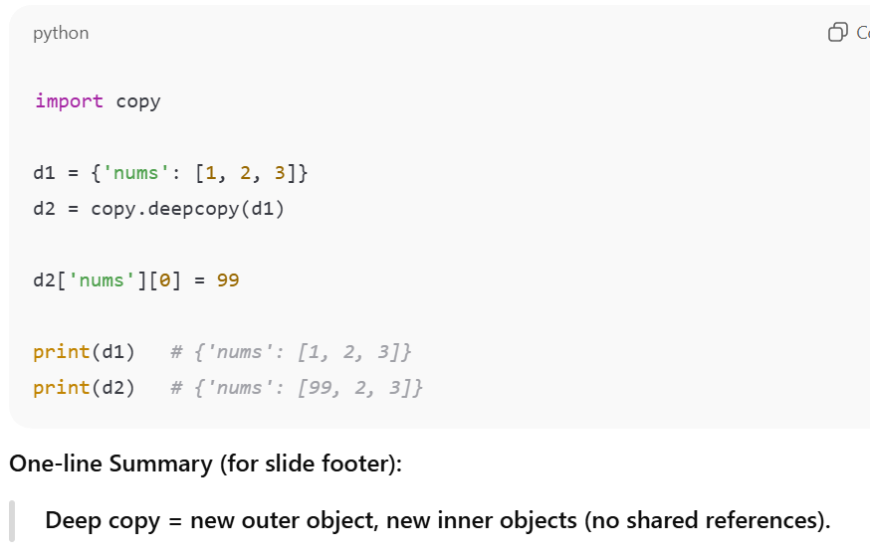

Slide 36
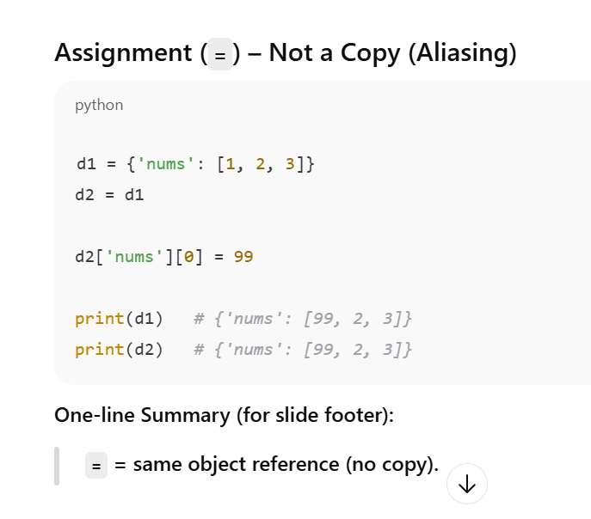

Slide 37
(xiii) d.pop( )
The pop() method removes and returns an element from a dictionary.
This method takes two arguments.
Syntax:
Dictionary_variable_name.pop(key, default_message)
Where,
Key - which is to be searched for removal.
Default - Message which is to be returned when the key is not in the dictionary.
The pop() method returns:
If key is found - removed/popped element from the dictionary.
If key is not found - value specified as the second argument (default)
If key is not found and default message is not specified - KeyError exception is raised

Slide 38

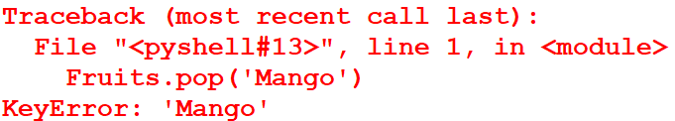
Example:

Slide 39
(xiv) d.popitem( )
The popitem() method removes and returns the last element (key, value) pair in the form of tuples inserted into the dictionary.
This method does not take any arguments.
Syntax:
Dictionary_variable_name.popitem( )

Slide 40


(xv) d.clear( )
The clear( ) method removes all the elements from dictionary.
This method does not take any arguments.
Syntax:
Dictionary_variable_name.clear( )

Slide 41

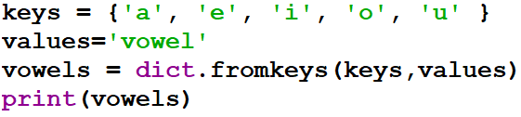
(xvi) d.fromkeys ( )
The fromkeys() method creates a new dictionary from the given sequence of elements with a value provided by the user.
Syntax:
dict.fromkeys(sequence, value)
Where,
sequence - sequence of elements which is to be used as keys for the new dictionary.
value (Optional) - value which is set to each element of the dictionary.
Example 1: Create a dictionary from a sequence of keys:
O/P:
Example 2: Create a dictionary from a sequence of keys with values:

Slide 42

(xvii) d.setdefault( )
The setdefault() method is used to returns the value of a key(if the key is present in the dictionary).
If the key is not present in the dictionary, then it will add that key to the dictionary by default with value None(if value is not give by the user).
Syntax:
Dictionary_variable_name.setdefault(key,value)
In the above syntax value is optional.
Example:
# Key ‘Arun’ is not present in the dictionary. So, it will added to the dictionary with value None.
# Key ‘Kumar’ is not present in the dictionary. So, it will added to the dictionary with value 45.

Slide 43
Aaj ka Gyan:
“Lists remember order, tuples protect data, and dictionaries give data meaning.”

