Slide 1
Introduction to APIs

Slide 2
What is API ?
API Stands for Application Programming Interface.
API’s allows two applications to communicate with each other.
It is a contract between the client and server.
Client sends a request through the API and after performing the action the API will send back a response to the client.

Slide 3
APIs can be use for;
Communication between services.
Example : payment through different payment APPs.
Access inbuilt hardware of a device.
Example :When you open Instagram and click 📷:
Step-by-step:
Instagram sends request → Camera API
API checks permission
API opens camera hardware
You capture photo
API returns image to app
Application
Assets
API

Slide 4
Types of Application Programming Interface (APIs)
Private API
Public API
Partner API

Slide 5
Private API
Private APIs are developed by own company to enhance the own products and services.
They have below characteristics ;
Less Common.
Exposed only to the internal systems.
Used across internal development teams within the company.

Slide 6
Public API
Public APIs are published publicly and that can be used by anyone(any third-party user).
They have below characteristics ;
Publicly available without any access restriction.
Used to communicate beyond the boundaries of the company.
No need to necessarily have a business relationship with them.

Slide 7
Partner API
Partner APIs are used by specific parties with whom the company agrees to share data.
They have below characteristics ;
Are exposed to selected business partners.
Used for communication between a company and its business partners.

Slide 8
What is Web Service ?
Used for exchanging data between applications or systems with the support of protocols and standards via internet.
Main component of a web service is the data which is transferred between the client and the server, and that is XML.

Slide 9



Web Service Architecture
Client
Internet
Web Server
Client request services from web server and server response to client with the web service.

Slide 10
Web Service API ?
There are two major types of web services;
SOAP Web Services (Simple Object Access Protocol)
REST Web Services (Representational State Transfer )

Slide 11
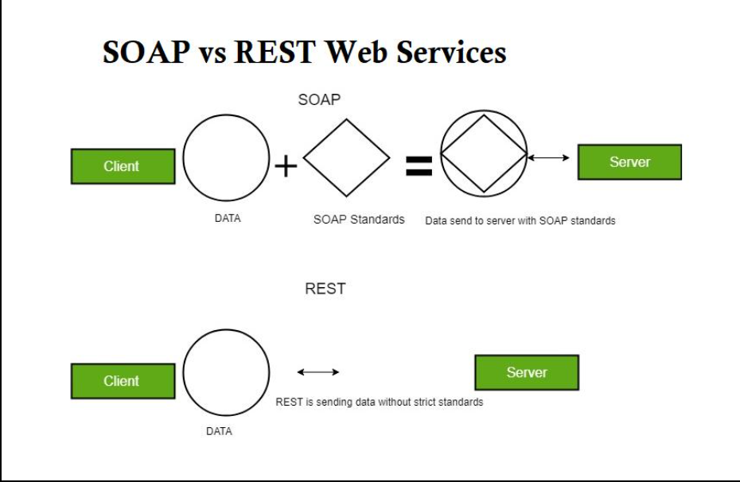
Web Service API ?

Slide 12
What is SOAP?
SOAP stands for Simple Object Access Protocol.
A format for sending and receiving messages.
SOAP is platform independent.
Originally developed by Microsoft.
The best way to communicate between applications is over HTTP.
SOAP provides a way to communicate between applications running on different operating systems, with different technologies and programming languages.

Slide 13
Building Blocks of SOAP?
A SOAP message is an ordinary XML document which contains;
An Envelope : identifies the XML document as a SOAP message
A Header : contains header information
A Body : contains call and response information
A Fault : contains errors and status information

Slide 14
What is REST?
REST stands for REpresentational State Transfer.
Relies on a stateless communications protocol most commonly, HTTP.
REST structures data in XML(Extensible Markup Language), YAML (Yet Another Markup Language), or any other format that is machine-readable.
Usually JSON(JavaScript Object Notation) is the most widely used format now.

Slide 15
Basic REST Request?
GET : read or retrieve data
POST : add new data
PUT : update existing data
DELETE : delete data

Slide 16
Compare and Contrast SOAP vs REST
SOAP | REST
Is a protocol. | Is an architectural style.
Permits only XML. | Permits many different data formats including plain text, HTML, XML, and JSON.
Requires more bandwidth and more resources. | Requires less bandwidth and less resources.
Supports both SMTP and HTTP protocols. | Requires the use of HTTP only.
SOAP is slower than REST. | REST is fasterthan SOAP.
SOAP defines its own security. | RESTful web services inherit security measures from the underlying transport.

Slide 17
Thank You

