Slide 1
XML

Slide 2
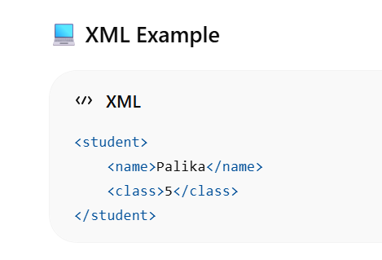
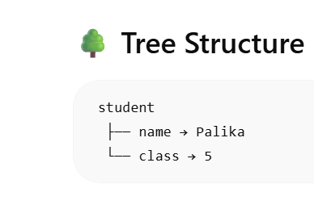
What is XML?
XML (Extensible Markup Language) is used to store and transfer data.

Slide 3
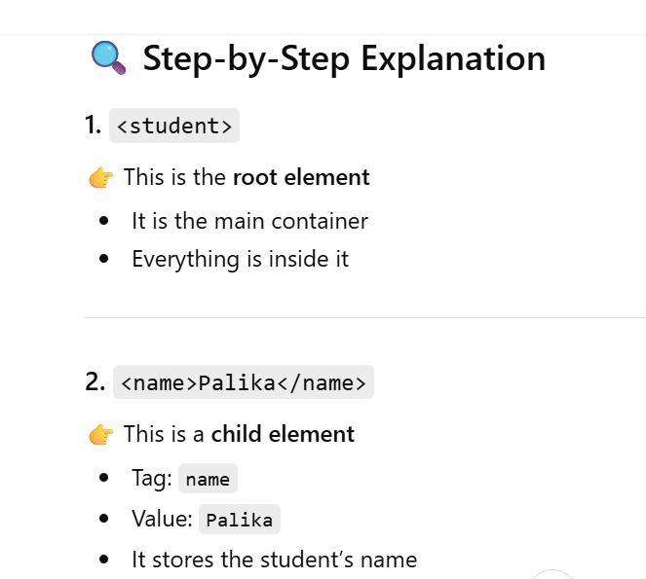
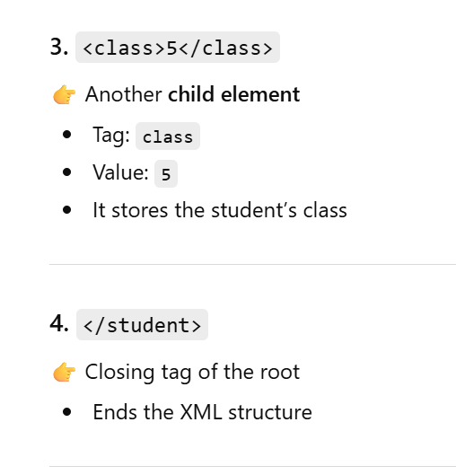

Slide 4
🐍 What does Python do with XML?
👉 Python is used to:
Read XML
Extract data
Modify data
Create XML files

Slide 5
Connection between Python & XML
👉 XML = data storage 👉 Python = data processing
✔ Together → used in real applications (APIs, configs, data exchange)

Slide 6
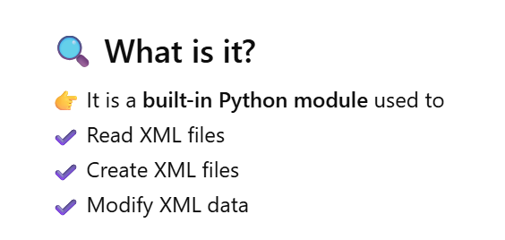
⚙️ Python Module for XML
👉 xml.etree.ElementTree

Slide 7
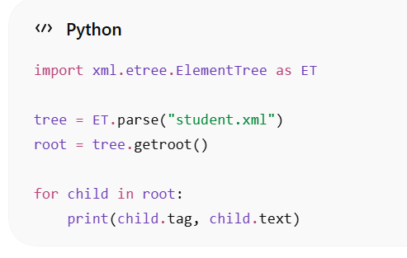
📖 Read XML in Python
• Imports xml.etree.ElementTree module as ET
• Reads XML file using ET.parse("student.xml")
• Gets root element using getroot()
• Loops through child elements using for loop
• Accesses tag using child.tag
• Accesses value using child.text
• Prints tag and corresponding data
• Output shows: name Palika, class 5

Slide 8
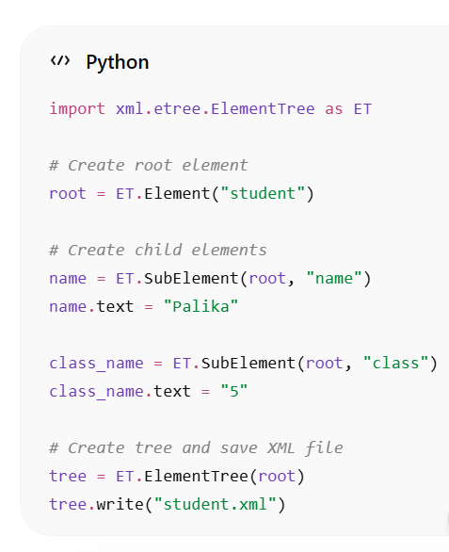
✍️ Create XML in Python
🌳 Tree
student → Root element
name → Child element with value Palika
class → Child element with value 5

Slide 9
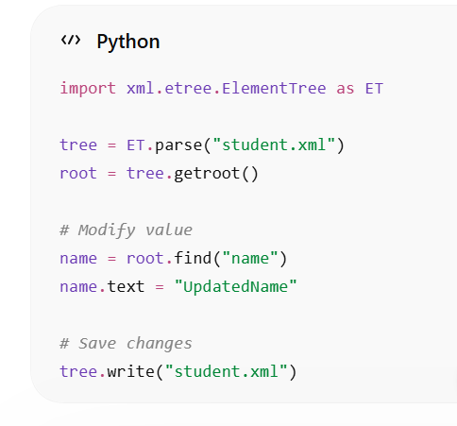
✏️ ✔ Modify Data in XML

Slide 10
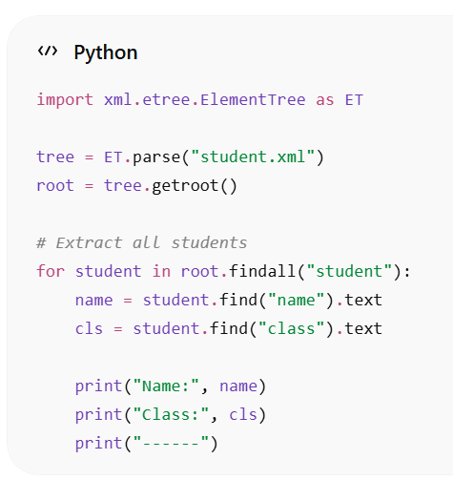
📖 ✔ Extract Data from XML

Slide 11
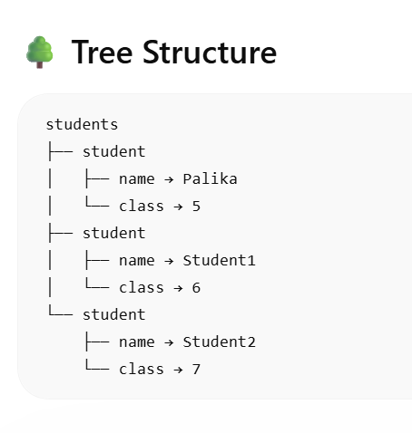
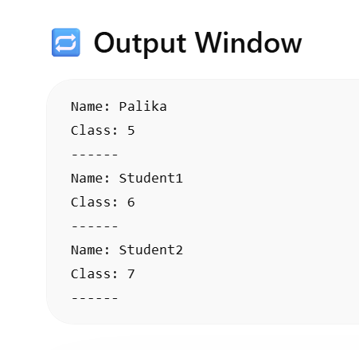
Output

Slide 12
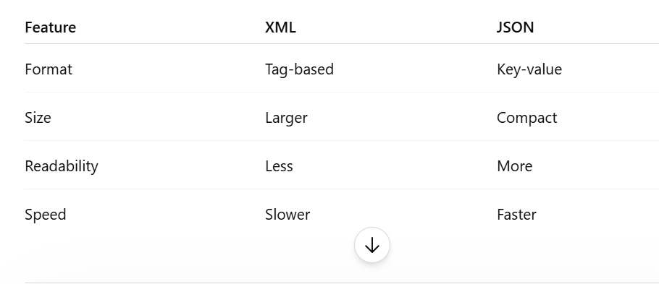
XML vs JSON

Slide 13
“Data rests in XML & JSON — Python makes it speak.”

