Slide 1
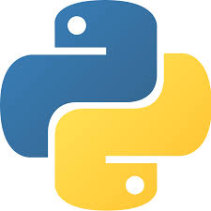
Python Basics

Slide 2
Content
What Is Python?
Python Features
Python Applications
Comments in Python
Variable Declaration in Python
Data Types in Python
Type Conversion in Python
Operators in Python

Slide 3
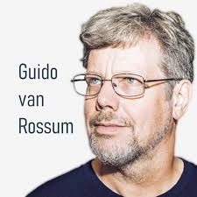
What Is Python?
Python is a general purpose, high-level, interpreted programming language.
Developed by Guido van Rossum in the
late 1980s at the National Research
Institute for Mathematics and Computer
Science in the Netherlands.
Python is one of the most popular and widely used programming language used for set of tasks including console based, GUI based, web programming and data analysis.
Fact: Python is named based on the comedy television show Monty Python's Flying Circus.

Slide 4
Python Features
Easy to Learn and Use
Python is easy to learn and use compared with other programming languages. It is developer-friendly and high level programming language.
Interpreted Language
Python is an interpreted language because no need of compilation. This makes debugging easy and thus suitable for beginners.
Cross-platform Language
Python can run equally on different platforms such as Windows, Linux, Unix and Macintosh etc. So, we can say that Python is a portable language.

Slide 5
Python Features Cont…
Free and Open Source
The Python interpreter is developed under an open-source license, making it free to install, use, and distribute.
Object-Oriented Language
Python supports object oriented language and concepts of classes and objects come into existence.
GUI Programming Support
Graphical user interfaces can be developed using Python.
Integrated
It can be easily integrated with languages like C, C++, and JAVA etc.

Slide 6
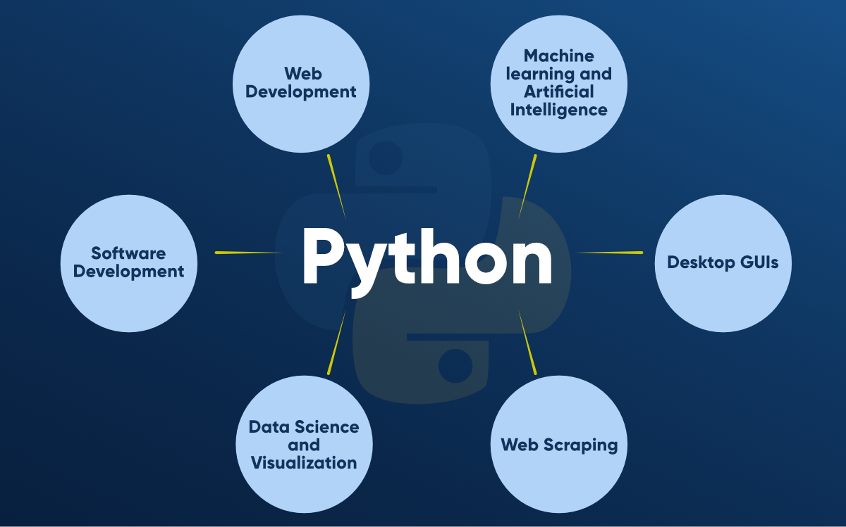
Python Applications

Slide 7
Comments in Python
In general, Comments are used in a programming language to describe the program or to hide the some part of code from the interpreter.
Comments in Python can be used to explain any program code. It can also be used to hide the code as well.
Comment is not a part of the program, but it enhances the interactivity of the program and makes the program readable.
Python supports two types of comments:
Single Line Comment
Multi Line Comment

Slide 8
Comments in Python Cont..
Single Line Comment:
In case user wants to specify a single line comment, then comment must start with ‘#’
Example:
# This is single line comment
print ("Hello Python“)
Output:
Hello Python
Multi lined comment can be given inside triple quotes.
Example:
“ “ “
This is
Multiline
Comment
“ “ “
Or ‘’’ hello
‘’’

Slide 9
Variable Declaration in Python
A variable is a named memory location in which we can store values for the particular program.
In other words, Variable is a name which is used to refer memory location. Variable also known as identifier and used to hold value.
In Python, We don't need to declare explicitly variable in Python. When we assign any value to the variable that variable is declared automatically.
In Python, We don't need to specify the type of variable because Python is a loosely typed language.

Slide 10
Variable Declaration in Python Cont..
In loosely typed language no need to specify the type of variable because the variable automatically changes it's data type based on assigned value.
Rules for naming variable:
Variable names can be a group of both letters and digits, but they have to begin with a letter or an underscore.
It is recommended to use lowercase letters for variable name. ‘SUM’ and ‘sum’ both are two different variables.
Example: Vardemo.py
a=10 #integer
b="StudyGlance" #string
c=12.5 #float
print(a)
print(b)
print(c)
output:
$python3 Vardemo.py
10
StudyGlance
12.5

Slide 11
Variable Declaration in Python Cont..
Python allows us to assign a value to multiple variables and multiple values to multiple variables in a single statement which is also known as multiple assignment.
Assign single value to multiple variables :
Assign multiple values to multiple variables :
Example: Vardemo1.py
x=y=z=50
print x
print y
print z
output:
$python3 Vardemo1.py
50
50
50
Example: Vardemo2.py
a,b,c=5,10,15
print a
print b
print c
output:
$python3 Vardemo2.py
5
10
15

Slide 12
Data Types in Python
In general, Data Types specifies what type of data will be stored in variables. Variables can hold values of different data types.
Python is a dynamically typed or loosely typed language, hence we need not define the type of the variable while declaring it.
The interpreter implicitly binds the value with its type.
Python provides us the type () function which enables us to check the type of the variable.

Slide 13
Data Types in Python Cont..
Python provides following standard data types, those are
  Numbers
  String
Numbers:
Number stores numeric values. Python creates Number type variable when a number is assigned to a variable.
There are three numeric types in Python:
  int
  float
  Complex

Slide 14
Data Types in Python Cont..
1. int:
Int, or integer, is a whole number, positive or negative, without decimals, of unlimited length.
Example:
a=10
b=-12
c=123456789
2. float:
Float or "floating point number" is a number, positive or negative, containing one or more decimals.
Example:
X=1.0
Y=12.3
Z=-13.4
3. complex:
Complex numbers are written with a "j" as the imaginary part.
Example:
A=2+5j
B=-3+4j
C=-6j

Slide 15
Data Types in Python Cont..
String:
The string can be defined as the sequence of characters represented in the quotation marks. In python, we can use single, double, or triple quotes to define a string.
In the case of string handling, the operator + is used to concatenate two strings as the operation "hello"+" python" returns "hello python".
Example:
S1=‘Welcome’ #using single quotes
S2=“To” #using double quotes
S3=‘’’Python’’’ #using triple quotes

Slide 16
Data Types in Python Cont..
Example: “datatypesdemo.py”
a=10
b=“Python"
c = 10.5
d=2.14j
print("Data type of Variable a :",type(a))
print("Data type of Variable b :",type(b))
print("Data type of Variable c :",type(c))
print("Data type of Variable d :",type(d))
Output:
python3 datatypesdemo.py
Datatype of Variable a : <class ‘int’>
Datatype of Variable b : <class ‘str’>
Datatype of Variable c : <class ‘float’>
Datatype of Variable d : <class ‘complex’>

Slide 17
Type Conversion in Python
Python provides Explicit type conversion functions to directly convert one data type to another. It is also called as Type Casting in Python
Python supports following functions
  int () : This function converts any data type to integer.
  float() : This function is used to convert any data type to a floating point number.
  str() : This function is used to convert any data type to a string.
Example:“Typeconversiondemo.py”
x = int(2.8)
y = int("3")
z = float(2)
s = str(10)
print(x);print(y)
print(z); print(s)
Output:
python3 typeconversiondemo.py
2
3
2.0
10

Slide 18
Operators in Python
The operator can be defined as a symbol which is responsible for a particular operation between two operands.
Python provides a variety of operators described as follows.
Arithmetic operators :
+ (addition) eg: a=20; b=10 then a + b=30
- (subtraction) eg: a=20; b=10 then a - b=10
*(multiplication) eg: a=20; b=10 then a * b=200
/ (divide) eg: a=20; b=10 then a / b=2
%( reminder) eg: a=20; b=10 then a % b=0
// (floor division) eg: a=24; b=7 then a // b=3
** (exponent) eg: a=2; b=3 then a ** b=8
Membership operators :
in (True, If the value is present in the data structure)
not in (True, If the value is not present in the data structure)

Slide 19
Operators in Python Cont…
Comparison operators :
== (Equal to)
!= (Not equal to)
<= (Less than or equal)
>= (Greater than or equal)
< (Less than)
> (Greater than)
Bitwise operators :
& (binary and)
| (binary or)
^ (binary xor)
~ (negation)
<< (left shift)
>> (right shift)
Assignment operators :
= (Assigns to)
+= (Assignment after Addition)
-= (Assignment after Subtraction)
*= (Assignment after Multiplication)
/= (Assignment after Division)
%= (Assignment after Modulus)
**= (Assignment after Exponent)
//= (Assignment after floor division)
Logical operators :
and (logical and)
or (logical or)
not (logical not)
Identity operators :
is (Returns true if both variables are the same object)
is not (Returns true if both variables are not the same object)

Slide 20
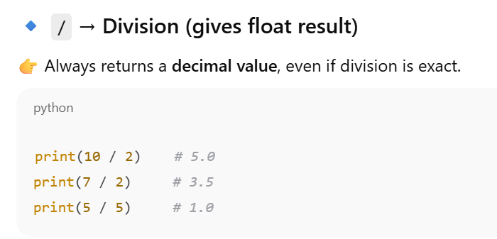
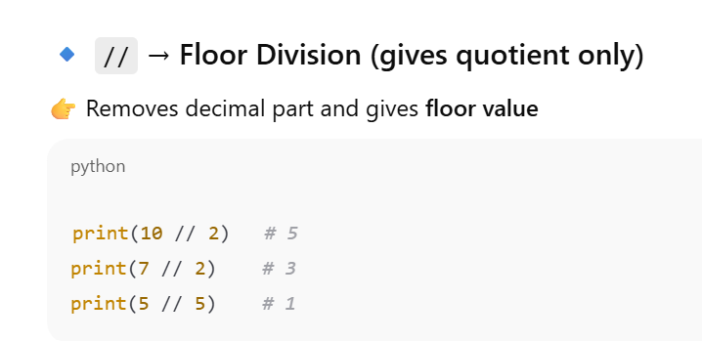

Slide 21
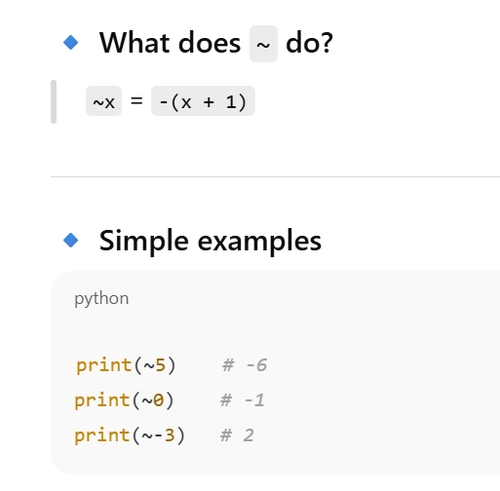

Slide 22
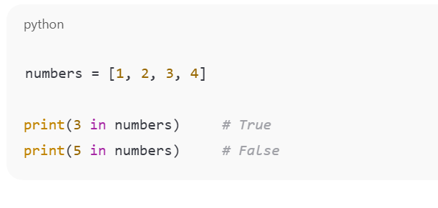
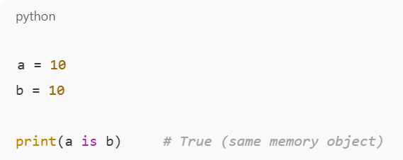
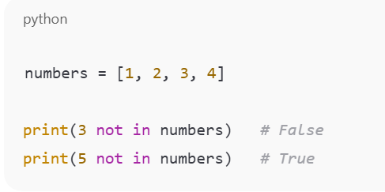
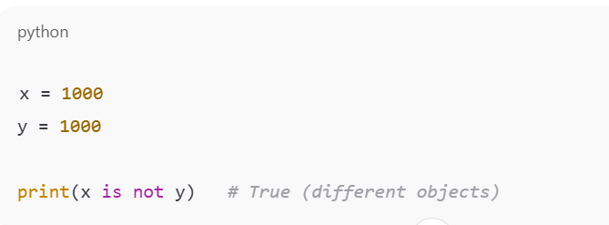

Slide 23
Done!
Aaj ka Gyan:
“The more you practice, the better you understand.”

