Slide 1
File Handling
Let’s handle a file now. ☺ ☺ ☺

Slide 2
INTRODUCTION
A file in itself is a sequence of bytes stored in some storage device like hard-disk, pen-drive etc.
Python allow us to create and manage three types of files :
TEXT FILE
BINARY FILE
CSV (Comma Separated Values) FILES

Slide 3
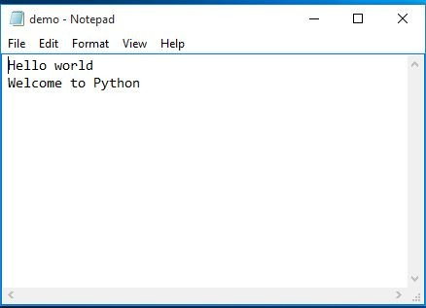
TEXT FILE
A text file is structured as a sequence of lines.
Text files are stored in human readable form and they can also be created using any text editor.

Slide 4
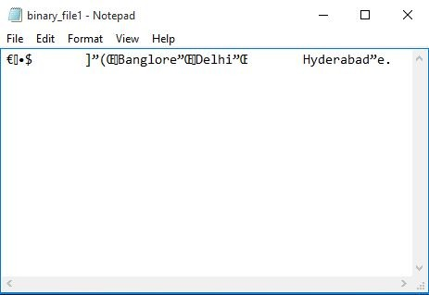
BINARY FILE
A file that contains information in the same format in which information is held in memory.
Binary file contains arbitrary binary data.
Python provides special module(s) for encoding and decoding of data for binary file.

Slide 5
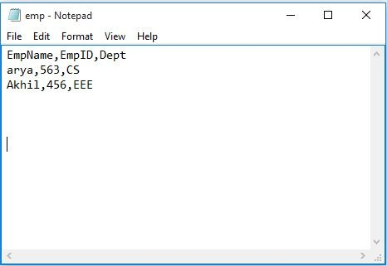
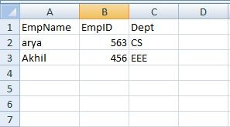
CSV FILES
CSV stands for Comma Separated Values.

Slide 6
STEPS TO PROCESS A FILE
Determine the type of file usage.
Reading purpose : If the data is to be brought in from a file to memory
Writing purpose : If the data is to be sent from memory to file.
Open the file and assign its reference to a file object or file-handle.
Process the file as required : Perform the desired operation from the file.
Close the file.

Slide 7
OPENING A TEXT FILE
The key function for working with files in Python is the open() function.
It accepts two parameters : filename, and mode.
Syntax:
<file_object_name> = open(<file_name>,<mode>)
Example: f = open(“demo.txt”,”r”)

Slide 8
Various Modes for opening a text file are:
Description●
Mode
“r”
Read
Default value. Opens a file for reading, error if the file does not exist.
“w”
Write
Opens a file for writing, creates the file if it does not exist
“a”
Append
Opens a file for appending, creates the file if it does not exist
“r+”
Read and Write
File must exist otherwise error is raised.Both reading and writing operations can take place.
“w+”
Write and Read
File is created if it does not exist.If the file exists past data is lost (truncated).Both reading and writing operations can take place.
“a+”
Append and Read
File is created if it does not exist.If the file exists past data is not lost .Both reading and writing(appending) operations can take place.
12

Slide 9
CLOSING A FILE
close()- method will free up all the system resources used by the file, this means that once file is closed, we will not be able to use the file object any more.
Syntax:
<fileObject>.close()
Example : f.close()

Slide 10
READING FROM A FILE
A Program reads a text/binary file from hard disk. Here File acts like an input to the program.
Followings are the methods to read a data from the file:
read() METHOD
readline() METHOD
readlines() METHOD

Slide 11
read() METHOD
By default the read() method returns the whole text, but you can also specify how many characters you want to return by passing the size as argument.
Syntax: <file_object>.read([n])
where n is the size
To read entire file : <file_object>.read()
To reads only a part of the File : <file_object>.read(size)
f = open("demo.txt", "r") print(f.read(15))
Returns the 15 first characters of the file "demo.txt".
15

Slide 12
# Read from a text file
f = open(r"C:\Users\PalikaC\Desktop\p1.txt", "r")
data = f.read()
print(data, end="")
f.close()
16

Slide 13
readline() METHOD
readline() will return a line read, as a string from the file.
Syntax:
<file_object>.readline()
Example
f = open("demo.txt", "r") print(f.readline())
This example program will return the first line in the file “demo.txt” irrespective of number of lines in the text file.
17

Slide 14
Reading a complete file line by line using readline().
# Read entire text using readline()
f = open(r"C:\Users\PalikaC\Desktop\p1.txt", "r")
line = f.readline()
while line != "":
print(line, end="")
line = f.readline()
f.close()

Slide 15
readlines() METHOD
readlines() method will return a list of strings, each separated by \n
readlines() can be used to read the entire content of the file.
.
Syntax:
<file_object>.readlines()
It returns a list, which can then be used for manipulation.
Example :
f = open("demofile.txt", "r")
print(f.readlines())

Slide 16
Read a file using Readlines()
# Read a file using readlines()
f = open(r"C:\Users\PalikaC\Desktop\p1.txt", "r")
lines = f.readlines()print(lines)
f.close()

Slide 17
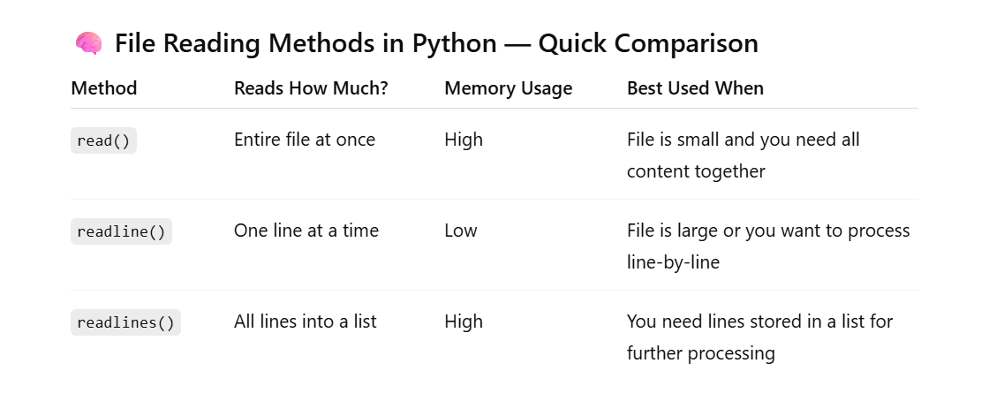

Slide 18
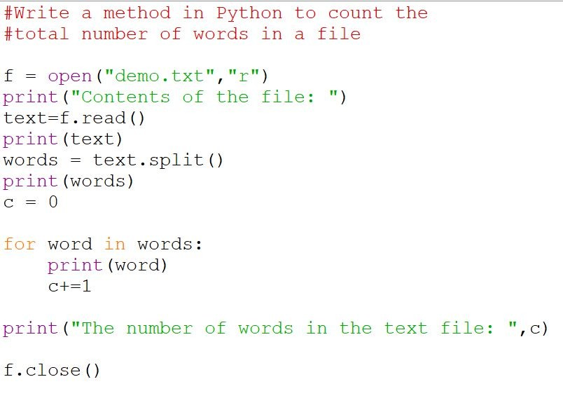

Slide 19
WRITING TO A TEXT FILE
A Program writes into a text/binary file in hard disk.
Followings are the methods to write a data to the file.
write () METHOD
writelines() METHOD
To write to an existing file, you must add a parameter to the open()
Function which specifies the mode :
"a" - Append - will append to the end of the file
"w" - Write - will overwrite any existing content

Slide 20
write() Method
write() method takes a string ( as parameter ) and writes it in the file.
For storing data with end of line character, you will have to add \n character to end of the string
# Open the file "demo_append.txt" in append mode and add content
f = open(r"C:\Users\PalikaC\Desktop\p1.txt", "a")
f.write("Hello students\nWe are learning data file handling...!")
f.close()
# Open and read the file after appending
f = open(r"C:\Users\PalikaC\Desktop\p1.txt", "r")
print(f.read())
f.close()
23

Slide 21
writelines() METHOD
For writing a string at a time, we use write() method, it can't be used
for writing a list, tuple etc. into a file.
So, whenever we have to write a sequence of string, we will writelines(), instead of write().

Slide 22
# Program to demonstrate writelines()
f = open(r"C:\Users\PalikaC\Desktop\p1.txt", "a")
f.writelines(["We love Python!\n", "File Handling\n"])
f.close()
# Open and read the file after appending
f = open(r"C:\Users\PalikaC\Desktop\p1.txt", "r")
print(f.read())
f.close()

Slide 23
The flush()
The flush function forces the writing of data on disc still pending on the output buffer.
Syntax : <file_object>.flush()

Slide 24
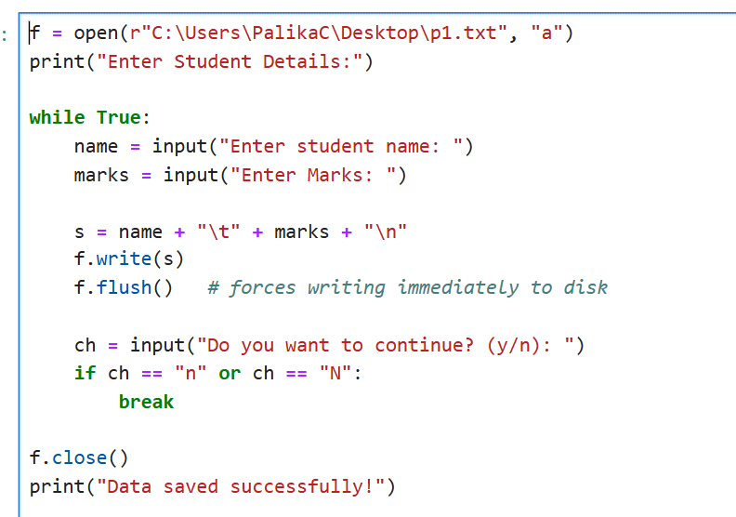

Slide 25

DATA FILE HANDLING IN BINARY FILES
Binary files store data as raw bytes that computers read directly without translation, but they are not human-readable.

Slide 26
Objects have a specific structure which must be maintained while storing or accessing them.
Python provides a special module called pickle module for this.
PICKLING refers to the process of converting the structure to a byte
stream before writing to a file.
UNPICKLING is used to convert the byte stream back to the original structure while reading the contents of the file.

Slide 27
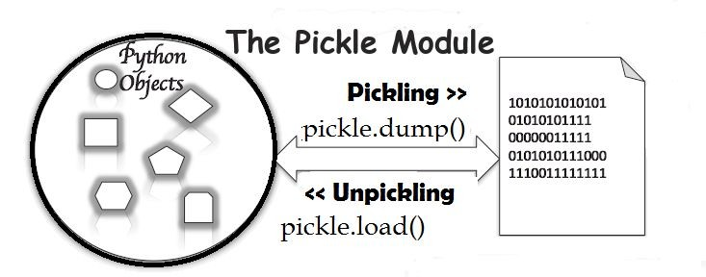
Pickling and Unpickling

Slide 28
PICKLE Module
Before reading or writing to a file, we have to import the pickle module.
import pickle
It provides two main methods :
dump() method
load() method

Slide 29
Opening and closing binary files
Opening a binary file:
Similar to text file except that it should be opened in binary mode.Adding a ‘b’ to the text file mode makes it binary - file mode.
EXAMPLE :
f = open(“demo.dat”,”rb”)
Closing a binary file
f.close()

Slide 30
Mode | Description● | Various Modes for opening a binary file are:
“rb” | Read | Default value. Opens a file for reading, error if the file does not exist.
“wb” | Write | Opens a file for writing, creates the file if it does not exist
“ab” | Append | Opens a file for appending, creates the file if it does not exist
“r+b”or “rb+” | Read and Write | File must exist otherwise error is raised.Both reading and writing operations can take place.
“w+b”or “wb+” | Write and Read | File is created if it does not exist.If the file exists past data is lost (truncated).Both reading and writing operations can take place.
“a+b” or “ab+” | Append and Read | File is created if it does not exist.If the file exists past data is not lost .Both reading and writing operations can take place. 35

Slide 31
pickle.dump() Method
pickle.dump() method is used to write the object in file which is opened in binary access mode.
Syntax :
pickle.dump(<structure>,<FileObject>)
Structure can be any sequence in Python such as list, dictionary etc.
FileObject is the file handle of file in which we have to write.

Slide 32
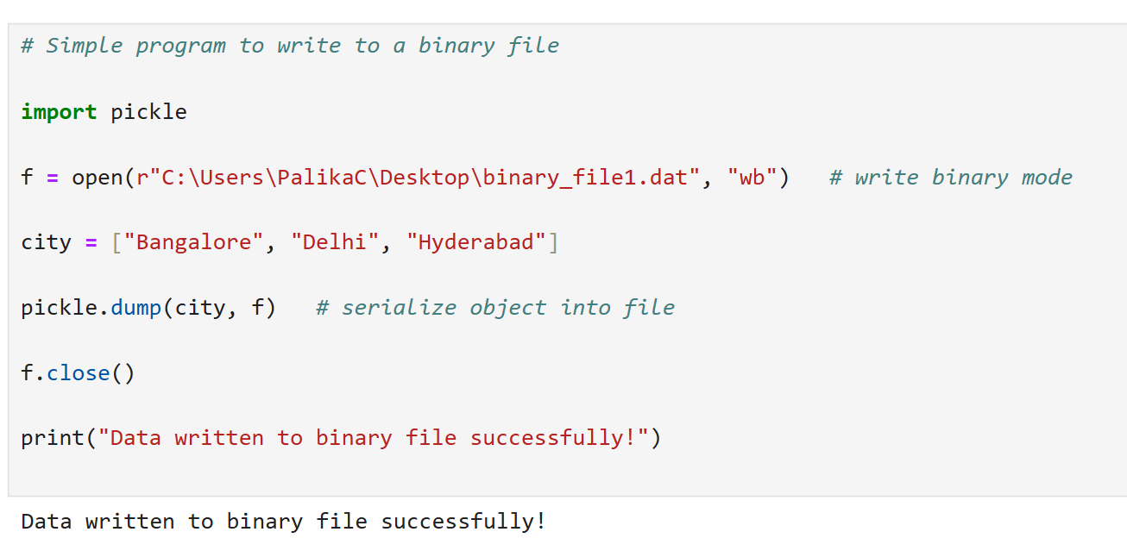

Slide 33
pickle.load() Method
pickle.load() method is used to read data from a file
Syntax :
<structure> = pickle.load(<FileObject>)
Structure can be any sequence in Python such as list, dictionary etc.
FileObject is the file handle of file in which we have to write.

Slide 34
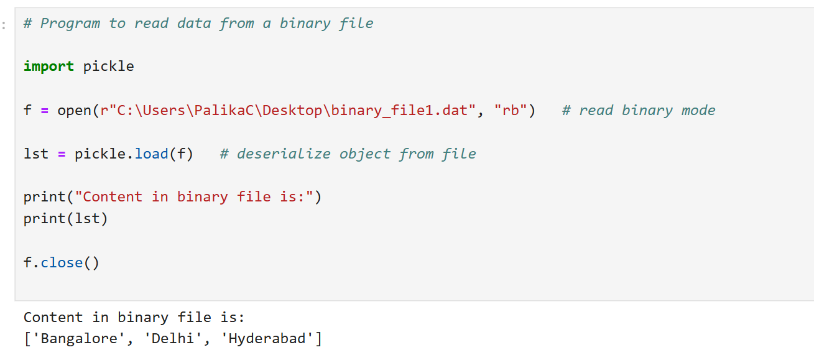

Slide 35
Random Access in Files : tell() and seek()
❏ tell() function is used to obtain the current position of the file pointer
Syntax : f.tell()
❏ File pointer is like a cursor, which determines from where data has to be read or written in the file.
❏ seek () function is used to change the position of the file pointer to a given position.
Syntax : f.seek(offset,reference_point)
Where f is the file object

Slide 36
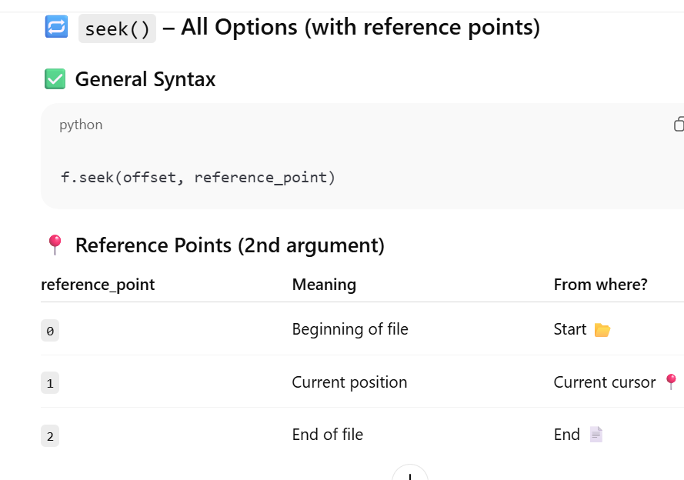

Slide 37
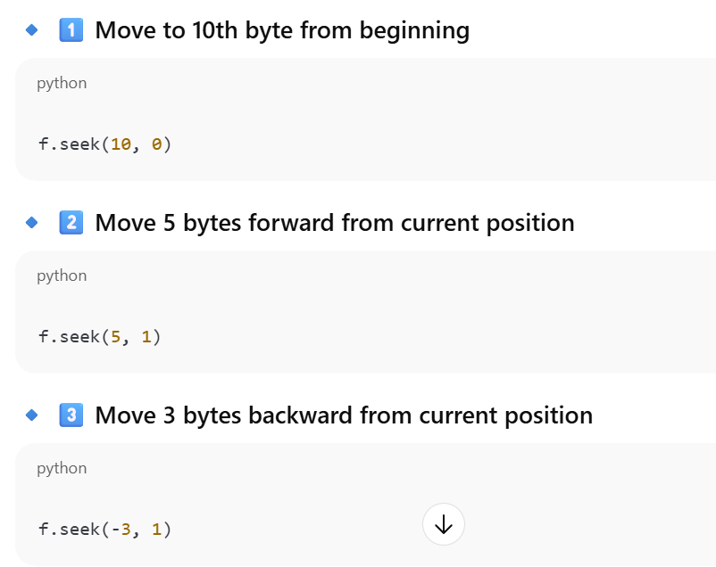
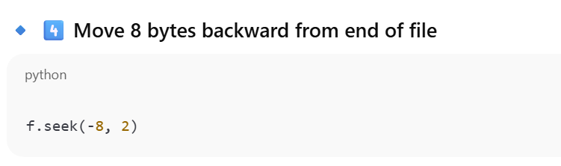

Slide 38
Demo of tell() +seek()
f = open("demo.txt", "r")
print("Before:", f.tell())
f.seek(5, 0)
print("After seek:", f.tell())
print(f.read(10))
f.close()

Slide 39
CSV files
CSV is a human-readable text format for storing tabular data where each row is a record and fields are separated by delimiters such as comma (,), tab (\t), colon (:), pipe (|), or semicolon (;).

Slide 40
Python CSV Module
CSV module provides two types of objects :
reader : to read from cvs files
writer : to write into csv files.
To import csv module in our program , we use the following statement:
import csv

Slide 41
Opening / Closing a CSV File
Open a CSV File :
f = open(“demo_csv.csv”,”r”)
OR
f = open(“demo_csv.csv”,”w”)
Close a CSV File:
f.close()

Slide 42
Steps to write data to a csv file
1. Import csv module
import csv
2. Open csv file in write mode.
f = open(“csv_demo.csv”,”w”)
3. Create the writer object.
demo_writer = csv.writer(f)
4. Write data using the methods writerow() or writerows()
demo_writer.writerow(<iterable_object>)
5. Close the file
f.close()
46

Slide 43
Writing in CSV Files
csv.writer() :
Returns a writer object which writes data into csv files.
writerow() :
Writes one row of data onto the writer object.
Syntax : <writer_object>.writerow()
writerows() :
Writes multiple rows into the writer object
Syntax : <writer_object>.writerows()

Slide 44
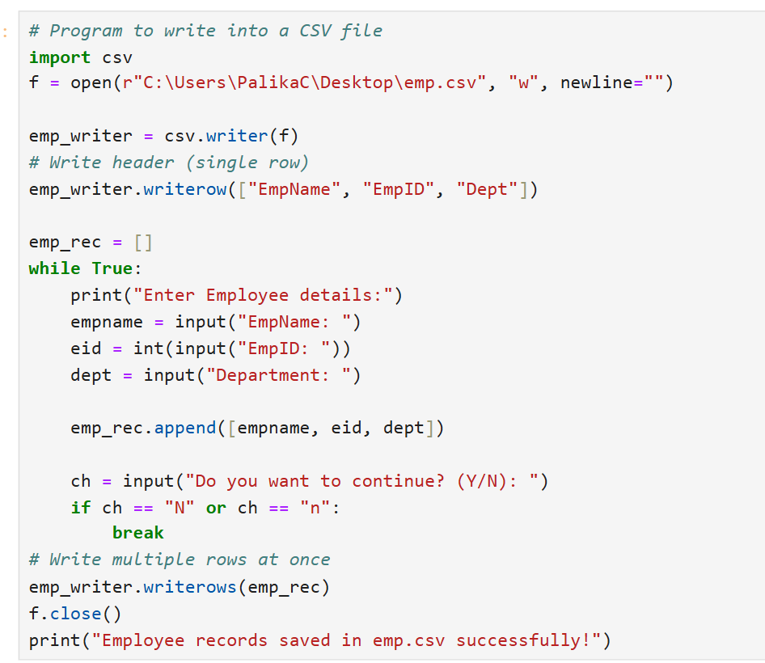


Slide 45
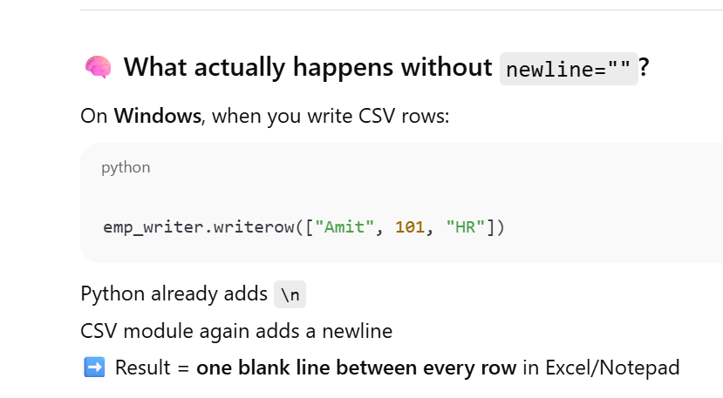
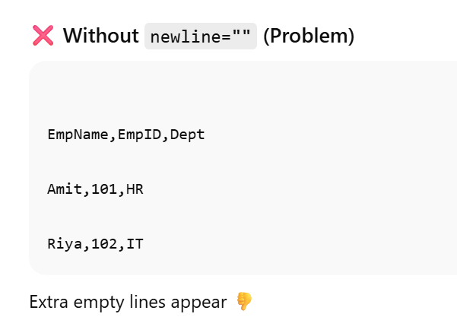

Slide 46
Reading from CSV Module
To read data from csv files, reader function of csv module is used.
csv.reader() :
Returns a reader object.
It loads data from a csv file into an iterable after parsing delimited data.

Slide 47
Steps to read data from a csv file
1. Import csv module
import csv
1. Open csv file in read mode.
f = open(“csv_demo.csv”,”r”)
1. Create the reader object.
demo_reader = csv.reader(f)
1. Fetch data through for loop, row by row.
1. Close the file
f.close()
52

Slide 48
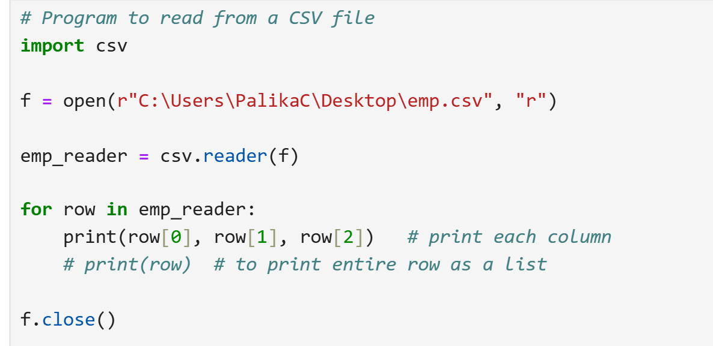

Slide 49
Aaj ka Gyan : “Be mindful of what you write into your life; one day, you’ll read it back.”

