Slide 1
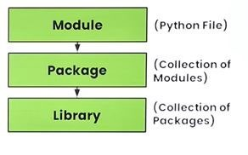
Introduction to Python Libraries:
1
Python libraries contain a collection of built-in modules that allow us to perform many actions without writing detailed programs for it.
Each library in Python contains a large number of modules that one can import and use.

Slide 2
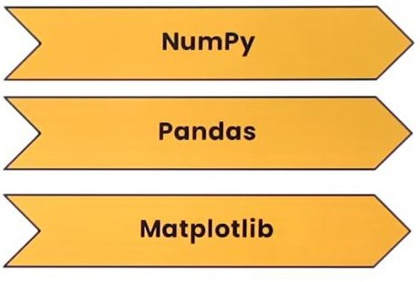
NumPy, Pandas and Matplotlib are three well- established Python libraries for scientific and analytical use.
3
These libraries allow us to manipulate, transform and visualise data easily and efficiently.

Slide 3
Numpy (Numeric Array) Library
4
It is a library for the Python programming language, adding support for large, multi-dimensional arrays and matrices, along with a large collection of high- level mathematical functions to operate on these arrays.
The core functionality of NumPy is its “ndarray”, for n-dimensional array, data structure.
It was originally created by Jim Hugunin with contributions from several other developers.

Slide 4
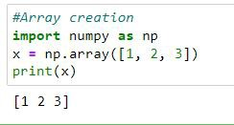
5

Slide 5
Matplotlib Library
6
Matplotlib is an amazing visualization library in Python for 2D plots of arrays.
Matplotlib is a multi-platform data visualization library built on NumPy arrays and designed to work with the broader SciPy stack.
It was introduced by John Hunter in the year 2002.
The Matplotlib library in Python is used for plotting graphs and visualisation.
Using Matplotlib, with just a few lines of code we can generate publication-quality plots, histograms, bar charts, scatterplots, etc.

Slide 6
Pandas (Panel Data) Library
7
PANDAS has derived its name from Panel Data System, which is an econometrics term for a multidimensional, structured data set.
Started by Wes McKinney in 2008 out of a need for a powerful and flexible quantitative analysis tool, pandas has grown into one of the most popular Python libraries.
It is a high-level data manipulation tool used for analysing data.

Slide 7

Data Analysis refers to process of evaluating big data
8
sets using analytical and statistical tools so as to discover useful information and conclusion to support business decision making.
It is very easy to import and export data using Pandas library which has a very rich set of functions.
Pandas has three important data structures, namely ~ Series, DataFrame and Panel to make the process of analysing data organised, effective and efficient.

Slide 8
Differences between Pandas and Numpy:
9
A Numpy array requires homogeneous data, while a Pandas DataFrame can have different data types (float, int, string, datetime, etc.).
Pandas have a simpler interface for operations like file loading, plotting, selection, joining, GROUP BY, which come very handy in data-processing applications.
Pandas DataFrames (with column names) make it very easy to keep track of data.
Pandas is used when data is in Tabular Format, whereas Numpy is used for numeric array-based data manipulation.

Slide 9
10
1. NumPy | Pandas
Numerical array Mathematical Calculation Homogenous Data (Same datatype) Used array | Panel Data System Tabular Structure Heterogenous Data Used Series, DataFrame

Slide 10
Why Pandas?
11
Pandas is the most popular library in the scientific Python ecosystem for doing data analysis. Pandas is capable of many tasks including:
It can read or write in many different data formats (integer, float, double, etc.).
It can calculate in all the possible ways data is organized i.e., across rows and down columns.
It can easily select subsets of data from bulky data sets and even combine multiple dataset together. It has functionality to find and fill missing data.
It allows you to apply operations to independent groups within the data.
It supports reshaping of data into different forms.
It supports visualization by integrating matplotlib and seaborn etc. libraries.

Slide 11
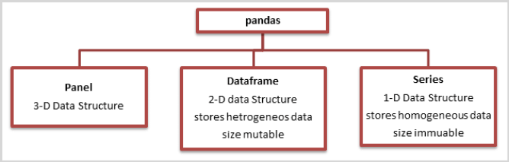
Data Structure in Pandas
12

Slide 12

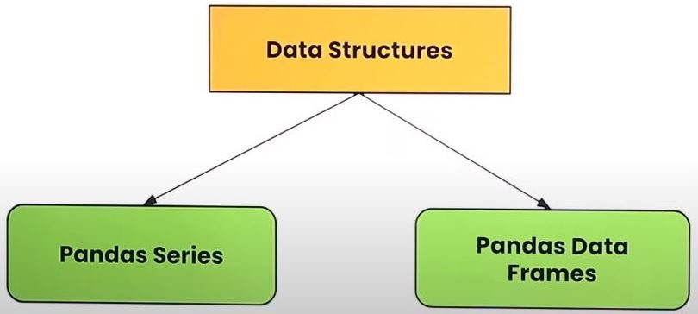
Data Structure in Pandas
13
A data structure is a collection of data values and operations that can be applied to that data.
It enables efficient storage, retrieval and modification to the data.
Two commonly used data structures in Pandas that we will cover in this book are:

Slide 13
Series
14
A Series is a one-dimensional array containing a sequence of values of any data type (int, float, list, string, etc) which by default have numeric data labels starting from zero.
DataFrame
A DataFrame is a two-dimensional labelled data structure like a table of MySQL. It contains rows and columns, and therefore has both a row and column index.

Slide 14
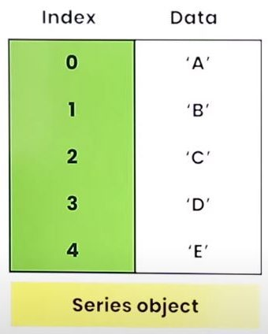
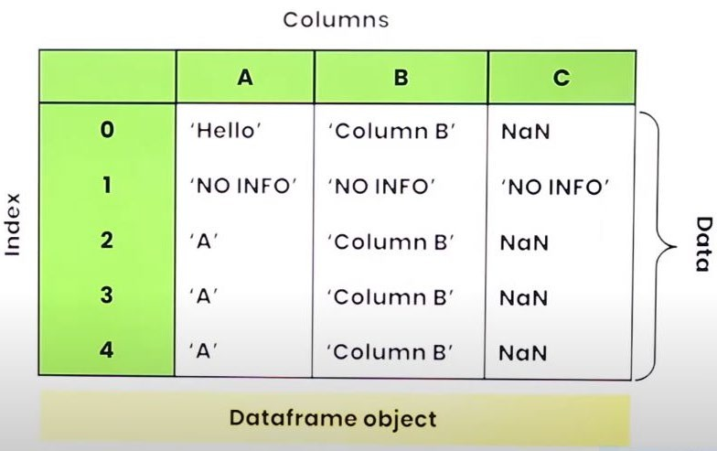
15

Slide 15
Property | Series | DataFrame
Dimensions | 1-Dimensional | 2-Dimensional
Type of Data | Homogeneous, i.e., all the elements must be of same data type in a Series object. | Heterogeneous, i.e., a DataFrame object can have elements of different data types.
Mutability | Value mutable, i.e., their elements’ value can change. size—immutable, i.e., size of a Series object, once created, cannot change. If you want to add/drop an element, internally anew Series object will be created. | Value mutable, i.e.. Their elements’ value can change. size—mutable, i.e., size of a Dataframe object, once created, can change in place. That is, you can add/drop elements in an existing dataframe object.
16

Slide 16
:Series:
17
Series is an important data structure of pandas.
It represents a one-dimensional array of indexed data.
A Series type object has two main components:
An array of actual data
An associated array of indexes (Numeric index) or data labels (Labelled index).

Slide 17
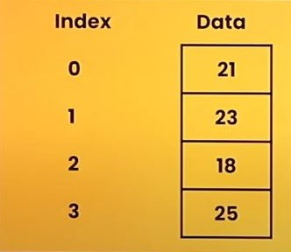
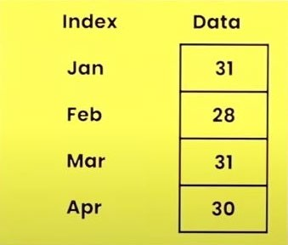
Both components are one-dimensional arrays with the same length.
The index is used to access individual data values, eg. The following shows some series objects:
18

Slide 18
19
Creation of Series
Syntex: (import pandas as pd)
<Series_Object> = pd.Series()
<Series_Object> = pd.Series(data,index=idx)
III.
<Series_Object> = pd.Series(<any python sequence>)

Slide 19


















Different ways to create Series:
20

Slide 20
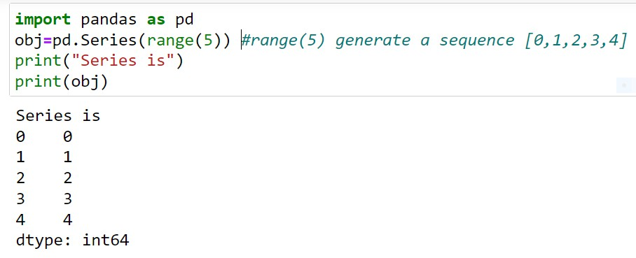
Creation of Series from Python Sequence
21
To create series, give sequence of values as attribute to Series()

Slide 21
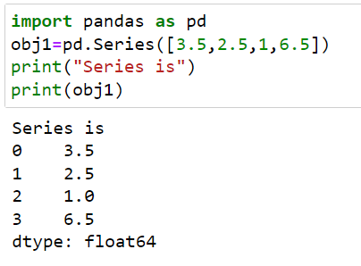
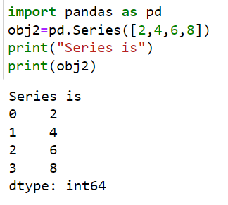
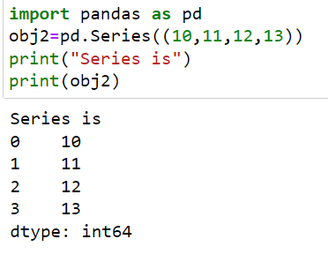
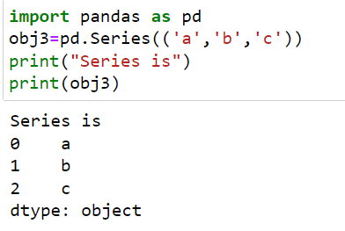
22

Slide 22
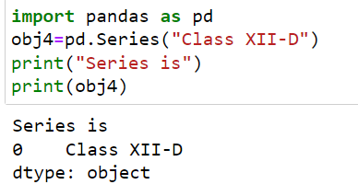
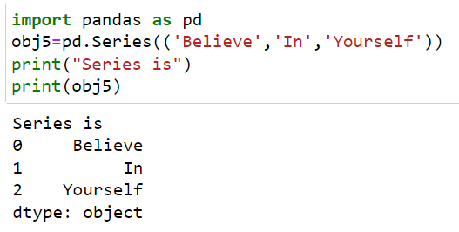
23

Slide 23
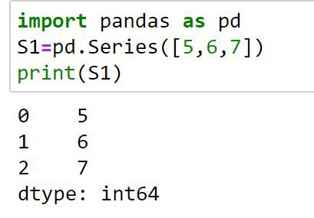
Creation of Series from Scalar Values
24
A Series can be created using scalar values as shown in the example below:
Observe that output is shown in two columns - the index is on the left and the data value is on the right. if we do not explicitly specify an index for the data values while creating a series, then by default indices range from 0 through N 1. Here N is the number of data elements.

Slide 24
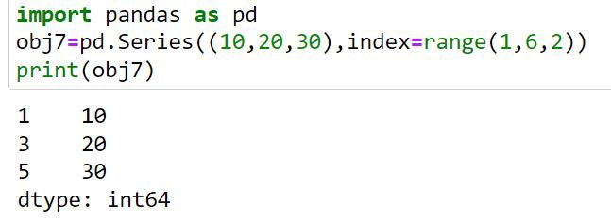
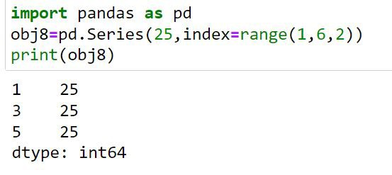
25

Slide 25
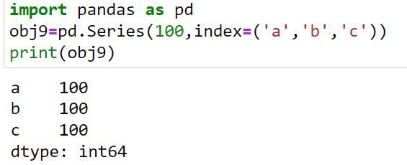
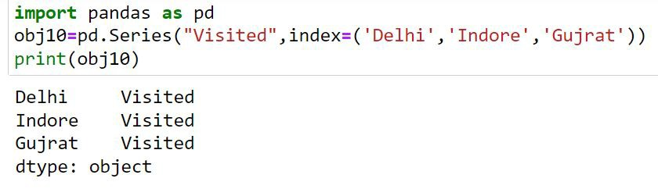
26

Slide 26
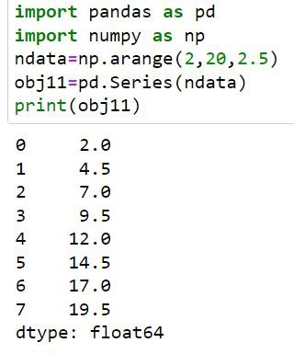
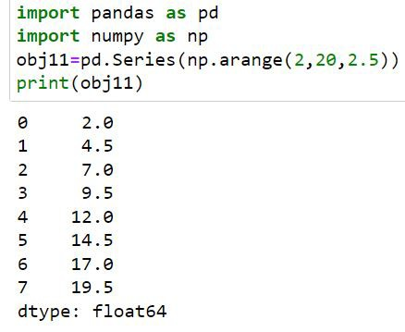
Creation of Series from Numpy Array
27

Slide 27
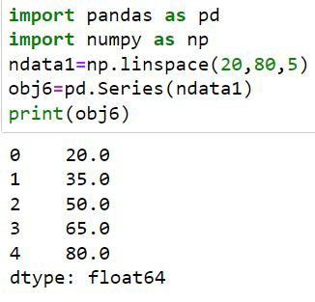
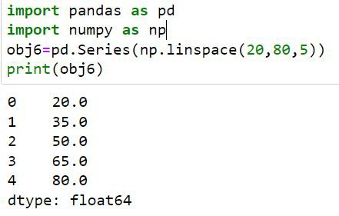
28

Slide 28
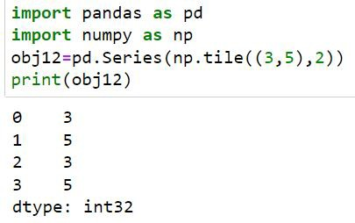
29

Slide 29
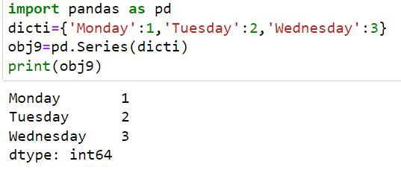
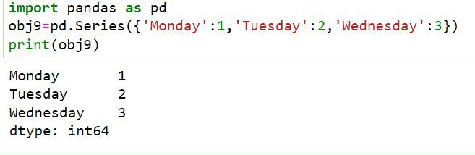
Creation of Series from Dictionary
30
Python dictionary has key: value pairs and a value can be quickly retrieved when its key is known.
Dictionary keys can be
used to construct an index for a Series.

Slide 30
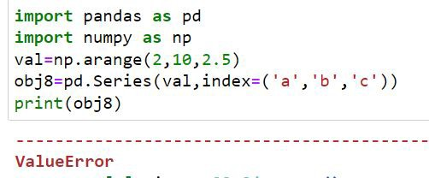
Series
31
When index labels are passed with the array, then the length of the index and array must be of the same size, else it will result in a ValueError.
In the example shown below, array! contains 4 values whereas there are only 3 indices, hence ValueError is displayed.

Slide 31







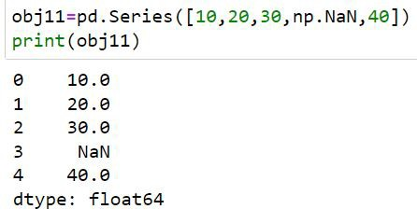
Specifying/Adding NaN values in a Series Object
32
Sometimes you need to create a series object of a certain size but you do not have complete data available at that time.
In such cases, you can fill missing data with a NaN (Not a Number) value.

Slide 32
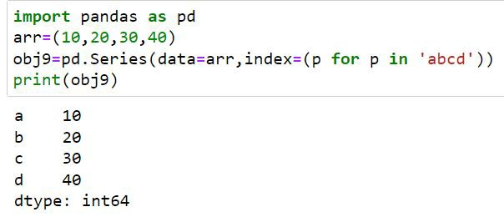
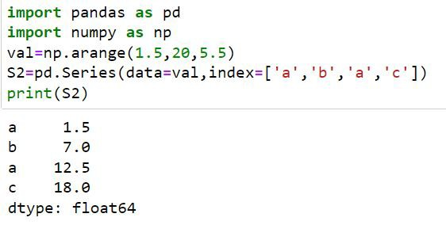
33

Slide 33
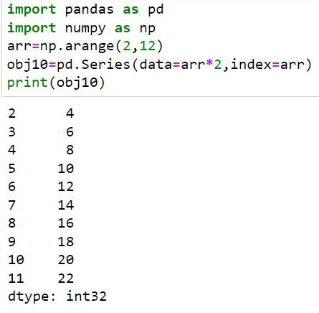
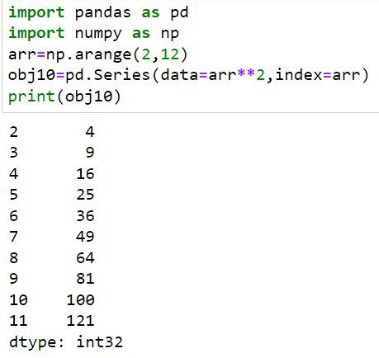
34

Slide 34
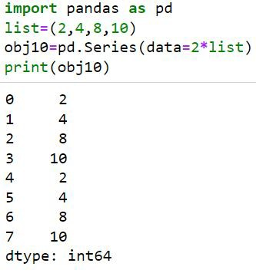
35

