Slide 1
Ownership
Lynden from the pub

Slide 2
Agenda
What it means
Motivations
Examples
Managing ownership with types
Other languages
Gotchas
Tips and Take-aways

Slide 3
Agenda
Please interrupt me
if something important is unclear or wrong
Save language wars for when we have smart juice

Slide 4
What I mean by ownership
Resource management
Allocation, registration, acquisition
Deallocation, reregistration, release-ification
Applies to more than just memory
Locks etc
Mostly memory
Ownership is not the same as aliasing
Ownership matters even when not using smart pointers or C++

Slide 5
Motivating errors
Double delete / release
Forgetting to delete / release
Exception safety
Forgetting to allocate / acquire
CVEs and security issues
Vast majority stem from memory management errors

Slide 6
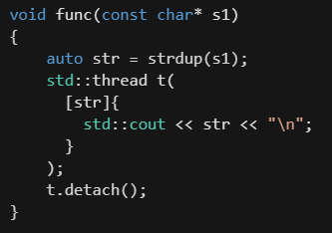
Examples
Find the bug:

Slide 7
Examples
Find the bug:
Never frees str

Slide 8
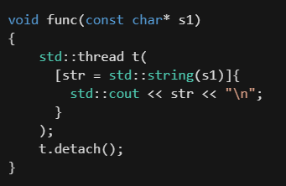
Examples
A solution:

Slide 9
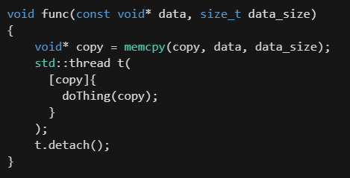
Examples
Find the bug:

Slide 10
Examples
Find the bug:
Never allocates copy

Slide 11
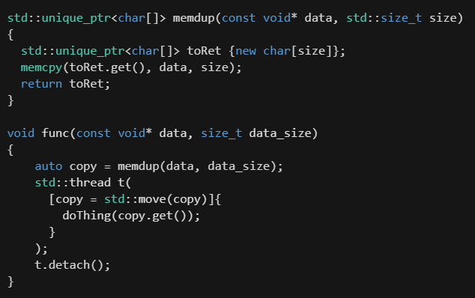
Examples
A solution:
Or use a static analyser

Slide 12
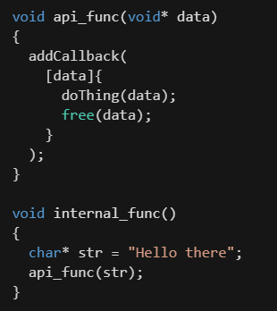
Examples
Find the bug:

Slide 13
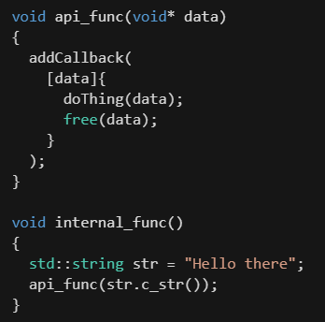
Examples
Find the bug:
str’s buffer is freed twice

Slide 14
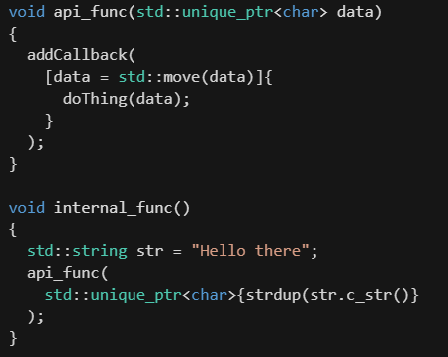
Examples
A solution:

Slide 15
Examples
typedef or using declaration that adds "owning" to the pointer type names.
Better yet, using a smart pointer that handles the resource management for you and use APIs that support them

Slide 16
Gotchas 1
memory leaks and double deletes still possible - you still need to think about ownership
Smart pointers also don't remove the need to do null checks

Slide 17
Gotchas 2
Separate chains of std::shared_ptr to the same object will cause issues
use copy constructor or copy assignment operator
typedefs and using declarations are weak;

Slide 18
Gotchas 3
If you have a smart pointer that's aliased or otherwise accessible through means outside of function parameters, e.g. a global object or something that can be looked up, then make sure you "pin" an owning copy of the smart pointer before passing a pointer or reference to the object down a call chain
A function you call might reset the smart pointer, which might otherwise destroy the object

Slide 19
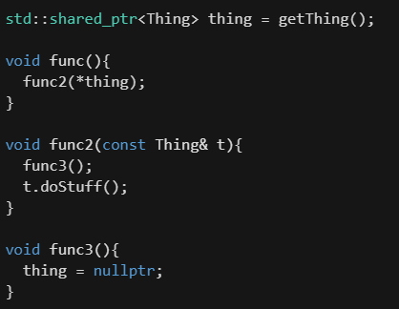
Gotchas 3
Example:

Slide 20
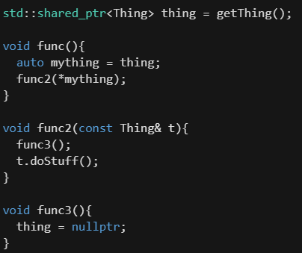
Gotchas 3
Good:

Slide 21
Tips and take-aways
Dos
Do use the type system to enforce or at least inform ownership
Do pass by const& by default
Do prefer automatic storage over smart pointers
Do make sure you understand the ownership semantics of C and legacy C++ APIs that you interface with and try to represent that in your code

Slide 22
Tips and take-aways
Don'ts
Don't use shared ownership unless you really need to (it's pretty rare)
Sorry Marx :(
Don't take parameters by smart pointer unless you need to manipulate ownership
Don't put things on the free store / heap unless you have to (it's less common than most C++ developers think)
Don’t use new and delete – even if you’re using the heap

Slide 23
Find out more
the article I wrote as the basis for this talk
"I didn't have time to write a short letter, so I wrote a long one instead."
It has much more detailed explanations
Also has guidelines for choosing the right type in various situations
C++ core guidelines (it’s on github)

Slide 24
Thank
Please ask me anything at any time
Please give me ideas for similar talks
༼ つ ◕_◕༽つ Please gib feedbacks ༼ つ ◕_◕༽つ
Do the significant eat and drink

