Slide 1
LLM Engineering & Practice 大模型工程应用和实践
2026/4/13
陈卓

Slide 2
Content
Online LLM & External Tools API Usage
Data synthesis, preliminary experiments, etc.
LLM Training
Code Frameworks
Arguments
Case study
LLM Inference/Deployment
Past and Present
Implementations
Why these stuff?

Slide 3



Why these stuff?
老板：
去！训个模型，让它能按照我们公司的要求/政策/话术/语言风格，回复客户消息。
我们：
浏览器打开 豆包、Gemini、 DeepSeek、GPT，一通prompt engineering……
：【东拉西扯一堆废话】【“你可以查阅相关规定。”】抱歉，我无法执行该操作。

Slide 4
Content
Online LLM & External Tools API Usage
Data synthesis, preliminary experiments, etc.
LLM Training
Code Frameworks
Arguments
Case study
LLM Inference/Deployment
Past and Present
Implementations

Slide 5

Online LLM API Usage
当想利用强模型制作一批数据，限制：闭源、资源不足以部署……
OpenAI
Anthropic
OpenRouter
Ofox.ai
阿里云
……
Let’s see the code.

Slide 6
Online LLM API Usage
id | 唯一标识 ID（用于日志、排查问题）
model | 模型名称（ OpenRouter 命名）
choices | 模型输出列表（通常只有一条结果） 也许同时包含 reasoning 内容
usage.prompt_tokens | 输入消耗的 token 数
usage.completion_tokens | 输出消耗的 token 数
usage.total_tokens | 本次请求总 token 数
usage.cost | 本次请求花费的金额

Slide 7
Online LLM API Usage
Suggestions
Start with toy examples
Be caution of your key. Don’t upload to GitHub
Concurrency, retries, loops
Token is money
Keep output tokens concise (unless you need reasoning)
Natural Language → JSON
Unnecessary chat history

Slide 8
External Tools API Usage
Google Search
Jina
Code Interpreter Sandbox
Image Search
File Parser
Google Scholar
…

Slide 9
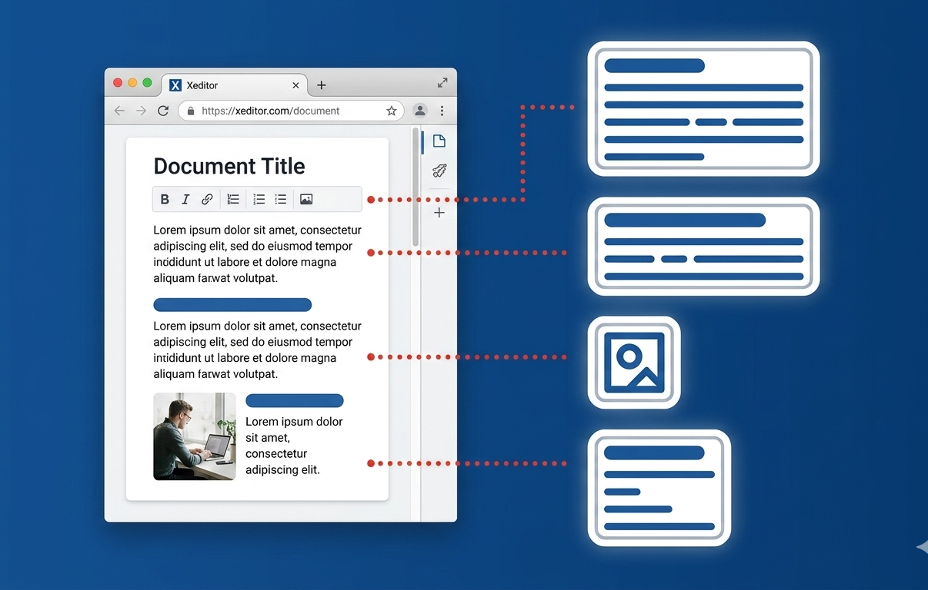

Jina
Let’s see the code.
Web Reader. Generate clean, structured and stable content.
v.s. scraper
 | 自己写爬虫 | Jina
开发速度 | 慢 | 秒级，一行 API
反爬处理 | 自己处理（代理、验证码、指纹） | 内置，全自动
动态页面 | 需 Selenium/Puppeteer，慢且不稳 | 自动渲染 JS
输出格式 | 手动写清洗、去重、结构化 | 输出干净 Markdown/JSON
维护成本 | 网站一变就崩 | 零维护
LLM 友好 | 脏数据、长文本 | 精简、结构化

Slide 10
Online API Usage
After that, before training
Data cleaning!
Hallucination
Error format
Low quality
Privacy
……

Slide 11
Content
Online LLM & External Tools API Usage
Data synthesis, preliminary experiments, etc.
LLM Training
Code Frameworks
Arguments
Case study
LLM Inference/Deployment
Past and Present
Implementations

Slide 12
LLM Training
Situation
We have annotated a set of data as training data
What should we do now? Code from scratch?

Slide 13
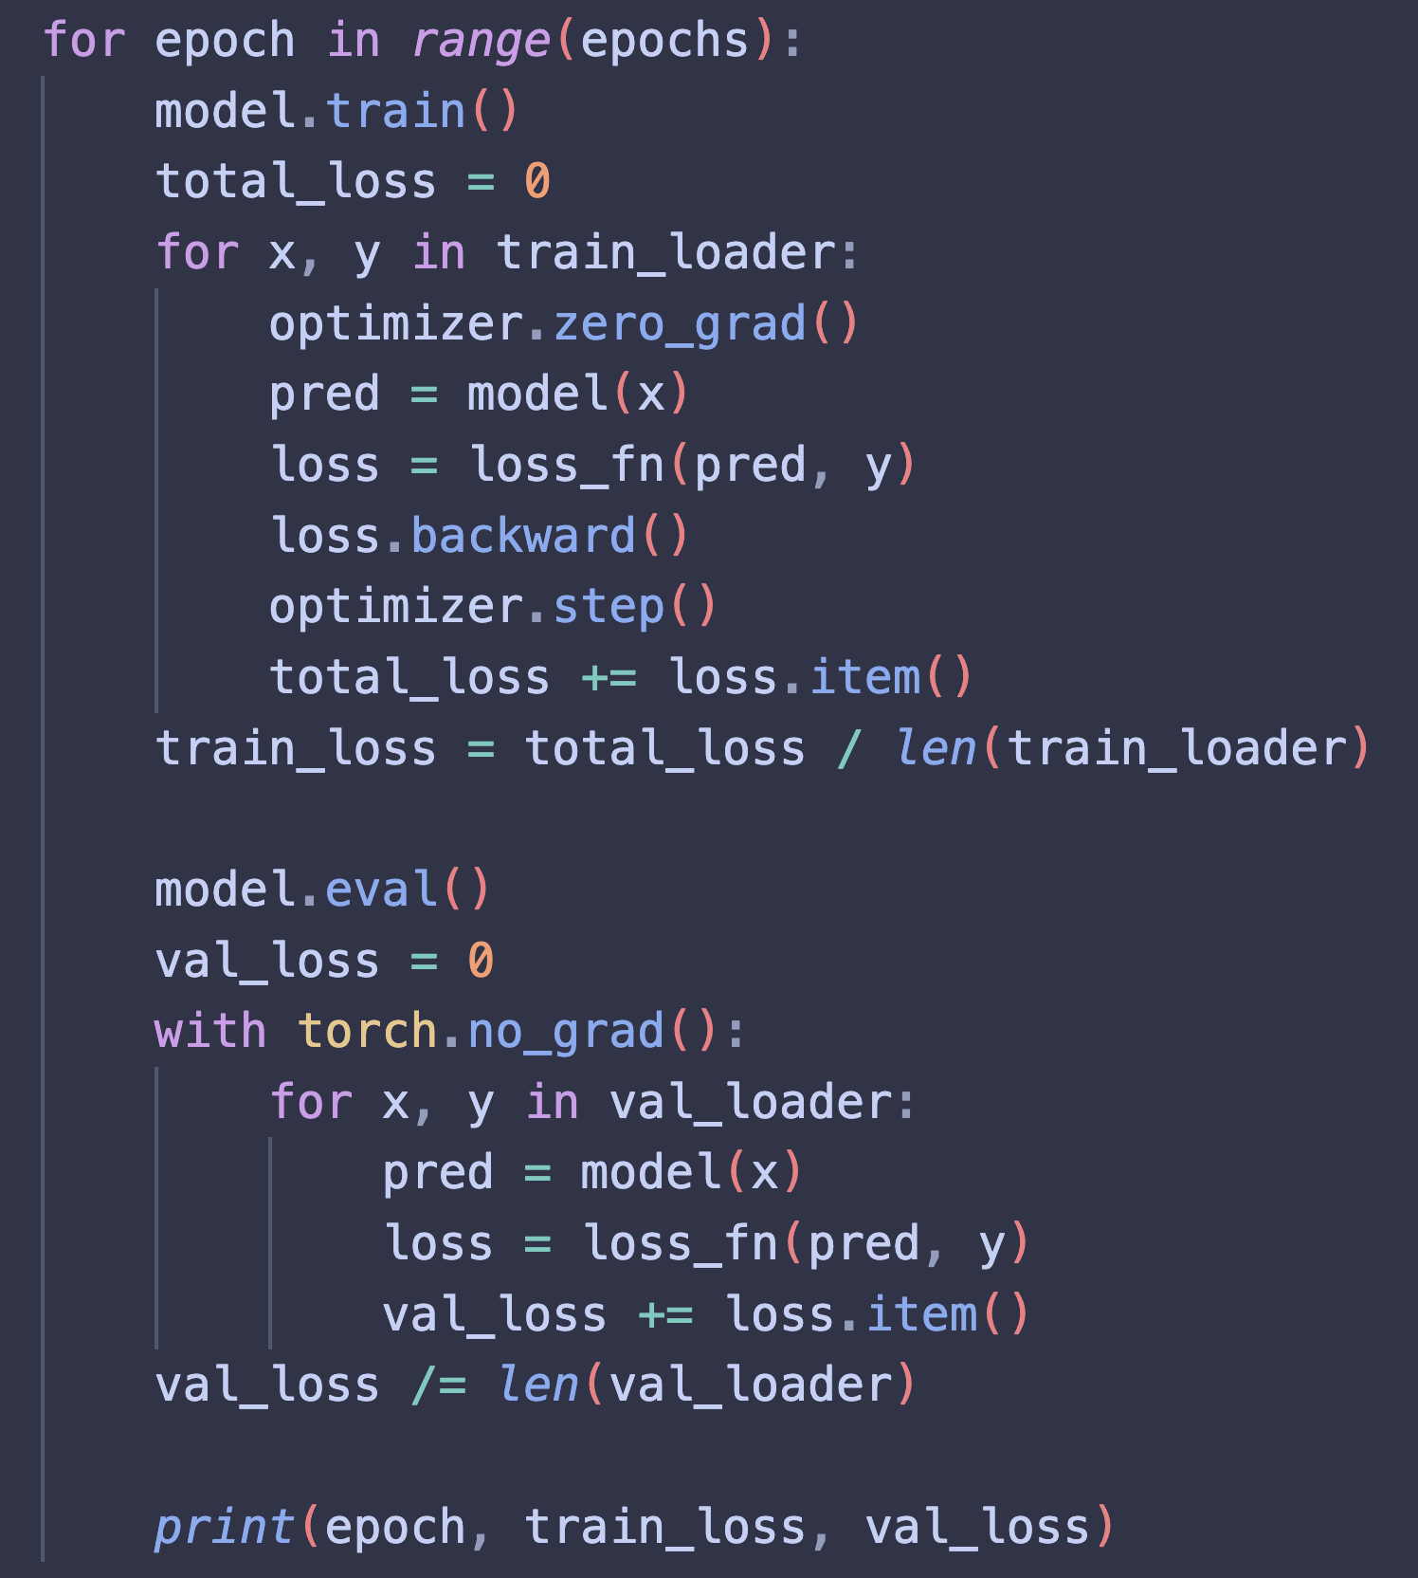
LLM Training
The past
Manual training setting
Basic acceleration features
Low development efficiency

Slide 14
LLM Training
The present: Code frameworks
Megatron-LM
NVIDIA 开发，工业级、超大规模（百亿～万亿参数）LLM 预训练 / 微调
GPU 优化加速框架
ms-swift
兼顾中文、多模态模型
GitHub Issue 响应快
Llama-Factory
全训练范式：预训练、SFT、RL …
PEFT 支持度高

Slide 15
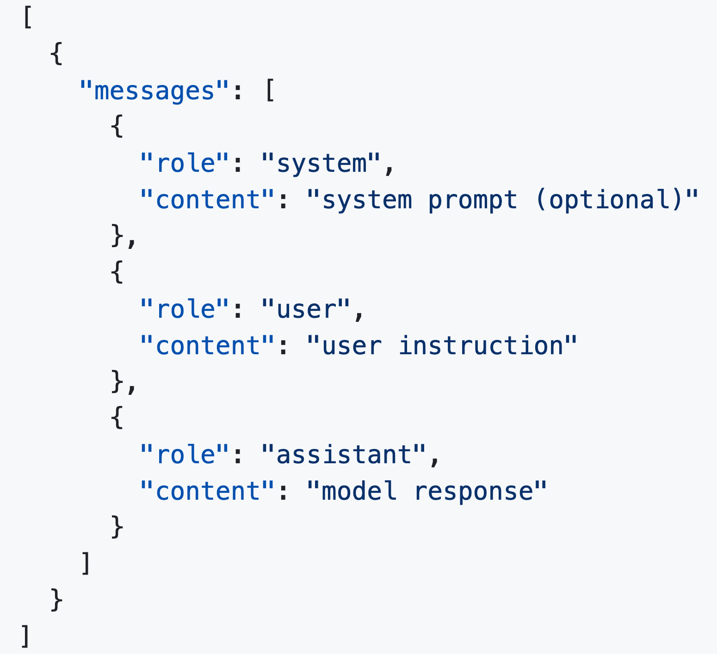
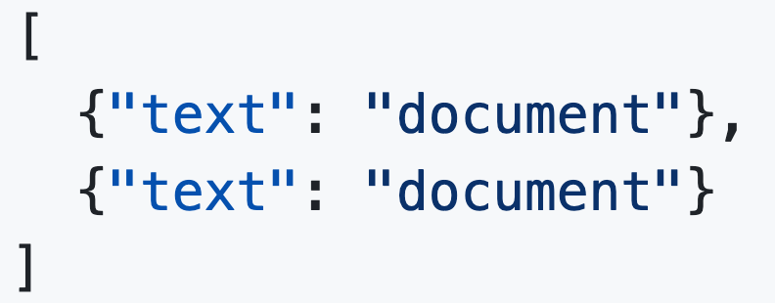
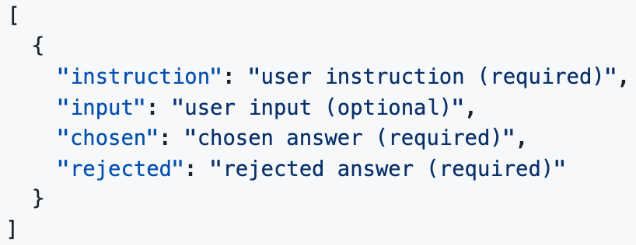
LLM Training (Llama-Factory)
1. Data format
Pre-training
SFT (OpenAI format)
DPO
Put data to LlamaFactory/data
Modify dataset_info.json
Loss
Let’s see the code.
https://github.com/hiyouga/LlamaFactory/tree/main/data

Slide 16
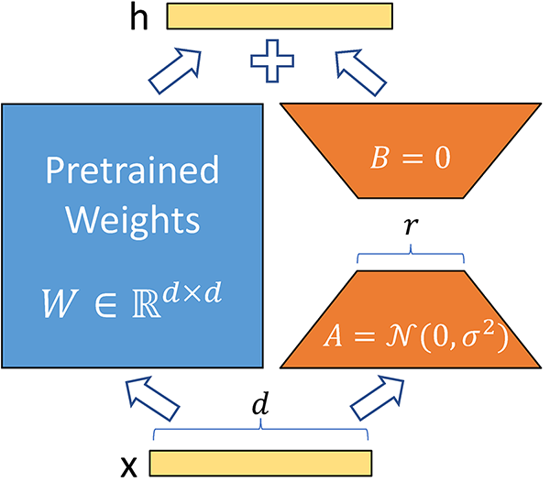
LLM Training (Llama-Factory)
2. Training Setting
If the task is not a difficult one, try PEFT methods first
If you have no idea about hyperparameters, resorting to LLM is a good practice
❌ “我要训个7B的模型，超参怎么写？”
✅ “我的任务是… 数据量有… 模型大小&来源… 手头资源有… 精度… 训练范式… 已有经验… 上下文长度…”
LlamaFactory/examples/train_lora/qwen3_lora_sft.yaml
Let’s see the code.

Slide 17
LLM Training (Llama-Factory)
一键启动：
llamafactory-cli train examples/train_lora/qwen3_lora_sft.yaml
https://github.com/hiyouga/LlamaFactory/blob/main/examples/README.md

Slide 18
LLM Training (Llama-Factory)
3. Things will happen…
Case 0: CUDA Out Of Memory
Half precision: fp16, bf16
Gradient checkpointing (时间换空间)
↓ mirco batch size, use gradient accumulation
↓ sequence length (if you have short context lengths)
PEFT?
(Start simple)

Slide 19
LLM Training (Llama-Factory)
3. Things will happen…
Case 1: Training loss decreases slowly until the end but does not converge.
Training is not complete → load ckpt and try continuing training
Learning rate is too small

Slide 20
LLM Training (Llama-Factory)
3. Things will happen…
Case 2: Training loss explodes at the beginning / training loss fluctuates sharply
Try smaller Learning Rate, larger batch size
Use gradient accumulation
Precision mismatch

Slide 21
LLM Training (Llama-Factory)
3. Things will happen…
Case 3: Training loss converges at some point. Evaluation results are bad. A arbitrary perspective is overfitting. However, it depends…
If the loss is near zero, it may be overfitting
If not, it could be
Model capacity
Data complexity
Training setting (Try larger LoRA rank, full finetune)
…

Slide 22
LLM Training (Llama-Factory)
3. Things will happen…
Case 4: Worse than base model
Check data quality/format FIRST
Learning rate is too large
Use development set
Inference setting (wrong tokenizer)

Slide 23
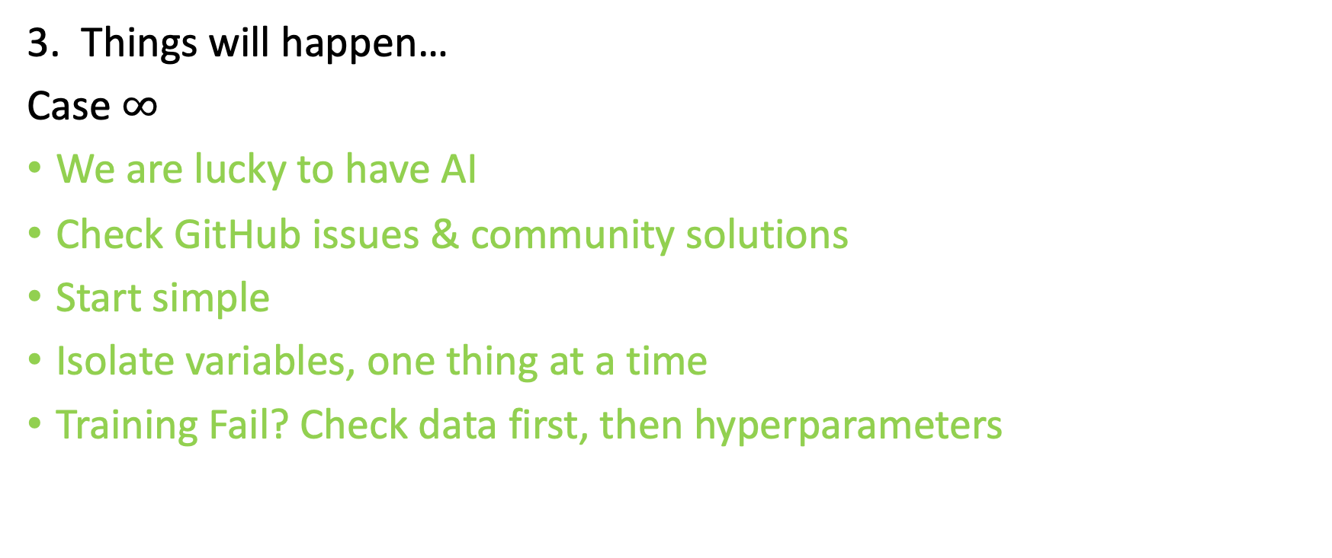
LLM Training (Llama-Factory)
3. Things will happen…
Case $∞$
We are lucky to have AI
Check GitHub issues & community solutions
Start simple
Isolate variables, one thing at a time
Training Fail? Check data first, then hyperparameters

Slide 24
Content
Online LLM & External Tools API Usage
Data synthesis, preliminary experiments, etc.
LLM Training
Code Frameworks
Arguments
Case study
LLM Inference/Deployment
Past and Present
Implementations

Slide 25
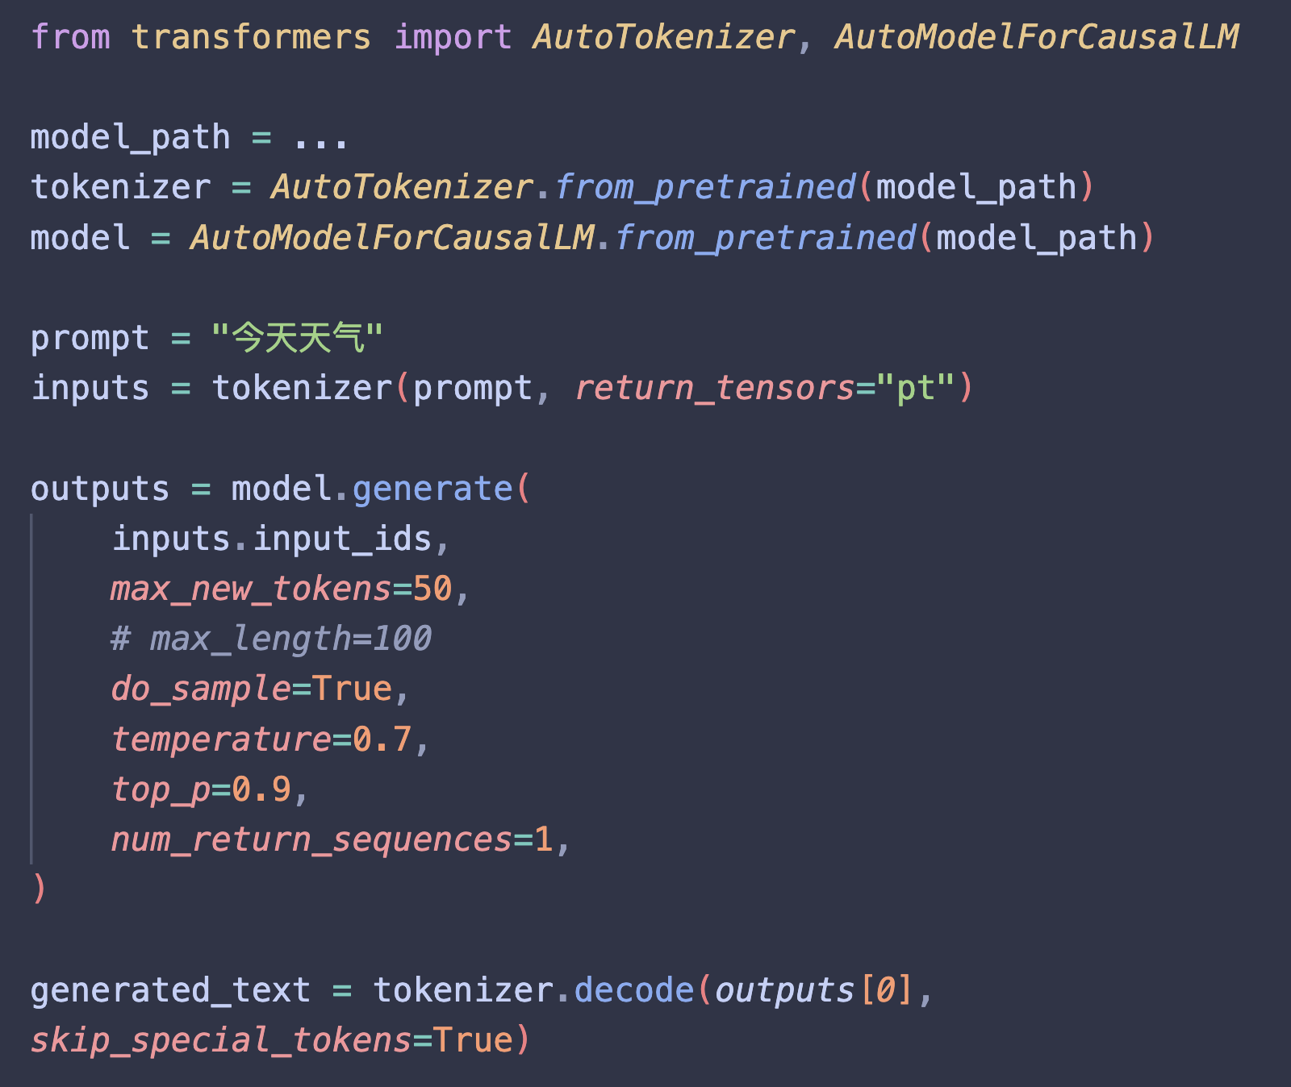
LLM Inference/Deployment
Alright! We now have trained a model
The Past
Load model
Tokenize
model.generate
✅ Batch
❌ Multi-processing

Slide 26
LLM Inference/Deployment
The Present: Code frameworks
vLLM
简单易用, OpenAI-compatible API, 社区生态
SGLang
结构化生成, 多轮对话
TensorRT-LLM
NVIDIA 开发, 极致性能
llama.cpp
C/C++, local deployment

Slide 27
LLM Inference/Deployment (vLLM)
Pros
PagedAttention
灵活调度
前缀缓存
Usage
Launch a server
Visit IP (with multi-processing)
KV Cache 是针对单样本的推理优化，PagedAttention 解决了多样本并发时导致的显存碎片化问题。
Let’s see the code.

Slide 28
Sum up & Further Applications
Online LLM & External Tools API Usage
LLM 评分、结构化抽取、帮忙读论文总结内容、审核（安全、不当内容）
LLM Training
指令遵循、风格迁移、蒸馏小模型
LLM Inference/Deployment
移动端App、企业内部部署
https://github.com/Chord-Chen-30/ShanghaiTech-NLP-Lecture-S26

