Slide 1
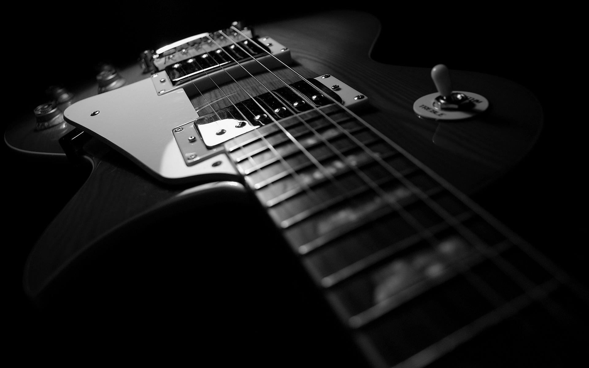
ChordSense

Slide 2

Context
Guitar learners often struggle to identify chords correctly when practicing alone.
Existing tools can be expensive, limited, or lack real-time feedback.
ChordSense provides real-time chord detection and immediate visual feedback to make practice easier and more effective.
Notes:
If you've ever tried to learn guitar on your own, you know the frustration: you're watching a tutorial, trying to match a chord, and you have no way to tell if what you're playing is actually right. Without an instructor there to listen and correct you, it's easy to build bad habits or just get stuck. Now, there are tools out there that try to help. Apps like Moises and Chordify can analyze a recorded song and give you a chord chart, and platforms like Songsterr have huge libraries of tabs. But most of these require a paid subscription to get accurate results, and more importantly, none of them are giving you feedback on your playing in real time. That's the gap ChordSense fills. Our device listens to your guitar, detects the chords you're playing in real time, and shows you exactly what it hears on a display. No subscription, no delay, just immediate visual feedback so you can practice with confidence."

Slide 3
Project State
Digital Visualization:
Frontend displays current and surrounding chords in sync with audio playback
Audio Processing Pipeline:
Generated timestamped chord data from analyzed audio for frontend playback sync
Heavy Chord Detection:
Ran Chord-CNN-LSTM on Jetson Nano to produce chord predictions
Custom Light ML Model:
Trained lightweight 21k-parameter model with about 90% accuracy for recorded and real-time input
Embedded Hardware:
Configured ESP32C3 ADC, DMA sampling, and began constant-Q transform implementation
Analog Hardware:
Built circuitry to scale and shift guitar signals into the ADC range

Slide 4

Demonstration

Slide 5
Timeline
Playback-synced chord display
WEEK 3
Custom lightweight ML model
WEEK 4
ESP32C3 ADC/DMA setup
WEEK 4
Analog input conditioning
WEEK 4
Analog-to-ESP integration
WEEK 4
Finalize display hardware
WEEK 5
GPIO button controls
WEEK 5
Real-time feedback
DESIGN 2
Enclosure design
DESIGN 2
System testing
DESIGN 2
Wireless companion app support
DESIGN 2
Jetson Nano - Chord Detection
WEEK 2-3
Initial Research & Planning
WEEK 1
Single Note Detection DESIGN 2
* times are from design draft due date (3/11/26)

