Slide 1
RELIABLE PREDICTION AND STATISTICAL EVALUATION
Diagnosing Conformal Prediction Failures Under Distribution Shift: A COVID-19 Case Study
Chorok Lee
KAIST
When conformal coverage fails
01 / 10
Notes:
Conformal prediction produces a set of plausible labels, not just a single prediction. Coverage is the fraction of examples whose true label appears in that set. The appeal is a statistical guarantee under exchangeability, which roughly requires calibration and future examples to be comparable. Deployment can violate that assumption. This study asks a practical question: can something measured before deployment identify models that are more vulnerable to future coverage loss? The proposed signal is the concentration of SHAP feature importance in the single most influential feature. We will connect that idea to the COVID-19 supply-chain case study, an idealized mechanism, and the observed cross-domain association. The result is a warning signal for a particular family of classifiers. It is not a replacement for conformal calibration or a guarantee under arbitrary future shift.
Sources
https://github.com/ChorokLeeDev/conformal-covid-uai2026/blob/96d9616961e5ae8607373181d35262cb21a2b0d1/paper/main.tex — Abstract; §Introduction
UAI 2026 camera-ready source; fixed 29 September 2026 snapshot

Slide 2
Same calendar shock, very different failures
Eight SALT tasks share the COVID-era split; their coverage losses vary sharply.
Task | Validation | Post-shift | Drop
Sales payment terms | 90.8% | 13.7% | 77.1 pp
Sales shipping condition | 93.5% | 21.8% | 71.6 pp
Item plant | 92.0% | 81.4% | 10.6 pp
Sales office | 99.9% | 99.9% | 0.1 pp
Non-randomized APS targets 90% coverage; values are 50-seed means.
Drop = validation coverage minus post-shift coverage; rounded values may not subtract exactly.
When conformal coverage fails
02 / 10
Notes:
The benchmark supplies eight classification tasks under the same calendar split. Models train before February 2020, validation covers February through July 2020, and test observations come afterward. This is an observational temporal case study, not a randomized intervention identifying the causal effect of COVID. Each of fifty seeds trains an independent LightGBM model and calibrates its own predictor; the experiment is not an ensemble of fifty predictions. The table shows four tasks to make the contrast visible. Payment-term coverage falls by 77.1 percentage points, while sales-office coverage is essentially unchanged. The seed runs measure algorithmic variation on these tasks; they are not fifty independent shocks. Rounding explains why displayed validation and test values occasionally differ from the separately reported drop. The central problem is explaining this heterogeneous vulnerability.
Sources
https://github.com/ChorokLeeDev/conformal-covid-uai2026/blob/96d9616961e5ae8607373181d35262cb21a2b0d1/paper/main.tex — §Methodology; Table tab:main_results
UAI 2026 camera-ready source; fixed 29 September 2026 snapshot

Slide 3
Measure where the model places its reliance
Top-1 concentration is the largest share of total mean absolute SHAP importance.
C = largest mean |SHAP| / total mean |SHAP|
Compute SHAP on validation data before deployment.
A large C means one feature dominates the measured attribution.
C measures reliance concentration; it does not measure how much future data will shift.
When conformal coverage fails
03 / 10
Notes:
For each feature, average the absolute SHAP attribution over validation examples. Then divide the largest of those averages by the sum across all features. The result lies between zero and one and is comparable across the tasks despite different raw attribution scales. A value of 0.5 means that one feature accounts for half of the measured attribution mass. This does not say that half of prediction errors will come from that feature, nor that the feature will necessarily change in deployment. It describes concentration in a fitted model's explanation. The timing matters: no future labels or future covariates are needed to compute this diagnostic. The hypothesis is that a model with one dominant reliance point can be fragile when a damaging shift affects that point. Stability of the feature still matters.
Sources
https://github.com/ChorokLeeDev/conformal-covid-uai2026/blob/96d9616961e5ae8607373181d35262cb21a2b0d1/paper/main.tex — §SHAP Concentration Diagnostic; Eq. eq:concentration
UAI 2026 camera-ready source; fixed 29 September 2026 snapshot

Slide 4
Why concentration can amplify vulnerability
The theory explains a mechanism under stated assumptions.
Idealized mechanism
Formal conclusion
Empirical boundary
The class-probability model combines a dominant-feature component and a residual component. Shift damages the dominant component while residual behavior stays exchangeable.
Under the theorem's conditions, a lower bound on expected APS score increases with concentration; a corresponding coverage upper bound worsens.
Probability-space additivity is an idealization. Measured TreeSHAP concentration is a proxy, not a guaranteed mixing coefficient.
When conformal coverage fails
04 / 10
Notes:
APS scores accumulate predicted probability down the ranked labels until the true class is reached. If the model becomes confidently wrong, the true class can appear late in that ranking, moving its score beyond the cutoff calibrated earlier. The theorem studies a deliberately simplified model: a mixture in probability space of a component depending on one feature and a residual component. The dominant feature's shifted component puts little probability on the true class, while the residual component and label retain their calibration distribution. Under the additional inequalities stated in the theorem, increasing the mixture weight worsens bounds on scores and coverage. The paper explicitly notes that TreeSHAP operates in log-odds space here. Thus this is directional mechanistic support under assumptions, not a formal guarantee that any measured SHAP concentration determines future coverage.
Sources
https://github.com/ChorokLeeDev/conformal-covid-uai2026/blob/96d9616961e5ae8607373181d35262cb21a2b0d1/paper/main.tex — §Theory; Theorem thm:score_inflation, assumptions A1–A3 and A1 footnote
UAI 2026 camera-ready source; fixed 29 September 2026 snapshot

Slide 5
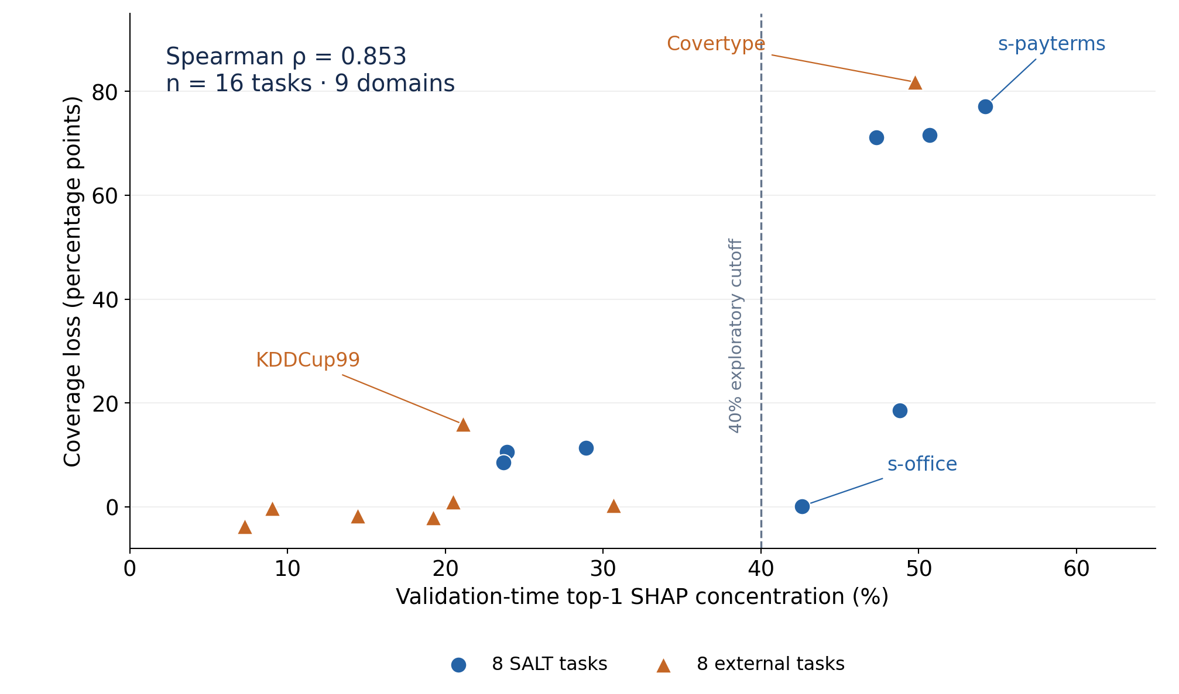
A strong association across the study tasks
Primary pooled endpoint: Spearman ρ = 0.853 across 16 multiclass tasks in 9 domains.
Reported p < 0.001; bootstrap 95% interval [0.50, 0.96].
The pool includes the original 8 SALT tasks and 8 external tasks.
Exact source data replotted: 8 SALT and 8 external multiclass tasks. The 40% cutoff is exploratory.
When conformal coverage fails
05 / 10
Notes:
Each point is a task: concentration measured on validation data appears on the horizontal axis, and subsequent coverage loss on the vertical axis. The pooled association is strong, with Spearman correlation 0.853. The unit of analysis is the task, not an individual prediction or seed. The sixteen-task result combines the original eight SALT tasks with eight external multiclass tasks. It is therefore not sixteen wholly independent new validations of a rule developed elsewhere. Four external tasks use documented shifts, and four are null-shift controls with random or predefined splits. The three-class Stack Overflow task is excluded from this primary endpoint, which uses at least four classes. The dashed threshold is exploratory. Notice the exceptions, especially sales-office and KDDCup99: they are important for interpreting the signal as a risk diagnostic rather than a deterministic rule.
Sources
https://github.com/ChorokLeeDev/conformal-covid-uai2026/blob/96d9616961e5ae8607373181d35262cb21a2b0d1/paper/main.tex — §SHAP Concentration Correlates with Failure; Table tab:stratified_correlation; Figure fig:n16_correlation
UAI 2026 camera-ready source; fixed 29 September 2026 snapshot

Slide 6
Detecting shift and predicting damage differ
On the eight SALT tasks, model-specific reliance is more associated with coverage loss.
Diagnostic | Spearman ρ | When available
Top-1 SHAP concentration | 0.833 | Before deployment
Native gain concentration | 0.667 | Before deployment
Across-seed disagreement | 0.452 | Before deployment
MMD / C2ST / PSI | ≤ 0.19 | Requires shifted data
Different information requirements: this is not a same-input forecasting contest.
Association does not establish a causal effect of concentration.
When conformal coverage fails
06 / 10
Notes:
A distribution test can correctly detect that data changed while saying little about which fitted model loses coverage. In this case study, the three reported shift indicators identify differences across all tasks but have weak rank associations with the severity of coverage loss. SHAP concentration is more strongly associated with that severity and is available earlier. Native feature-gain concentration and variability of validation coverage across seeds are alternative pre-deployment diagnostics. Their observed correlations are smaller on the eight SALT tasks. This comparison must retain its information distinction: shift tests use post-shift observations, so we should not imply a controlled same-input forecasting competition. The small task count also limits statistical separation between alternative explanations. In particular, class count and concentration are related within SALT; the cross-domain partial-correlation analysis gives additional evidence but does not turn the study into a causal experiment.
Sources
https://github.com/ChorokLeeDev/conformal-covid-uai2026/blob/96d9616961e5ae8607373181d35262cb21a2b0d1/paper/main.tex — Table tab:diagnostic_comparison; §Comparison with Standard Shift Detection
UAI 2026 camera-ready source; fixed 29 September 2026 snapshot

Slide 7
The 40% rule has useful exceptions
An exploratory flag is not a safe-deployment certificate.
Task | C | Drop | Interpretation
Sales payment terms | 54.2% | 77.1 pp | High-C failure
Sales office | 42.6% | 0.1 pp | False positive
Covertype | 49.8% | 81.8 pp | External failure
KDDCup99 | 21.1% | 15.9 pp | False negative
At-risk means mean coverage loss > 15 percentage points.
A protective-feature rule came from one case; it requires further validation.
When conformal coverage fails
07 / 10
Notes:
The proposed 40 percent concentration cutoff is a compact screening rule. It should not be read as a universal threshold at which a predictor suddenly becomes unsafe. Sales-office has concentration above the cutoff but almost no coverage loss. The manuscript motivates a protective-secondary-feature check from that one observation; its numerical cutoffs remain provisional. KDDCup99 illustrates the reverse problem: concentration is below the threshold but the mean loss crosses the study's fifteen-percentage-point at-risk definition, with substantial seed variability. Covertype is the principal catastrophic external case, with the stated geographic split. A separate specificity experiment uses another Covertype split and obtains different results; those experiments should not be merged. The practical interpretation is to investigate concentrated dependence, examine feature stability, and keep monitoring empirical coverage. A low concentration value does not establish future validity.
Sources
https://github.com/ChorokLeeDev/conformal-covid-uai2026/blob/96d9616961e5ae8607373181d35262cb21a2b0d1/paper/main.tex — Table tab:framework_validation; §Decision Framework; §Cross-Domain and External Validation
UAI 2026 camera-ready source; fixed 29 September 2026 snapshot

Slide 8
Scope changes with the classifier
The strongest evidence concerns gradient-boosted multiclass APS predictors.
LightGBM
Random forest
MLP
Within SALT, concentration–drop ρ = 0.833. Single-feature reliance aligns with the studied failure mechanism.
Within SALT, ρ = 0.30. Concentration is a weaker diagnostic in the reported architecture check.
Within SALT, ρ = 0.43. Large losses also occur with low concentration; the top-feature signal misses these cases.
These are observed model-family differences, not proof of their training causes.
When conformal coverage fails
08 / 10
Notes:
The central result has a scope: gradient-boosted multiclass classifiers using APS. The model-sensitivity analysis is useful because it tests whether the same compact diagnostic behaves similarly in other architectures. It does not. Random forests show a weaker association, and the multilayer perceptron can lose substantial coverage while its measured attribution remains relatively distributed. The source discusses these as global-sensitivity failures that a top-feature metric does not capture. One example is the MLP on sales-group, with roughly 27.5 percent concentration but 78.4 percentage points of coverage loss. That is a direct reason not to use a low C value as a universal reliability certificate. The architectural explanations are plausible interpretations, rather than isolated causal effects of bagging, boosting, or neural representations. Neural diagnostics and broader transfer need dedicated validation.
Sources
https://github.com/ChorokLeeDev/conformal-covid-uai2026/blob/96d9616961e5ae8607373181d35262cb21a2b0d1/paper/main.tex — Appendix Model Class Sensitivity; Tables tab:model_sensitivity and tab:mlp_lgb_comparison
UAI 2026 camera-ready source; fixed 29 September 2026 snapshot

Slide 9
Recovering coverage can reduce usefulness
The diagnostic identifies vulnerability; mitigation remains mechanism-dependent.
Adaptive calibration
Regularized scores
Retraining
ACI increases coverage on severe tasks, but may return very large label sets. Coverage and informativeness must be reported together.
RAPS reduces loss for some high-class-count tasks, yet does not uniformly repair concentrated-dependence failures.
Quarterly retraining offers suggestive partial recovery; the highlighted single-seed effect is not significant after Holm correction.
When conformal coverage fails
09 / 10
Notes:
A useful diagnostic does not by itself provide a repair. The paper examines three possible responses. Adaptive conformal inference can bring marginal coverage closer to target, but the returned sets may cover a large fraction of all classes, limiting practical value. This is why a coverage number should be paired with set-size or informativeness measures. RAPS regularizes how many labels accumulate in a prediction set and helps some high-cardinality tasks in the reported comparison; it does not uniformly resolve failure associated with a dominant feature. Retraining shows partial recovery in one highlighted task, but that experiment is single-seed and the multiple-testing-adjusted p-value is 0.11. These findings motivate mechanism-specific follow-up, not a universally validated deployment recipe. Prospective studies should specify the diagnostic, intervention, monitoring schedule, and success criteria before seeing future outcomes.
Sources
https://github.com/ChorokLeeDev/conformal-covid-uai2026/blob/96d9616961e5ae8607373181d35262cb21a2b0d1/paper/main.tex — §Extended Experiments: ACI, RAPS and Retraining
UAI 2026 camera-ready source; fixed 29 September 2026 snapshot

Slide 10
Model reliance and future coverage
Concentration is a warning signal to test, not a new coverage guarantee.
Measure validation-time top-1 SHAP concentration for the fitted model.
Check whether a plausible shift threatens its dominant feature.
Treat the 40% cutoff and protective-feature rule as exploratory.
Validate prospectively and monitor both coverage and set usefulness.
Source: github.com/ChorokLeeDev/conformal-covid-uai2026
When conformal coverage fails
10 / 10
Notes:
The contribution is a practical change in the reliability question. Instead of only asking whether a distribution has shifted, ask how the fitted predictor distributes its reliance and whether a shift could hit that reliance. The COVID-19 case study provides a striking contrast among tasks exposed to the same time period, and the external experiments support a broader association while preserving counterexamples. The idealized theorem provides directional intuition under a probability-mixture assumption; it does not certify measured TreeSHAP values. Three limits should remain visible: the threshold was developed using a small task set, the pooled endpoint includes those original tasks, and the evidence is model-family specific. The next step is prospective testing across new settings, with predeclared thresholds and interventions. In practice, this diagnostic can motivate closer inspection and monitoring; it cannot replace the assumptions behind conformal prediction.
Sources
https://github.com/ChorokLeeDev/conformal-covid-uai2026/blob/96d9616961e5ae8607373181d35262cb21a2b0d1/paper/main.tex — §Conclusion; §Decision Framework; Theorem A1 footnote
UAI 2026 camera-ready source; fixed 29 September 2026 snapshot

