Slide 1
Subspace- & Distance-Aware
Two-Level Indexer
面向长上下文 LLM / DeepSeek Sparse Attention 的高效索引与 GPU Kernel Co-design
开题汇报 · 2026.09

Slide 2
Background – 长上下文稀疏注意力的瓶颈正在转移
● Sparse Attention 将主注意力从“全量 KV”缩减到 Top-k token，但索引器本身仍可能扫描完整前缀。
● 随着 Context 从 32K → 128K，Indexer 的显存读取、打分与 Top-k 开销逐渐成为新的主导瓶颈。
● 已有工作已沿 token / head / query / layer 轴做削减；本课题关注仍未充分利用的 feature/subspace 轴。
Dense Attention
O(L²)
Sparse Attention
O(L·k)
Indexer Scan
still O(L²) in prefill
Related: DeepSeek Sparse Attention / HISA / MISA / PIVOT / IndexCache
2

Slide 3
Background – DSA 把系统瓶颈推向 Indexer
Lightning Indexer
Full-prefix scoring
Query
Top-k = 2048
Sparse MLA
Output
● DeepSeek-V3.2 reference indexer：64 heads × 128-d indexing representation，Top-k=2048。
● HISA 等最新工作说明：hierarchical indexer 已经有效，但 coarse stage 仍主要在完整 feature space 上计算。
● 核心问题：能否同时减少“看多少 token”和“每个 token 看多少维度”？
Sources: DeepSeek-V3.2-Exp reference implementation; HISA (arXiv:2603.28458).
3

Slide 4
Observation – 将直觉变成三个可验证假设
H1 Position Skew
Top-k token 是否主要集中于近邻，
同时保留少量关键远邻？
→ 决定 near / far 是否值得异构表示
H2 Feature Redundancy
128-d DSA score 是否存在可利用的
feature/subspace 冗余？
→ 决定 selected-dim coarse 是否可行
H3 Hardware Skew
coarse regular 与 refine irregular
是否适合不同 GPU execution path？
→ 决定 TC/CC co-design 是否有收益
先验证 observation，再决定算法和 kernel。
These are hypotheses to be validated on real DSA traces; not claimed as universal facts yet.
4

Slide 5
Related Work – 2024–2026 Indexer 研究版图
Feature / Proxy
Quest · Loki · PQCache
cheap proxy / low-rank / compressed retrieval
Hierarchy / Token
HISA · Double-P · NSA
block / cluster coarse → token refine
Reuse / Routing
MISA · PIVOT · IndexCache
head / query / layer axis reduction
Kernel / Top-k
DeepGEMM · DeepSelect · Libra
scoring / top-k / heterogeneous execution
Potential Gap: DSA-specific feature/subspace axis + distance-aware hierarchy + heterogeneous kernel
Quest’24; Loki’24; ClusterKV’24; NSA’25; Libra’25; HISA/MISA/IndexCache/PIVOT’26.
5

Slide 6
Research Questions – 论文主线不应只是 “two-level”
● RQ1：能否用 DSA-specific 的 selected subspace 做 Stage-1 coarse scoring，在显著减少 HBM read / FLOPs 的同时保持 ≥99% candidate recall？
● RQ2：near token 与 far token 是否应采用不同 representative（local avg / remote cluster），并通过统一 token-level exact refinement 恢复精度？
● RQ3：能否将 regular coarse work 与 irregular refine/top-k 分别映射到 Tensor Core / CUDA Core，并通过融合与流水化获得端到端收益？
核心 claim：减少 Feature Bytes × Candidate Tokens × Execution Waste
6

Slide 7
Overall Workflow – Proposed Two-Level Indexer
Near Region
local block summary
Query
Stage-1 Coarse
selected subspace
Candidate
Union
Stage-2 Fine
full 128-d
Far Region
semantic cluster
Top-k → Sparse MLA
● Stage-1 同时削减 feature dimensions 与 candidate tokens。
● Stage-2 只对候选做原始 DSA score refinement，保持 drop-in 接口。
● 目标：accuracy-efficiency Pareto 优于 strongest hierarchical baseline。
Framework: hierarchical coarse→fine; novelty sought in subspace + distance + kernel co-design.
7

Slide 8
Innovation A – Subspace-Preserving Coarse Index
Current reference
Proposed
RoPE 64d
noPE 64d
RoPE 64d
noPE 64d
● 关键：不宣称“总 cache 减半”，而是减少 Stage-1 memory traffic。
● 扫描 d′∈{32,48,64,96,128}，并统计 overall / remote / worst-layer recall。
H128 rotation
H64
H64
mixed 128d cache
Full refine path
Coarse-only load
32/48/64d
Motivation: DeepSeek-V3.2 index representation mixes RoPE/noPE before quantized cache; proposed layout must preserve accessible subspaces.
8

Slide 9
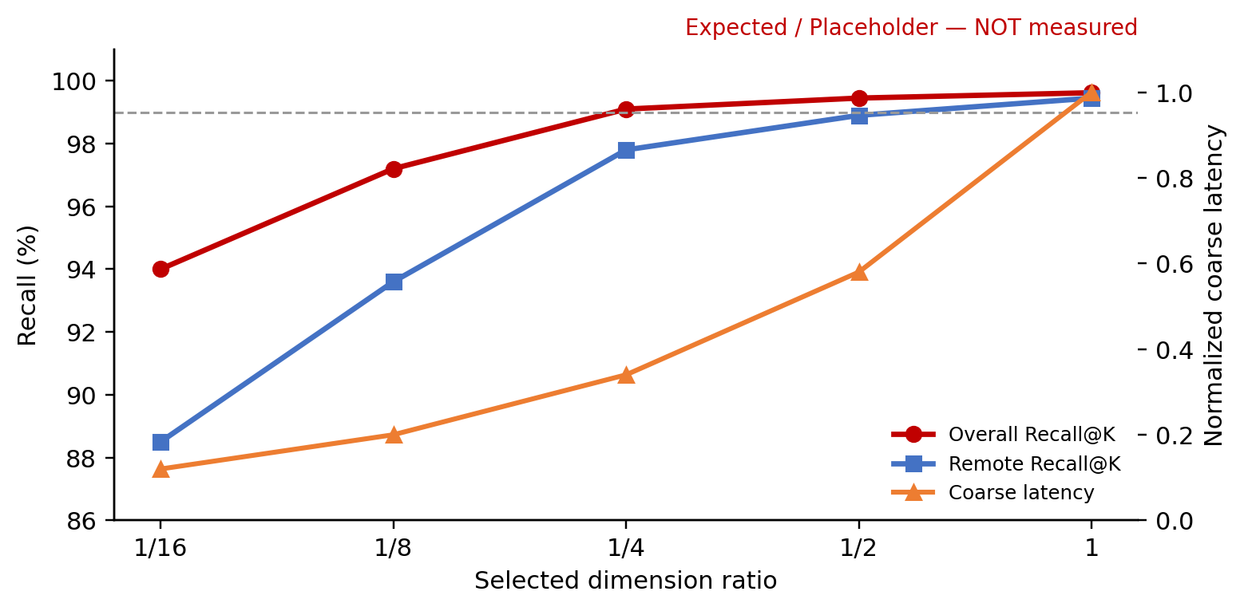
Innovation A – Expected Trade-off Template
Expected / NOT measured
● Survival：4× candidate 下 Recall@K ≥ 99.0%。
● Publishable target：Stage-1 HBM bytes ↓≈45%，且 remote recall 不出现系统性崩塌。
● 若 fixed subspace 不稳 → adaptive / query-aware dimension selection。
Synthetic placeholder only. Replace with real DSA trace replay: candidate recall, remote recall, HBM bytes, worst-layer P5.
9

Slide 10
Innovation B – Local Avg + Remote Cluster Hybrid Index
Far history
Near query
Far
semantic clusters
Mid
block mean / mean+std
Near
small block / exact
Candidate Budget
C = Cnear + Cfar
关键创新不是“near/far 不同方法”本身，而是 distance-conditioned representative + adaptive budget + exact token refinement。
Full DSA token refine
Prior-art risk: ClusterKV / NSA / Double-P already cover clustering or hierarchical selection; novelty must be DSA-specific and measurable.
10

Slide 11
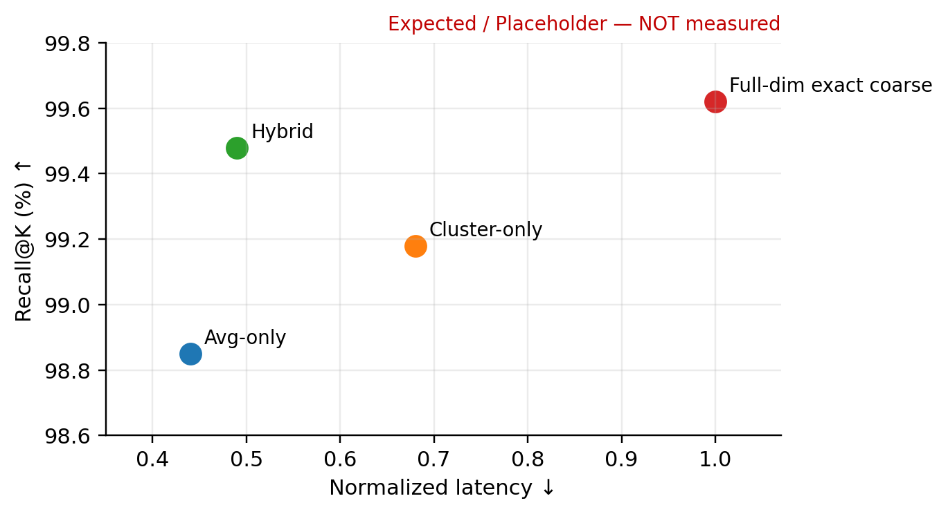
Innovation B – Expected Recall–Latency Pareto
Expected / NOT measured
● Avg-only：低延迟，但远邻 rare hit 容易漏。
● Cluster-only：召回改善，但 build/update 与 irregularity 较高。
● Hybrid：目标是在相同 Recall 下形成 Pareto-front 改善。
● No-Go：若相对 HISA-like mean pooling 无 ≥10% latency gain 或无 Recall 增益，则降级为辅助优化。
Synthetic placeholder only; real experiment must report distance-bucket recall and cluster maintenance overhead.
11

Slide 12
Innovation C – CUDA Core × Tensor Core Heterogeneous Indexer
Regular coarse tiles
block / cluster score
Irregular candidates
gather / refine / Top-k
Tensor Core lane
MMA / dense tiles
CUDA Core lane
SIMT / selection
Candidate Queue
shared-memory staging
● Coarse → TC：规则、可 tile 化。
● Refine / Top-k → CC：不规则 gather 与 selection。
● 可选：persistent kernel / warp specialization / fused top-k / double buffering。
Runtime cost model
Prefill vs Decode path
System novelty requires indexer-specific mapping; TC+CC coexistence alone is not new (cf. Libra).
12

Slide 13
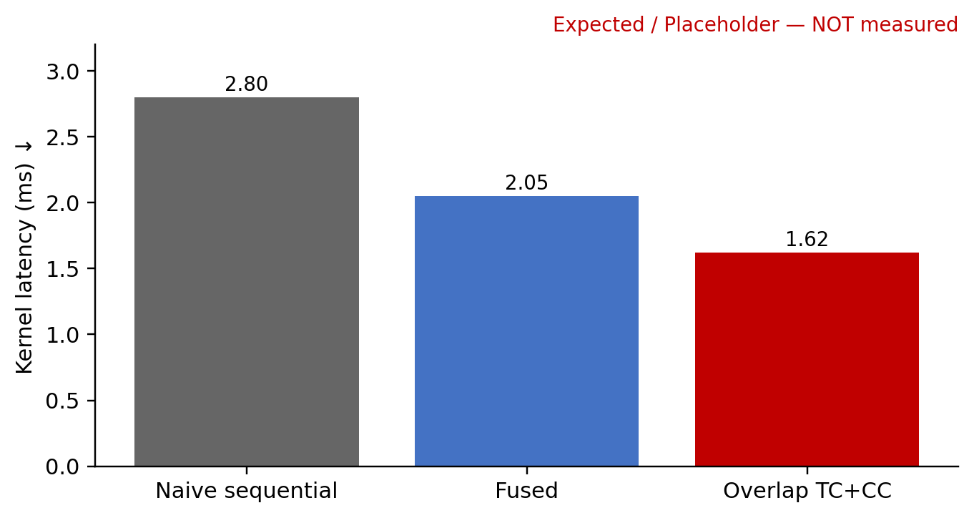
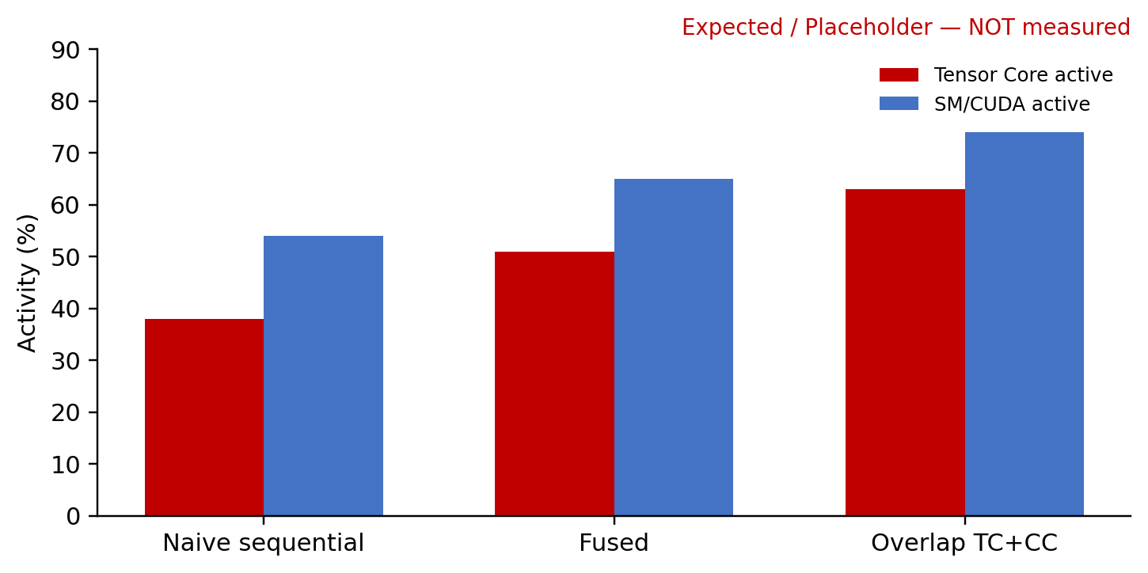
Innovation C – Expected Kernel Behavior
Expected / NOT measured
Kernel target
strongest comparable baseline 上 ≥1.3× kernel speedup；packing/gather 不超过总 kernel 的 15%。
Synthetic placeholders. Replace with Nsight Compute: DRAM bytes, L2 hit, SM active, Tensor Core active, occupancy, stall reasons.
13

Slide 14
Index Build / Update – 在线增量索引必须足够便宜
Index projection
RoPE / noPE split
rotation / quant
Local summary
block stats update
Remote index
cluster assign / lazy merge
New KV token
Queryable index
● 目标：append/update 为 O(1) 或 amortized low-cost；避免频繁全局重聚类。
● 远邻 cluster 可采用 lazy maintenance；近邻 summary 直接滚动更新。
● 必须单独报告 build/update overhead，不能只看 query latency。
14

Slide 15
Experimental Setup – 模型 × 数据 × 长度
模型
开发：DSA trace replay / 单层 microbench
主实验：DeepSeek-V3.2
Cross-model：GLM-5.x（资源允许）
系统平台：A100 + H100/H200（如可用）
数据 / Benchmark
LongBench / LongBench v2
RULER
Needle-in-a-Haystack / passkey
PG19 / WikiText perplexity
Synthetic locality benchmark
长度 / Sweep
8K / 16K / 32K
64K / 128K
selected dim：1/16…1
Candidate：2×…8×
Block：64 / 128 / 256
ANN datasets can be used for coarse-retrieval stress tests, but cannot replace real DSA selector fidelity evaluation.
15

Slide 16
Metrics & Success Criteria – 等精度再比速度
Selector Fidelity
• Candidate Recall@K
• Final Top-k IoU
• Remote Recall@K
• Worst-layer / P5 recall
• score-weighted recall
System
• Stage-1 / Stage-2 latency
• End-to-end TPOT / tok/s
• DRAM bytes / L2 hit
• TC / SM utilization
• index update overhead
Quality
• LongBench / RULER
• NIAH / passkey
• Perplexity
• Context-length robustness
• Cross-model generalization
Primary operating point: Candidate Recall@K ≥ 99% · LongBench relative drop ≤ 0.5%
16

Slide 17
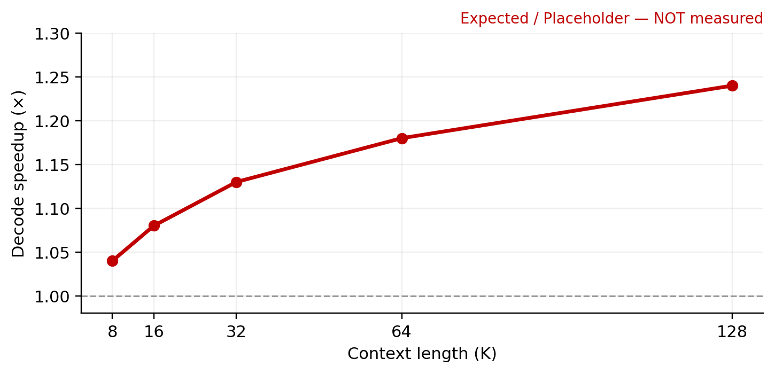
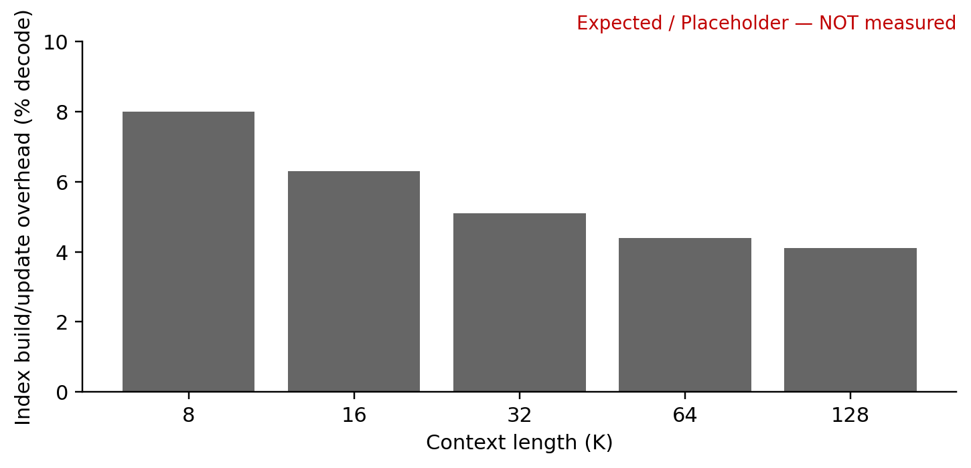
Expected End-to-End Benefit – Placeholder Templates
Expected / NOT measured
目标不是“只赢 flat DSA”，而是在 matched fidelity 下超过 HISA / MISA / PIVOT 等 strongest available baseline。
Synthetic placeholders. End-to-end gains must be measured with a complete serving stack.
17

Slide 18
Ablation Plan – 哪个因素真正贡献收益？
● Selected-dim：full-dim vs 1/2, 1/4, 1/8, 1/16；random vs magnitude/variance vs learned vs query-aware。
● Hybrid index：avg-only vs cluster-only vs avg+cluster；local window / remote budget 扫描；fixed vs adaptive budget。
● Candidate：2× / 3× / 4× / 6× / 8×；单独统计 remote-token recall，而非只报 overall。
● Kernel：TC-only / CC-only / naive sequential / fused / overlap；prefill 与 decode 分开。
● Profiler：SM occupancy、Tensor Core active、DRAM bytes、L2 hit、stall reason、packing/gather time。
● 泛化：layer/head locality heatmap；不同 task / context / model 的稳定性。
18

Slide 19
Risks & Go / No-Go
A – Subspace
GO: Recall ≥99%@4× candidate
HBM bytes ↓≥35%
NO-GO: Recall <98%
B – Hybrid Index
GO: matched Recall 下
vs HISA-like latency ↓≥10%
NO-GO: no Pareto improvement
C – Kernel
GO: vs strongest kernel ≥1.3×
packing <15%
NO-GO: <1.1×
● 若 A 不成立：切换到 learned / query-aware projection，而不是硬做 noPE-only。
● 若 B 收益不稳定：降级为辅助优化，不作为主 contribution。
● 若 C 在 decode small-M 上不划算：保留 CUDA-only decode path，只对 prefill 用 TC。
19

Slide 20
Timeline – 先证伪算法，再做复杂 Kernel
M1
Trace & Observation
2–3周
M2
Subspace Prototype
3–4周
M3
Hybrid Index
3–4周
M4
GPU Co-design
4–6周
M5
Full Eval & Paper
3–4周
M1 不通过，不进入复杂 TC/CC kernel 开发。
20

Slide 21
References & Placeholder Note
● Quest: Query-Aware Sparsity for Efficient Long-Context LLM Inference (2024) · arXiv:2406.10774
● Loki: Low-Rank Keys for Efficient Sparse Attention (2024) · arXiv:2406.02542
● ClusterKV (2024) · arXiv:2412.03213
● Native Sparse Attention (2025) · arXiv:2502.11089
● Libra: GPU Heterogeneity for Sparse Matrix Multiplication (2025) · arXiv:2506.22714
● HISA (2026) · arXiv:2603.28458 · code: MuLabPKU/TransArch
● MISA (2026) · arXiv:2605.07363
● IndexCache (2026) · arXiv:2603.12201 · code: THUDM/IndexCache
● PIVOT (2026) · arXiv:2607.24593
● DeepSeek-V3.2-Exp / DeepGEMM / DeepSelect official GitHub repositories
Important: Slides 9 / 11 / 13 / 17 contain synthetic “Expected / NOT measured” data only. Replace them with real measurements before any formal paper or defense claim.
Deck style adapted from the user-provided CuNeS presentation.
21

