Slide 1
機器學習及其應用
Regression

Slide 2






課程軟體
使用套件與環境
Vscode
Python 3.6.8
Pytorch 1.6.0 (cpu)
Torchvision 0.7.0 (cpu)
numpy
Opencv
Matplotlib
Pandas

Slide 3
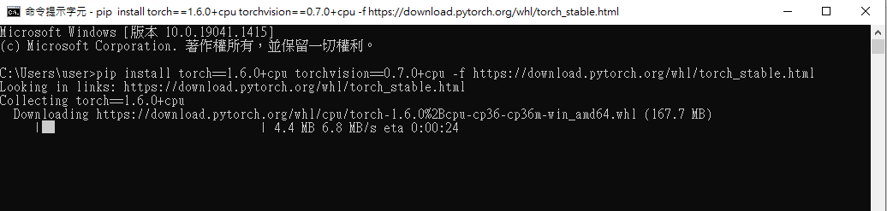
套件安裝(1)
Pytorch : https://pytorch.org/get-started/previous-versions/
pip install torch==1.6.0+cpu torchvision==0.7.0+cpu –f https://download.pytorch.org/whl/torch_stable.html

Slide 4
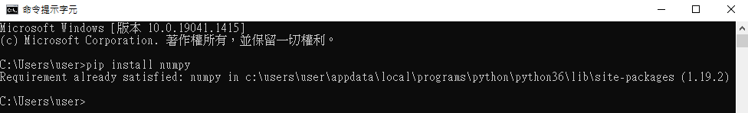

套件安裝(2)
numpy
pip install numpy

Slide 5
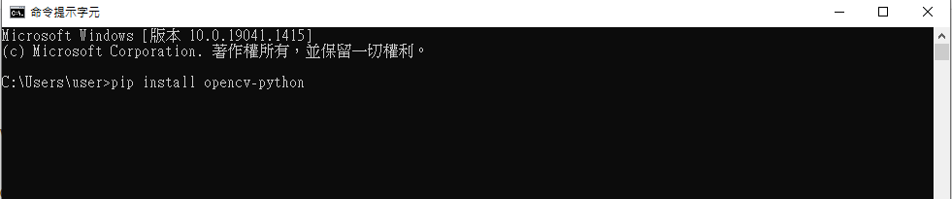

套件安裝(3)
Opencv
pip install opencv-python

Slide 6
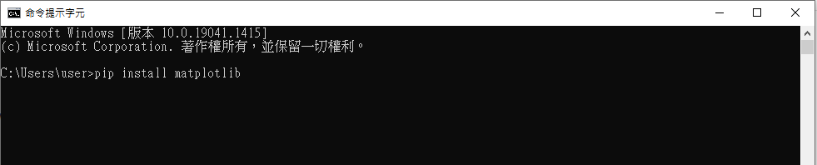
套件安裝(4)
Matplotlib
pip install matplotlib

Slide 7
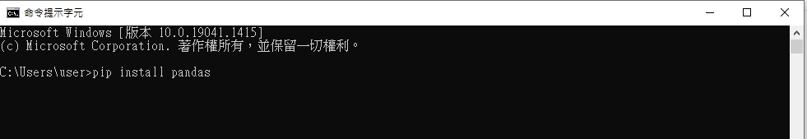
套件安裝(5)
pandas
pip install pandas

Slide 8
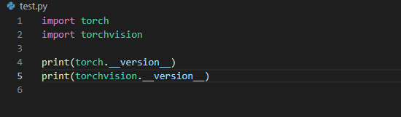
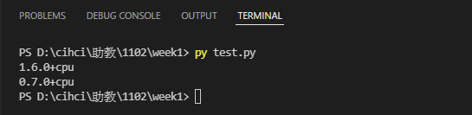
測試(1)
code
result

Slide 9
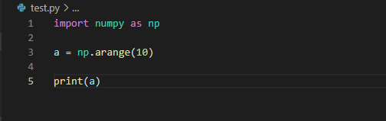
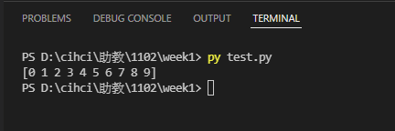
測試(2)
code
result

Slide 10
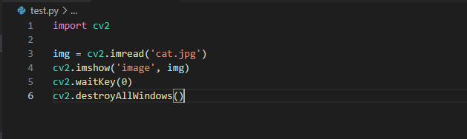
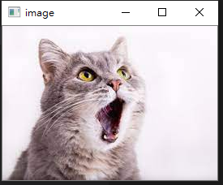
測試(3)
code
result
圖片: http://gofile.me/3F8pZ/Hztkpym4v

Slide 11
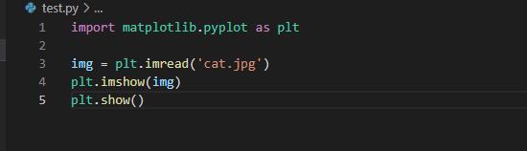
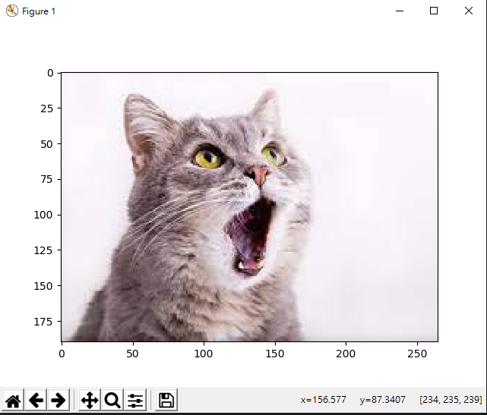
測試(4)
code
result

Slide 12
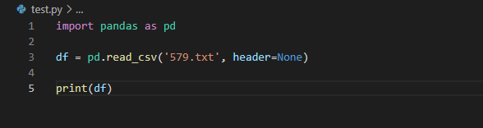
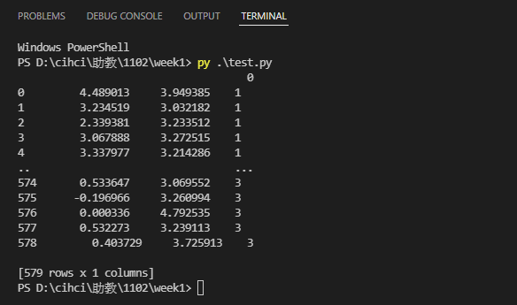
測試(5)
code
result
文件: http://gofile.me/3F8pZ/lVwjEvSqm

Slide 13
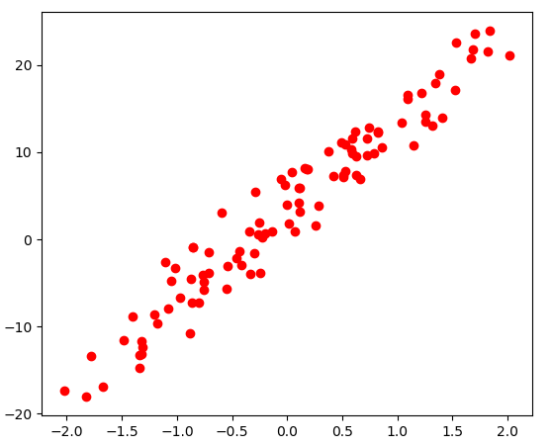
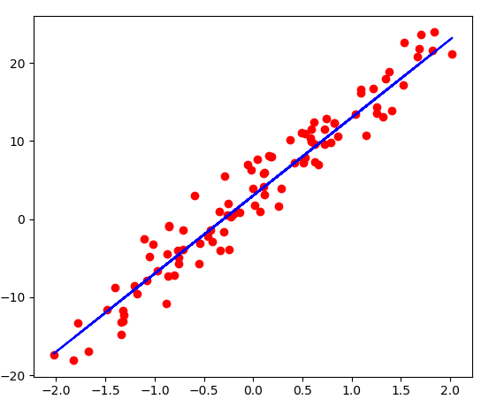
Regression
Find a function to fit the feature
Output a scalar

Slide 14
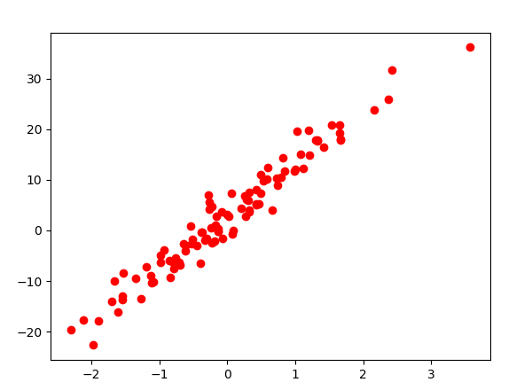
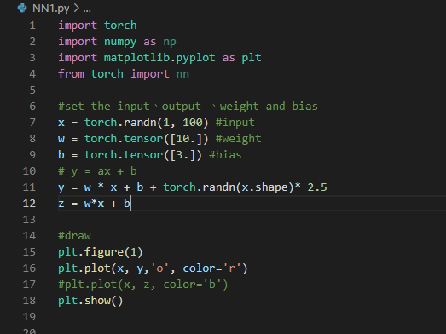
Step1 : set data

Slide 15
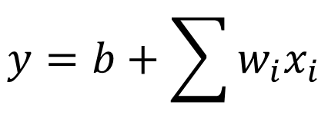
Step1 : model
Input data : x
Output : y = 3 + 10x+random
A set of function
$$y=b+\sum{w_{i}x_{i}}$$
Linear model:

Slide 16
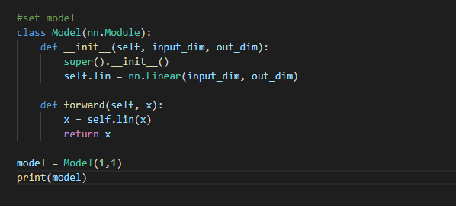
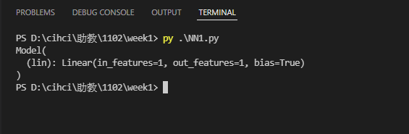
Step1 : model

Slide 17



Step2 : Goodness of Function
A set of function
$$f_{1}$$
$$f_{2}$$
$$f_{3}$$
…
Goodness of Function f
Loss function
Training
Data

Slide 18
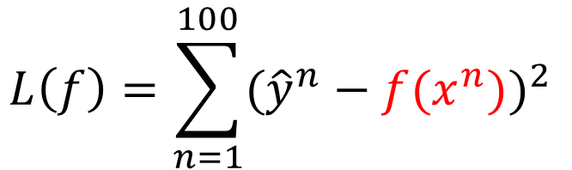
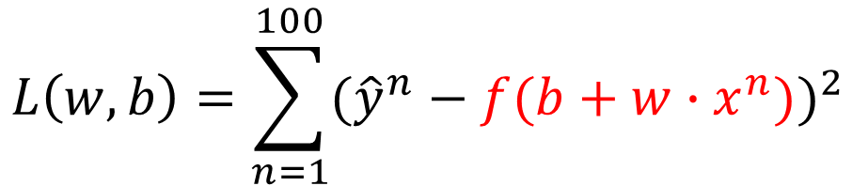
Step2 : Goodness of Function
Loss function L :
$$L\left(f\right)=\sum_{n=1}^{100}{({\hat{y}}^{n}−f(x^{n}))^{2}}$$
$$L\left(w,b\right)=\sum_{n=1}^{100}{({\hat{y}}^{n}−f(b+w∙x^{n}))^{2}}$$

Slide 19

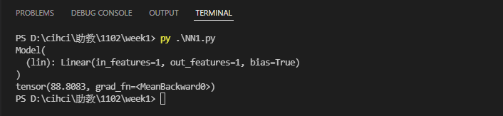
Step2 : Goodness of Function

Slide 20

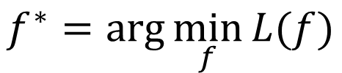
Step3 : Best Function
A set of function
Pick the “Best” function
Goodness of Function f
Gradient Descent
$$f^{∗}=\arg{\min_{f}{L(f)}}$$
$$w^{∗},b^{∗}=\arg{\min_{w,b}{L(w,b)}}$$
Training
Data

Slide 21

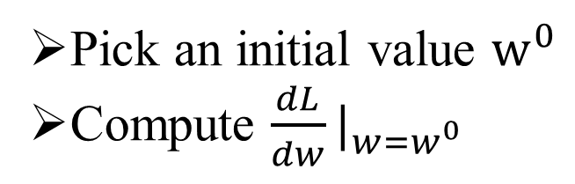


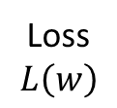
Step3 : Best Function(Gradient Descent)
Consider loss function L(w) with one parameter w:
$$w^{∗}=\arg{\min_{w}{L(w)}}$$
Loss
$$L\left(w\right)$$
Pick an initial value $w^{0}$
Compute $\frac{dL}{dw}|_{w=w^{0}}$
$$W^{0}$$
$$W$$

Slide 22
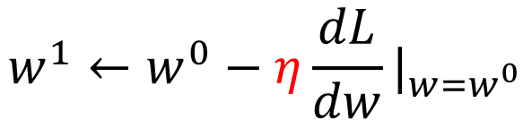

Step3 : Best Function(Gradient Descent)
Add learning rate
$$w^{1}←w^{0}−η\frac{dL}{dw}|_{w=w^{0}}$$
Loss
$$L\left(w\right)$$
$$W^{0}$$
$$−η\frac{dL}{dw}|_{w=w^{0}}$$
$$W$$

Slide 23
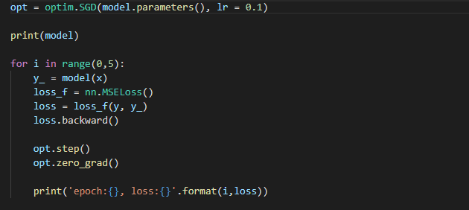
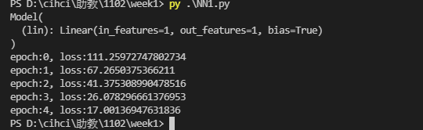
Step3 : Best Function

Slide 24
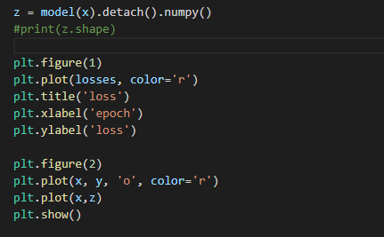
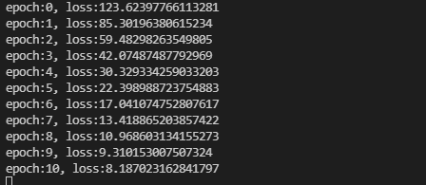
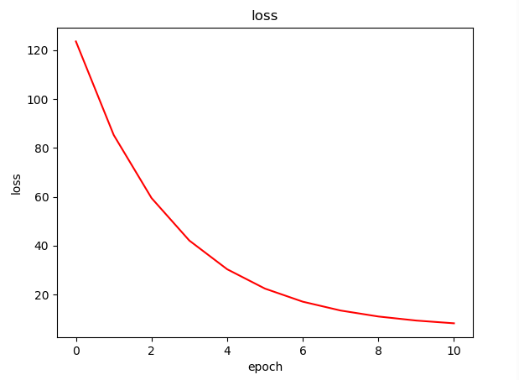
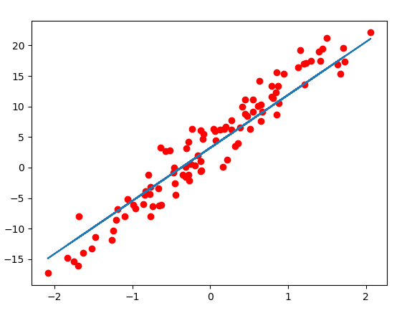
Step4 : Train model

Slide 25
Example 2: pokemon
http://gofile.me/3F8pZ/fp5bmS8vS

Slide 26
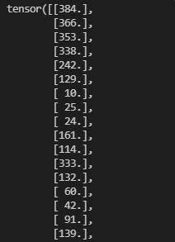
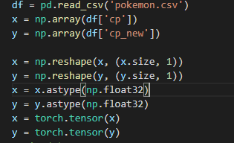
Pokemon(1)
Read data

Slide 27
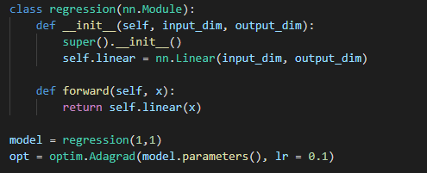
Pokemon(2)
Set model

Slide 28
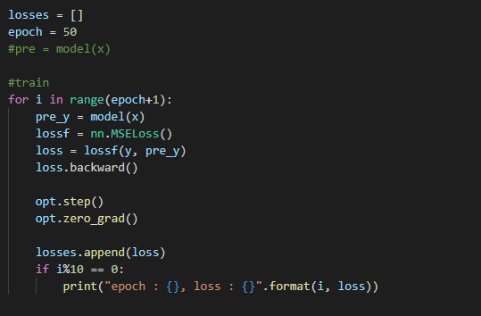
Pokemon(3)
train

Slide 29
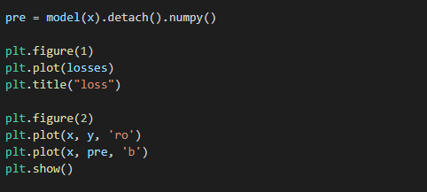
Pokemon(4)
Draw

Slide 30
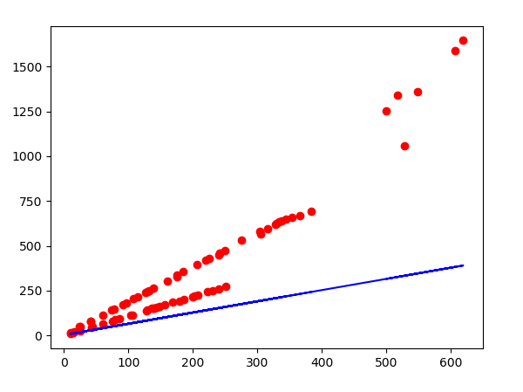
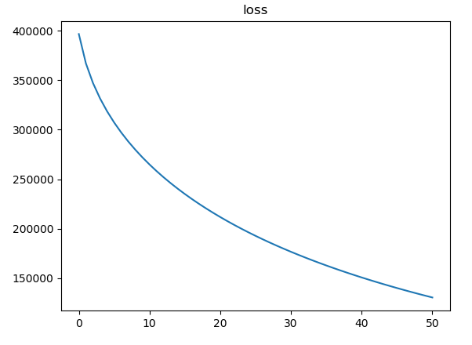
Pokemon(5)
result

