Slide 1
機器學習及其應用
CNN

Slide 2
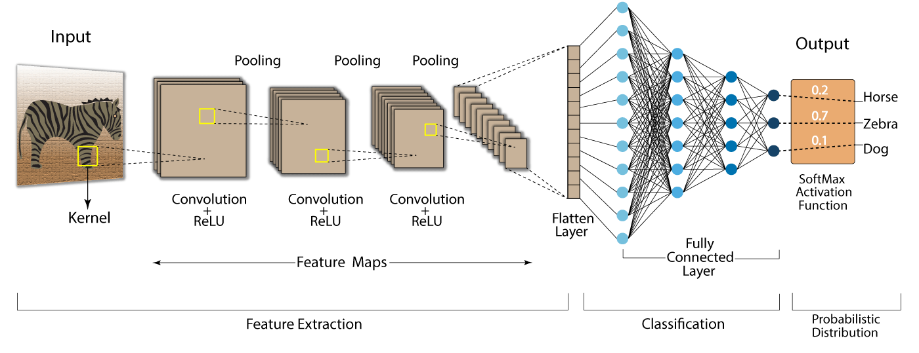
CNN

Slide 3
CNN-Convolution
1 | -1 | -1
-1 | 1 | -1
-1 | -1 | 1
1 | 0 | 0 | 0 | 0 | 1
0 | 1 | 0 | 0 | 1 | 0
0 | 0 | 1 | 1 | 0 | 0
1 | 0 | 0 | 0 | 1 | 0
0 | 1 | 0 | 0 | 1 | 0
0 | 0 | 1 | 0 | 1 | 0
3 | -1 | -3 | -1
-3 | 1 | 0 | -3
-3 | -3 | 0 | 1
3 | -2 | -2 | -1

Slide 4
CNN-Max Pooling
3 | -1 | -3 | -1
-3 | 1 | 0 | -3
-3 | -3 | 0 | 1
3 | -2 | -2 | -1
3 | 0
3 | 1

Slide 5
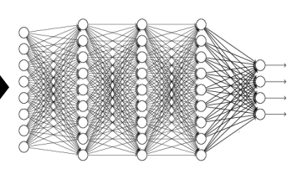
CNN-Flatten
3
3 | 0
3 | 1
0
1
3

Slide 6
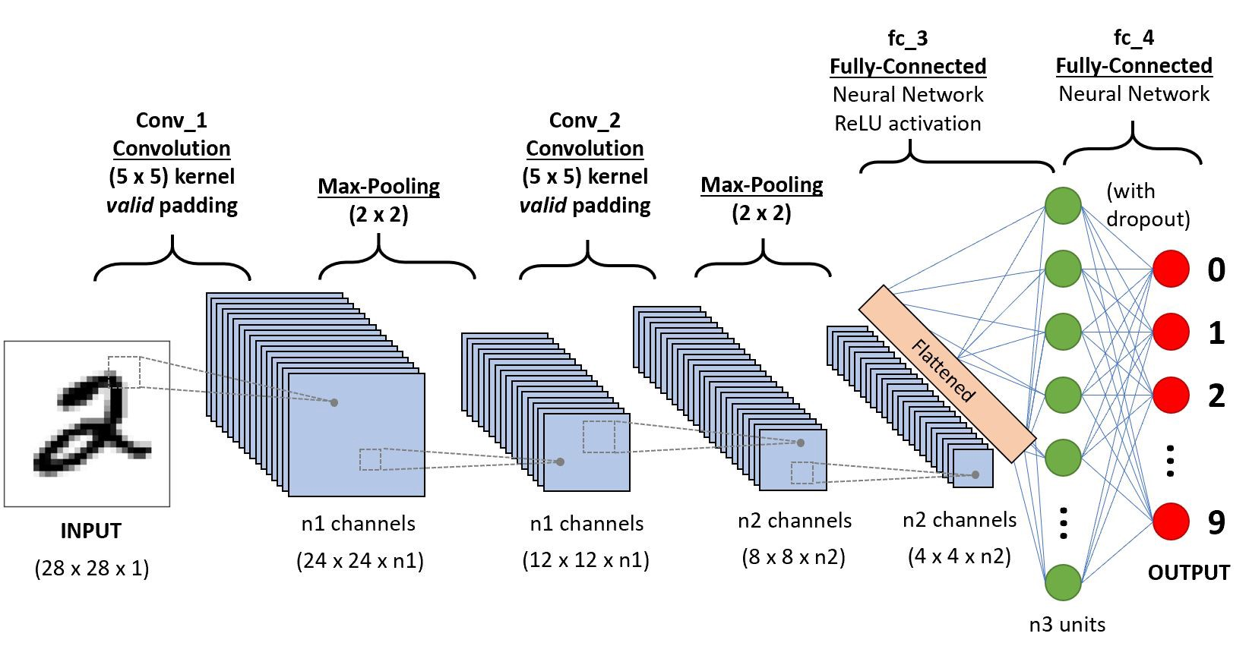
CNN-Mnist

Slide 7
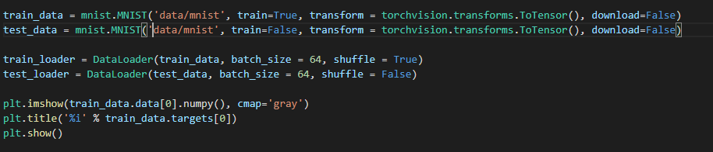
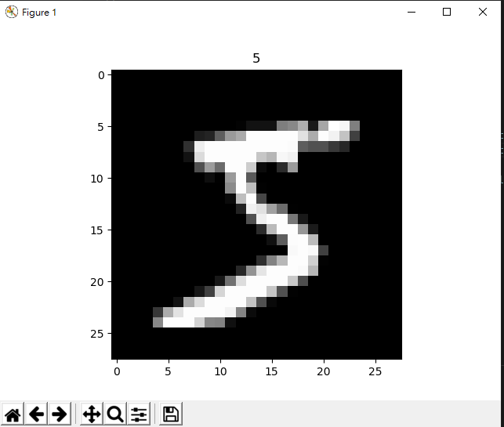
Load Mnist Data

Slide 8
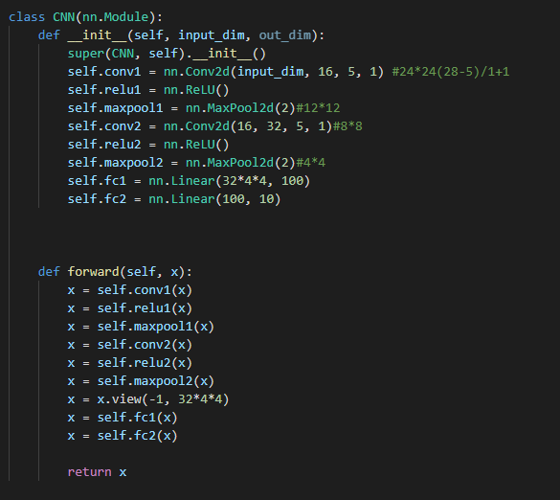

Model

Slide 9

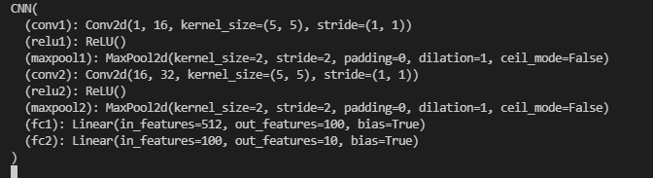
Loss function & optimizer

Slide 10
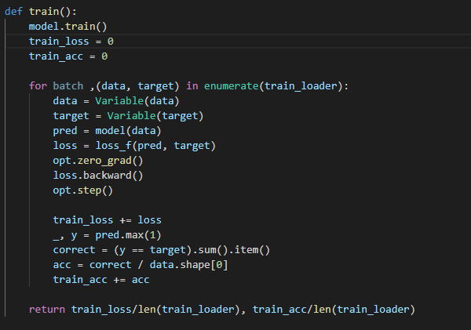
Train

Slide 11
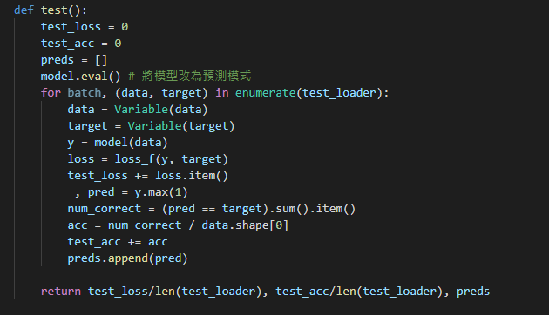
Test

Slide 12
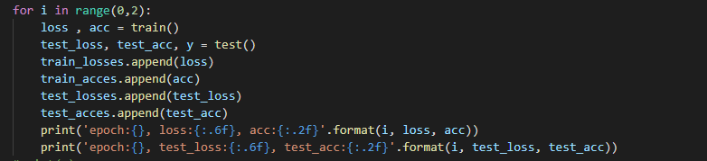

Train model

Slide 13
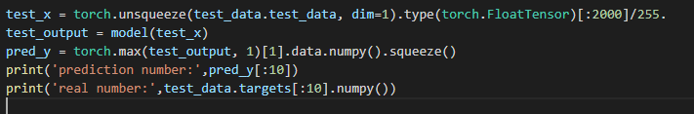

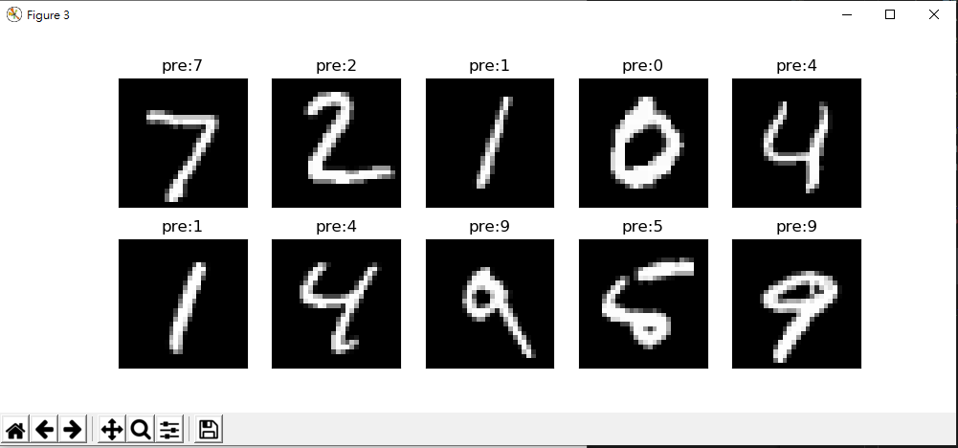
Result

Slide 14
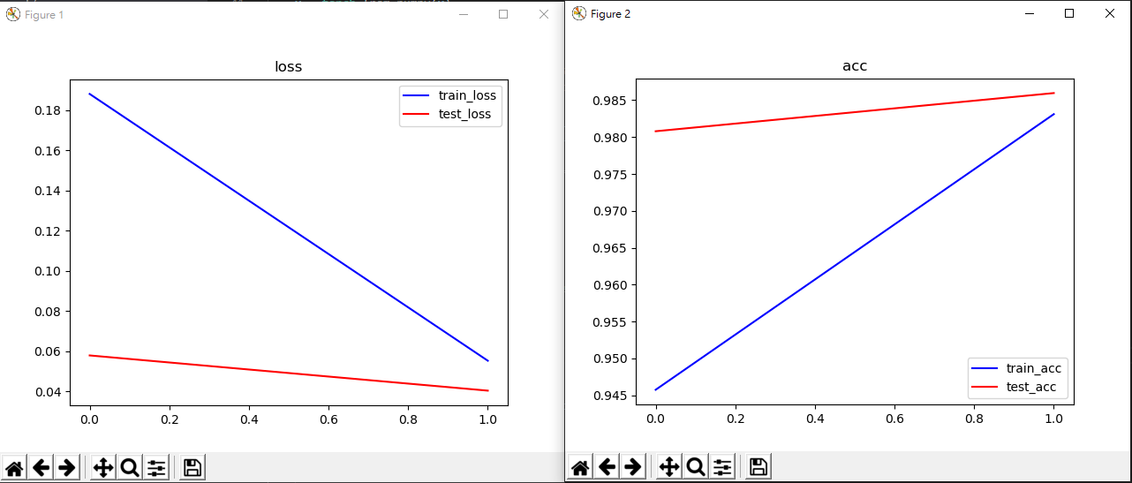
Result Loss & Accuracy

Slide 15
Exercise: Cifar10

Slide 16
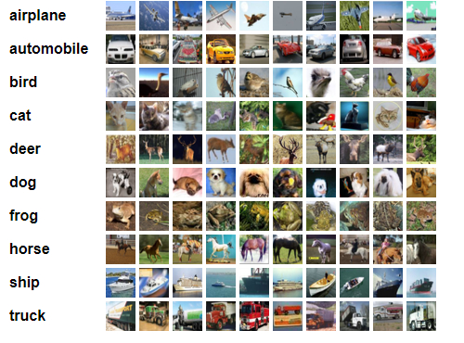
Cifar10
Image size:32*32

Slide 17
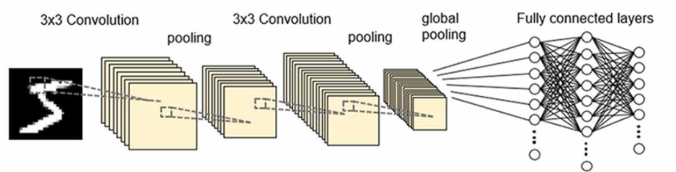
Model
Flatten
layer
Max
pooling
Max
pooling

Slide 18
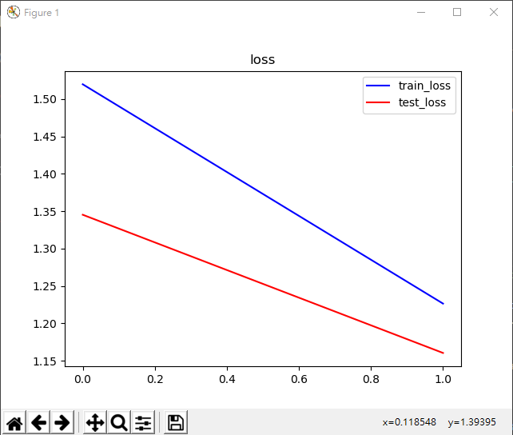
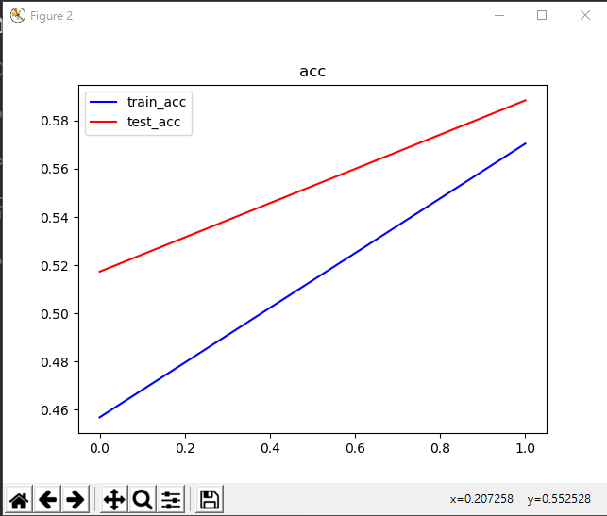
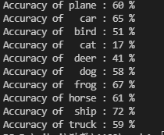
Result

