Slide 1
Lab3: Multiply Accumulation Unit Design with PA
Machine Learning Intelligent Chip Design
2024 Spring

Slide 3
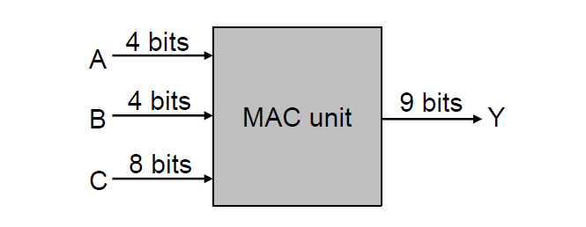
Introduction
Design a multiply accumulate unit
𝑌=𝐴×𝐵+𝐶

Slide 4
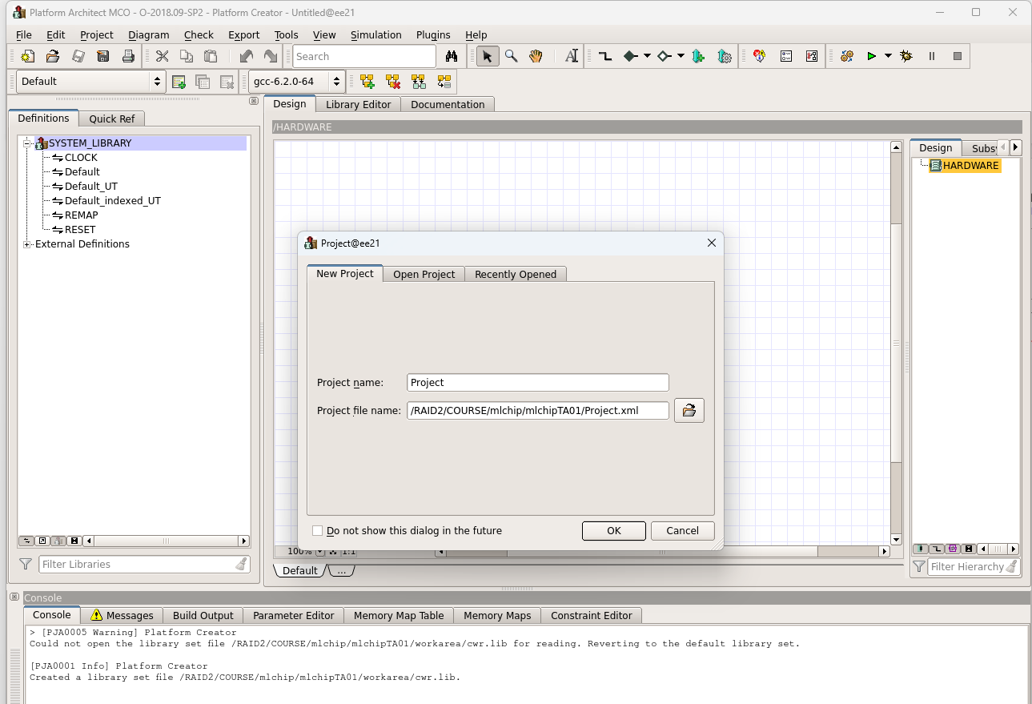
Environmental preparation
cp /RAID2/COURSE/mlchip/mlchipTA01/sharing/lab3.zip .
unzip lab3.zip
source /RAID2/cad/synopsys/CIC/vcs.cshrc
source /RAID2/cad/synopsys/CIC/pa_virtualizer.cshrc
pct &

Slide 5
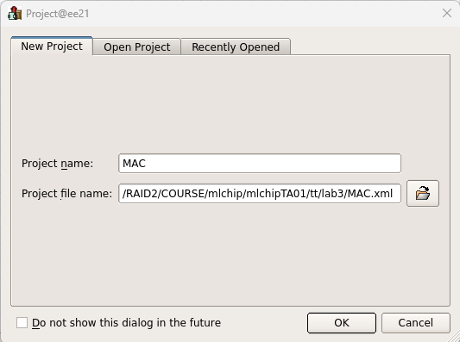
Platform Architect
Create project -> Project name -> Project file name -> OK

Slide 6
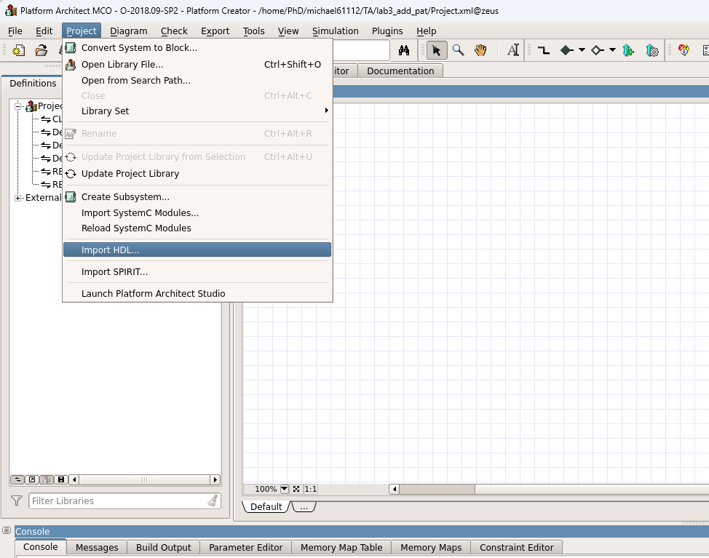
Import HDL (1/4)

Slide 7
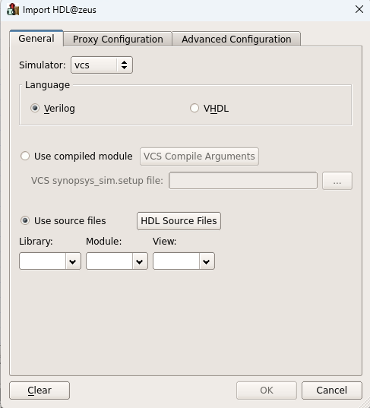
Import HDL (2/4)
General -> Use source files

Slide 8
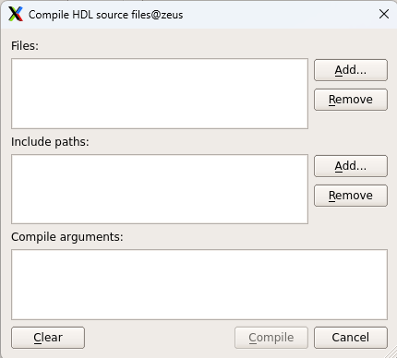
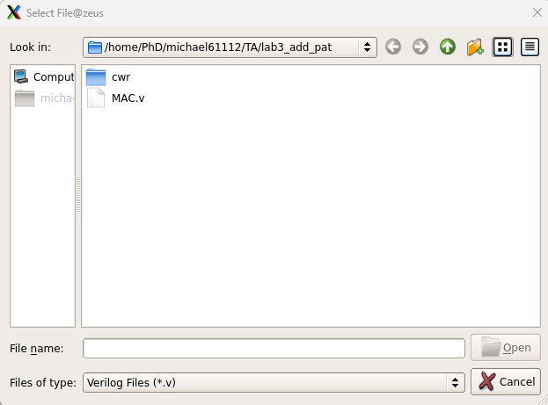
Import HDL (3/4)
Add MAC.v
1.
2.
3.
4.

Slide 9
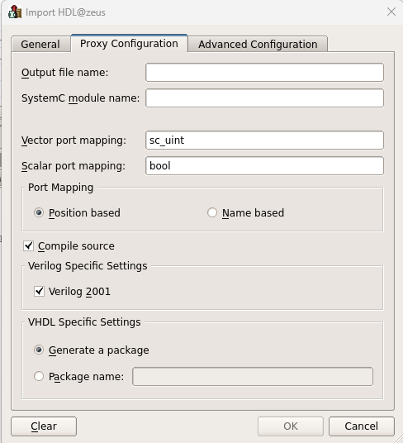
Import HDL (4/4)
General -> Use source files
1.
2.
3.

Slide 10
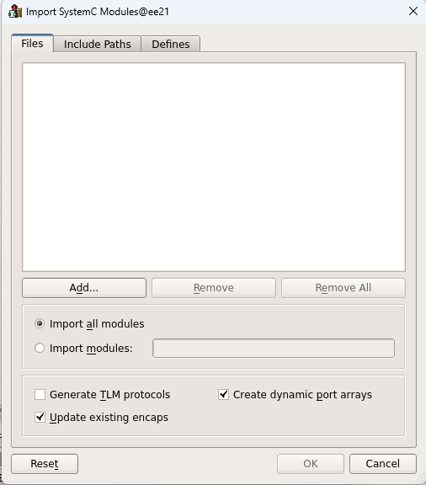
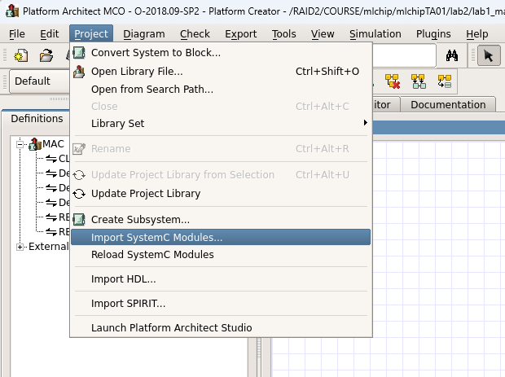
Platform Architect
Import SystemC Modules -> Add

Slide 11
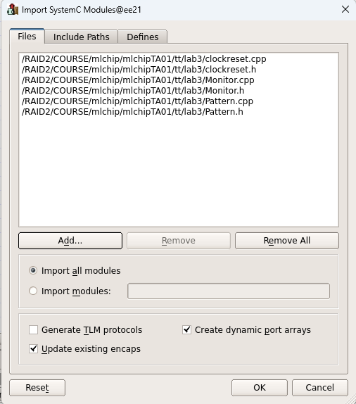
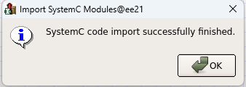
Platform Architect
Choose the source file -> OK

Slide 12
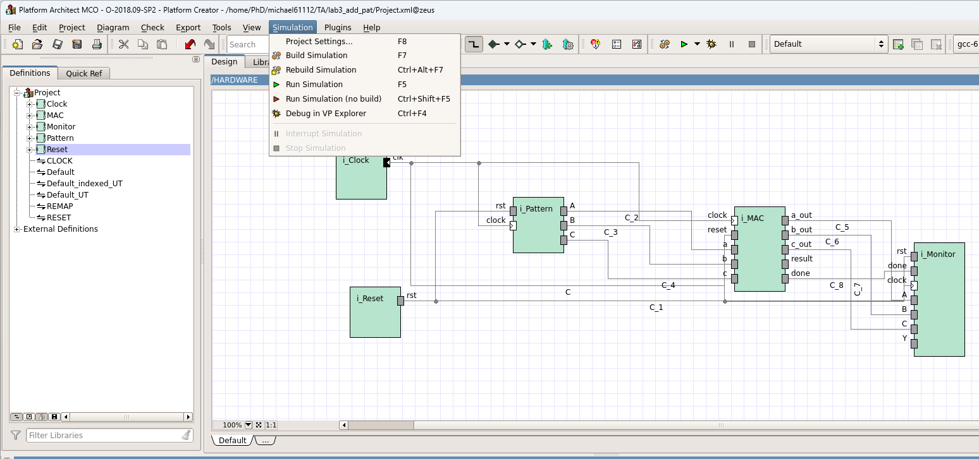
Set Simulation Timescale (1/2)
Simulation -> Project Settings...

Slide 13
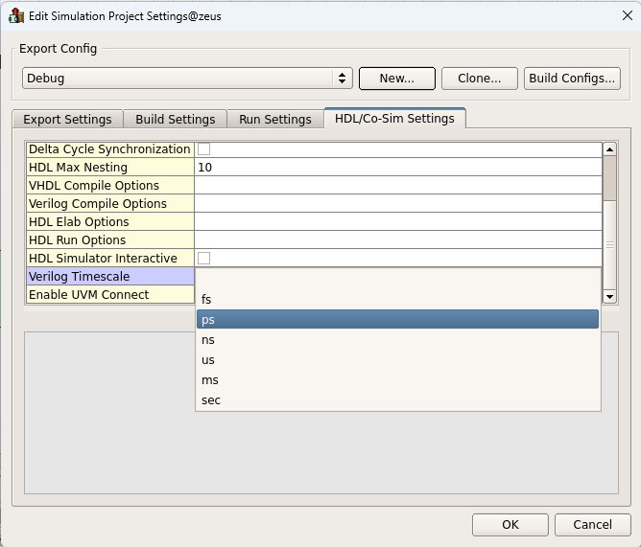
Set Simulation Timescale (2/2)
1.
2.
3.

Slide 14
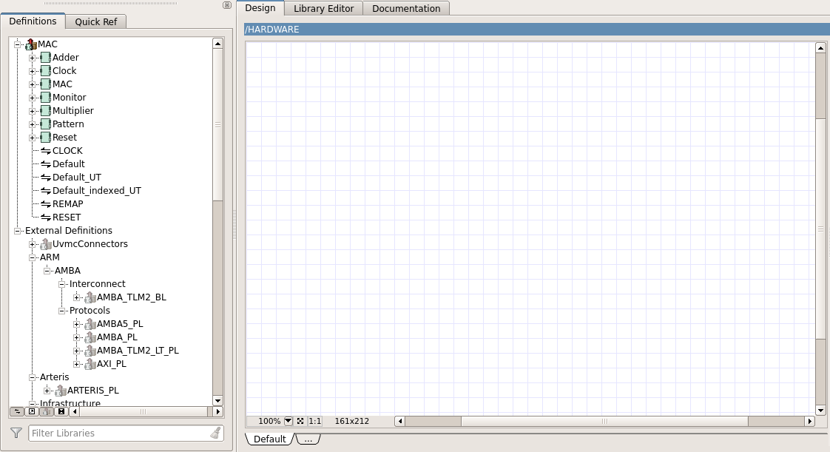
Platform Architect
Hardware block
IP Library

Slide 15
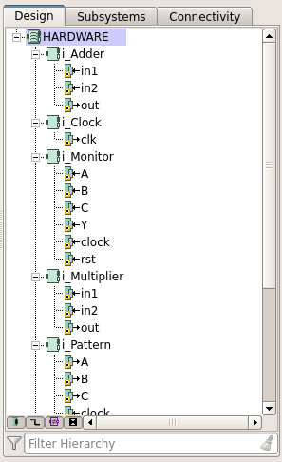
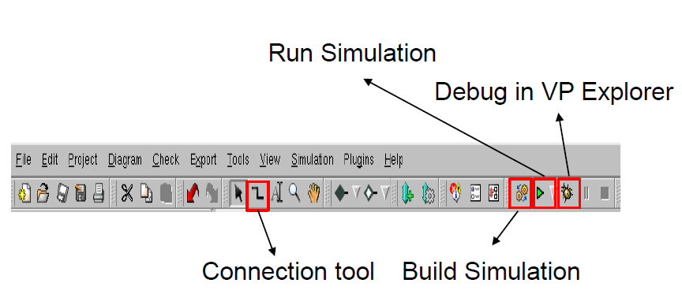
Platform Architect

Slide 16
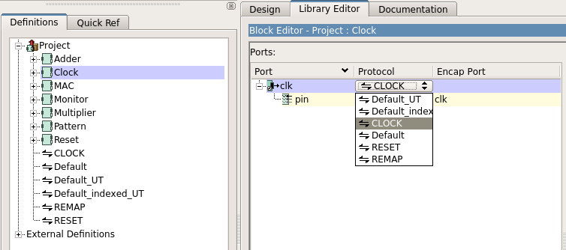
Platform Architect
Change protocol of clock port
Double click Clock -> Click Default -> Choose CLOCK

Slide 17
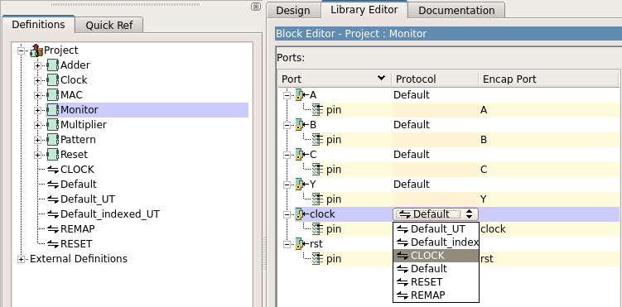
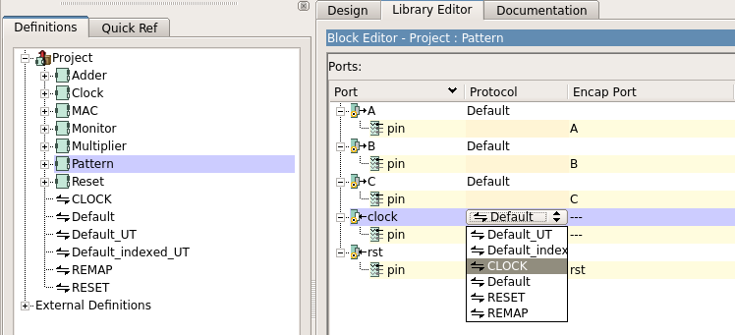
Platform Architect
Repeat the same action to change the clock protocol of Pattern and Monitor block

Slide 18
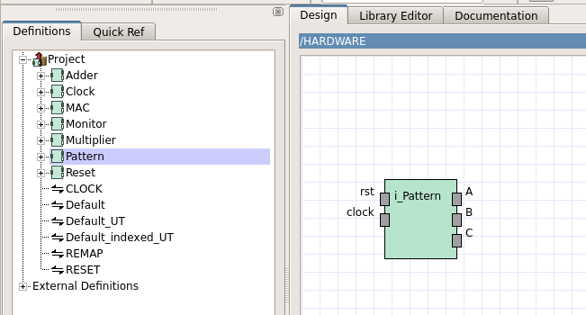
Platform Architect
Create the block
Click and drag to the design window

Slide 19
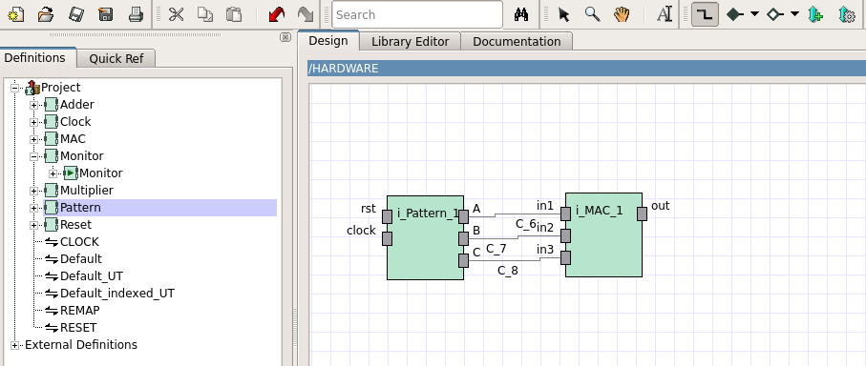
Platform Architect
Use connection tool to connect the block

Slide 20
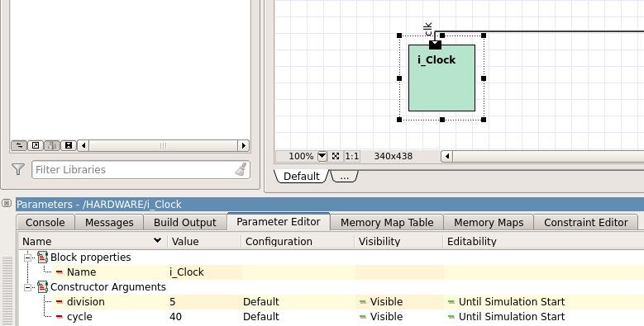
Platform Architect
Click Clock block -> Set clock period
division -> 5
cycle -> 40

Slide 21
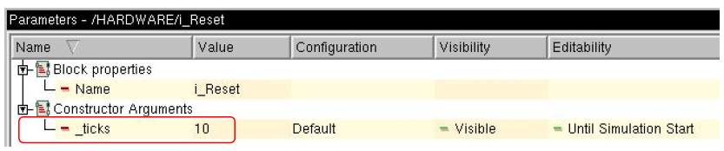
Platform Architect
Click Reset block -> Set reset period
_ticks -> 10

Slide 22
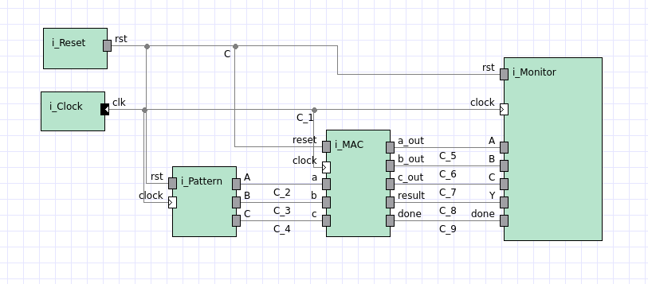
System Overview

Slide 23
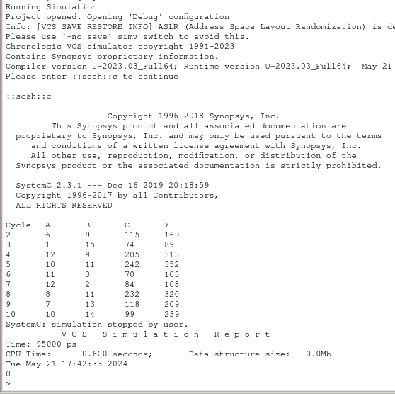
Run Simulation

Slide 24
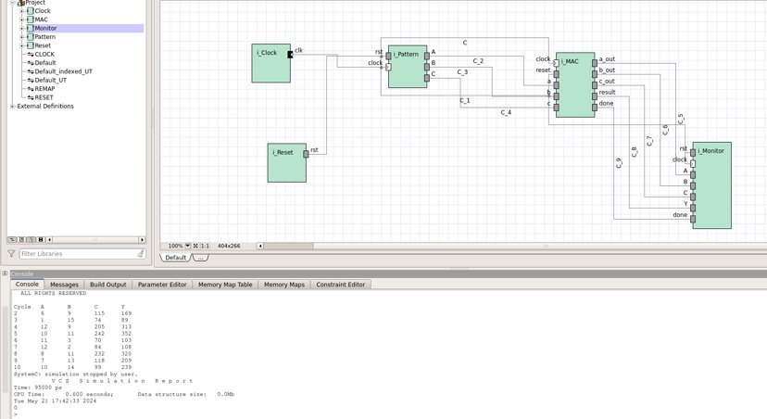
Platform Architect
Console
Show the simulation result

Slide 25
Lab Requirement
Complete MAC unit.
Use Platform Architecture to simulate output result.
Upload screenshots of simulation results and module connection to E3@NYCU

