Slide 1



Hypertext Preprocessor

Slide 2

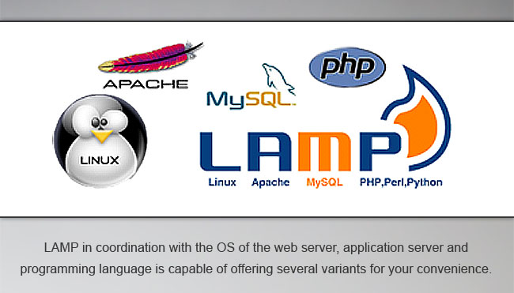
What is PHP
PHP is an extremely popular server-side scripting language that, together with MySQL RDBMS and Apache web server, forms LAMP — one of the most widely used development stack of today’s Web, known for its simplicity, universality, outstanding flexibility, cross-platform support, security and reliability
Websites written in PHP:WordPress,Facebook,Wikipedia etc
Slide * | © R Systems International | www.rsystems.com | www.ecnet.com

Slide 3

What is LAMP
LAMP stack empowers you to set up a convenient web server on your local machine so that you can run and test PHP scripts on your local machine itself. This makes the life for web developers very easy as it saves a lot of time and cost involved in uploading and executing scripts to a remote web host. It also enables you to set up a database that is virtually unlimited and that too on your local machine, as compared to a lot of web hosts which allow creating on limited databases.
Below mentioned are the several variants can be used:
XAMPP – X is for “cross-platform” and an extra P is for “Perl”
WAMP -W is for “Windows”.
MAMP – M is for “Mac”
SAMP – S is for “Solaris”
FAMP – F is for “FreeBSD”
LIMP – I is for “IIS”, Windows web server
Slide * | © R Systems International | www.rsystems.com | www.ecnet.com

Slide 4
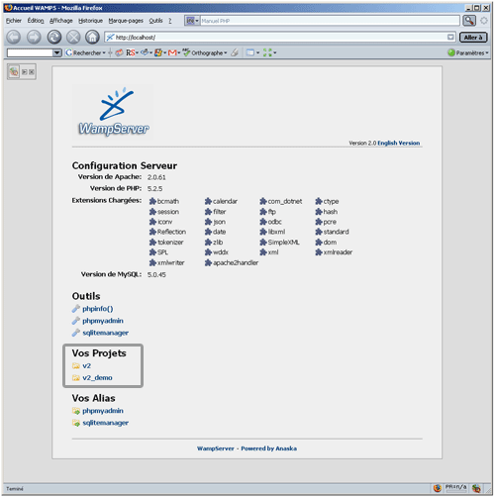
What is WAMP
The WAMP stack provides developers with the four key elements of a Web server: an operating system, database, Web server and Web scripting software. The combined usage of these programs is called a server stack. In this stack, Microsoft Windows is the operating system (OS), Apache is the Web server, MySQL handles the database components, while PHP object-oriented scripting language.
Slide * | © R Systems International | www.rsystems.com | www.ecnet.com

Slide 5
PHP over others ,Why?
Cost:Completely free and runs on Linux web hosting, can be used on Windows, Mac or Linux, and is supported by a number of free and paid IDEs
Performance:Most web application functions of the interaction between the script, the database and the server. Most web applications written in PHP follow the LAMP stack – Linux (OS), Apache (server), MySQL (database) and PHP (scripting language).
Another factor that affects performance is the OS and file system used on the server. Most tests indicate that Linux and ext4 file system have better I/O performance than Windows and the NTFS file system. Thus, there’s a good chance a PHP application running on a Linux web host will slightly outperform
Support:Huge open source developer community that regularly contributes to PHP development
Availability of Tools and Editors:PHP developers prefer using text editors like VIM and Notepad++ instead of a full-fledged IDE. If you did want to use an IDE, however, you’ll find solid support for PHP in free editors like Eclipse.
Slide * | © R Systems International | www.rsystems.com | www.ecnet.com

Slide 6
PHP IDEs
Some most popular PHP IDEs: Codelobster PHP Edition, Eclipse PDT, Komodo IDE, NetBeans IDE, PHPStorm, NuSphere PhpED.
Open Source Free PHP IDEs:
  NetBeans IDE- Elaboration of NetBeans IDE is performed by independent NetBeans community and NetBeans Org Company. Oracle maintains and invests in NetBeans IDE. Program allows editing several files at once by dividing screen into several parts. In order to do it, you need to open two files and drag a marker of any file to the bottom of the screen. Then you can see a red framework in text box in the lower part of screen. Supported operating systems: Linux, Windows and Mac OS X.
  Aptana Studio PHP Editor- Aptana Studio, Developed by Aptana Inc. is a leading open-source HTML editor and many people are not aware that it also comes with a PHP support. Aptana Studio is developed on Eclipse platform. Supported operating systems: Linux, Windows and Mac OS X.
Slide * | © R Systems International | www.rsystems.com | www.ecnet.com

Slide 7
Pros
Lotus Domino-Notes | PHP
Not Open-Source | Open Source
To navigate a view using links at the bottom. Next Page, Previous Page kind of thing. In Domino you can add them using some simple @Commands.What you can't do is tell whether you are at the beginning or end of the view and hence if there is in fact a previous or next page to go to. | With PHP this is a doddle. You know what page number you're on, how many documents are on each page and, most importantly, how many documents are in the table (i.e. view) in total. Your user won't click on a next page link on to be told there were "No Documents Found".
Notes View:Databases can end up with dozens and dozens of views, each requiring an index, which leads to an increased file size and a decrease in performance. | Can tailor our SQL queries to the strangest of user requests by creating a new query that doesn't alter the size or performance of the database. In effect we can have as many "views" of the data as we like
Slide * | © R Systems International | www.rsystems.com | www.ecnet.com

Slide 8
Cons
Lotus Domino-Notes | PHP
No need to worry about how data is stored and how we handle this data when a form is submitted over the web. | Need to use a relational database to store the submitted information.need to plan, design and create these databases then need to actually program forms and buttons and write the routines to enter the data to the backend and to retrieve it for web presentation.
Domino Designer,provides to create and edit forms directly on the webserver or can develop locally and replicate to the server at the push of a button. | Need to get files on to server manually.This normally mean using an FTP client.
Unique identifiers, author name, creation dates and such like, taken care by notes | Need to create extra columns to store things like the ID of the entry.
To work with forms and documents ,use a predefined list of URL commands known to Domino | Little more complicated.
Slide * | © R Systems International | www.rsystems.com | www.ecnet.com

Slide 9

R Systems International Ltd.
© R Systems International | www.rsystems.com | www.ecnet.com

