Slide 1
Data Structures and Algorithms -3 (25CS2103E) Complaint Tracker
Team Members
Name :B SURYA PRAKASH REDDY _25020030145
Name: CH MEGHANADH SAI REDDY_2520030274
Name: C DHANUSH CHANDRA_2520030014
Under the Esteemed Guidance of
DR.V.Sireesha
CSE

Slide 2
Contents
Abstract
Introduction
Literature survey
Problem Statement and Objectives
Hardware and Software requirements
Results
Conclusion
Future Scope

Slide 3
Abstract
Organizations receive a large number of customer complaints every day, making it difficult to manage, track, and resolve issues efficiently using manual processes. Delayed responses, misplaced records, and poor tracking can negatively affect customer satisfaction and service quality.
The Complaint Tracker provides a centralized system for registering, tracking, categorizing, assigning, updating, and resolving complaints. Each complaint is assigned a unique tracking ID and stored securely, allowing quick retrieval and efficient record management. The system also maintains complaint history, supports search functionality, and generates reports for identifying recurring issues.
The project applies Data Structures and Algorithms to improve complaint management and processing efficiency. By automating the complaint-handling process, the system reduces manual effort, minimizes response time, and provides transparency throughout the complaint lifecycle. Overall, the Complaint Tracker offers a reliable and user-friendly solution that helps organizations achieve faster complaint resolution and improved customer satisfaction.

Slide 4
Introduction
In today’s organizations, handling a large number of customer complaints efficiently is an important part of maintaining good customer service. Manual complaint management can lead to delayed responses, misplaced records, difficulty in tracking complaints, and poor communication between customers and support teams.
The Complaint Tracker is developed as a centralized system to simplify and automate the complaint-handling process. Customers can register complaints and track their progress, while administrators can view, categorize, assign, update, and resolve complaints. Each complaint receives a unique tracking ID, making it easier to retrieve and manage individual complaints.
The system maintains complaint details and history, provides search and tracking functionality, and can generate reports to help organizations identify common or recurring problems. By applying suitable Data Structures and Algorithms, complaints can be organized and accessed efficiently.
Overall, the Complaint Tracker helps reduce manual effort, improve response time, provide transparency in complaint resolution, and support organizations in delivering better and faster customer service.

Slide 5
Literature Survey
Existing complaint management systems help organizations register, track, assign, and resolve complaints. Traditional manual systems can cause delays, misplaced records, and difficulty in maintaining complaint history.
Modern complaint systems use databases and automated tracking to improve complaint management. The proposed Complaint Tracker uses HashMap, Queue, Priority Queue, and ArrayList to provide efficient complaint storage, searching, prioritization, and processing. These data structures help organize a large number of complaints and make information retrieval faster.
The system also supports categorizing complaints based on their type and priority, allowing administrators to handle important complaints first. Maintaining complaint history helps track the progress of each complaint from registration to resolution.
Overall, the proposed system aims to reduce manual effort, improve response time, maintain accurate records, and provide better transparency in the complaint resolution process

Slide 6
Problem Statement and Objectives
Organizations receive a large number of complaints, making it difficult to search, track, prioritize, assign, and resolve complaints efficiently. Manual complaint handling can lead to delayed responses, misplaced records, duplicate complaints, and difficulty in maintaining complaint history. Therefore, the Complaint Tracker aims to provide an automated system that manages complaints efficiently using suitable advanced data structures and algorithms.
Objectives
To provide an easy system for registering and tracking complaints.
To assign a unique ID to each complaint.
To enable fast searching of complaint details.
To identify similar or duplicate complaints using edit-distance techniques.
To categorize and prioritize complaints for efficient processing.
To assign complaints to suitable departments or support teams.
To maintain complete complaint history and status updates.
To reduce manual effort and response time.
To apply String Algorithms, Dynamic Programming, Network Flow, and Hashing in a real-world application.

Slide 7
Flow Chart
START
↓
Register Complaint
↓
Generate ID
↓
HashMap Storage
↓
Category + Priority
↓
Duplicate Check
(Edit Distance)
↓
Department Assignment
↓
Priority Queue
↓
Update Status
↓
Resolved?
↙ ↘
Yes No
↓ ↓
Report Re-process
↓
END

Slide 8
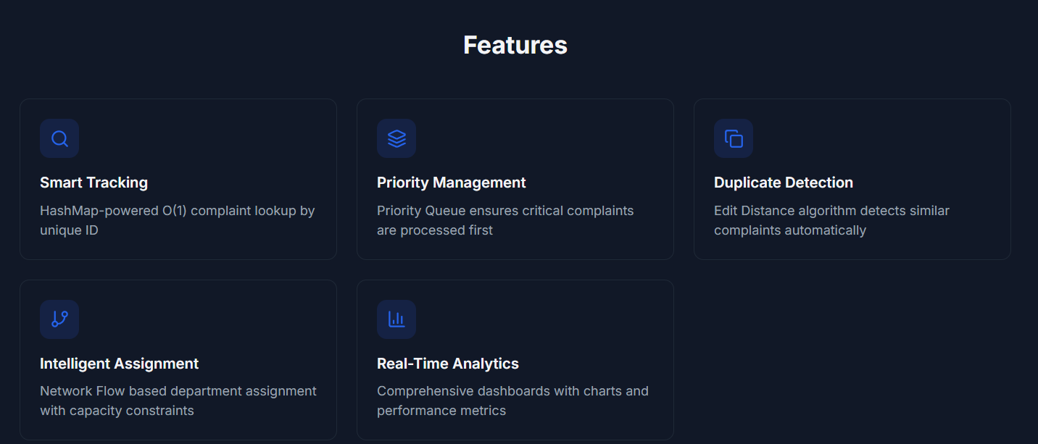
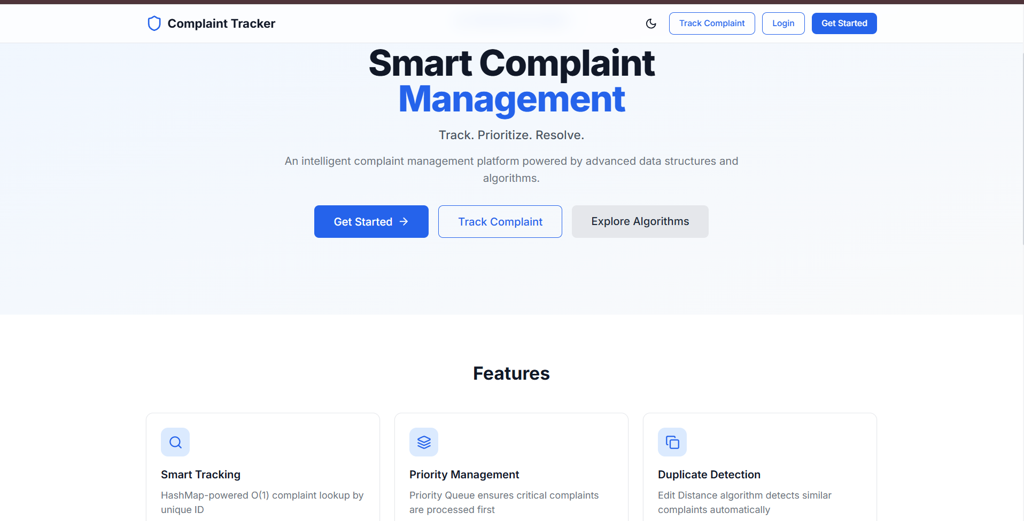
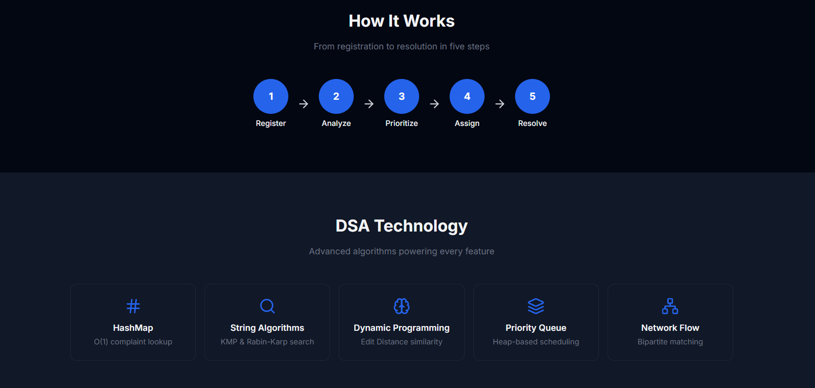
Results

Slide 9
Hardware and Software requirements
Hardware Requirements
Processor: Intel Core i3 or equivalent
RAM: 4 GB or above
Storage: 10 GB free space
Input: Keyboard and Mouse
Display: Monitor
Internet: Required for online database/server features
Software Requirements
Operating System: Windows / Linux
Programming Language: Java
JDK: Java 17 or above
IDE: VS Code / Eclipse / IntelliJ IDEA
Database: MySQL / MongoDB
Libraries: Java Collections Framework (if permitted by the project rules)

Slide 10
Conclusion
The Complaint Tracker provides a centralized and efficient approach to managing customer complaints from registration to resolution. It helps organizations maintain accurate records, track complaint status, categorize issues, and ensure that complaints are handled systematically.
The application demonstrates the practical use of advanced Data Structures and Algorithms, including HashMap for fast searching, Edit Distance for identifying similar complaints, Network Flow for department assignment, and Priority Queue for handling urgent complaints.
By automating these operations, the system can reduce manual effort, minimize response time, improve complaint tracking, and increase transparency. It also provides useful complaint history and reports that can help organizations understand recurring problems and improve their services.
Overall, the Complaint Tracker demonstrates how DSA concepts can be applied to solve a real-world problem and create a more reliable, organized, and user-friendly complaint management system.

Slide 11
Future Scope
Mobile Application: Develop an Android/iOS app for easy complaint registration and tracking.
AI-Based Complaint Classification: Automatically identify complaint categories and priority levels.
Smart Duplicate Detection: Improve similar-complaint detection using advanced text-analysis techniques.
Real-Time Notifications: Send SMS, email, or app notifications when complaint status changes.
Advanced Analytics: Generate dashboards showing complaint trends, resolution time, and recurring issues.
Automatic Assignment: Use optimization algorithms to assign complaints to the most suitable department or employee.
Cloud Integration: Store complaint data securely on cloud platforms for scalable access.
Multilingual Support: Allow customers to submit complaints in multiple Indian languages.
Predictive Analysis: Analyze historical complaints to predict recurring problems and help organizations take preventive action.

Slide 12
Thank you

