Slide 1
Monte Carlo Analysis of Occupancy-Driven Energy and CO₂ Variability in a Public Building
Chowdhury Ali Imam

Slide 2
Brief
Modeling a non-parametric Monte Carlo uncertainty of occupant behavior to investigate its effect on energy demand and indoor carbon dioxide levels.
No simulation engine is used
Physics-based simulation under the uncertainty of occupancy

Slide 3
Validation
Comparing the Monte Carlo resampled occupancy distribution with the original dataset
Comparing the measured carbon-di-oxide concentration with the original dataset

Slide 4
Hypothesis
As average occupancy increases, the per-capita energy consumption decreases
Compared to fixed ventilation, occupancy-based ventilation will reduce CO₂ exceedance hours and energy use.

Slide 5
CO₂ Mass Balance Equation
C(t+1) = C(t) + (Δt/V) * [G_CO2*N(t) + V̇(t)*(C_out - C(t))]
C(t): indoor CO₂ concentration [ppm]
Δt: time step duration [s]
V: room air volume [m³] [The volume of the three rooms were given in the reference paper]
G_CO2: CO₂ generation per person [mg/s-person]
N(t): occupancy at time t [persons]
V̇(t): ventilation flow rate [m³/s]
C_out: outdoor CO₂ concentration [ppm]

Slide 6
Ventilation Thermal Load
Q_vent(t) = ρ * c_p * V̇(t) * (T_set - T_out(t))
Q_vent(t): ventilation heating/cooling load [W]
ρ: air density (1.2 kg/m³)
c_p: specific heat of air (1005 J/kg·K)
V̇(t): supply airflow [m³/s]
T_set: indoor set point temperature [°C]
T_out(t): outdoor temperature [°C]

Slide 7
Envelope (Conductive) Thermal Load
Q_env(t) = U* A * (T_set - T_out(t))
Q_env(t): envelope heat transfer load [W]
U: overall heat transfer coefficient [W/m²·K]
A: envelope area [m²]
UA: product of U and A [W/K]
T_set: indoor set point [°C]
T_out(t): outdoor temperature [°C]

Slide 8
Internal Heat Gains
Q_int(t) = N(t) * q_person + Q_plug + Q_light
Q_int(t): internal heat gain [W]
N(t): number of people [persons]
q_person: sensible heat per person (60–80 W/person)
Q_plug: plug load heat gain [W]
Q_light: lighting heat gain [W]

Slide 9
Net Thermal Load
Q_total(t) = Q_env(t) + Q_vent(t) - Q_int(t)
Q_total(t): combined load representing heating/cooling need [W]
Positive Q_total → heating required
Negative Q_total → cooling required

Slide 10
Heating Load & Energy
Q_heat(t) = max(0, Q_total(t))
E_heat = Σ[ Q_heat(t) * Δt ] / η_heat
Q_heat(t): instantaneous heating power [W]
E_heat: total heating energy [J or kWh]
Δt: timestep [s]
η_heat: heating system efficiency (0.8–0.95)

Slide 11
Cooling Load & Energy
Q_cool(t) = max(0, -Q_total(t))
E_cool = Σ[ Q_cool(t) * Δt ] / COP_cool
Q_cool(t): instantaneous cooling power [W]
E_cool: cooling electricity consumption [J or kWh]
COP_cool: cooling system coefficient of performance (2–4)

Slide 12
Exploratory Data Analysis
Room1 occupancy | Min value | Max value | Standard deviation | Skew | Kurtosis
My calc | 0 | 80 | 15.87 | 2.14 | 3.71
Literature | 0 | 80 | 16.22 | 2.18 | 3.96
The sourced dataset resembles the prior published result

Slide 13
V1-Occupancy Sampling (10 MC run)
Room1 occupancy | Min value | Max value | Standard deviation | Skew | Kurtosis
Bootstrapped | 0 | 78.533 | 15.60 | 2.159 | 3.912
Literature | 0 | 80 | 16.22 | 2.18 | 3.96
The occupancy sampling resembles the actual distribution of data
Bootstrapping from real data resulted in this accuracy

Slide 14
V1-Occupancy Sampling (10 MC run)
Room1 CO2 Concentration | Min value | Max value | Standard deviation | Skew | Kurtosis
Bootstrapped | 420 | 420.00507 | 0.000151 | 1.081772 | -0.420776
Literature | 406.72 | 1046.40 | 113.49 | 1.46 | 1.57
The CO2 concentration doesn’t match with the literature as we used a lot of assumtions
However, as we are doing comparative analysis, this mismatch with the real data distribution will not highly impact the hypothesis testing. The magnitude of the CO2 simulation matches the minimum value, means, we can use the simulation procedure with some inaccuracy.

Slide 15
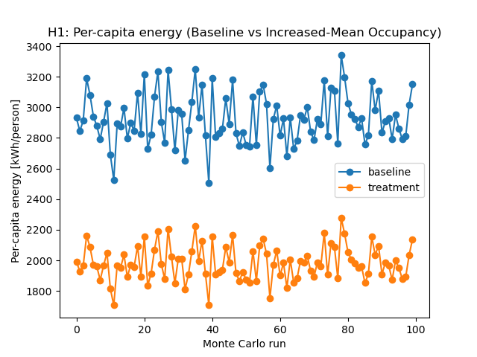
H1-As average occupancy increases, the per-capita energy consumption decreases
The Hypothesis1 is True as we can see that increasing the occupancy is decreasing the per capita energy consumption

Slide 16
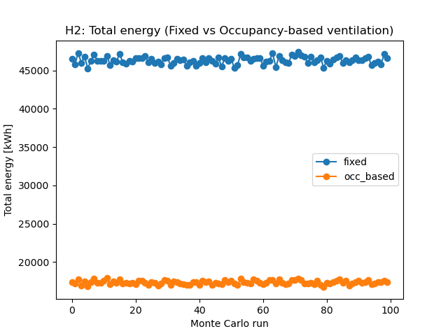
H1-Compared to fixed ventilation, occupancy-based ventilation will reduce CO₂ exceedance hours and energy use.
The Hypothesis 2 is partially True as we can see the occupancy based ventilation reduced energy use

Slide 17
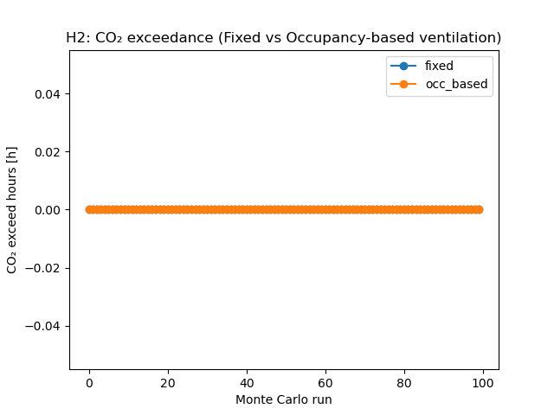
H1-Compared to fixed ventilation, occupancy-based ventilation will reduce CO₂ exceedance hours and energy use.
The Hypothesis 2 is partially False, as both of the ventilation strategy doesn’t result in any CO2 exceedance hours. In our hypothesis, we assumed the occupancy based strategy wiould be better.

