Slide 1
SYRIA TELECOMMUNICATION LIMITED
Exploration of High Churn Rate.
By : George Machoka.

Slide 2
BUSINESS UNDERSTANDING

Slide 3
OVERVIEW
The global telecommunications industry is known for intense competition and unpredictable business conditions, making it challenging for less resilient companies. Customer retention fluctuates dramatically due to factors such as economic downturns, rising costs, competitive alternatives, rapid technological advancements, globalization, government intervention, and various other influences.

Slide 4
PROBLEM STATEMENT
Syria Telecommunications is grappling with the same challenges as other major telecom companies, but possibly at a more severe level. While the industry standard churn rate falls between 5% and 7%, Syria Telecommunications has seen its churn rate spike to nearly 15% at the time of data collection. In response, the company's management has tasked the Data Science Department with the responsibility of gathering, cleaning, and analyzing data to uncover the reasons behind this alarming rate and to propose practical solutions to address the issue.

Slide 5
BUSINESS PROBLEM
Despite the potential for booming profits and increased market share, Syria Telecommunications is experiencing a decline in customer retention. This downward trend threatens to steer the company away from its business objectives and hinder its growth.

Slide 6
OBJECTIVES
To identify factors leading to increased churn rates
To create a classification model that predicts whether a customer will churn with a recall of over 80%
To give customer retention recommendations

Slide 7
DATA UNDERSTANDING

Slide 8
KEY FEATURES
Minutes and Calls
Charges
Subscriptions
Customer Service
Churn
Account Lenth

Slide 9
FINDINGS

Slide 10
UNIVARIATE ANALYSIS

Slide 11
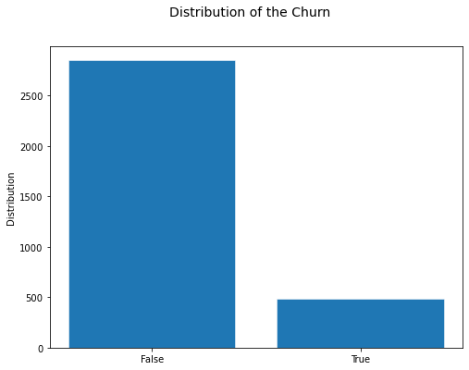
CHURN RATE
Almost 15% the customers churned while the rest stayed with Syria Telecommunications.

Slide 12
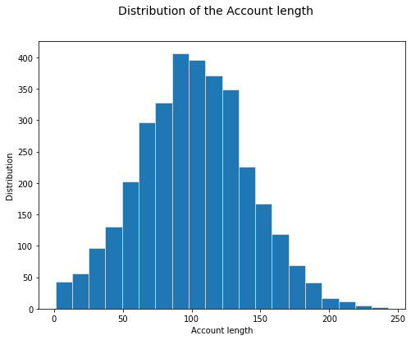
ACCOUNT LENGTH
A normal distribuition of the account length feature with the mean and median being around 100.

Slide 13
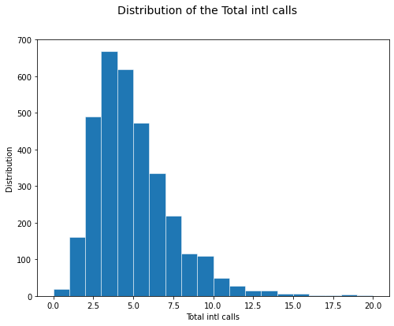
INTERNATIONAL CALLS
This right tailed feature shows it peaked at the 3 call mark and a sharp declined soon follows. Very few people made more than 3 calls.

Slide 14
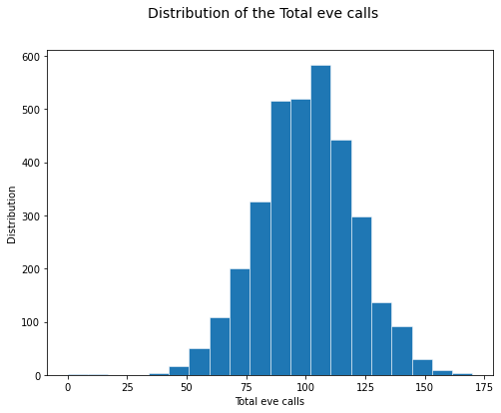
TOTAL EVENING CALLS
A near normal distribution of the total eve calls feature peaking at around 100 evening calls.

Slide 15
BIVARIATE ANALYSIS

Slide 16
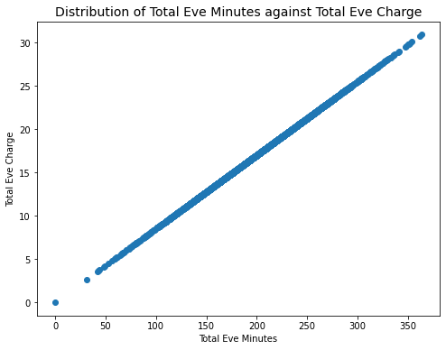
EVENING MINUTES AGAINST MINUTES
There seems to be a strong correlation between Total Evening Minutes against Total Evening Charge.

Slide 17
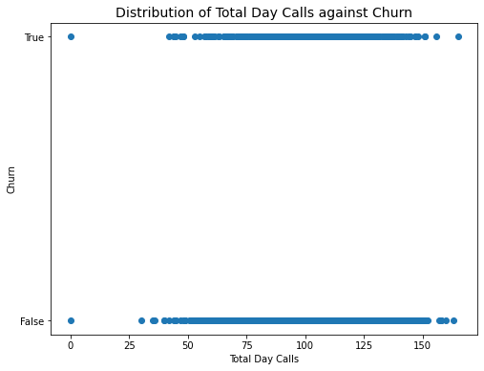
TOTAL DAY CALLS AGAINST CHURN
There seems to be a poor correlation between Total Day Calls against Churn.

Slide 18
MULTIVARIATE ANALYSIS

Slide 19
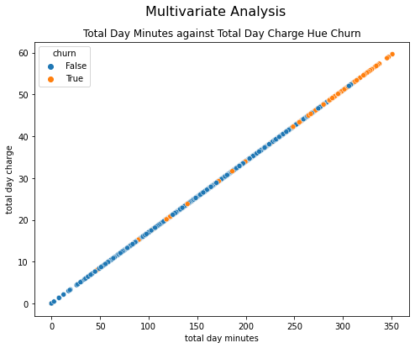
DAY MINUTES AGAINST DAY CHARGE
High paying customers churn more than the customers who are below the mean day charge value.

Slide 20
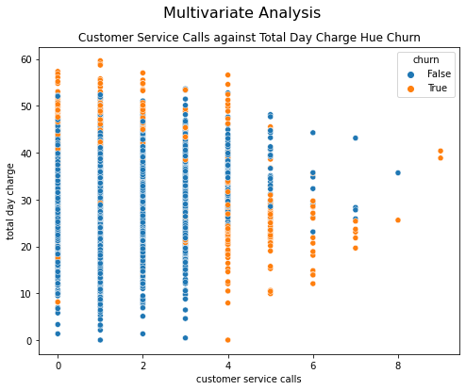
Day Charge against Customer Service Calls
Consumers paying higher than the average churn more on low customer service call rates than those who pay less. Inversely, customers who pay less than the mean day charge churn more on higher values of the customer service call rate

Slide 21
MODELLING

Slide 22
CLASSIFICATION PROBLEM
• The exploration of the data reveals that this is a classification problem where we attempt to predict whether a customer would churn or not.
• Minimizing misclassifying the status of a client as a non-churner would be our biggest objective.
• The appropriate metric to use based on this problem is recall which can defined simply as a measure of how well our model identifies the true positive cases from all the actual positive cases.
• Recall is often used when the cost of false negatives is high – in this case it would be detrimental to classify a customer as a non-churner when in reality the customer churns.

Slide 23
RANDOM FOREST MODEL
• Out of all tested models, Random Forest Classifier provided the highest metrics – a recall score of about 80% - to predict churning in consumers.
• Our model is very good at identifying the consumers who will churn, with very few misclassified as non-churners.
• Focusing on retaining the 80% will reduce the churn rate and increase the retention rate.

Slide 24
RECOMMENDATIONS

Slide 25
CONCLUSIONS AND RECOMMENDATIONS
Based on the findings from our churn model, the following recommendations are proposed:
Targeted Retention Programs: Offering rewards and discounts to customers can help lower the churn rate. Long-term customers or those who have used a certain amount of talk-time should be prioritized to foster loyalty. This approach could also attract new customers and enhance the company’s visibility.
Training for Customer Care Agents: As representatives of the organization, customer care agents should be trained to follow specific guidelines that make customers feel valued and understood. Proper training will help ensure even dissatisfied customers are listened to and their concerns are addressed.
Service Improvements: Syria Telecommunications should enhance its services by reviewing pricing strategies. Reducing call costs or offering fixed rates beyond a certain usage threshold would be beneficial. Bundling services, such as international plans or voicemail, with a specific amount of minutes could also be attractive. Additionally, addressing technical issues in problem-prone areas promptly would reduce customer complaints.
Ongoing Customer Feedback Collection: Customer feedback is a valuable resource that Syria Telecommunications should leverage. The company should actively encourage feedback from both current and exiting customers to identify areas where users feel neglected or dissatisfied.

Slide 26
QUESTIONS AND FEEDBACK

Slide 27
THANK YOU
GEORGE MACHOKA

