Slide 1
DB Viewer
Prototype introduction

Slide 2
40%

Slide 3
Classical Database UI solution
Are focused on administration and structure
Provide access to data
Need to be used by “expert” users
Do not represent the relational structure

Slide 4
Relational Structure
Relations between data are either explicit or implicit
Constrains like unique indexes and foreign keys describe the type of relation
Coherence of the data depends from those relations
Relations describe how data are organized in a coherent set

Slide 5
DB Viewer Functionalities
Analyzes the relational structure
Compute and generates views for each data table
Translates the tables relations into visual links
Provides a read/write access to data (transactional)

Slide 6
DB Viewer Key points
Allows the navigation between tables
Displays coherent data subset according to the relation’s link
Quick and “easy to use” interface to access and modify the data
Many data types supported, calculated fields
Available anywhere
Standalone app (java) for desktop and laptop
Web app (HTML / AnugularJS) for a no install use and mobiles

Slide 7
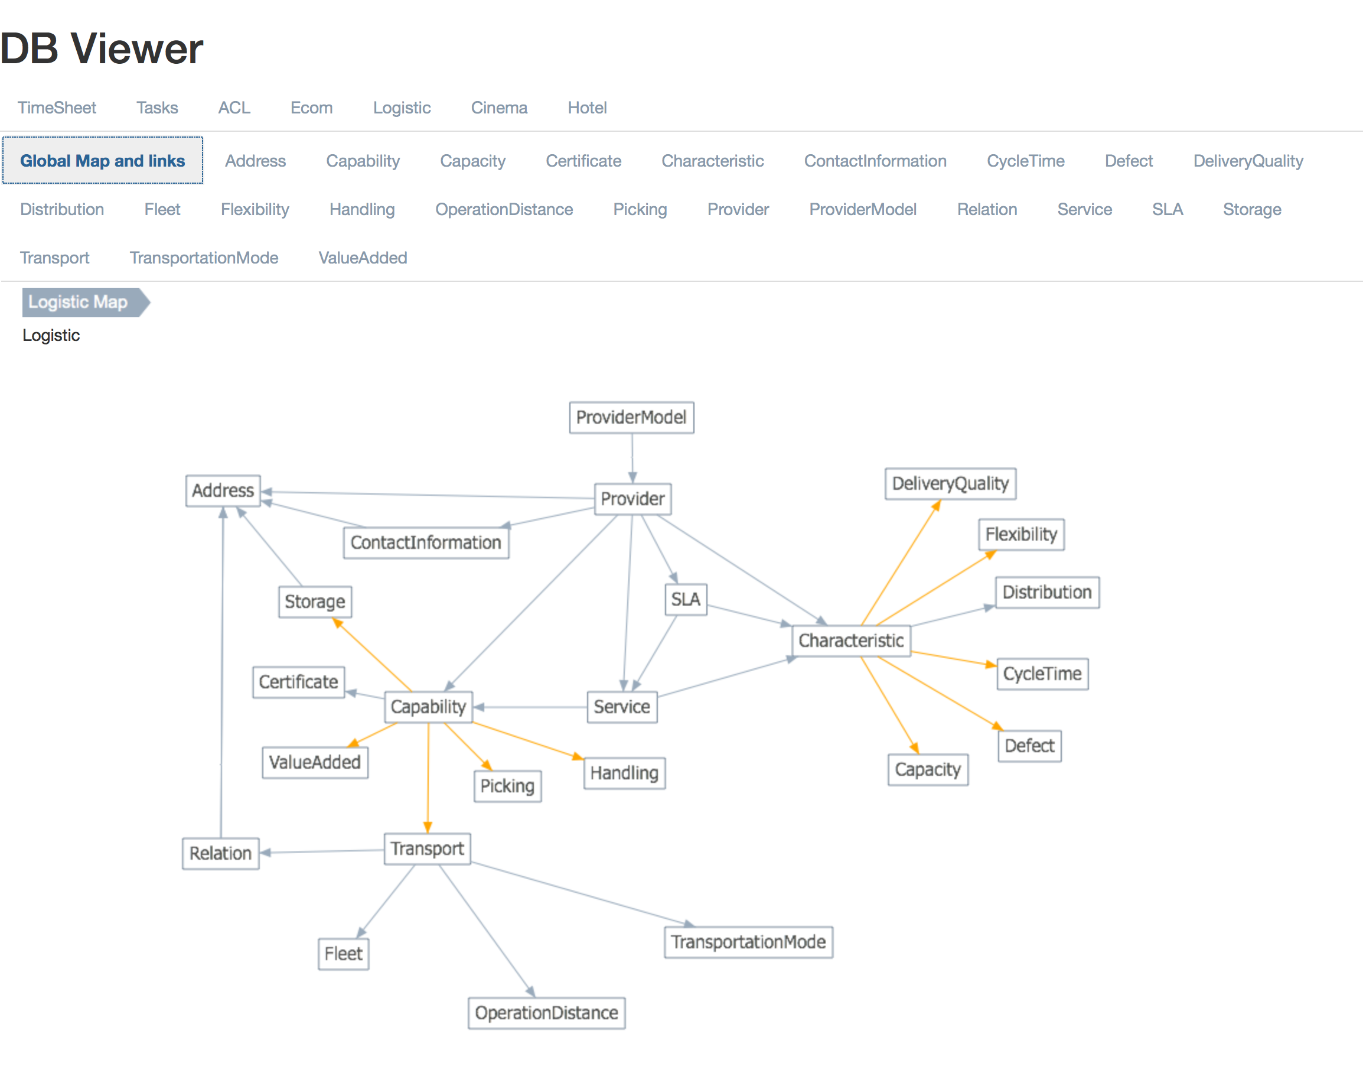
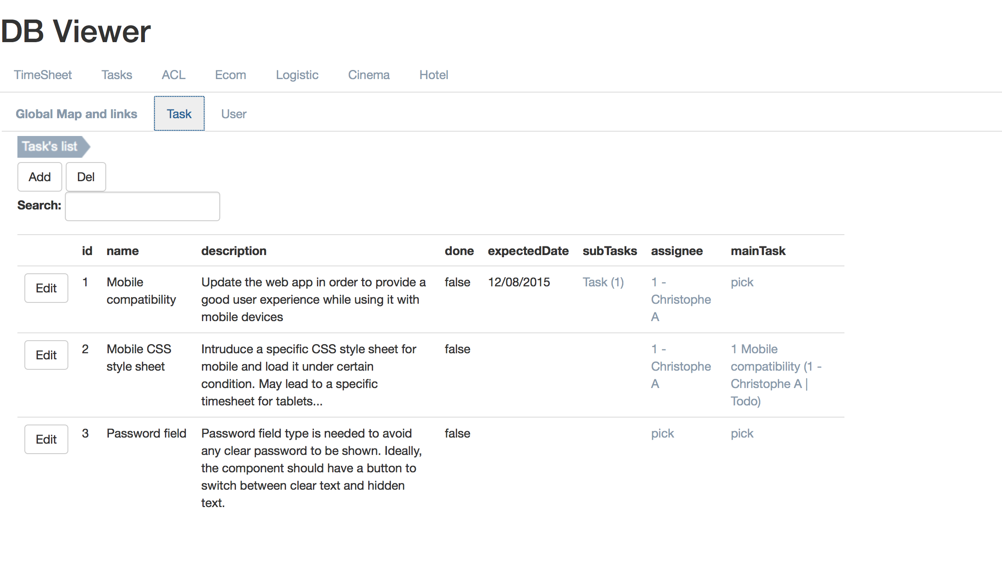
Screenshots Web App

Slide 8
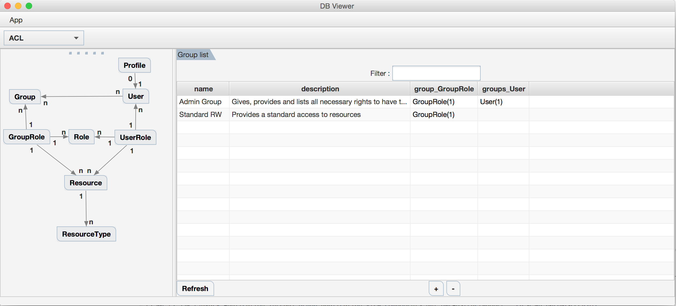
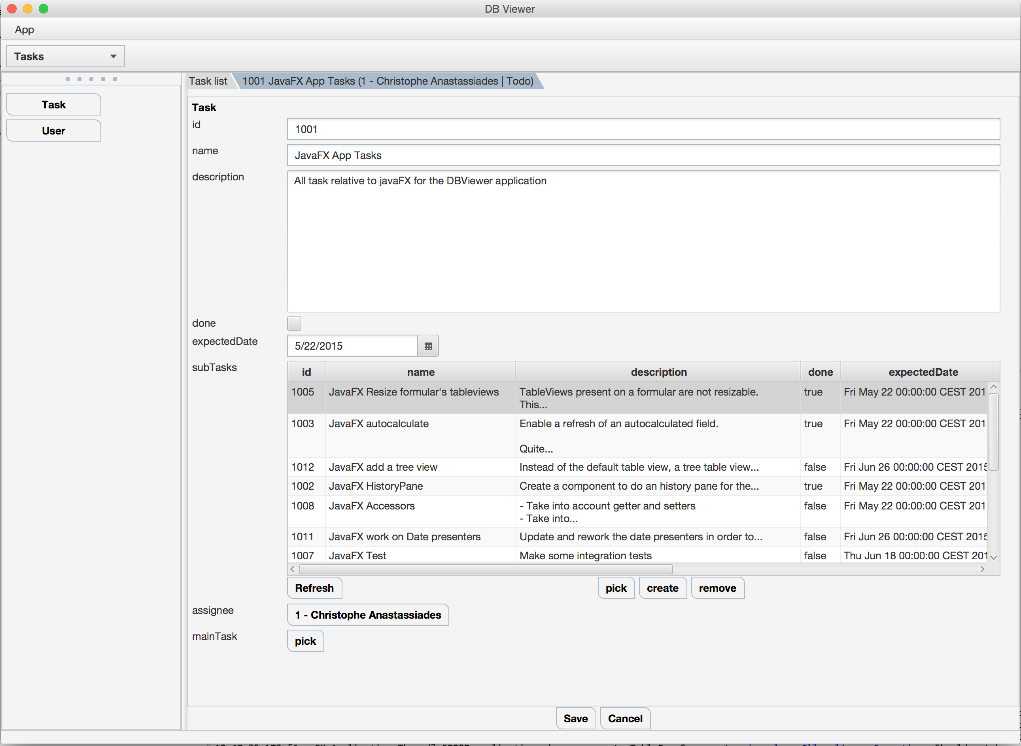
Screenshots Standalone App

Slide 9
DEMO

