Slide 1
ECE4512 · PROJECT REPORT
3.87
Physical-Border-
px · corner RMSE
Guided Screen
Frame-wise
30.37
Normalization
Optical flow
31.40
Stable screen-plane estimation from captured-display video
Physical border drives the homography
SCREEN NORMALIZE
2026
Notes:
This project normalizes the perspective of a physical display in real captured-screen video. The central result is a corner RMSE of 3.87 pixels, compared with more than 30 pixels for both the frame-wise and optical-flow baselines.

Slide 2
Rectifying one frame is easy
Resisting content motion is not
Two motions share the same input
Handheld camera motion + scrolling or video inside the screen
CORE IDEA
Common evidence mixes the two
The physical border
Per-frame detections jitter; internal optical flow drifts
drives the homography
Internal flow only diagnoses conflicts
The target is the physical screen plane
Track one quadrilateral and normalize to a fixed frontal view
TASK · GEOMETRIC FRONT END FOR CAPTURED-SCREEN VIDEO
02
Notes:
The hard part is not rectifying a single frame; it is keeping the screen plane stable while the camera and the content inside the screen move at the same time. Our key design choice is to let the physical border determine the homography and use internal optical flow only to diagnose conflicts.

Slide 3
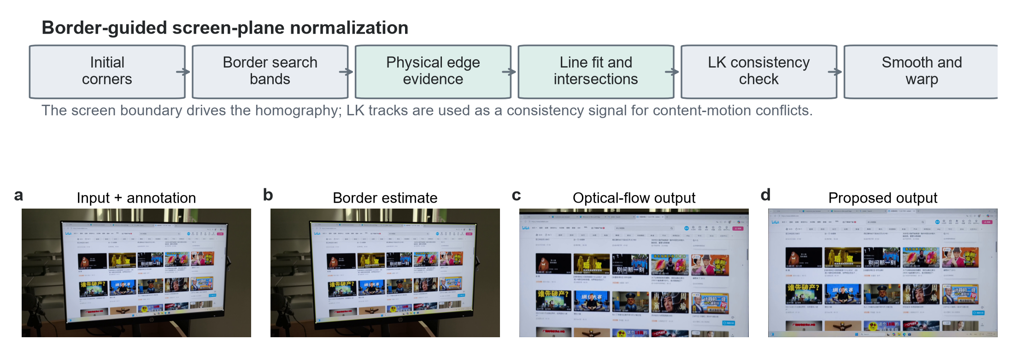
The pipeline follows the physical border
and uses diagnostics and recovery for continuity
01 · INITIALIZE
02 · BORDER OBSERVATION
03 · VALIDATE + RECOVER
04 · STABLE OUTPUT
First-frame corners
Profiles + line fit
Gates + LK check
Smooth + rectify
Initial quadrilateral
Four physical edges
Accept / redetect / hold
Normalized screen video
CURRENT METHOD · PROPOSAL_BORDER
03
Notes:
With the objective defined, this slide shows the complete pipeline. We initialize one quadrilateral, observe the four physical borders with local profiles, validate or recover the candidate, and finally smooth the trajectory before perspective normalization.

Slide 4
Local profiles search only around predicted borders
This suppresses interference from internal screen texture
1 · PREDICT A NARROW SEARCH BAND
2 · SAMPLE NORMAL PROFILES
3 · FIT FOUR LINES, THEN INTERSECT
Prediction limits where evidence is trusted
Gradient peak proposes the border position
RANSAC rejects outliers before corners are updated
Internal LK / RANSAC motion is a consistency diagnostic
It can flag conflict, but it does not replace the border-derived quadrilateral.
PIPELINE DETAIL · PROFILE-BASED BORDER OBSERVATION
04
Notes:
The default estimator does not search the full image again on every frame. It samples narrow normal profiles around predicted edges, selects strong gradient responses, fits robust lines, and obtains updated corners from line intersections; LK motion remains a consistency check rather than the geometric driver.

Slide 5
The three methods differ mainly
in which evidence they trust
DECISION AXIS
FRAME-WISE
OPTICAL FLOW
PROPOSED
Primary evidence
Independent screen detection
Internal feature motion
Physical screen border
State update
Restart every frame
Propagate previous corners
Fit four local border lines
Internal motion
Can perturb detections
Becomes false camera motion
Consistency diagnostic only
Failure signature
Jitter or frame-wise jumps
Accumulated drift
Hold or redetect on weak evidence
The advantage comes from a stable physical reference—not a heavier motion model.
05
Notes:
The main difference among the three methods is the evidence they trust. Frame-wise detection restarts from the current image, optical flow propagates internal feature motion, while our method follows the physical border and invokes hold or redetection only when that evidence becomes unreliable.

Slide 6
Formal evidence covers geometry and temporal stability
The ranked comparison uses 10 annotated clips across five scene categories
DATASET CONTEXT
RANKED IN THE CURRENT RESULTS
50
Geometry
captured-screen videos
Corner RMSE ↓ · quadrilateral IoU ↑
14,985
Temporal stability
frame-to-frame translation variation ↓
total frames represented in the project set
SUPPORTING, BUT NOT RE-RANKED FOR PROPOSAL_BORDER
10 annotated clips
Detail retention and frequency-domain behavior
used for the formal three-method ranking
Shown qualitatively; no current three-method numeric claim is made on these dimensions.
Evaluation priority: accurate screen geometry first, stable trajectories second.
06
Notes:
The broader project set contains 50 videos and 14,985 frames, while the formal three-method ranking uses 10 annotated clips across five scene categories. The current comparable evidence covers corner accuracy, quadrilateral overlap, and temporal translation stability; detail and frequency-domain behavior are supporting observations rather than current numeric rankings.

Slide 7
The proposed method improves accuracy, overlap,
and stability at the same time
Frame-wise
Optical flow
Ours
Corner RMSE ↓
Quadrilateral IoU ↑
Translation variation ↓
3.87 px
0.996
2.45
87% lower than the best baseline
+0.016 over the best baseline
13% lower than the best baseline
Frame-wise
30.37
Frame-wise
0.980
Frame-wise
2.83
Optical flow
31.40
Optical flow
0.979
Optical flow
4.13
Proposed
3.87
Proposed
0.996
Proposed
2.45
One border-driven trajectory wins all three aggregate metrics.
07
Notes:
Across the annotated set, the proposed method wins all three aggregate metrics. It reduces corner RMSE to 3.87 pixels, raises quadrilateral IoU to 0.996, and lowers translation variation to 2.45 pixels per frame.

Slide 8
The largest gains appear under scrolling and weak borders
Corner RMSE in pixels · lower is better
Frame-wise
Optical flow
Proposed
160
157.26
155.87
SCROLLING
2.87 px
120
vs 31.76 / 81.67
81.67
80
WEAK BORDER
9.35 px
40
31.76
9.35
vs 157.26 / 155.87
2.87
0
Scrolling
Weak border
CATEGORY-LEVEL RMSE · SAME ANNOTATED EVALUATION SET
08
Notes:
The advantage becomes especially clear when internal scrolling or weak physical borders challenge the baselines. On scrolling clips the RMSE falls to 2.87 pixels, and on weak-border clips it remains at 9.35 pixels while both baselines exceed 155 pixels.

Slide 9
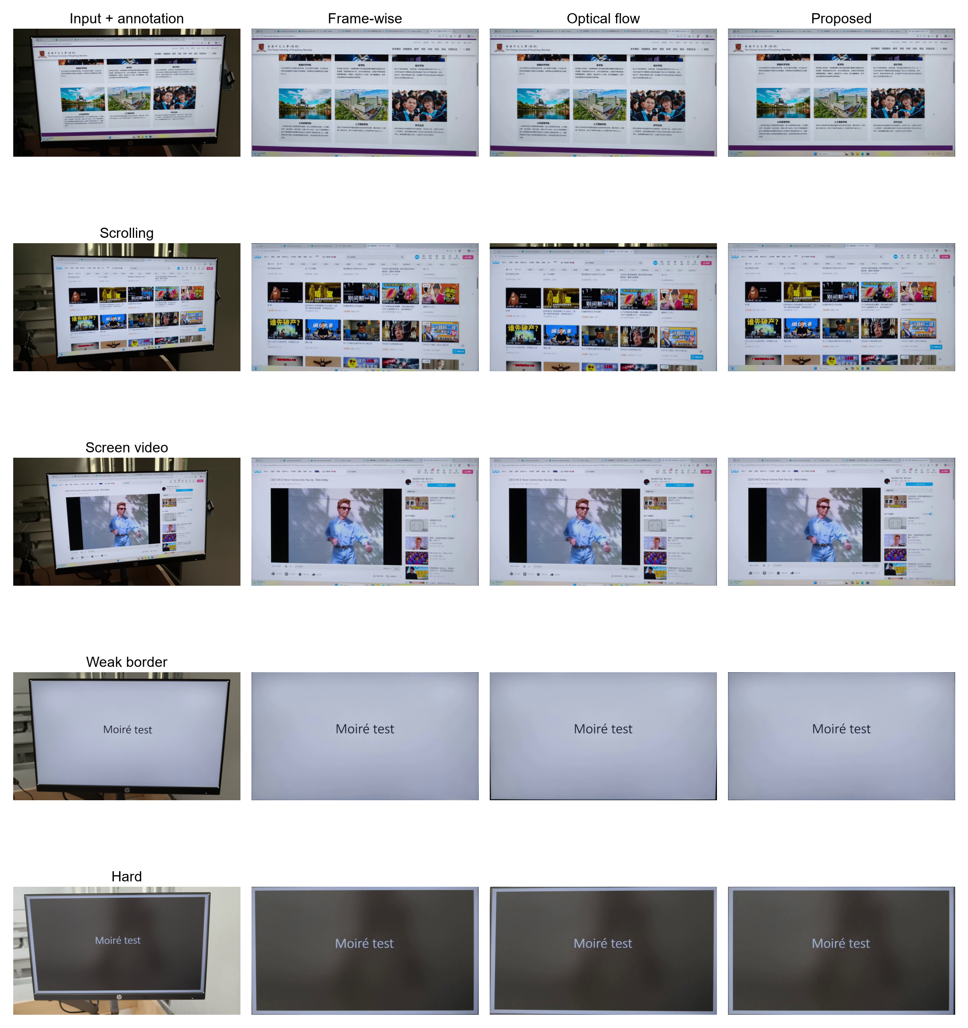
Qualitative results preserve content motion
Hard scenes still expose degraded border evidence
ACROSS THE FIVE SCENE CATEGORIES
The normalized view follows the display,
not the moving content inside it.
This is the qualitative signature of a physical-border reference.
CHALLENGE RMSE ↓
CHALLENGE VARIATION ↓
10.70
3.74
Frame-wise 9.62
Frame-wise 5.19
Optical flow 24.90
Optical flow 8.56
On hard clips, accuracy remains competitive while temporal stability stays best.
QUALITATIVE GRID · INPUT / FRAME-WISE / OPTICAL FLOW / PROPOSED
09
Notes:
The qualitative grid shows that the normalized view follows the physical display rather than the pixels moving inside it. On the hardest subset, frame-wise detection is slightly better in RMSE, but our method stays competitive in accuracy and gives the best temporal stability.

Slide 10
Trajectory smoothing is the only ablation
that directly changes this clip
VARIANT
CHANGE
RMSE ↓
IoU ↑
VARIATION ↓
Full method: Profile
Keep all modules
3.253
0.996038
0.752
No trajectory smoothing
Remove trajectory filter
2.932
0.996585
1.430
No LK diagnostic
Disable internal motion check
3.253
0.996038
0.752
No automatic redetection
Disable automatic recovery
3.253
0.996038
0.752
Loose edge gates
Relax edge geometry constraints
3.253
0.996038
0.752
Smoothing cuts frame-to-frame variation by 47%
1.430 → 0.752, with only a small geometry trade-off.
Identical rows indicate inactive branches on this sequence; the next slide explains why.
10
Notes:
The ablation results show that trajectory smoothing is the only tested removal that changes this sequence directly. Removing it improves the instantaneous geometry slightly, but increases frame-to-frame variation from 0.752 to 1.430, so the complete method cuts that instability by about 47 percent.

Slide 11
Identical metrics do not make the safety modules useless
Their conditional branches were not triggered on this sequence
WHAT THE RUN ACTUALLY DID
LK consistency diagnostic
1
No decisive border–motion conflict → removing it does not change output.
initial frame
initial quadrilateral
Automatic redetection
298
The accepted edge observation never failed → redetection was not called.
edge accepts
Profile succeeds directly
Edge gates
All candidates already passed the original gates → relaxing them adds nothing.
0
held frames
Ablation measures realized contribution, not latent safety value.
no recovery path used
These modules matter when the default border observation becomes unreliable.
ABLATION INTERPRETATION · EXECUTION COUNTS EXPLAIN EQUAL METRICS
11
Notes:
The equal rows are explained by execution counts, not by assuming that the safety modules have no value. After one initialization frame, the Profile observation is accepted on all 298 remaining frames, so the LK conflict branch, automatic redetection, and relaxed gates never alter the output.

Slide 12
Remaining risk comes from reflection, occlusion,
and extremely weak border evidence
Scene stress
Border ambiguity
Safety logic
Controlled response
Reflection
Weak profile peaks
Geometry gates
Accept a reliable update
Occlusion
False line support
LK consistency check
Redetect after failure
Extreme low contrast
Corner uncertainty
Confidence decision
Otherwise hold last state
If the border stays invisible, reliable corners cannot be recovered.
A weak-border aggregate RMSE of 9.35 px is a major gain, but difficult individual clips can still reach 14.39 px.
NEXT IMPROVEMENTS
Adaptive profile bands
Multi-frame redetection
Confidence-aware output
Expand only when evidence weakens
Aggregate evidence before reset
Expose uncertainty to downstream use
LIMITATIONS · IMPROVEMENT PRIORITIES
12
Notes:
The remaining failure modes occur when reflection, occlusion, or extreme low contrast makes the physical border ambiguous for a sustained period. The current gates, diagnostics, redetection, and hold behavior limit damage, while future work should improve adaptive search, multi-frame recovery, and confidence-aware output.

Slide 13
The physical border should drive the homography
Internal flow should only diagnose conflicts
3.87 px
A border-first pipeline
1
CORNER RMSE ↓
Local profiles → robust lines → validated corners → smooth output
A clean aggregate win
0.996
2
Best RMSE, IoU, and temporal stability on the annotated set
QUADRILATERAL IoU ↑
Robust where baselines break
3
2.45
Especially under scrolling content and weak physical borders
TRANSLATION VARIATION ↓
Track the display, not the pixels moving inside it.
Thank you · Questions
13
Notes:
The conclusion is simple: track the display, not the content moving inside it. A border-first pipeline produces the best aggregate geometry and stability, with its largest gains appearing exactly where frame-wise detection and optical flow are most easily confused.

