Slide 1
Border-Guided Screen-Plane Normalization
3.87 px
median corner RMSE
ECE4512 Final Project · Rongshuo Wen / Bihua Wen / Mingrui Liu · 2026
0.996
median quadrilateral IoU
Core claim
Physical screen borders anchor the homography
2.45
px/frame translation variation

Slide 2
Captured-screen geometry is misled by content motion
Context
Core conflict
•
Captured-screen video is useful when direct recording is unavailable
•
Displayed content and the physical screen do not share one motion model
•
The camera view adds perspective, shake, background clutter, and glare
•
Strong interior features can pull a tracker away from the screen boundary
•
Pages or videos inside the display can move independently
•
Frame-wise detection reduces drift but can jitter or fail on weak borders
Screen-plane estimation should first answer where the physical display is, not where the content is moving.

Slide 3
Three estimation strategies use different evidence
Strategy | Main evidence | Typical risk | Role
Frame-wise detection | Current-frame border / texture | Jitter under weak borders or clutter | Baseline
Adjacent-frame optical flow | Trackable interior features | Drifts with scrolling content | Baseline
Border-guided | Four physical screen sides | Requires visible boundary evidence | Proposed
The comparison asks whether the homography still fits the physical display, not only whether the trajectory is smooth.
•
Frame-wise detection depends on local image evidence and can be unstable
•
Optical flow follows strong texture and can be attracted to internal content
•
The proposed method demotes LK/RANSAC to a conflict diagnostic

Slide 4
The method makes border evidence the primary cue
Initialize
Search borders
Fit lines
Gate / fallback
Render
First-frame corners or detector fallback
Sample gradient profiles near predicted sides
Robustly fit four sides and intersect corners
Check convexity, step size, and redetection
Warp homography to a fixed screen canvas
>
>
>
>
Role of LK/RANSAC
•
No longer determines the homography
The core change is evidence priority: boundary lines define geometry; interior texture only checks consistency.
•
Only diagnoses internal content-motion conflicts
•
A valid border quadrilateral remains the geometry estimate

Slide 5
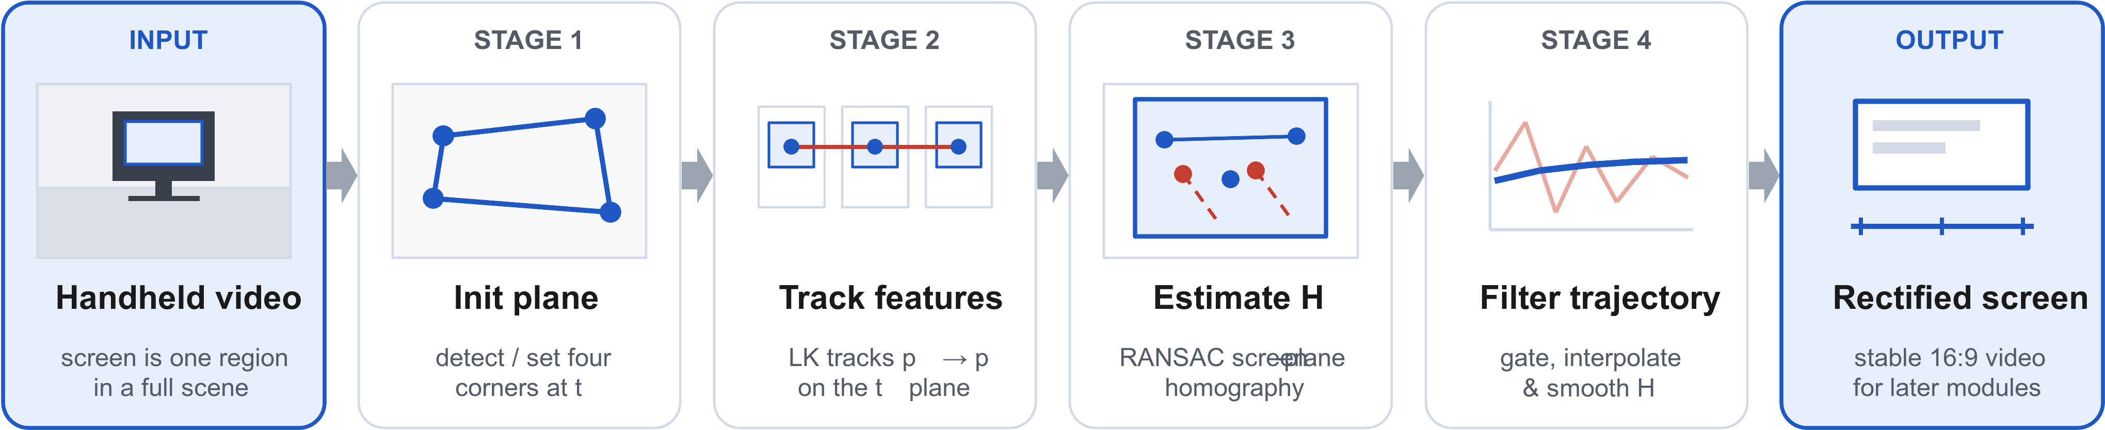
The workflow separates borders, diagnostics, and fallback
LK/RANSAC is only a consistency diagnostic for internal content motion.

Slide 6
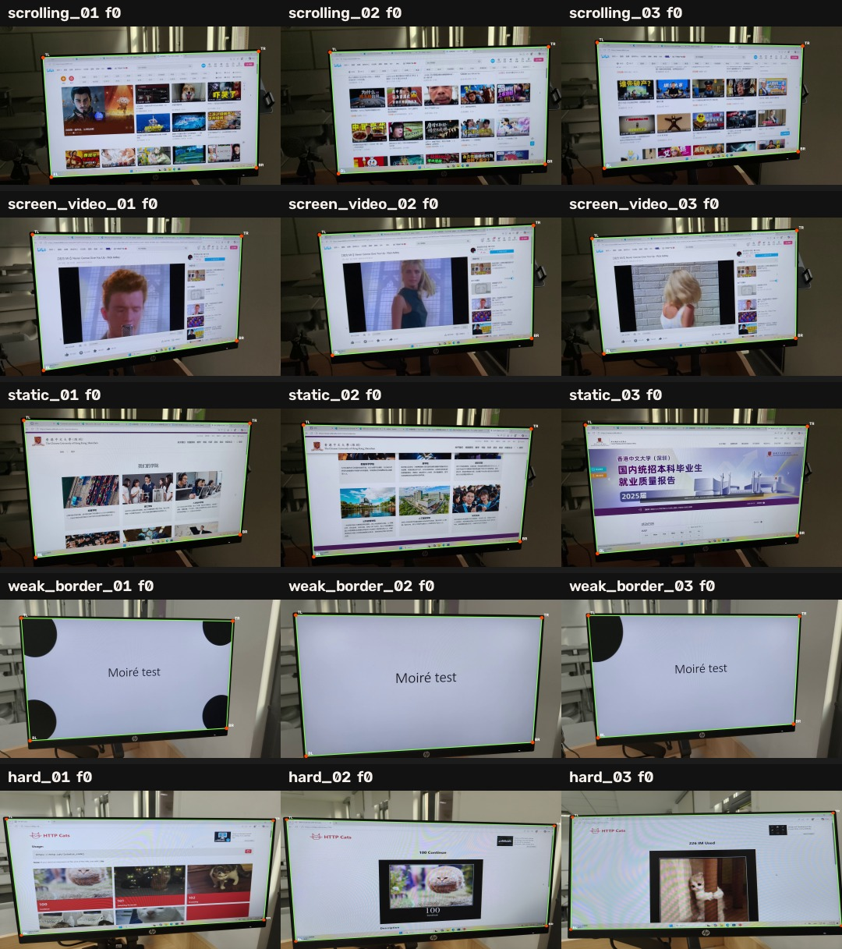
Evaluation covers five capture conditions
Capture condition | Collection clips
Static pages | 10
Scrolling pages | 10
Videos on screen | 10
Weak-border scenes | 10
Challenging scenes | 10
Main metrics
•
Corner RMSE: four-corner geometric error
•
Quadrilateral IoU: screen-region overlap
•
Translation variation: frame-to-frame trajectory stability
•
Reference-based diagnostics check signal preservation, not the main ranking
All methods use the same videos, initialization, output canvas, annotations, encoder, and metric code.

Slide 7
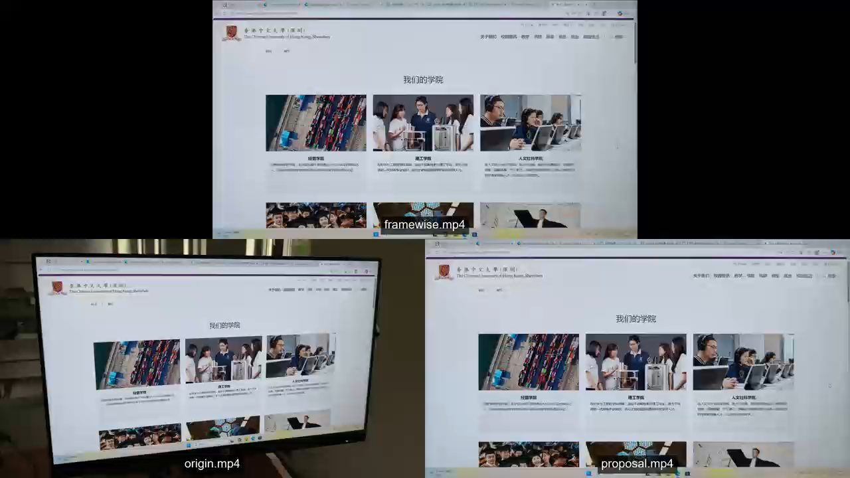

Slide 8
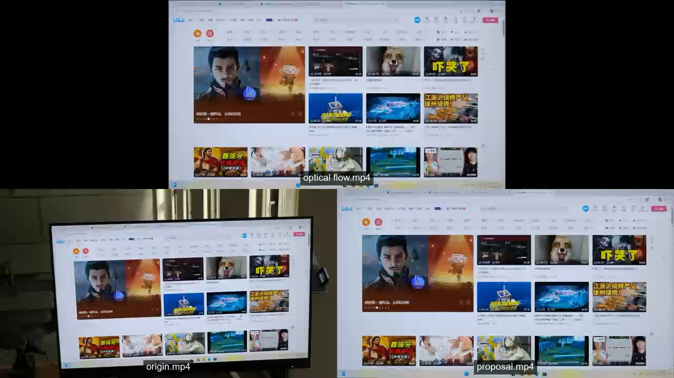

Slide 9
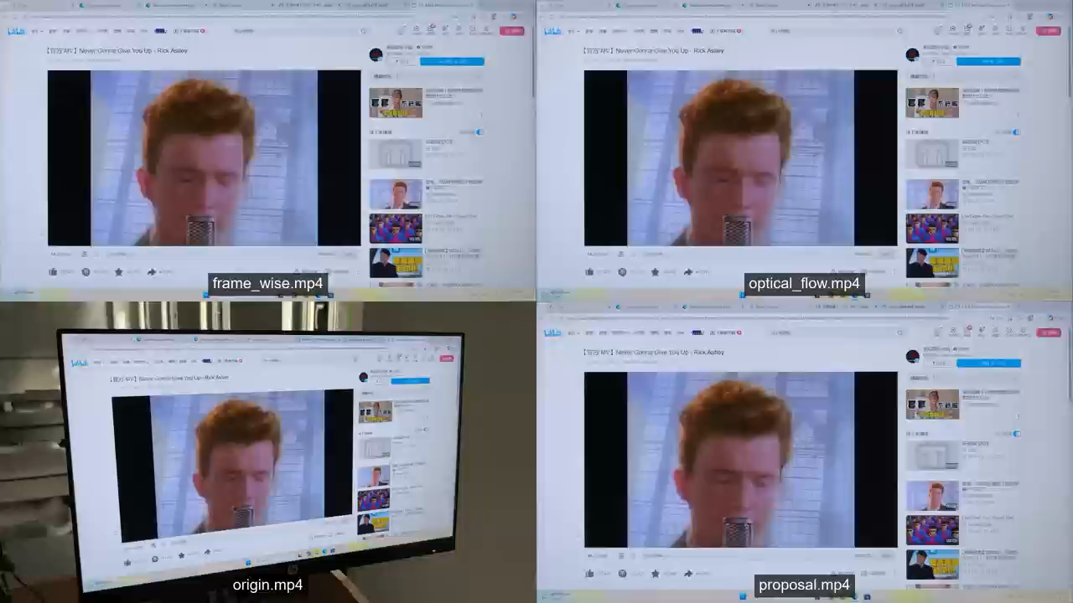

Slide 10
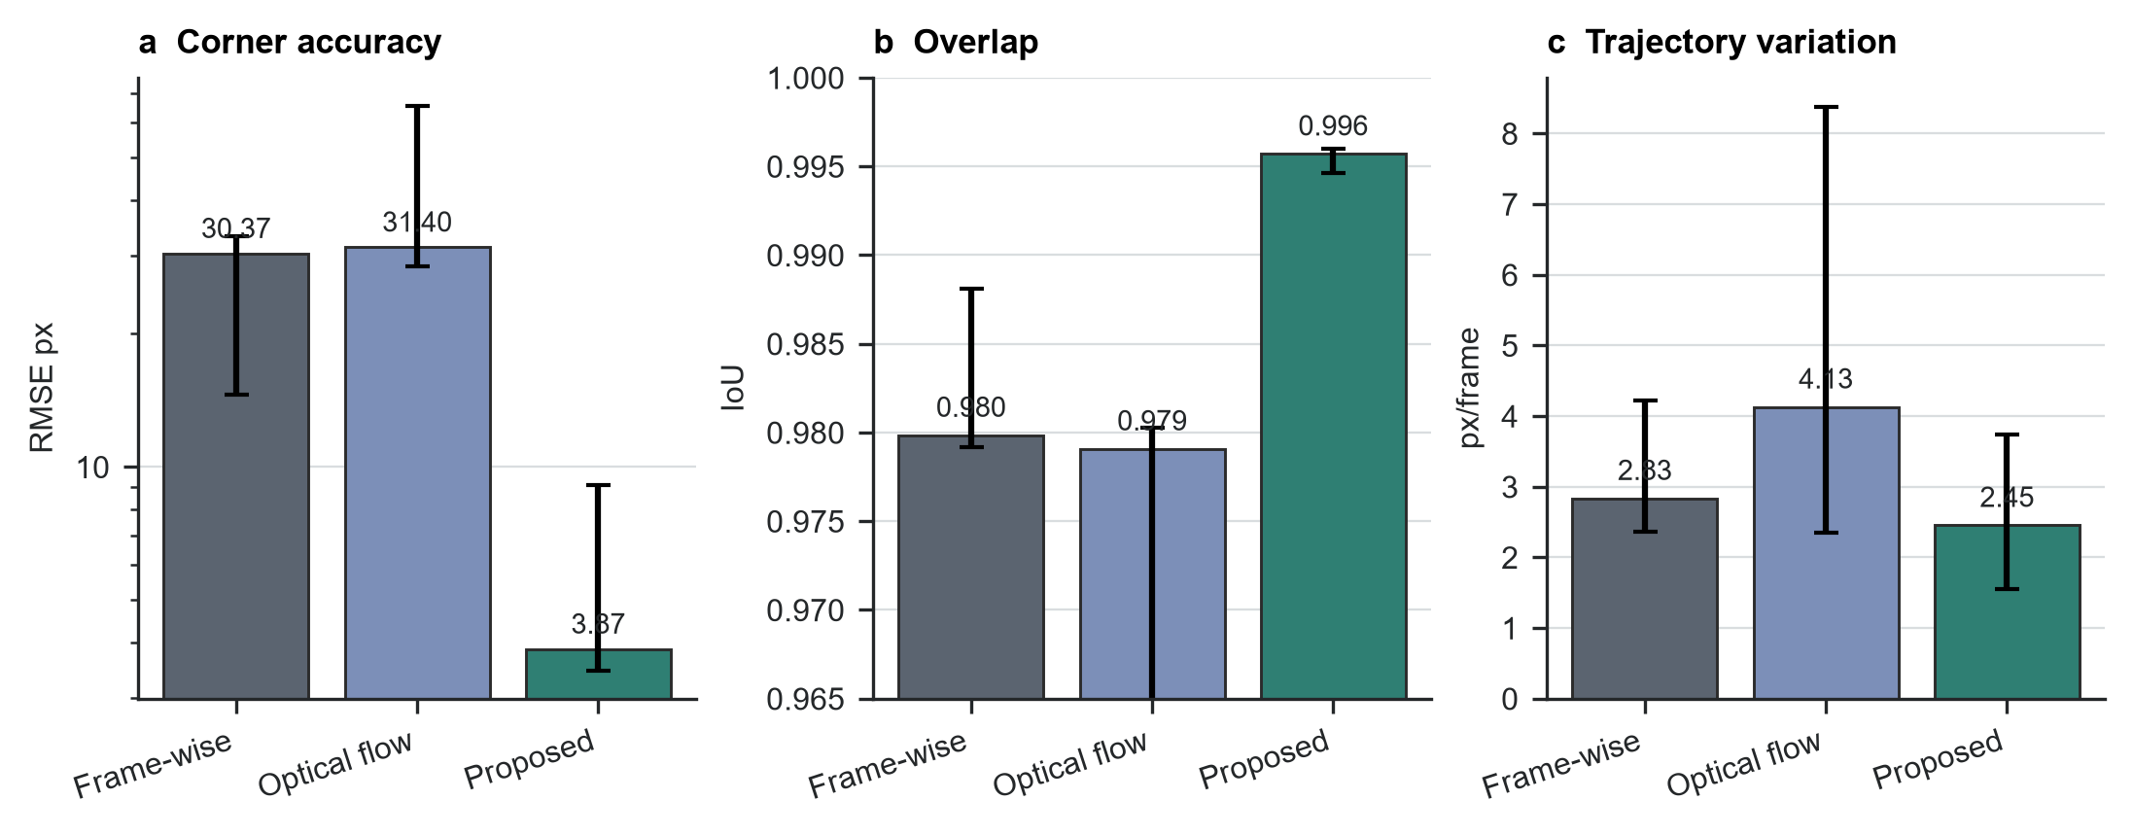
Proposed method improves geometry and stability
3.87 px
Proposed RMSE; baselines are around 30 px
0.996
highest quadrilateral IoU
2.45 px/frame
lowest translation variation
Border-guided estimation stays close to the annotated physical display while reducing frame-to-frame trajectory variation.

Slide 11
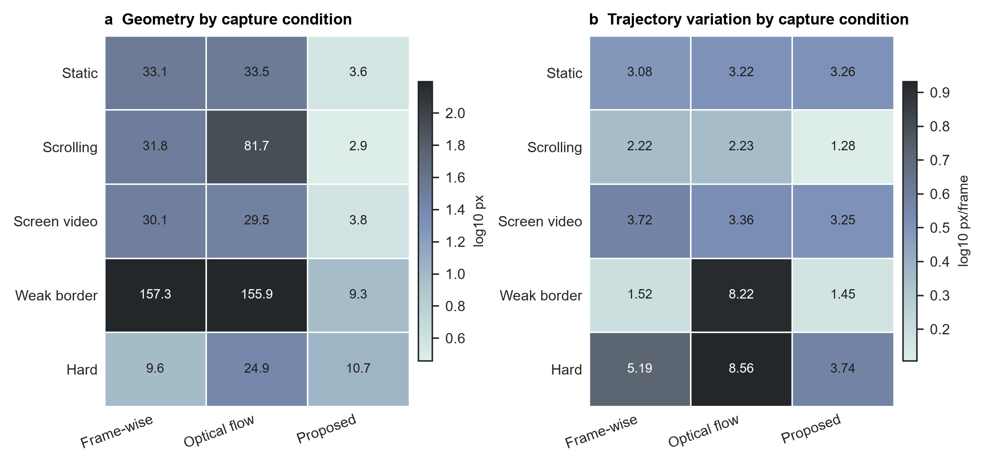
The largest gains occur on scrolling and weak-border clips
•
Scrolling pages: 2.87 px RMSE
•
Weak-border scenes: 9.35 px RMSE
•
In challenging clips, frame-wise detection is slightly lower, but the proposed trajectory is more stable
Strong content motion and weak boundaries are where content-driven tracking fails most clearly, and where the border-guided design is most useful.

Slide 12
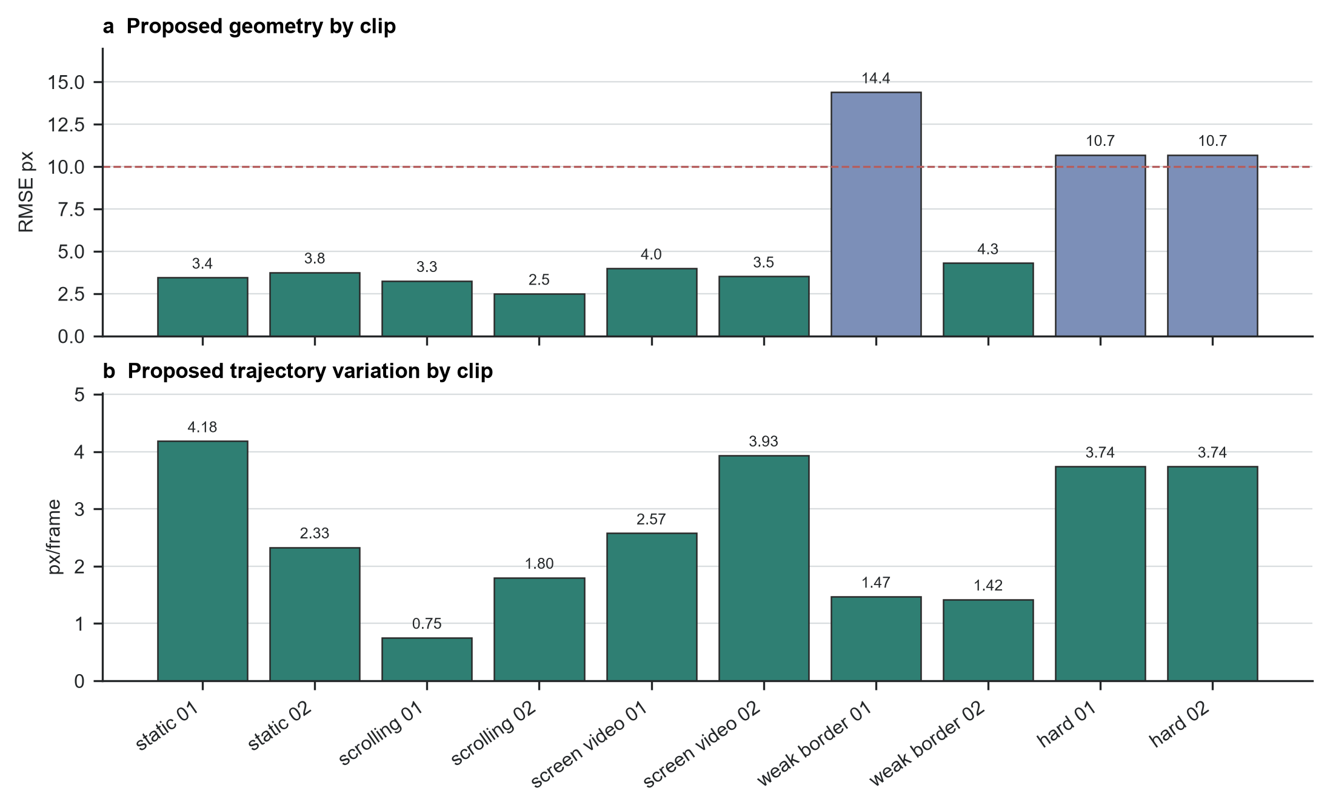
Per-clip results rule out a frozen-trajectory explanation
•
Seven clips have median RMSE below 5 px
•
All evaluated clips remain below 15 px
•
The run held zero frames
When the border is visible, the trajectory updates with the physical screen; conflict markers mainly indicate internal content motion.

Slide 13
Ablation identifies physical border evidence as decisive
Variant | Setting | RMSE↓ | IoU↑ | Trans.↓
Proposed, profile | Full chain | 3.253 | 0.996038 | 0.752
No trajectory filter | Window size = 1 | 2.932 | 0.996585 | 1.430
No LK diagnostic | Disable content-motion check | 3.253 | 0.996038 | 0.752
No physical border | Adjacent-frame optical flow | 76.114 | 0.916022 | 2.205
LSD border observation | Replace profile sampler | 3.604 | 0.995716 | 0.961
Hough border observation | Replace profile sampler | 27.335 | 0.974200 | 0.897
Key readout: removing border evidence breaks geometry; smoothing trades a slightly lower RMSE for worse frame-to-frame stability.

Slide 14
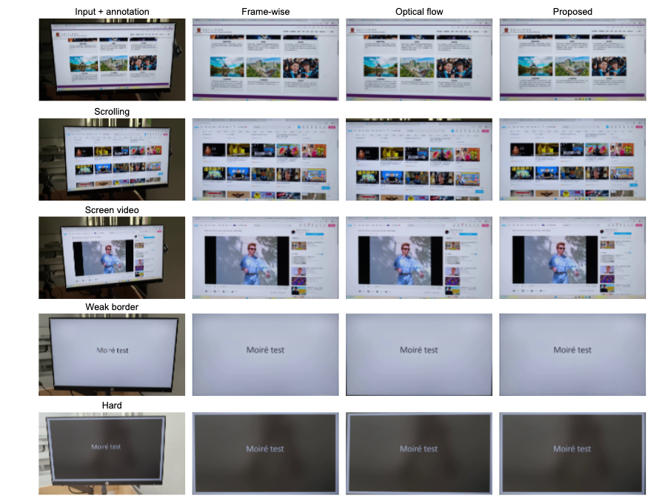
Qualitative examples show more stable screen extent
•
Scrolling and weak-border examples show the clearest differences
•
Content-driven methods can shift or crop the screen extent
•
Static pages and screen-video examples remain readable, but proposed alignment is steadier
Use this figure to inspect output extent and boundary alignment.
The quantitative conclusions come from the preceding metrics.

Slide 15
Signal diagnostics support the geometry results
0.890
SSIM
0.930
gradient-map similarity
0.952
edge F1
These diagnostics measure captured-signal preservation after geometric normalization; they do not measure demoireing and do not define the main ranking.

Slide 16
Prioritize the screen border over content motion
Main takeaways
Boundary and next steps
•
Physical borders avoid content-driven homography drift
•
Depends on visible boundary evidence
•
Reflections, occlusion, or low contrast can weaken the fit
•
The method reaches 3.87 px RMSE and 0.996 IoU on ten annotated clips
•
Stronger boundary models and denser annotations are the most direct improvements
•
Scrolling pages and weak-border scenes show the largest gains
This work is the geometric front end for captured-screen preprocessing, providing a more reliable screen plane for downstream OCR, reading restoration, or demoireing.

Slide 17
References
Full manuscript bibliography
1. L. Jagannathan and C. V. Jawahar, "Perspective Correction Methods for Camera-Based Document Analysis," 2005.
2. X.-C. Yin, J. Sun, S. Naoi, Y. Fujii, and K. Fujimoto, "Perspective Rectification for Mobile Phone Camera-Based Documents Using a Hybrid Approach to Vanishing Point Detection," 2007.
3. Williem, C. Simon, S. Cho, and I. K. Park, "Fast and Robust Perspective Rectification of Document Images on a Smartphone," CVPR Workshops, 2014.
4. T. Okatani and K. Deguchi, "Autocalibration of a Projector-Screen-Camera System: Theory and Algorithm for Screen-to-Camera Homography Estimation," ICCV, 2003.
5. B. D. Lucas and T. Kanade, "An Iterative Image Registration Technique with an Application to Stereo Vision," 1981.
6. J.-Y. Bouguet, "Pyramidal Implementation of the Lucas Kanade Feature Tracker," Intel Corporation, 2000.
7. J. Shi and C. Tomasi, "Good Features to Track," CVPR, 1994.
8. P. H. S. Torr and A. Zisserman, "MLESAC: A New Robust Estimator with Application to Estimating Image Geometry," Computer Vision and Image Understanding, 2000.
9. M. Grundmann, V. Kwatra, and I. Essa, "Auto-Directed Video Stabilization with Robust L1 Optimal Camera Paths," CVPR, 2011.
10. W. Guilluy, A. Beghdadi, and L. Oudre, "A Performance Evaluation Framework for Video Stabilization Methods," EUVIP, 2018.
11. P. Dai, X. Yu, L. Ma, B. Zhang, J. Li, W. Li, J. Shen, and X. Qi, "Video Demoireing with Relation-Based Temporal Consistency," CVPR, 2022.
12. S. Xu, B. Song, X. Chen, and J. Zhou, "Direction-Aware Video Demoireing with Temporal-Guided Bilateral Learning," AAAI, 2024.
13. H. Yue, Y. Cheng, X. Liu, and J. Yang, "Recaptured Raw Screen Image and Video Demoireing via Channel and Spatial Modulations," NeurIPS, 2023.

