Slide 1
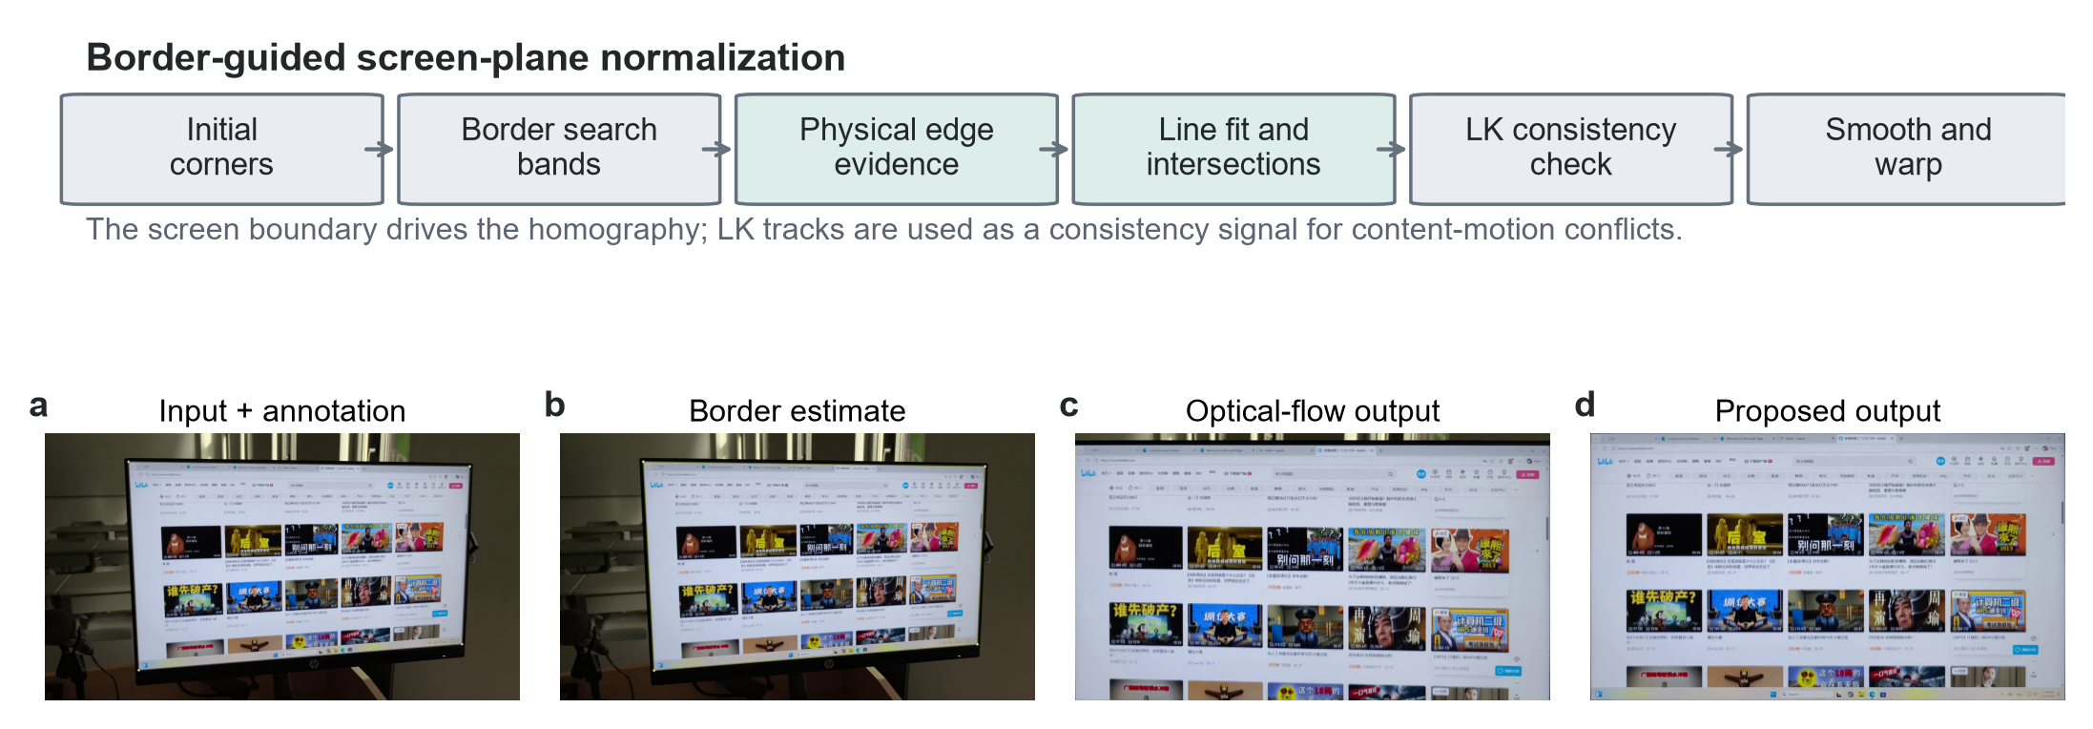
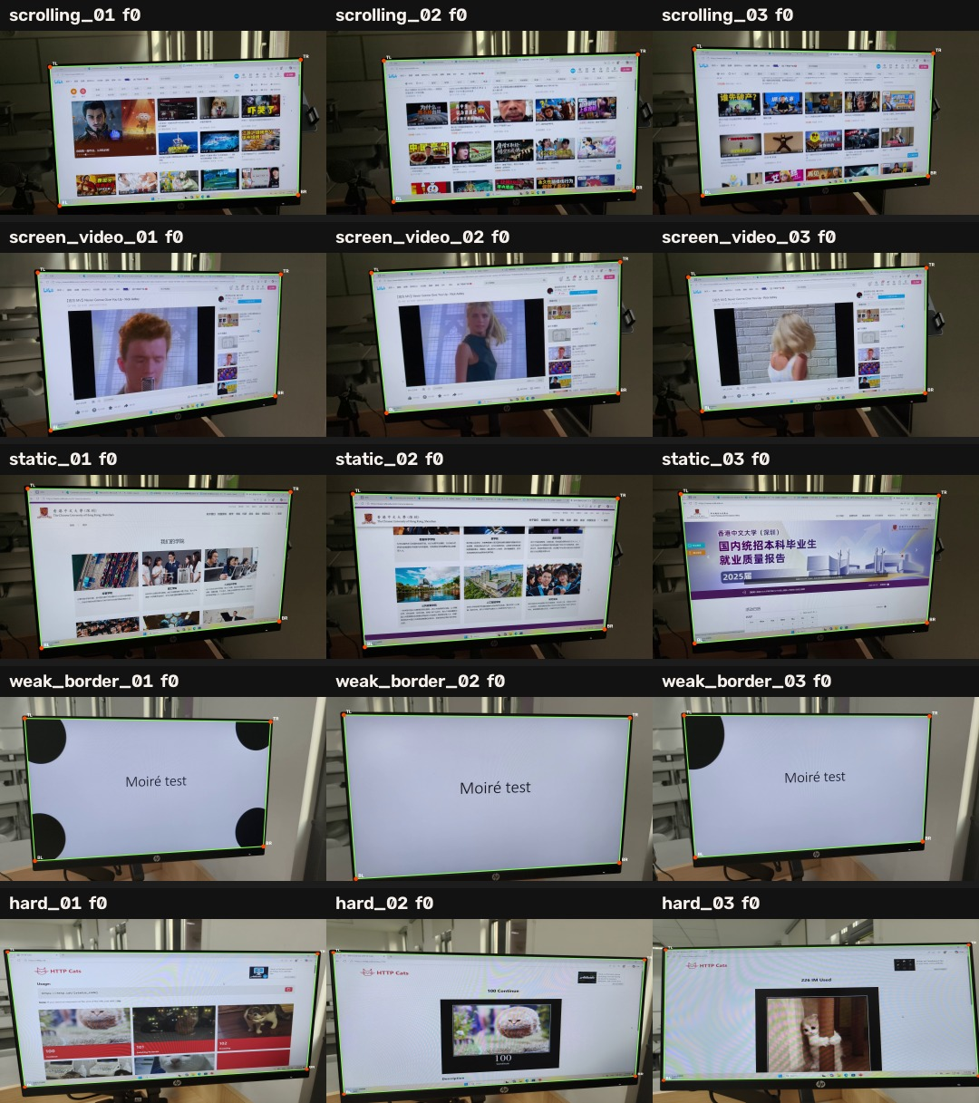
ECE4512 FINAL PROJECT · 2026
Border-Guided Screen-Plane
Normalization for Captured-Screen Videos
Physical screen boundaries—not internal content—drive the homography
Rongshuo Wen 124020369 Bihua Wen 124090670
Mingrui Liu 124090375
Core claim
Separating physical-border motion from displayed-content motion improves both geometric accuracy and temporal stability.
ECE4512 Final Project · 2026
Source: paper Figure 1; dataset mosaic
1
Notes:
[About 15 seconds] This project addresses the geometric front end of captured-screen video. Our core claim is simple: the physical screen boundary should drive the homography, while internal content motion should remain independent.

Slide 2
PROBLEM
A Handheld Camera and the Display Do Not Share One Motion
THE CAMERA VIEW ADDS
THE DISPLAY CONTENT ADDS
Perspective distortion and off-screen background
Page scrolling and cursor motion
Handheld translation, rotation, and scale change
Video playback and animated regions
Glare, weak borders, partial visibility, and clutter
Coherent texture motion unrelated to the physical screen
Goal. Continuously estimate the physical screen plane and render a stable frontal video while preserving true content motion.
ECE4512 Final Project · 2026
Source: paper Introduction
2
Notes:
[About 25 seconds] A handheld recording mixes two different sources of motion. The camera changes the physical screen geometry, while the displayed page or video can move independently. The task is to remove camera-induced plane changes without suppressing genuine content motion.

Slide 3
SCOPE & CONTRIBUTIONS
A Focused Geometry Stage Before Restoration
RAW CAPTURE
THIS PROJECT
DOWNSTREAM
Background + perspective + hand motion
Locate, rectify, and stabilize the physical screen
OCR · restoration · demoiréing · archival
Three contributions
01
Border-driven estimation
02
Reproducible evaluation
03
Evidence across failure modes
A complete captured-screen pipeline in which physical boundary evidence drives the screen-plane trajectory.
Corner annotations, shared metric code, and five capture conditions with common initialization and output settings.
Geometry and temporal improvements are largest on scrolling pages and weak-border scenes.
ECE4512 Final Project · 2026
Source: paper Introduction and Related Work
3
Notes:
[About 25 seconds] The project stops at geometry. It produces the stable screen region required by later OCR, restoration, or demoiréing. The paper contributes a border-driven pipeline, a reproducible five-condition evaluation, and evidence that the design is especially useful under scrolling and weak boundaries.

Slide 4
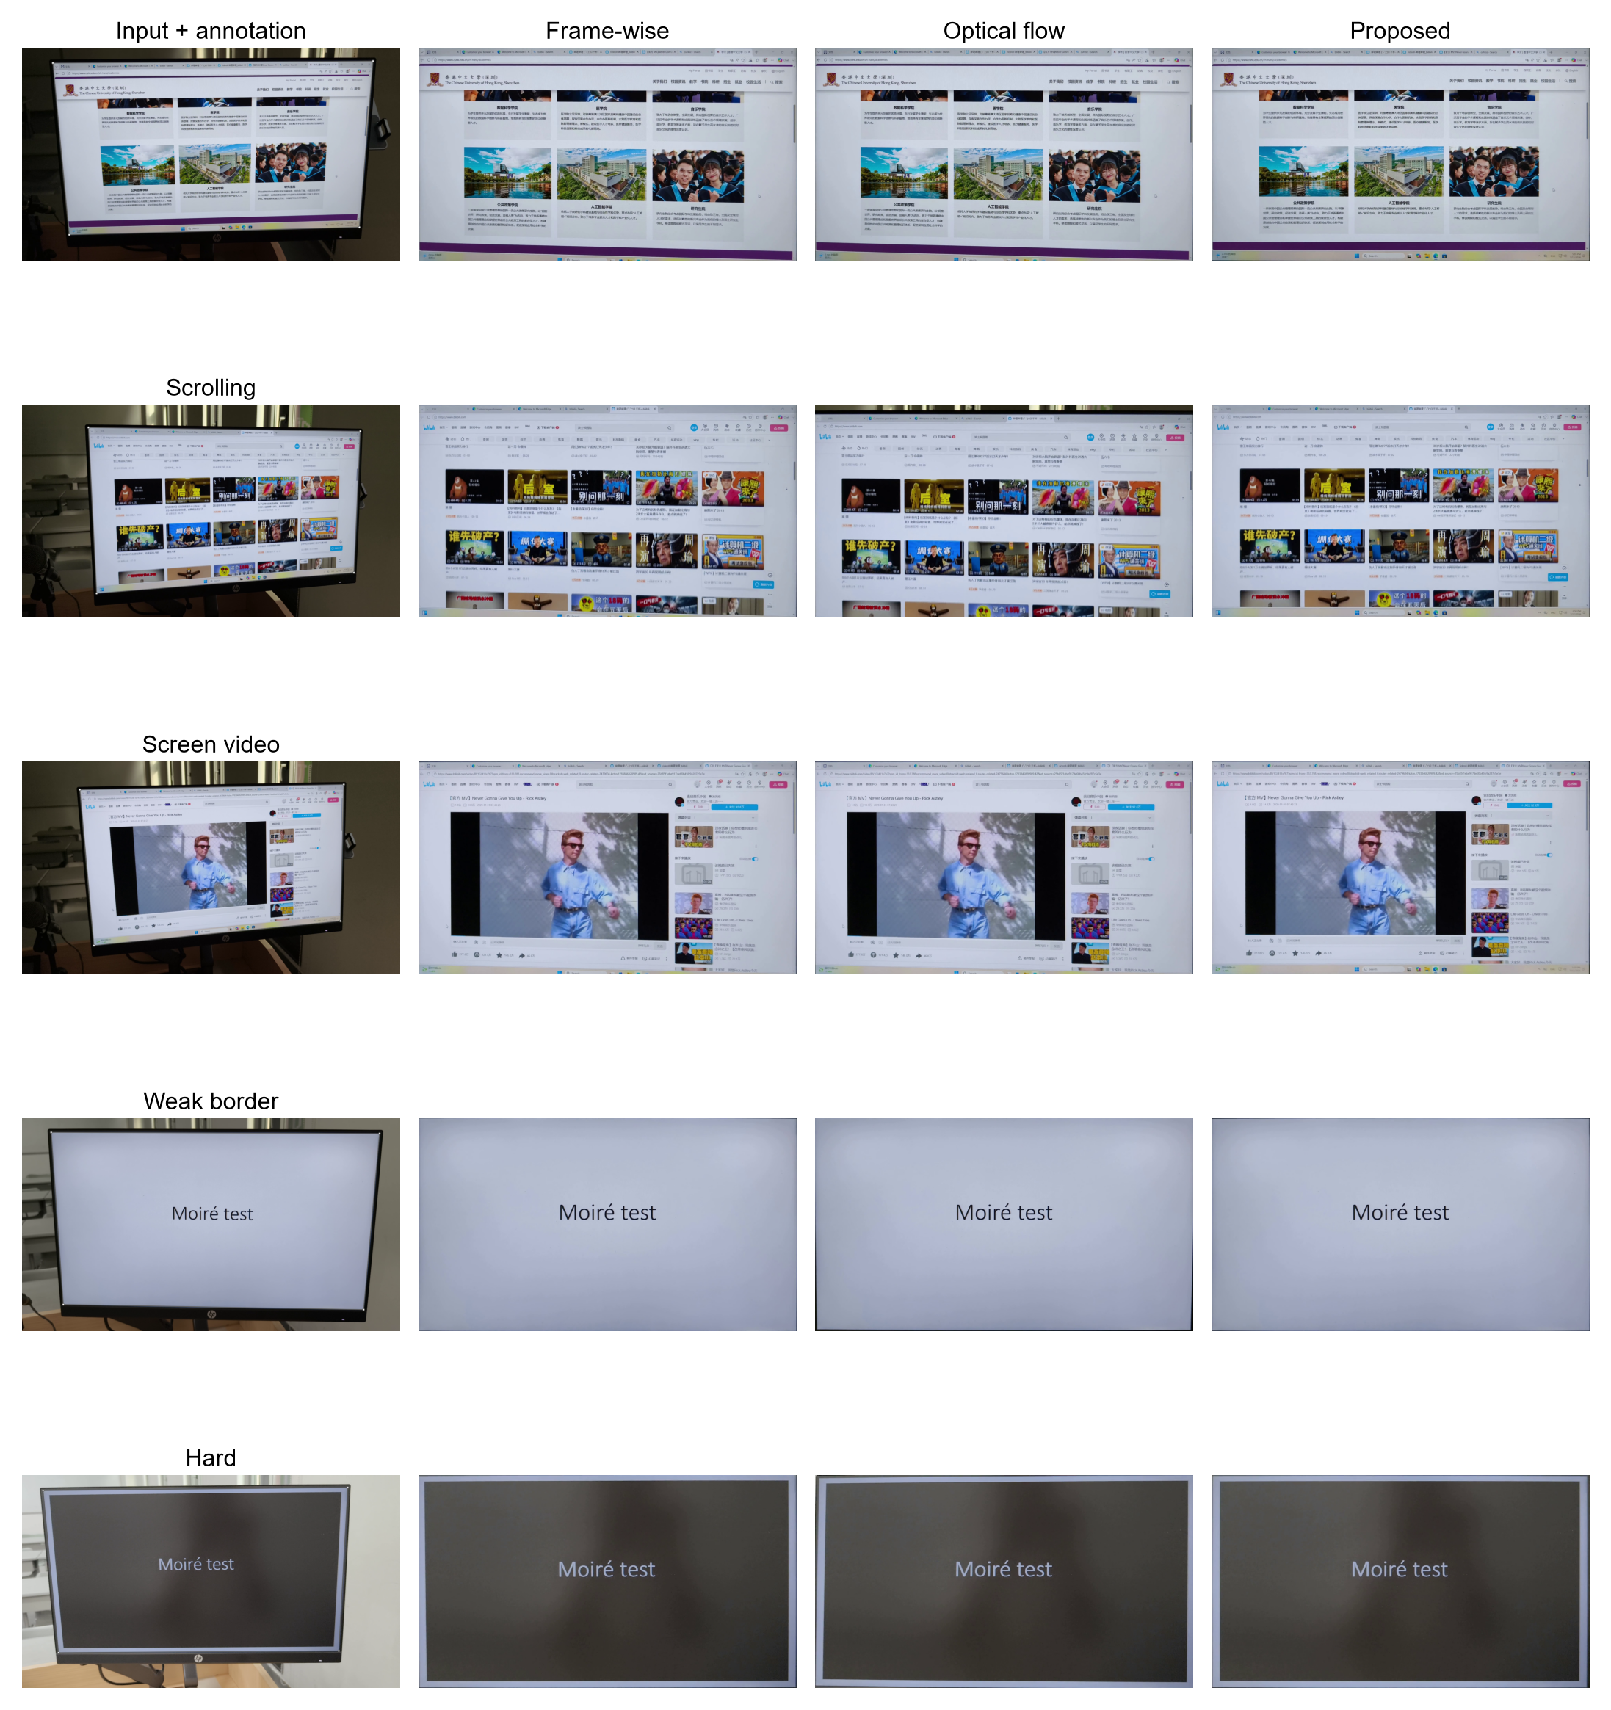
KEY INSIGHT
Three Methods Trust Three Different Sources of Evidence
FRAME-WISE
OPTICAL FLOW
BORDER-GUIDED
Trusts the current frame
Trusts internal texture
Trusts the physical boundary
Independent detection
Noise becomes jitter
Content motion propagates
Scrolling becomes drift
Border defines the plane
Flow diagnoses conflict
Same scrolling moment: input annotation · frame-wise · optical flow · proposed
ECE4512 Final Project · 2026
Source: paper Sections 1 and 3.4; Figure 5
4
Notes:
[About 30 seconds] The comparison methods differ mainly in what they trust. Frame-wise detection trusts each image independently. Optical flow trusts interior texture over time. Our method trusts the physical screen border and uses interior flow only to flag a content-motion conflict. This distinction is most visible on a scrolling page.

Slide 5
METHOD OVERVIEW
Border Evidence Drives the Homography
Previous quadrilateral → local border evidence → four fitted lines → valid quadrilateral → diagnostics → smoothing and warp
ECE4512 Final Project · 2026
Source: paper Figure 1
5
Notes:
[About 25 seconds] Starting from initial corners, the previous quadrilateral predicts local search bands. Physical edge evidence produces four fitted lines and their intersections. LK consistency, gating, fallback, smoothing, and warping complete the pipeline, but the boundary remains the main geometry cue.

Slide 6
FRAME UPDATE
Boundary Observation Plus Explicit Safety Logic
A. RECOVER FOUR PHYSICAL SIDES
B. ACCEPT, RECOVER, OR HOLD
Sample profiles along inward normals
Four usable sides?
Select strong gradients near the predicted side
Valid, convex, geometrically plausible?
Robustly fit four lines and intersect neighbors
Accept boundary + record LK conflict
predicted search bands
If missing:
automatic redetection
If still missing:
carry forward last valid
ECE4512 Final Project · 2026
Source: paper Sections 3.2–3.3
6
Notes:
[About 35 seconds] Each side is recovered locally around its predicted position. Profiles are sampled along inward normals, strong nearby gradients are selected, and four robust lines are intersected. A candidate is accepted only when all sides are usable and the quadrilateral is valid and plausible. Missing evidence triggers redetection; only a second failure carries forward the last valid plane.

Slide 7
DATASET & PROTOCOL
Five Capture Conditions, One Shared Evaluation
50
14,985
10
self-collected clips
total frames
annotated evaluation clips
Capture conditions
Static
Scrolling
Screen video
Weak border
Challenging
Shared protocol
Same input · initialization · output canvas · annotations · encoder · metric code
Frame 0 supplies initialization and is excluded from geometry scoring.
ECE4512 Final Project · 2026
Source: paper Section 4.1; dataset mosaic
7
Notes:
[About 25 seconds] The collection contains fifty clips and 14,985 frames across five conditions. Ten clips, two per condition, form the annotated evaluation split. Every method shares the same initialization, output canvas, annotations, encoder, and metric implementation.

Slide 8
METRICS
Accuracy, Stability, and Signal Preservation
GEOMETRY
TRAJECTORY
SIGNAL DIAGNOSTICS
Corner RMSE ↓
Translation variation ↓
SSIM · gradient similarity · Edge F1
Quadrilateral IoU ↑
Rotation variation ↓
FFT and orientation similarity
Aspect-ratio error ↓
Scale variation ↓
High-frequency / band energy ratios
Is the estimated screen in the correct position and shape?
Does the estimated screen plane change smoothly over time?
Does rectification preserve the captured screen signal?
Signal metrics are reference-based diagnostics on annotated frames; they do not measure demoiréing and are not primary ranking metrics.
ECE4512 Final Project · 2026
Source: paper Section 4.2
8
Notes:
[About 25 seconds] Geometry metrics test position and shape, trajectory metrics test temporal change, and signal diagnostics test whether the warped result preserves the captured screen structure. The signal panel is explicitly diagnostic: it does not claim demoiréing performance.

Slide 9
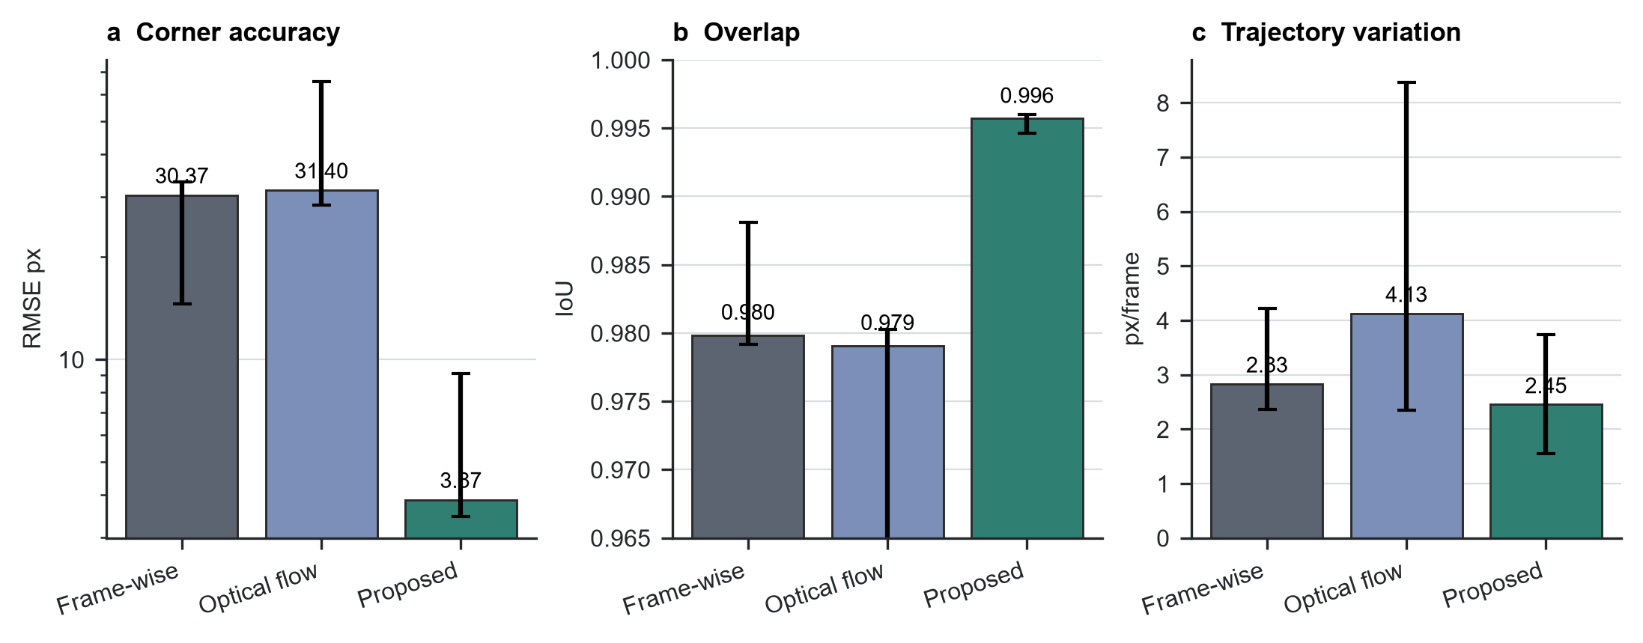
OVERALL RESULTS
The Border-Guided Method Is More Accurate and More Stable
3.87 px
Corner RMSE ↓
0.996
Quadrilateral IoU ↑
2.45
px/frame translation ↓
ECE4512 Final Project · 2026
Source: paper Figure 2
9
Notes:
[About 35 seconds] Across ten clip-level summaries, the proposed method reaches 3.87-pixel corner RMSE, 0.996 IoU, and 2.45 pixels per frame of translation variation. Geometry and temporal stability improve together, so the result is not created by simply freezing the trajectory.

Slide 10
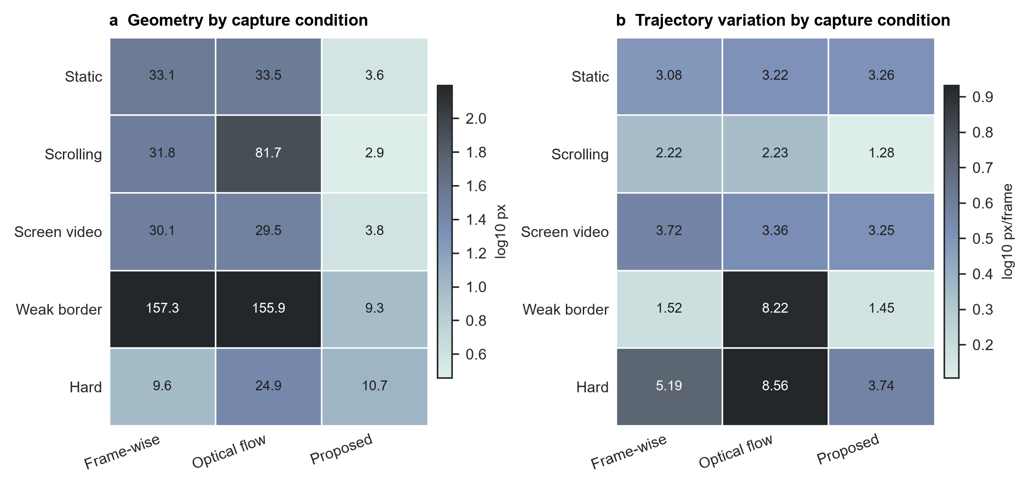
RESULTS BY CONDITION
The Largest Gains Occur Under Scrolling and Weak Borders
2.87 px
Scrolling RMSE
31.76 frame-wise · 81.67 flow
9.35 px
Weak-border RMSE
Both comparisons >155 px
LIMIT
Challenging scenes: geometry is slightly worse than frame-wise detection, but the trajectory is more stable.
ECE4512 Final Project · 2026
Source: paper Figure 3
10
Notes:
[About 30 seconds] Scrolling creates the strongest content-motion conflict: optical-flow RMSE rises to 81.67 pixels, while the proposed method reaches 2.87. Weak borders also show a large gain, with 9.35 pixels versus more than 155 for both comparison methods. Challenging scenes remain the main limitation.

Slide 11
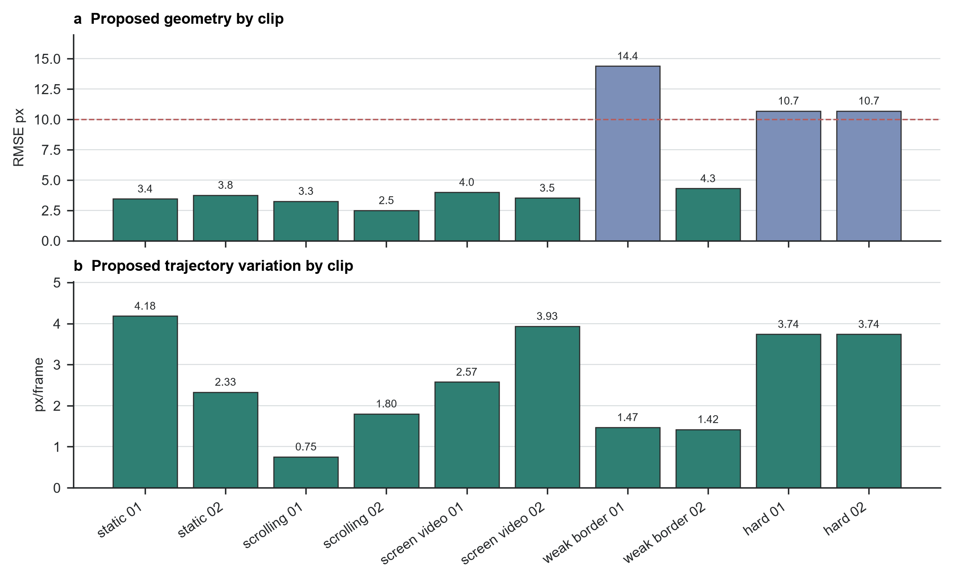
PER-CLIP CONSISTENCY
The Method Does Not Rely on Freezing the Trajectory
7 / 10 clips below 5 px RMSE
10 / 10 clips below 15 px RMSE
0 held frames in the evaluated run
ECE4512 Final Project · 2026
Source: paper Figure 4
11
Notes:
[About 25 seconds] Seven of ten clips remain below five-pixel RMSE and all ten remain below fifteen. The evaluated run contains zero held frames, so the stability is not produced by refusing updates. The higher-error clips are concentrated in weak-border and challenging conditions.

Slide 12
QUALITATIVE COMPARISON
The Screen Extent Is Preserved Under Content Motion
Scrolling page
Weak-border example
ECE4512 Final Project · 2026
Source: paper Figure 5
12
Notes:
[About 25 seconds] Qualitative outputs match the metrics. On scrolling content, the border-guided result preserves the physical screen instead of following the page. In the weak-border example, it also maintains the full screen extent where independent detection can shift the crop.

Slide 13
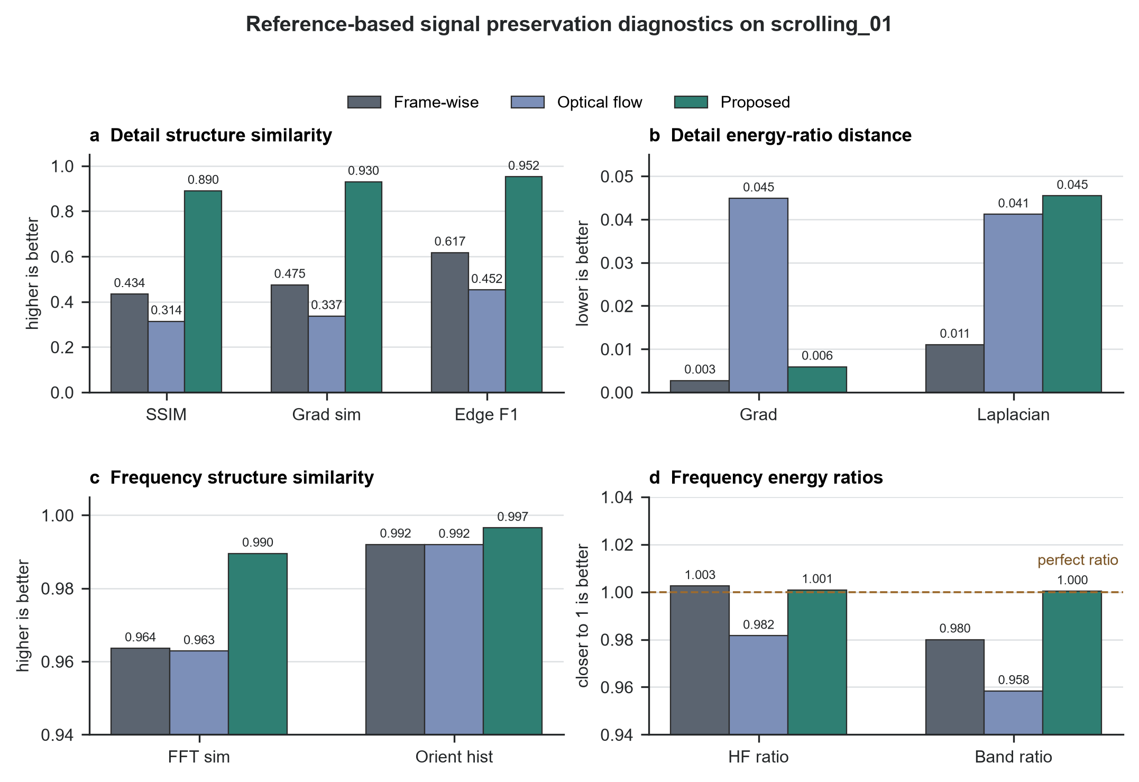
SIGNAL PRESERVATION
Rectification Preserves Local and Frequency Structure
0.890
SSIM
0.930
Gradient-map similarity
0.952
Edge F1
Diagnostic only—not a demoiréing claim
ECE4512 Final Project · 2026
Source: paper Figure 6
13
Notes:
[About 25 seconds] On the representative scrolling clip, the proposed output has higher local-structure similarity: SSIM 0.890, gradient similarity 0.930, and Edge F1 0.952. Frequency similarity and energy ratios also remain close to the annotation-warped reference. These are preservation diagnostics, not demoiréing results.

Slide 14
ABLATION
Physical Borders Are Decisive; Smoothing Adds Temporal Stability
Variant | RMSE ↓ | IoU ↑ | Translation ↓
Full Profile-border method | 3.253 | 0.996038 | 0.752
No trajectory smoothing | 2.932 | 0.996585 | 1.430
No physical border: optical flow | 76.114 | 0.916022 | 2.205
LSD border observation | 3.604 | 0.995716 | 0.961
Hough border observation | 27.335 | 0.974200 | 0.897
0.752 → 1.430
No smoothing nearly doubles translation variation
3.253 → 76.114
Removing physical-border evidence causes content-driven failure
Profile is the default
LSD is close but slower; Hough degrades geometry on this clip.
ECE4512 Final Project · 2026
Source: paper Table 4; proposal_border_ablation_2026-07-14.md
14
Notes:
[About 35 seconds] The ablation separates the roles of the modules. Removing smoothing nearly doubles translation variation, so filtering mainly adds stability. Removing physical-border evidence raises RMSE from 3.253 to 76.114 because optical flow follows scrolling content. Profile observations are the default: LSD is close but slower, while Hough clearly degrades geometry on this clip.

Slide 15
LIMITATIONS & CONCLUSION
The Boundary Is the Strength—and the Main Limitation
LIMITATIONS
FINAL CONCLUSION
Very dark or low-contrast borders
Physical screen edges are a better primary cue for the screen plane than independent frame detection or internal-content optical flow.
Reflections, glare, and partial occlusion
Sparse keyframe annotations rather than dense ground truth
NEXT STEPS
Multi-cue boundary models
Per-edge confidence
Active recovery
Fuse profiles, long lines, color differences, and rectangular constraints.
Estimate four independent confidence values and complete weak sides across frames.
Reinitialize after repeated failures and expand glare/occlusion annotations.
3.87 px RMSE · 0.996 IoU · 2.45 px/frame
ECE4512 Final Project · 2026
Source: paper Discussion and Conclusion
15
Notes:
[About 20 seconds] The method remains limited by weak or occluded boundaries and by sparse annotations. The direct next steps are multi-cue boundary models, per-edge confidence, and stronger recovery. The final result is 3.87-pixel RMSE, 0.996 IoU, and 2.45 pixels per frame of translation variation.

