Slide 1
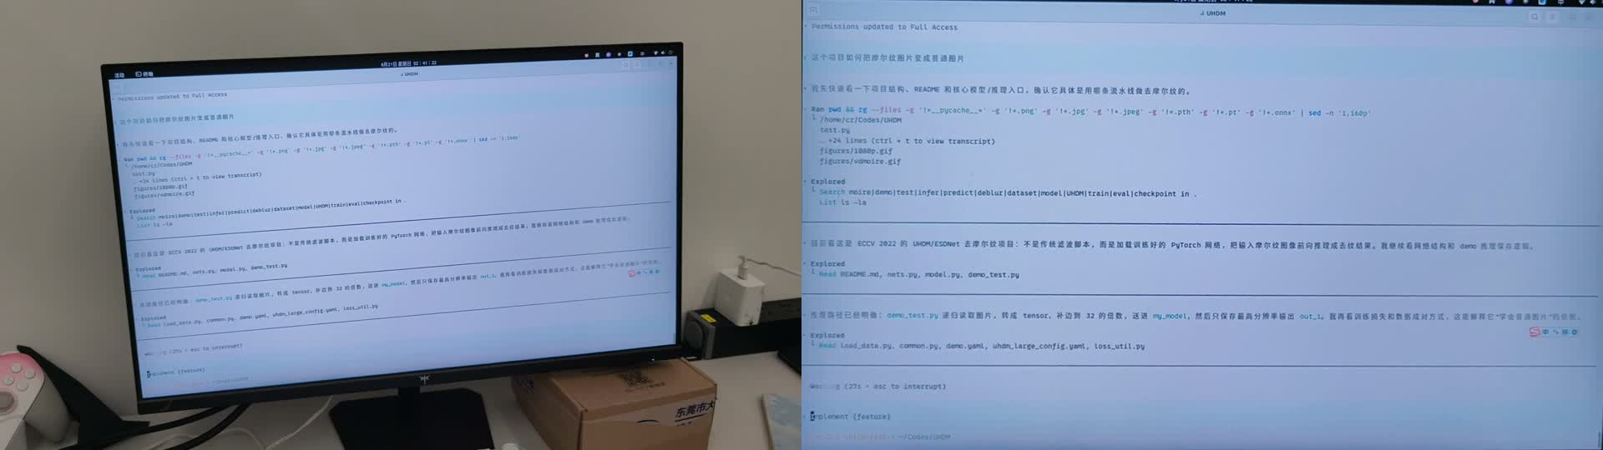
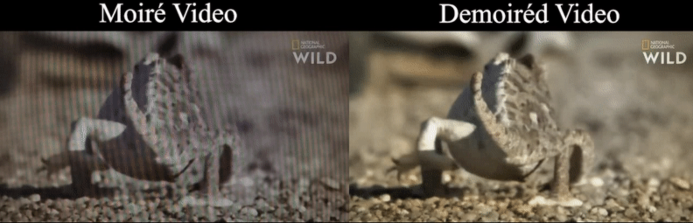
ECE4512 FINAL PROJECT PROPOSAL · 2026
Screen Capture Rectification and
Temporal Stabilization for
Real-world Captured-screen Videos
Rongshuo Wen 124020369 Bihua Wen 124090670
Mingrui Liu 124090375
Our stage: handheld capture → rectified screen
Motivation. Screen demoiréing and screen-image restoration show captured-screen content is a real image-processing problem — yet most datasets start after the screen is already cropped, aligned, or paired with a clean reference.
Real phone-captured video is far less controlled: background clutter, perspective tilt, hand-held shake, weak borders, glare, moiré, and dynamic on-screen content. We tackle this missing geometric preprocessing step.
Downstream enabled: video demoiréing on the stable output
This project is the geometry stage BEFORE restoration: locate, rectify, and stabilize the screen.
ECE4512 Final Project Proposal · 2026
1

Slide 2
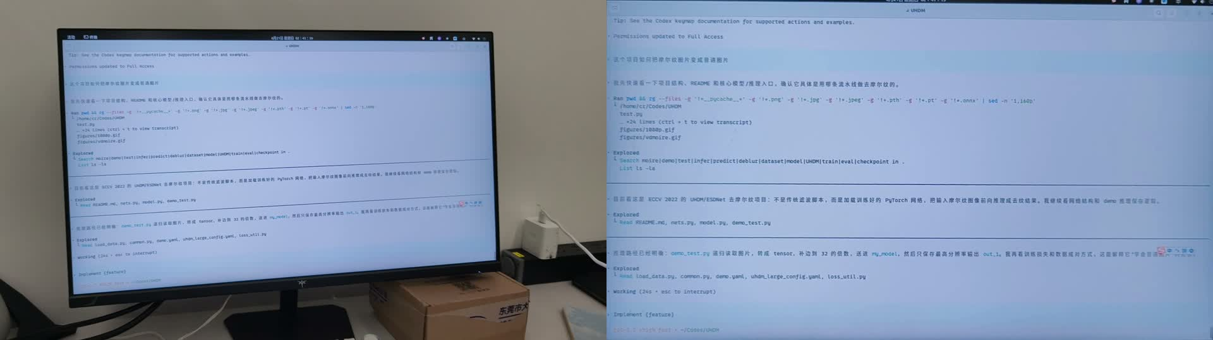
THE GAP WE FILL
Problem & Goal
The gap
▸ Downstream restoration assumes the screen is already cropped & aligned.
▸ Real handheld video has off-screen background, perspective tilt, and frame-to-frame jitter.
▸ Weak borders, glare and moiré make a single frame-by-frame detector unstable.
Goal. Continuously estimate the screen plane and render its content as a front-facing video that:
• suppresses non-screen background & perspective
• reduces hand-held jitter while keeping true content motion
• preserves physical aspect ratio (default 1920×1080)
Same frame: raw handheld input → rectified, stable screen output
ECE4512 Final Project Proposal · 2026
2

Slide 3
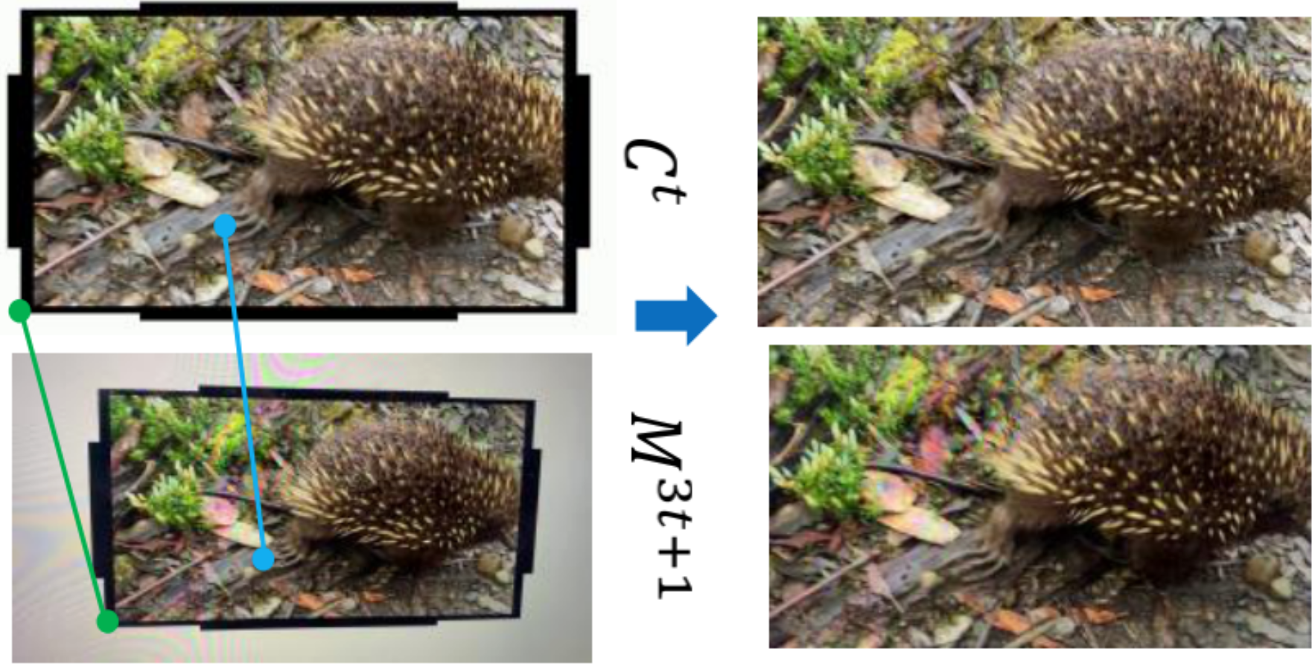
APPROACH OVERVIEW
Method — Geometric Pipeline
INPUT
STAGE 1
STAGE 2
STAGE 3
STAGE 4
OUTPUT
Handheld video
Init plane
Track features
Estimate Hₜ
Filter trajectory
Rectified screen
screen is one region in a full scene
detect / set four corners at t₀
LK tracks p₀ → pₜ on the t₀ plane
RANSAC screen-plane homography
gate, interpolate & smooth Hₜ
stable 16:9 video for later modules
Downstream after this stage: video demoiréing · OCR · archival · manual review
Real example: tilted frames → corners + homography → upright, plane-locked frames
ECE4512 Final Project Proposal · 2026
3

Slide 4
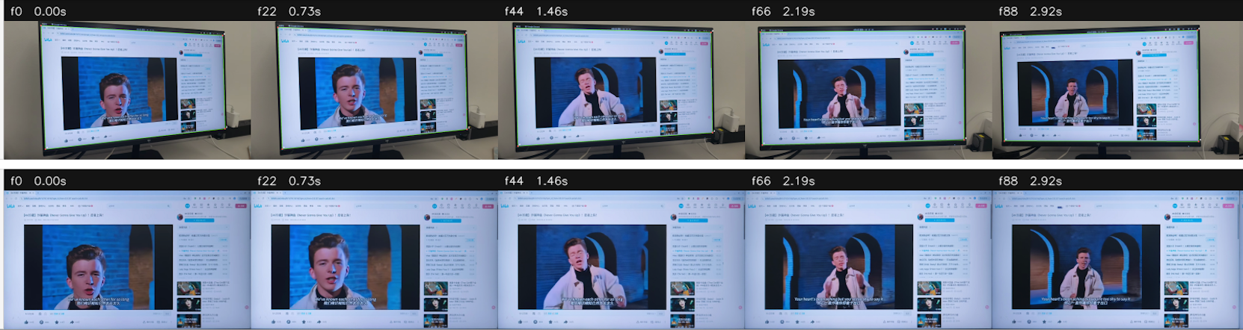
WHY IT STAYS STABLE
Method — Screen Motion vs. Content Motion
Core distinction: estimate the homography from the physical screen border, and treat motion inside the screen as content — not camera — motion.
1 · Border drives geometry
2 · Inner points = check only
3 · Robust fallback
• Edge filtering + LSD / Hough locate the four screen borders.
• The main homography is anchored to this physical boundary, not to texture inside the screen.
• Inner Lucas–Kanade points serve as a consistency signal.
• If inner motion conflicts with border motion under RANSAC, it is labelled screen-content motion and excluded from H estimation.
• Low border confidence, low inlier ratio, or an invalid quadrilateral triggers re-detection.
• If recovery fails, freeze the last valid Hₜ and flag invalid regions; corner trajectory is finally smoothed in time.
Normalized output over time (content moves, frame stays aligned)
Result: in-screen content changes over time, yet each frame stays rectified and plane-aligned — screen motion removed, content motion preserved.
ECE4512 Final Project Proposal · 2026
4

Slide 5
SELF-COLLECTED EVALUATION SET
Dataset & Experiment
5 scenario classes × 10 clips × ~5 s = 50 real captured-screen clips. Classes are designed around failure modes.
CLASS 1
CLASS 2
CLASS 3
CLASS 4
CLASS 5
Static page
Scrolling page
In-screen video
PPT / weak border
4K / moiré / glare
documents, browser UI, mostly fixed content
page motion, cursor, local UI changes
large dynamic regions inside the display
low texture, pale UI, unclear screen edges
hard cases linking to the restoration pipeline
10 clips × 5 s
10 clips × 5 s
10 clips × 5 s
10 clips × 5 s
10 clips × 5 s
Annotation. Selected key frames from each class are manually labelled with the four screen corners — connecting quantitative metrics to visual comparison, without requiring any downstream demoiréing model.
ECE4512 Final Project Proposal · 2026
5

Slide 6
WHAT WE MEASURE
Evaluation Metrics
1
Geometric accuracy
2
Temporal stability
3
Signal preservation
• Corner error on annotated key frames
• Quadrilateral IoU
• Aspect-ratio error
• Residual adjacent-frame translation (px)
• Residual rotation (deg) & scale change
• Reported as p95 of the normalized video
• Mean gradient magnitude on texture patches
• Edge-preservation index (same screen scale)
• 2D FFT grid orthogonality for moiré cases
Is the screen located & rectified correctly?
How much jitter remains after normalization?
Does rectification keep high-frequency detail?
These measures tie geometric correctness, video stability and signal preservation together — with no dependence on a downstream restoration model.
ECE4512 Final Project Proposal · 2026
6

Slide 7
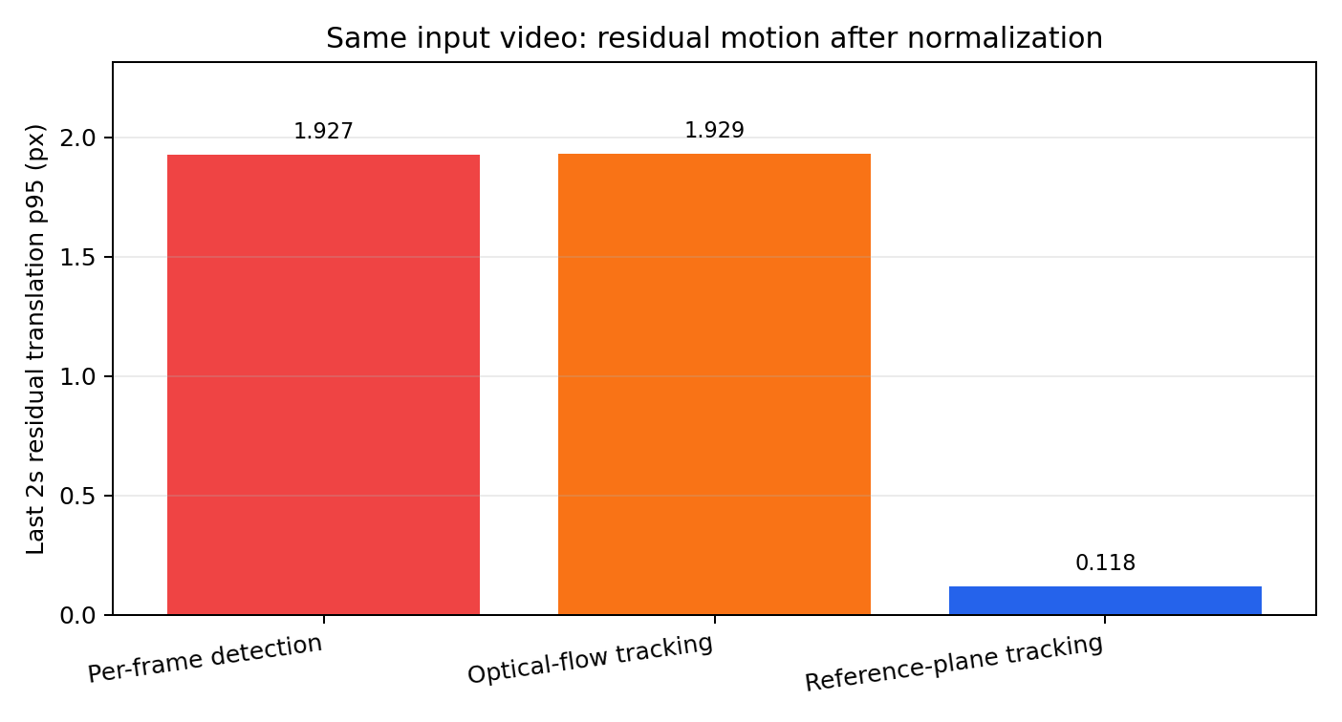
BORDER-GUIDED TRACKING WINS
Initial Results & Timeline
0.118 px residual jitter
Reference-plane (border-guided) tracking cuts residual motion ~16× vs. per-frame detection (1.927) and optical-flow tracking (1.929).
Final report will compare three strategies:
Per-frame detection — re-detects each frame — jittery
Optical-flow tracking — drifts with on-screen content
Same input video · residual translation p95 over the last 2 s (lower = steadier)
Border-guided (ours) — stable, content-aware
Timeline
Jun 22–24
Jun 25–30
Jul 1–7
Jul 8–12
Jul 13–15
Proposal & presentation
50-clip set + key-frame labels
Method ablation & metrics
Visual comparison & report
Code, samples, final talk
ECE4512 Final Project Proposal · 2026
7

