Slide 1
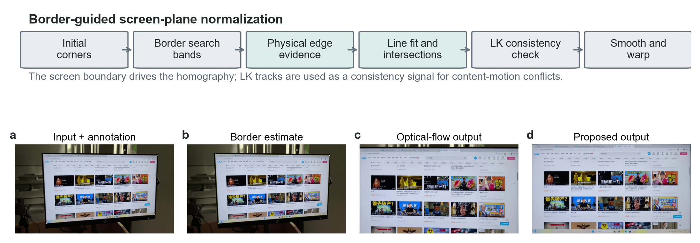
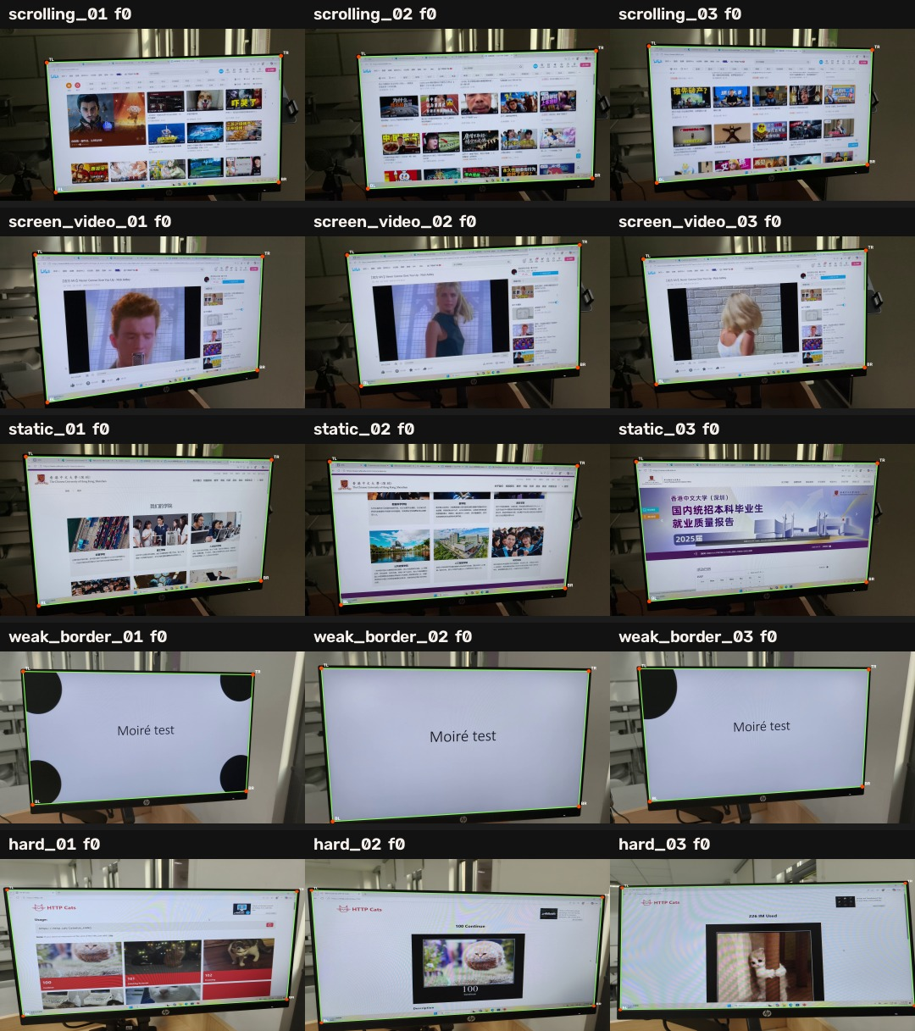
ECE4512 FINAL PROJECT · 2026
Border-Guided Geometric
Normalization of Captured-Screen Video
Physical screen boundaries as the primary homography cue
Rongshuo Wen 124020369 Bihua Wen 124090670
Mingrui Liu 124090375
Repository method figure: border-guided normalization
Core problem. Page scrolling, in-screen video, and camera motion are not the same motion.
We let the physical screen border directly determine the homography. Internal LK/RANSAC tracks are used only for consistency diagnostics, so true content motion is preserved while the screen plane remains stable.
Self-collected captures with manual corner annotations
ECE4512 Final Project · 2026
Source: figure_01_pipeline.png; annotated_dataset_mosaic.jpg
1
Notes:
[About 25 seconds] This project studies the geometric front end for captured-screen video. The input is a full handheld video containing background clutter, perspective distortion, camera shake, and dynamic content inside the display. The output is a stable, front-facing screen video. The key idea is to let the physical screen border determine the homography instead of allowing page scrolling or in-screen video to move the estimated screen plane.

Slide 2
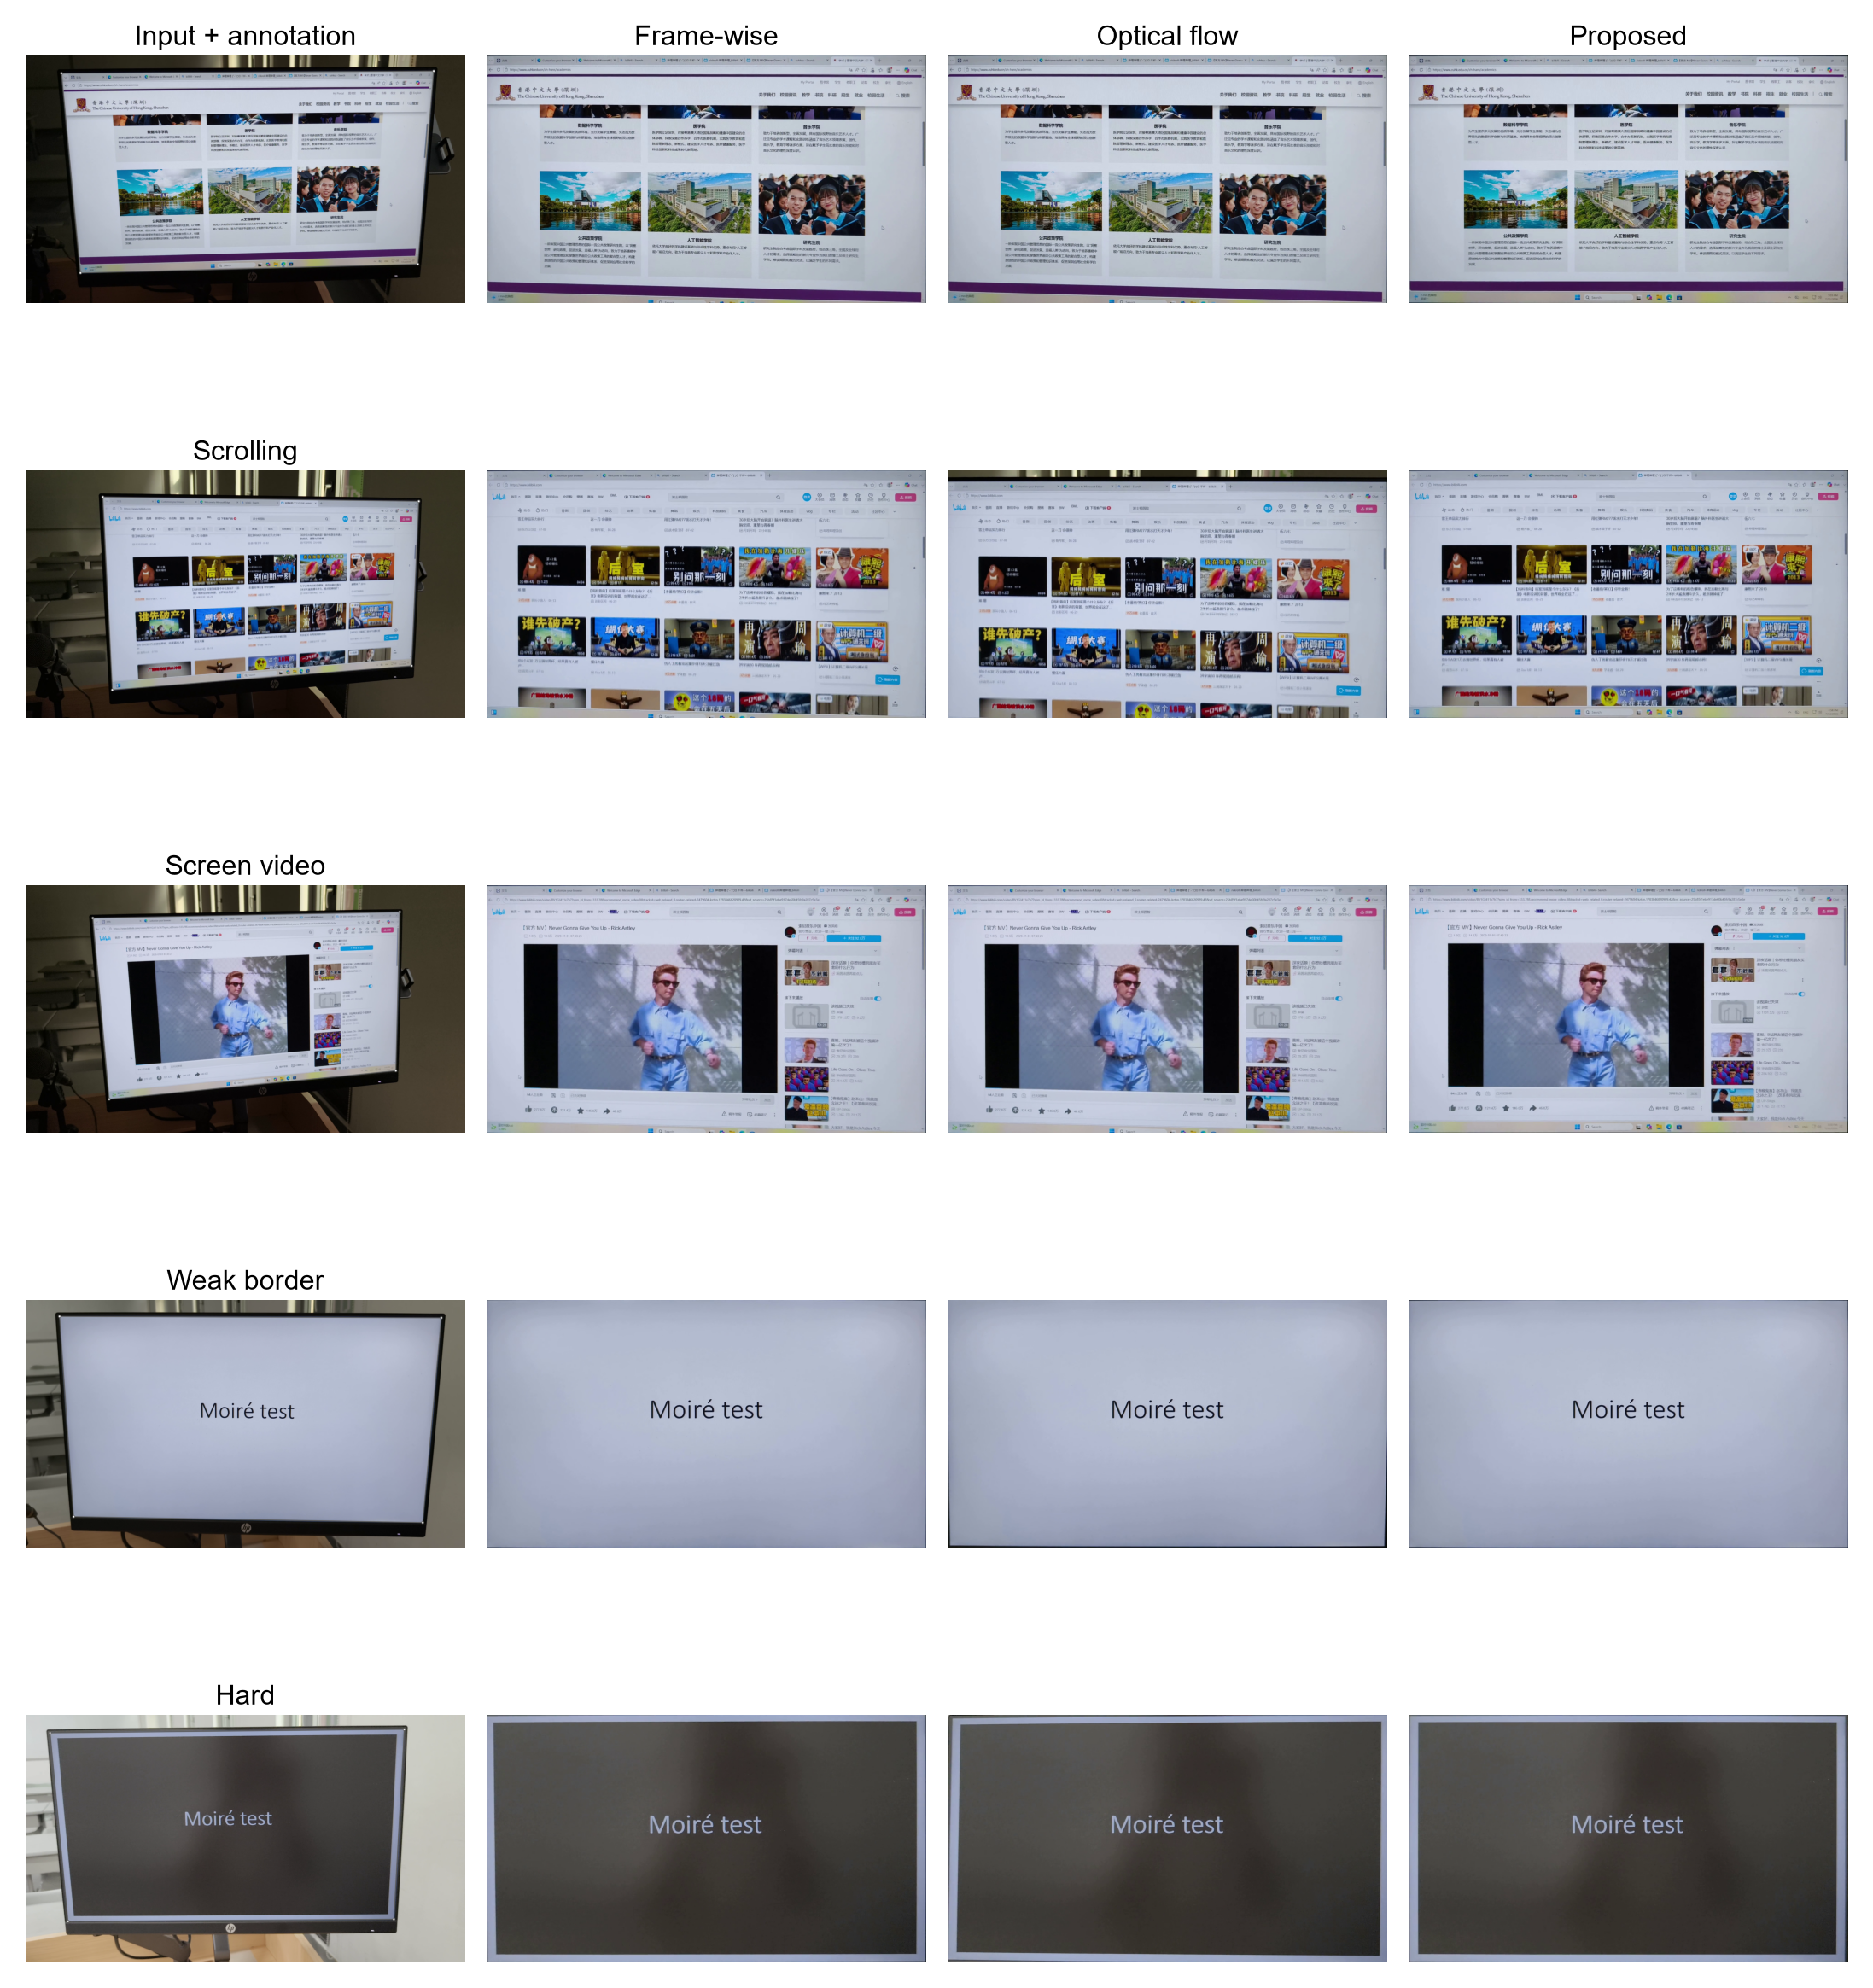
WHY BORDER EVIDENCE
The Core Problem: Content Motion ≠ Screen Motion
Frame-wise detection
Adjacent optical flow
Border-guided (ours)
Trusts the current frame
Trusts internal texture
Trusts the physical boundary
Detection noise → jitter
Weak borders → localization bias
Page scrolling → content-driven motion
Frame propagation → accumulated drift
Border defines the quadrilateral
Internal flow is diagnostic only
Same moment on a scrolling page: input + three methods
Check whether the full screen is preserved, the border drifts, and the scrolling content remains intact.
ECE4512 Final Project · 2026
Source: project outline; figure_05_qualitative.png
2
Notes:
[About 45 seconds] The problem is not merely cropping the image into a rectangle; it is separating screen motion from content motion. Frame-wise detection trusts each current frame, so weak borders cause localization bias and jitter. Adjacent-frame optical flow trusts internal texture, so page scrolling can be mistaken for screen motion and accumulate drift. Our method prioritizes the physical screen boundary. The comparison below shows the same scrolling moment: we must check the complete screen extent, border stability, and whether true scrolling is retained.

Slide 3
METHOD
The Current Border-Guided Pipeline
01
Physical borders define H
02
LK/RANSAC is diagnostic
03
Gating, redetection, smoothing
Sample profiles near predicted borders, fit four lines, and intersect them.
Detect internal-motion conflict without letting scrolling content control the plane.
Reject invalid quadrilaterals, redetect when needed, and smooth the final trajectory.
ECE4512 Final Project · 2026
Source: figure_01_pipeline.png
3
Notes:
[About 55 seconds] The pipeline begins with four-corner initialization on the first frame. The previous quadrilateral predicts local search bands for all four sides. We sample gradient profiles along inward normals, select strong candidates close to each predicted border, and robustly fit four lines. Their intersections form the current quadrilateral, which is checked for convexity, side geometry, and plausible frame-to-frame change. LK/RANSAC only diagnoses disagreement between internal texture and border motion. If the border is valid, the physical boundary still wins. Finally, the trajectory is interpolated, smoothed, and warped to a fixed canvas.

Slide 4
EVALUATION
Dataset & Experimental Setup
50
14,985
10
self-collected clips
total frames
annotated evaluation clips
Five capture conditions
CLASS 1
CLASS 2
CLASS 3
CLASS 4
CLASS 5
Static page
Scrolling
In-screen video
Weak border
Challenging
Fair comparison. All three methods share the same input, initialization, canvas, annotations, and metric code.
Geometry excludes initialization frame 0. We take medians within each clip, then aggregate across clips.
Repository dataset mosaic; green quadrilaterals mark manual screen boundaries.
ECE4512 Final Project · 2026
Source: project outline; annotated_dataset_mosaic.jpg
4
Notes:
[About 40 seconds] The complete dataset contains fifty self-collected captured-screen videos and 14,985 frames, with ten clips in each of five capture conditions. The current formal quantitative evaluation uses ten annotated clips, two per condition. All methods share the same input, first-frame initialization, output canvas, corner annotations, and metric implementation. Geometry excludes frame zero; metrics are summarized by the median within each clip and then by the median across clips.

Slide 5
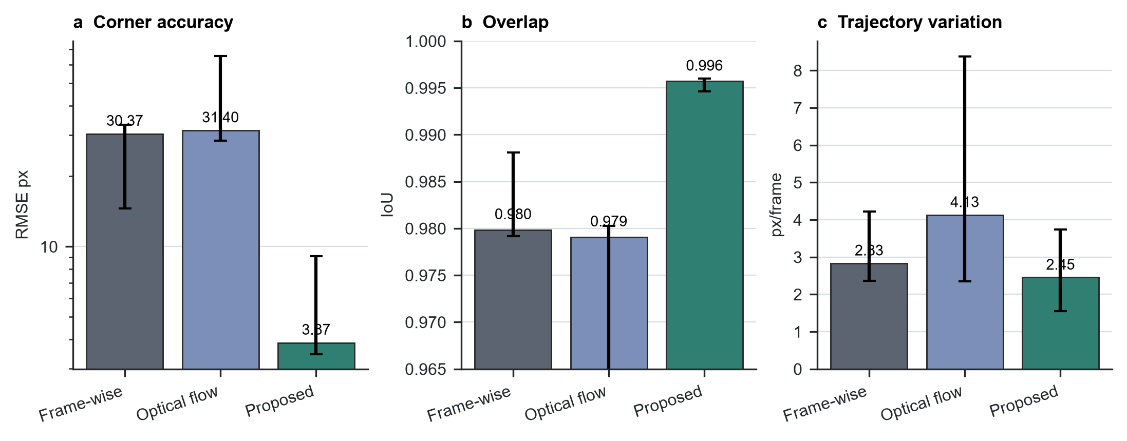
MAIN RESULTS
Overall Results: More Accurate and More Stable
3.87 px
Corner RMSE
LOWEST
0.996
Quadrilateral IoU
HIGHEST
2.45
px/frame translation variation
LOWEST
TAKEAWAY
The result is not merely smoother—the estimated quadrilateral is also much closer to the annotation.
ECE4512 Final Project · 2026
Source: figure_02_overall_results.png
5
Notes:
[About 55 seconds] These three metrics come directly from the repository's overall-results figure. The border-guided method reaches a corner RMSE of 3.87 pixels, compared with 30.37 for frame-wise detection and 31.40 for optical flow. IoU rises to 0.996, while translation variation falls to 2.45 pixels per frame. Crucially, this is not superficial stability created by freezing the trajectory. Geometry and temporal stability improve together, supporting the physical screen border as a better primary homography cue than internal content motion.

Slide 6
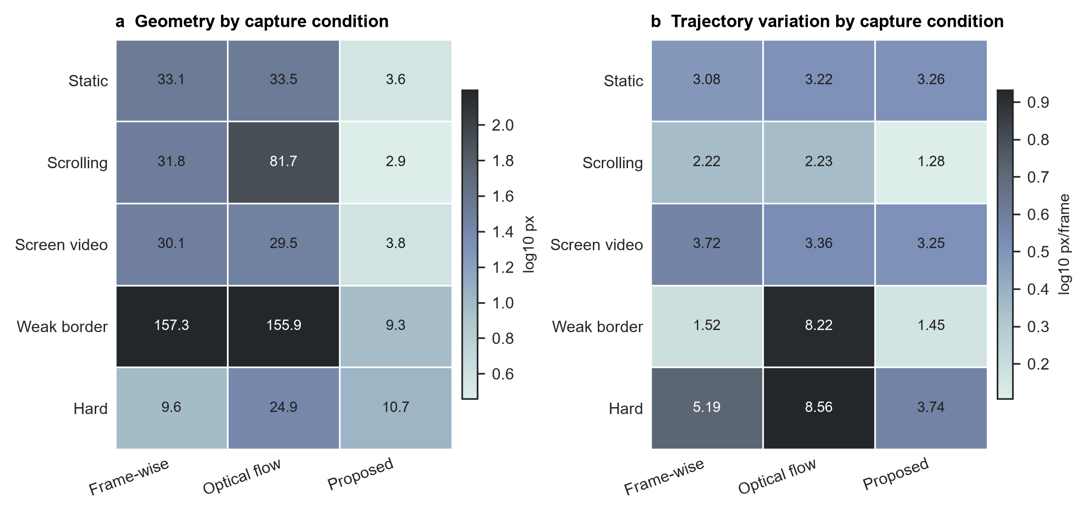
WHERE IT HELPS
Largest Gains on Scrolling and Weak-Border Scenes
SCROLLING PAGE
RMSE 2.87 px
Frame-wise 31.76 · Flow 81.67
WEAK BORDER
RMSE 9.35 px
Both comparison methods >155 px
CHALLENGING SCENES REMAIN A LIMIT
Geometry is slightly worse than frame-wise detection, but translation variation is 3.74 versus 5.19 / 8.56.
ECE4512 Final Project · 2026
Source: figure_03_category_results.png
6
Notes:
[About 50 seconds] The category results show where the improvement comes from. On scrolling pages, optical flow follows the moving content and RMSE rises to 81.67 pixels. The border-guided method stays on the physical screen and reaches 2.87 pixels. In weak-border scenes, the local search band predicted from the previous frame is far more stable than independent full-frame detection: our RMSE is 9.35, while both comparison methods exceed 155. Challenging scenes remain the main limitation. Frame-wise detection has slightly lower geometry error there, but our trajectory is still more stable, so future work should focus on glare, occlusion, and very low contrast.

Slide 7
ABLATION
Filtering Adds Stability; Other Modules Form a Safety Net
Variant | RMSE ↓ | IoU ↑ | Translation ↓
Full method: Profile border | 3.253 | 0.996038 | 0.752
No trajectory smoothing | 2.932 | 0.996585 | 1.430
No LK consistency diagnostic | 3.253 | 0.996038 | 0.752
No redetection fallback | 3.253 | 0.996038 | 0.752
Loose edge gates | 3.253 | 0.996038 | 0.752
0.752 → 1.430
Translation variation nearly doubles without smoothing
Trade-off: sparse-frame RMSE improves slightly, but frame-to-frame jitter increases.
LK / REDETECTION / GATING
No metric change on this scrolling clip
Profile border evidence succeeds on every frame here. These modules mainly handle abnormal detection and recovery rather than normal-frame estimation.
All values are transcribed directly from the repository's Proposal Border Ablation document.
ECE4512 Final Project · 2026
Source: proposal_border_ablation_2026-07-14.md
7
Notes:
[About 55 seconds] This ablation uses a representative scrolling clip. The full method reaches an RMSE of 3.253 and translation variation of 0.752. Without trajectory smoothing, RMSE on sparse annotated frames improves slightly to 2.932, but translation variation rises to 1.430, almost doubling. This shows that smoothing primarily improves temporal stability rather than single-frame accuracy. Removing the LK diagnostic, redetection, or edge gating does not change this clip because Profile border evidence succeeds on every frame. These components are a safety net for abnormal cases and do not interfere with the normal main chain.

Slide 8
LIMITS & TAKEAWAY
Boundary Evidence Is Still the Limitation—but the Conclusion Is Clear
MAIN LIMITATIONS
FINAL CONCLUSION
• Weak edges / very low contrast: true gradients fade and background texture may become the stronger candidate
• Strong glare / occlusion: false gradients can shift a fitted line or trigger redetection and hold
The physical screen border is a better primary cue for the screen plane than independent frame detection or internal-content optical flow.
NEXT STEPS
01
Multi-cue boundary fusion
02
Per-edge confidence
03
Stronger failure recovery
Combine profiles, long line segments, color differences, and rectangular constraints.
Estimate confidence for each side and complete low-confidence edges across frames.
Actively reinitialize after repeated failures and expand glare/occlusion annotations.
3.87 px RMSE · 0.996 IoU · 2.45 px/frame
ECE4512 Final Project · 2026
Source: project outline §§4–5
8
Notes:
[About 35 seconds] The current method still depends on a visible and distinguishable screen boundary. Very low contrast, strong glare, and occlusion can weaken the true gradient and create stronger false edges. Future work should fuse multiple boundary cues, estimate confidence for each side, and actively reinitialize after consecutive failures. However, the experimental conclusion is already clear: allowing the physical screen border to drive the homography improves both geometric accuracy and temporal stability. This brings the full presentation to approximately six minutes.

