Slide 1

SCIENCE 4
QUARTER 3 WEEK 4
Learning Competency 1: The learners measure accurately the distance and time when things move using simple equipment.
Learning Competency 2: The learners identify that how far an object moves in a given time is called speed.

Slide 2

DAY 1

Slide 3
Show & Tell: Show the class several pictures of students doing daily tasks like sweeping the floor, wiping the table, arranging the chairs, picking up trash, and other chores. Ask them how these pictures show the previous lesson learned about forces.

Slide 4
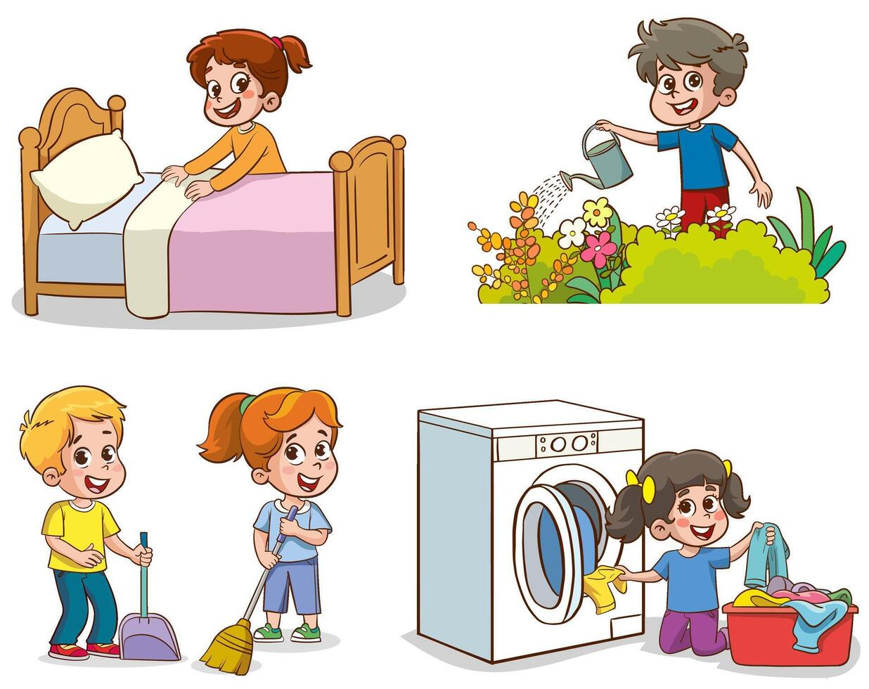
How is force applied in these household chores?

Slide 5
Picture Analysis
Show a picture of a 100-m dash. Tell them to examine the picture carefully. Ask them the following questions:
i. Who do you think will win in this race? Why?
ii. How do we determine the winner?
iii. Have you tried participating in a 100-m dash or similar races?
iv. When can we say that a person runs fast?
v. Why is understanding the concept of speed important in sports like track and field?

Slide 6
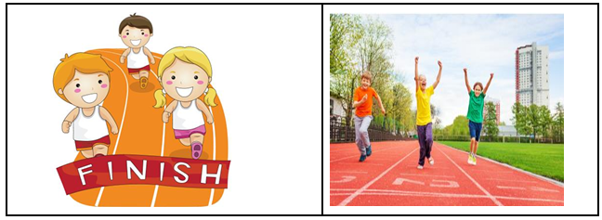

Slide 7
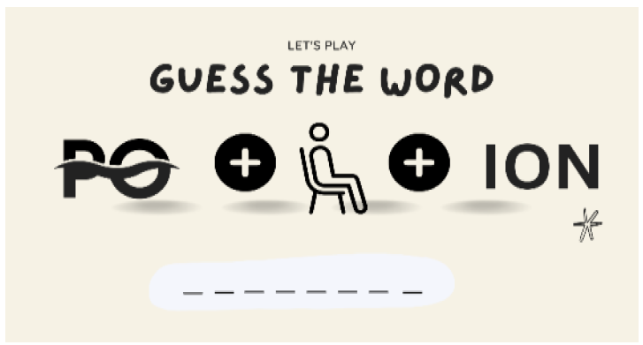
Guess the Word:
Tell the students that they will be given sets of pictures that can reveal the terms to unlock.
POSITION

Slide 8
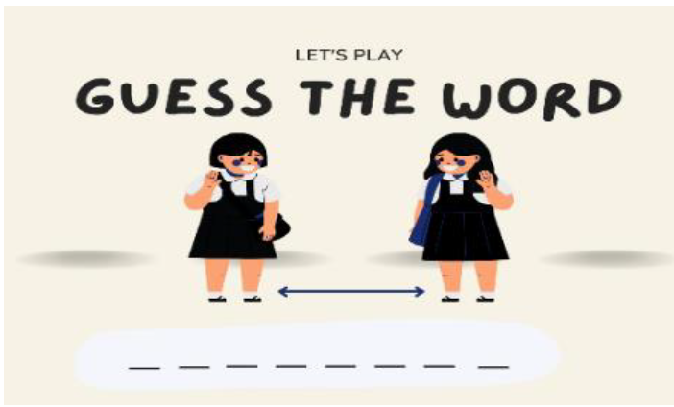
DISTANCE

Slide 9

TIME

Slide 10
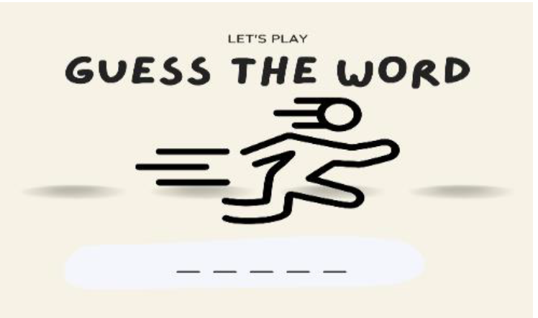
SPEED

Slide 11
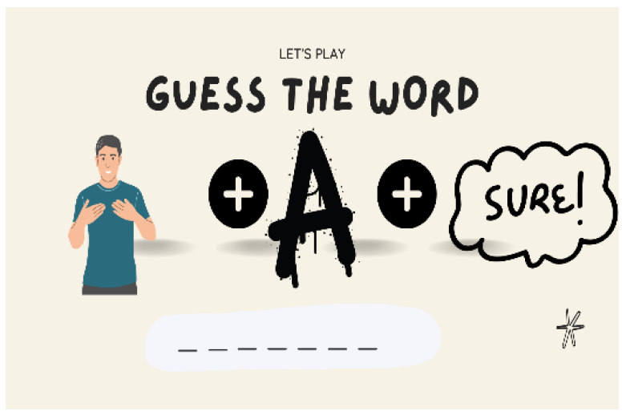
MEASURE

Slide 12
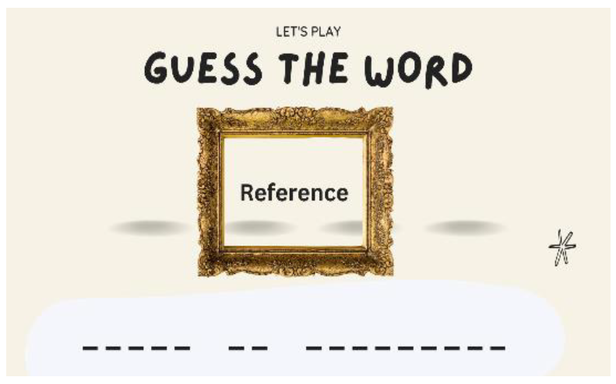
Frame of Reference

Slide 13
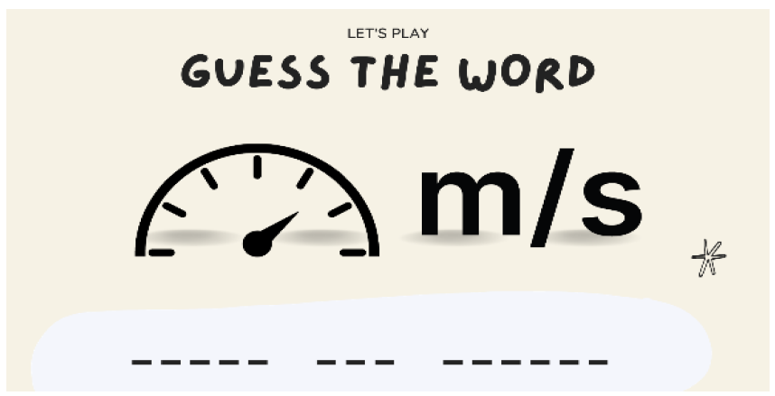
Meters per second (m/s)

Slide 14
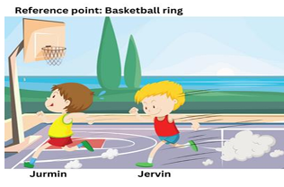
a. Situation Analysis: Who wins?
Jurmin and Jervin are classmates and decided to race from one end of the basketball court at their school to the other end. Jurmin reached the other end in 10 seconds, while Jervin took 12 seconds. Who won?

Slide 15
Motion is defined as the change in position from a reference point.

Slide 16
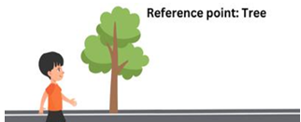
1. What is a reference point in the context of motion?

Slide 17
A reference point is a stationary object or place that is used to determine if an object has moved or not. It can also be the starting point or origin for measuring motion.

Slide 18
2. Why is it important to have a reference point when describing the motion of an object?

Slide 19
When describing the motion of an object, it is important to have a reference point to have a basis for the change in the object’s position.
For example, in the picture at the right, the boy’s motion can be observed clearly because of his change in position relative to the tree, our reference point in this situation.

Slide 20
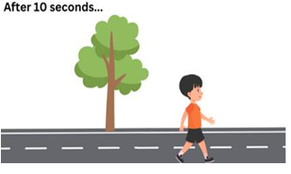

Slide 21
3. How do we select a suitable reference point for describing the motion of an object?
We select a suitable reference point for describing an object’s motion by choosing an object in the environment that is fixed on the ground or that is stationary and does not
move.

Slide 22
4. Can you think of examples where different reference points might be chosen to describe the same motion?
Examples of reference points include a tree, a sign, or a building.

Slide 23
The motion of a person or an object can be described using the concepts of distance, time, and speed.

Slide 24
● Distance is a measure of how far two points are from each other. It can be measured using a ruler, a meter stick, or a tape measure.
● Time is a measure of the duration of an event taking place. It can be measured with a watch.
● Speed is a measure of how fast an object moves.

Slide 25
How do you compute speed?
Follow the following steps below:
1. Determine the Distance (d): Measure the total path length covered by the object. This could be the length of a racetrack, the distance a car travels, or any other relevant measurement. Use appropriate units such as meters (m) or kilometers (km).

Slide 26
2. Determine the Time (t): Measure the duration it takes for the object to cover the specified distance. Use a stopwatch, timer, or any other time-keeping device. Time is typically measured in seconds (s), minutes (min), or hours (h).

Slide 27
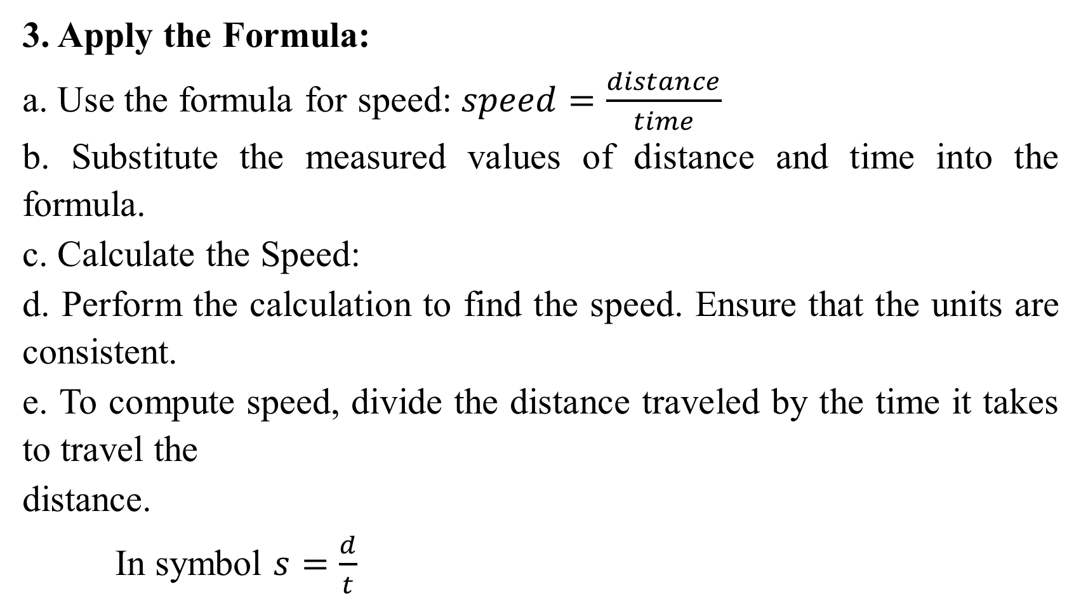
3. Apply the Formula:
a. Use the formula for speed: $speed=\frac{distance}{time}$
b. Substitute the measured values of distance and time into the formula.
c. Calculate the Speed:
d. Perform the calculation to find the speed. Ensure that the units are consistent.
e. To compute speed, divide the distance traveled by the time it takes to travel the
distance.
In symbol $s=\frac{d}{t}$

Slide 28
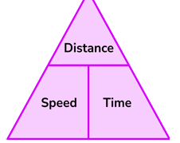
To easily remember the speed formula, we present it using the triangle at the right. On the triangle's base, in the bottom left, we put speed and time in the bottom right, while in the upper corner, we put distance.

Slide 29
4. Expressing the Result:
Report the calculated speed in the appropriate units. Common units for speed include meters per second (m/s) or kilometers per hour (km/h), depending on the context. Additionally, in real-world scenarios, choosing an appropriate reference point and a coordinate system is crucial when measuring distance and time, especially for moving objects. The choice of reference point can affect how speed is perceived and measured.

Slide 30
Discuss how real-life situations, such as cars on the road or athletes running a race, use speed to make decisions.
How does the concept of speed affect our decisions in daily life?

Slide 31
Ask students to reflect on and generalize how they might encounter speed in their daily lives, from walking to school to watching cars on the road.

Slide 32
Ask students to write down one thing they learned about speed and one question they still have.

Slide 33
DAY 2

Slide 34
Ask students about their experiences with motion.
Prompt them with questions:
"What happens when you walk faster?"
"Have you ever raced someone?
What did you notice about speed?"

Slide 35
Video viewing (5 minutes)
Show the YouTube video titled “What is Speed? | Science for Kids”
Guide questions:
a. What new information or lesson have you learned from the video?
b. What happens to speed if the distance increases?"
"If an object moves the same distance in less time, what happens to its speed?"

Slide 36
Definitions:
1. Position - a place or point where something or someone is located or has been placed in relation to other things
2. Distance - describes the length of the path traveled by a person or object from the initial position to the final position; describes how far a moving object or person has traveled
3. Time - is the duration of an event

Slide 37
Definitions:
4. Speed - describes how fast or slow an object or person has traveled
5. Measure - quantifying the length, width, and many more quantities
6. Frame of Reference - a set of coordinates that can be used to determine the position and motion of an object.
7. Meters per second (m/s) - A common unit for measuring speed in the International System of Units (SI).

Slide 38
Worked Example
Steps to solve word problems:
1. Read and understand the problem.
2. Identify what is known (given values) and unknown (what is asked).
3. Determine the formula to use in computing the unknown.
4. Substitute the given values in the formula.
5. Write the final answer with the correct unit of measure.

Slide 39
Problem-solving: Motion Problems
Let’s answer the sample problem below.
1. A female Palarong Pambansa sprinter from Negros Oriental finished the 100-m dash competition in 10 seconds. What was her speed?

Slide 40
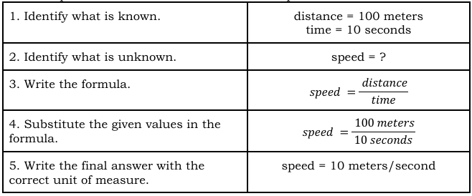

Slide 41
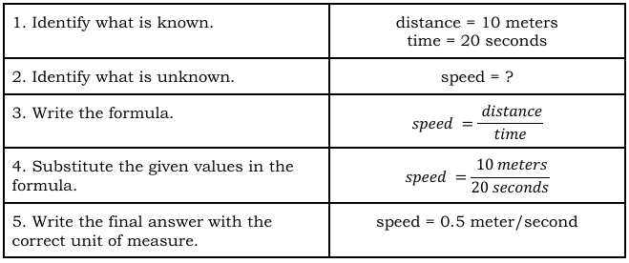
2. Recess time is almost over, so a Grade 4 pupil walks fast from the canteen to her classroom for 20 seconds. Her classroom is 10 meters from the canteen.
How fast did she walk?

Slide 42
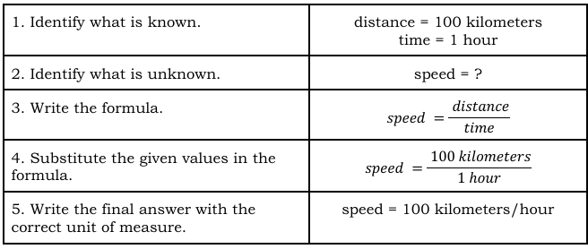
Lesson Activity (25-30 minutes)
a. Problem-solving: Motion Problems
Let’s answer the sample problems below:
1. The Philippine eagle is the national bird of the Philippines. If it can travel 100 kilometers in one hour, what is its speed?

Slide 43
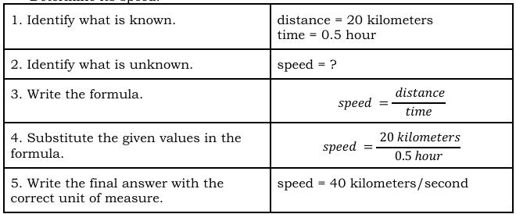
2. The Philippine tarsier is famous for being the smallest monkey in the world. These tiny creatures like to stay high up in the trees and jump from branch to branch in the jungle. They can travel 20 kilometers in 0.5 hour. Determine its speed.

Slide 44
Summarize key points:
• Speed can be calculated by dividing distance by time.
• If the distance increases, speed increases if the time stays the same.

Slide 45
Ask students to solve a similar problem on their own:
"A car travels 200 meters in 20 seconds. What is its speed?“
Allow time for independent practice and provide feedback.

Slide 46
DAY 3

Slide 47
Briefly review the concepts of motion, speed, and distance with the students.

Slide 48
Explain the activity's objective: to conduct a race using toy cars and determine which one is the winner based on their speed. For this activity, you will need toy cars for each group to explore speed. Ensure each group has the same type or model of toy car. You may ask each group to bring one battery-powered or pullback toy car. If there are no available toy cars, you may use a ball or any other toys that can be moved. Since this involves a race/contest, please always establish rules on honesty and safety.

Slide 49
Vocabulary focus:
Speed, Distance, Time, Formula, Unit of Measure

Slide 50
Activity 1: Who Wins the Race? (20 minutes)
Instructions: In groups with five members, students conduct a racing activity to determine which toy car is the fastest.
Assign the members of the groups a role to play:

Slide 51
Leader | Responsible for overseeing the cooperation of the group members.
Timer | In charge of measuring the time it takes for the toy car to complete the race using a stopwatch or timer.
Recorder | Takes notes and records the toy car’s distance and time of travel.
Toy car in-charge | Responsible for handling and releasing the toy cars at the starting line.
Racetrack in-charge | Responsible for checking the group’s racetrack, ensuring that marks at the starting and finishing points are clear.

Slide 52
Set up the racetrack using markers on the classroom floor or the corridor. Let the racetrack in-charge assist you in measuring and marking the tracks.
Ask the other students to observe. Recall their Grade 2 math lesson on measuring distances.

Slide 53
Group Preparation:
• Assign roles within each group (e.g., one student measures distance, one operates the stopwatch, etc.).
• Have each group inspect and test their toy car to ensure fair competition.
Race Set-up:
● Line up all the groups at the starting line.
● Explain any specific rules, such as staying within the designated track.

Slide 54
Guide Questions During the Race:
● How will you measure the distance covered by your toy car?
● What factors might affect the speed of your toy car?
● How will you ensure a fair and accurate race?

Slide 55
Race Execution:
● Start the race, and have each group complete the course.
● Ensure that each group measures the distance their toy car traveled.
● In conducting the race, ask everyone to get ready to perform their assigned roles. Ask the toy car in charge to position itself at the starting point. When all of them are ready, give them a go signal for them to release their toy cars at the same time. Depending on the type of toy car, everyone must agree on what is allowed to make it move. At this point, the timers should start recording the time and stop when the toy car reaches the finish line. The recorders then record their data. Do two more trials. Then, ask them to return to their seats to reflect on what they just did and answer the process questions.

Slide 56
Group Reflection:
● Have each group discuss their strategies, challenges faced, and how they optimized the performance of their toy car.
● Discuss the relationship between speed, time, and distance.

Slide 57
Results and Awards:
● Announce the winners based on the fastest time or farthest distance.
● Consider giving awards for creativity, teamwork, or innovative strategies.
Closure:
● Conclude the activity by discussing the importance of understanding motion and the practical applications of these concepts in real life.

Slide 58
Process questions:
1. Which toy car has the shortest travel time?
2. Who wins the race? Why?
3. Why is it important to have accurate measurements when describing motion?

Slide 59
During the race, observe each student's involvement in their assigned role.
Were they actively engaged in the task, demonstrating teamwork and cooperation?
Did the group follow the roles assigned (Leader, Timer, Recorder, Toy Car In-Charge, and Racetrack In-Charge)?

Slide 60
DAY 4

Slide 61
Review the concept of speed from the previous lesson.
"How do you think speed changes when you walk faster or slower?"

Slide 62
Emphasize safety as they conduct the walking activity.
Ask the student to remain close by and watch how other members perform the activity.

Slide 63
Vocabulary focus: Fast, Slow, Time, Distance
Use these terms in sentences to reinforce understanding:
"The faster you walk, the shorter the time it takes to cover a distance.”

Slide 64
Remind students:
"Speed can be determined by dividing the distance traveled by the time taken to travel that distance. In today’s activity, we will use this concept to find out who is the fastest in each group."

Slide 65
Discuss how different paces (normal, slower, faster) will result in different travel times and speeds.

Slide 66
Activity 2: Who is the fastest? (25 minutes)
Instructions:
In groups with five members, students conduct a walking activity to determine how fast or slow each walk is and who walks fastest in the group.

Slide 67
Instruct the students to follow the following procedure:
1. Go to the corridor or the nearest area to your room that is clear and safe for this walking activity.
2. Using the meter stick, measure 10 meters. Use chalk or any marker to indicate the starting and ending points with a line.
3. Let each member walk at a normal pace (not fast nor slow) along the path from the starting to the ending points. Ask another member to record the time taken to walk 10 meters.
4. Let each member do two more trials by walking slower and faster than the first.
5. Compute the fastest speed of each member by dividing the distance traveled by the shortest time of travel.

Slide 68
Process questions:
1. What happened to your travel time when you walked slower? faster?
2. Who walked fastest in your group? What is the basis for concluding that he
or she is the fastest in your group?
3. Is it safe when you move fast? Why?

Slide 69
Multiple Choice. Carefully read the questions below. Choose the correct answer from the choices below each question. Encircle the letter corresponding to the correct answer.
1. Which tool is best suited to precisely measure the distance traveled by a moving object?
A. calculator
B. clock
C. meter stick
D. stopwatch

Slide 70
2. Which of the following measures how far two points are from each other?
A. distance
B. graph
C. speed
D. Time
3. The measure of the duration of an event taking place is called:
A. distance
B. graph
C. speed
D. time

Slide 71
4. What is its speed if a bird flies 100 meters (m) in 50 seconds (s)?
A. 2 m/s C. 10 m/s
B. 5 m/s D. 50 m/s
5. Kath walks to the canteen that is 10 meters (m) away from her classroom for 10 seconds (s). What is her speed?
A. 1 m/s C. 5 m/s
B. 2 m/s D. 10 m/s

Slide 72
DAY 5

Slide 73
Briefly discuss the walking activity from the previous lesson to help students recall how speed is calculated. Ask,
"What did we observe when we changed our walking pace?"

Slide 74
The students will create a concept map to summarize their learnings on describing motion.
The students, at this point, will reflect on their learning by answering Reflecting on Bright Ideas. This will allow them to map the ideas or words that they were not sure about, key concepts that were new to them, and the important things to remember.

Slide 75
Review key terms:
Motion, Speed, Distance, Time, Pace, Measurement, Accuracy.

Slide 76
Present the core idea:
"Describing motion requires understanding how speed is affected by time and distance."

Slide 77
Introduce the importance of summarizing information and reflecting on what has been learned to reinforce understanding.

Slide 78
Concept Mapping (15 minutes)
Make a concept map about how motion is described in this lesson. Do this lesson map with the students to summarize the lesson.

Slide 79
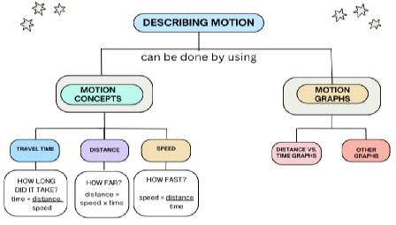

Slide 80
Reflection on Learning (10 minutes)
Using the provided template, ask the students to reflect on bright ideas. In the light bulb image, they will write 2 – 3 things in this lesson that were new to them, 1 important thing to remember, and 4 ideas or words that they’re not sure about.

Slide 81
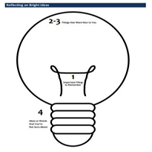
Note: Reflecting on Bright Ideas (Reflecting on Bright Ideas, 2013)

Slide 82
Essay. Read carefully the situation below. Answer the given question based on the rubric. Observe proper punctuation, capitalization, and spelling.

Slide 83
In speed contests, like a 100-meter sprint race, athletes do their best to speed up and win the contest. Sometimes, the difference is only a matter of few milliseconds. In these events, why is it important to have accurate measurements when describing motion?

Slide 84
Excellent (4) | The answer is clear, easy to read, and covers the topic well. (5 points)
Proficient (3) | The answer is mostly clear but may have some confusing parts. (4 points)
Satisfactory (2) | The answer is hard to understand and lacks detail. (3 points)
Developing (1) | The answer is difficult to read or doesn't address the topic. (2 points)
Beginning (0) | No attempt to answer (0 points)

