Slide 1


Data Analysis for Market Research
Helping the sales team

Slide 2
1º: Predicting Customer Preferences
Sales Team asks if we can predict the preferred brand of computer for each customer, based on its demographic data and a survey.
Solution: Classification algorithms (Random Forest, Stochastic Gradient Boosting,…)
Conclusion: Yes, we may expect very high accuracy.

Slide 3
2º: Sales Prediction Report
Sales Team asks if we can predict volume of sales based on past information (product attributes).
Solution: Multilinear Models.
Conclusions: Reviews and service reviews have great impact.

Slide 4
3º: Discover Associations
Sales Team asks for finding trends and buying patterns in Electronidex clientele.
Further evaluation: Should Blackwell Electronics acquire Electronidex?
Solution: Market Basket Analysis.

Slide 5
Statement:
We consider we may NOT have enough data to recommend acquiring Electronidex.

Slide 6
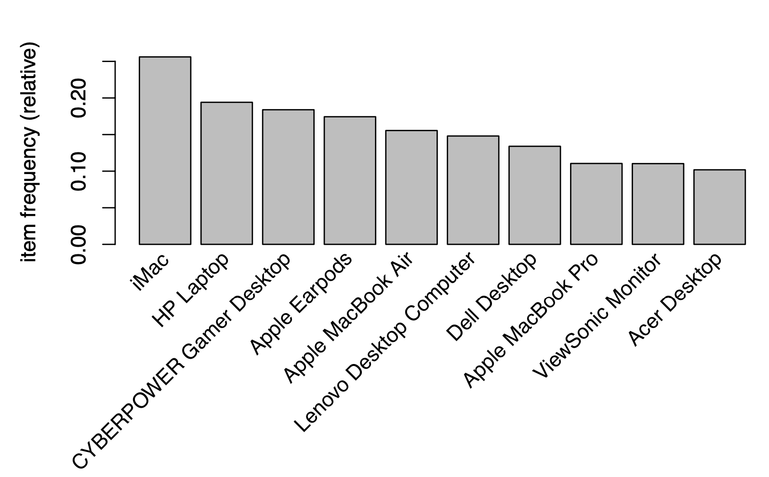
Pros
1. We lack online store in South region
2. Some similarities in the product portfolio
Computers, accessories, displays…

Slide 7
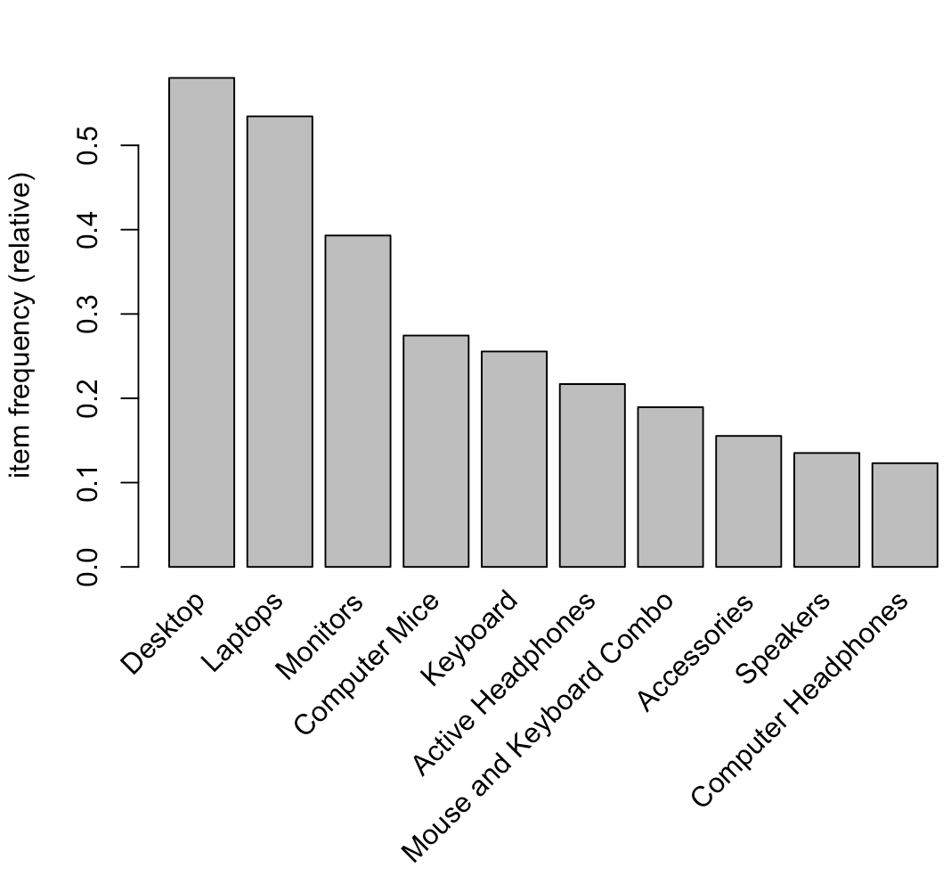
Pros

Slide 8
Pros
3. Some interesting insights in customers patterns
iMac is the top notch sale, 25% of frequency.

Slide 9
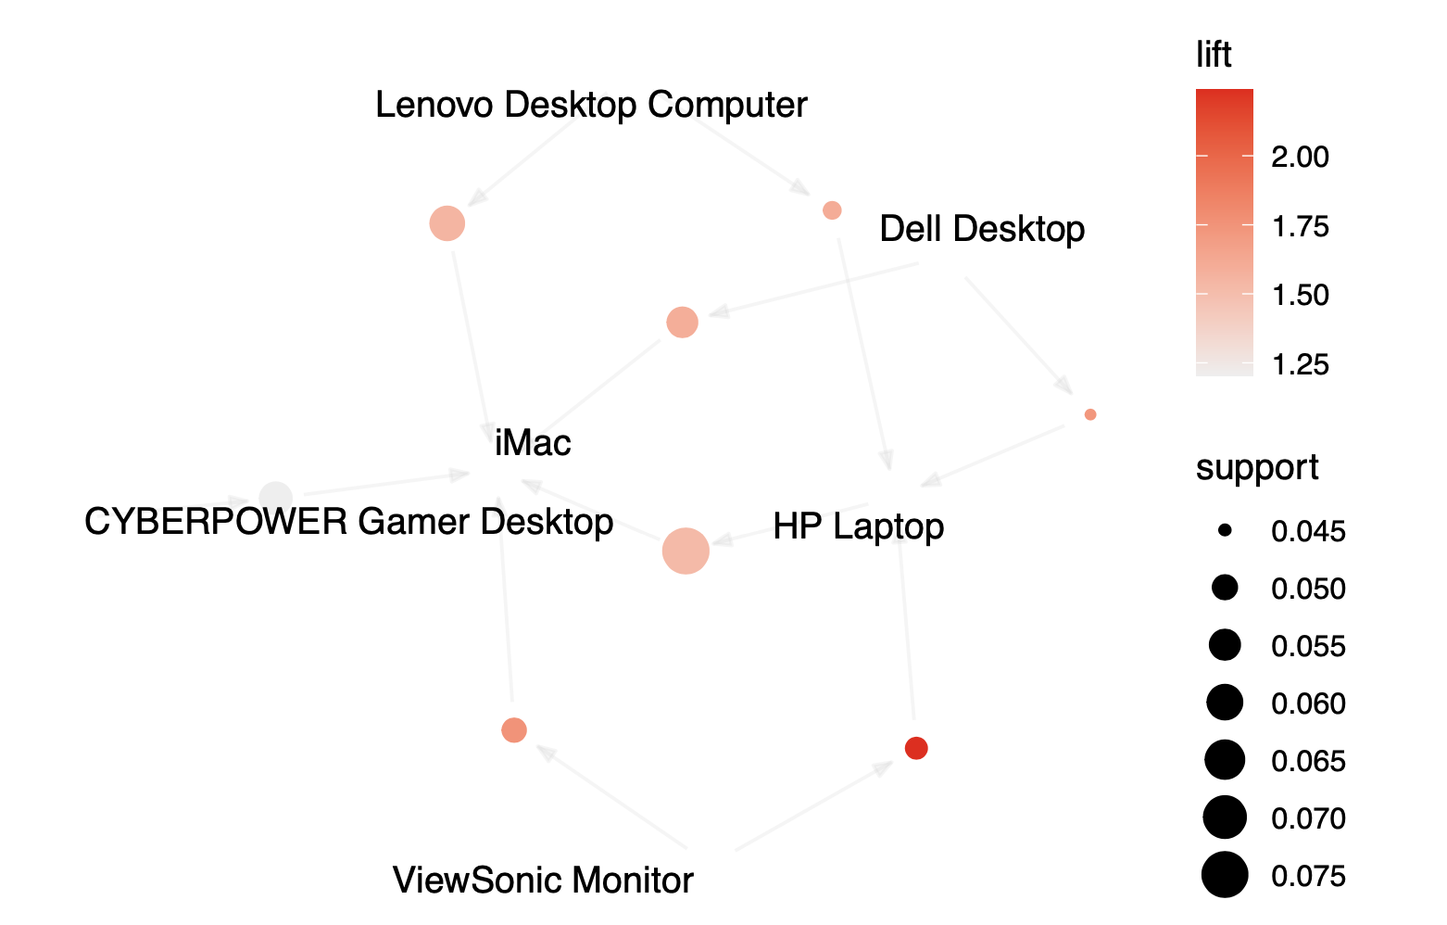
Representation of a priori rules

Slide 10
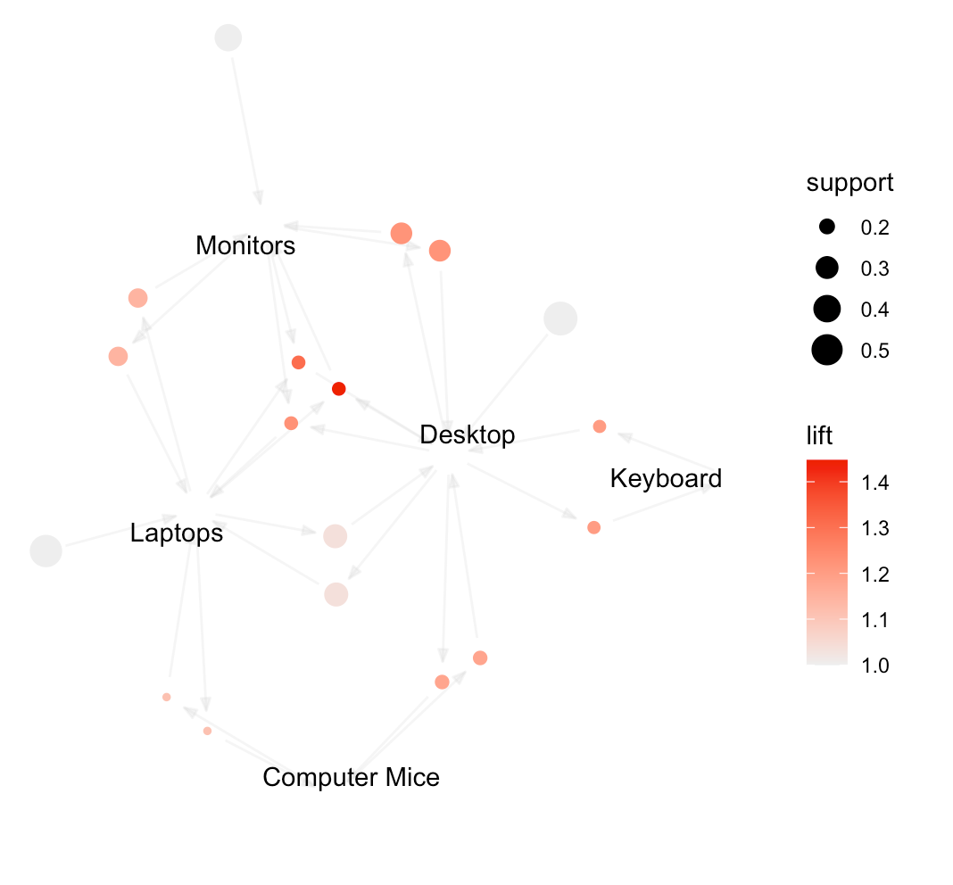
Representation of a priori rules

Slide 11
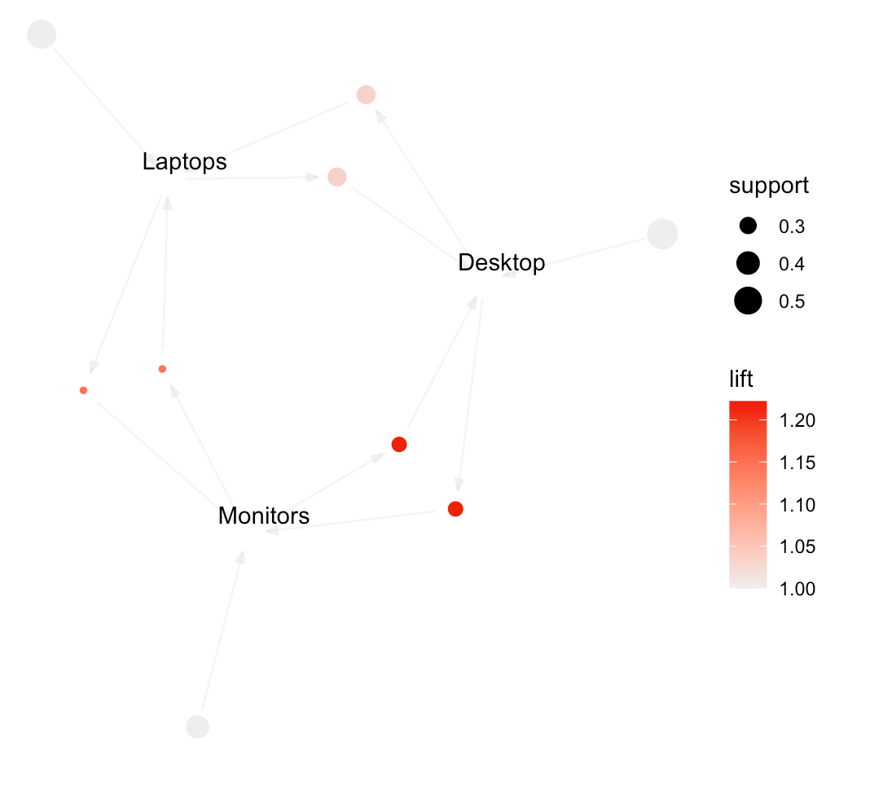
Representation of a priori rules

Slide 12
Cons
1. Not strong enough (ungrouped) rules
Supports: 4%-8%
Max. Confidence: 45%

Slide 13
Cons
2. Not enough data
Just 1 month of data is not representative
Unknown month (high or low sale seasons?)
Unknown profit margin
Portfolio might be limited
No date-time in transactional data
No customer ID in transactional data

Slide 14
Challenge
Different customers
Blackwell Electronics: B2C.
Electronidex: B2B.

Slide 15
Suggestion:
Ask Electronidex for updated data in a more extended format and re-do the analysis

