Slide 1

Credit One Data Science Project
Is the customer giving the money back?

Slide 2
Problems & Goals

Slide 3
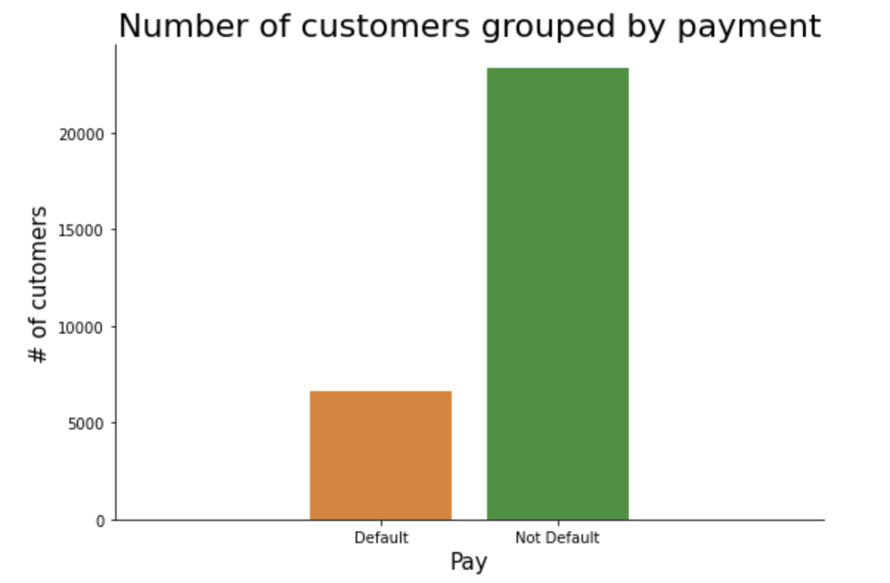
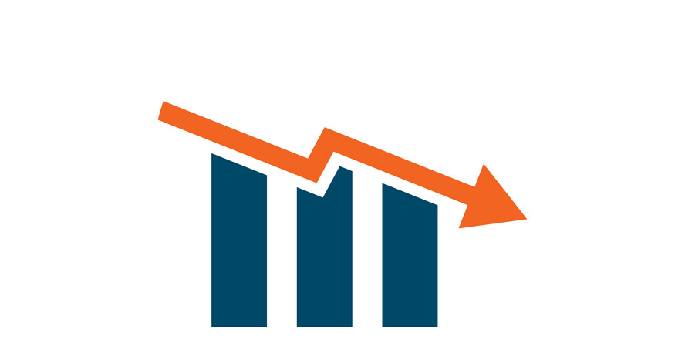
The Problem
Credit One has seen an increase in the number of customers who have defaulted on loans they have secured.
Credit One, as their credit scoring service, could risk losing business if the problem is not solved right away.

Slide 4
22.12 %
Default payments

Slide 5
Goals
Determine if a credit should be approved to a customer.
Understand how much credit to allow someone to use.
Try to develop a score system to evaluate the risk when a credit is provided to a customer.

Slide 6
Example of business questions
Correlation between age and default payment?
Identify customers treats that may be indicative of payment consistency.

Slide 7
Data Analysis Framework

Slide 8
0. Get the Data
0.1 Load the data stored in the MySQL database and extract it into a Pandas dataframe.
0.2 Save it locally in a file.

Slide 9
1. Cleaning the Data
1.1 Check duplicates or empty data. Remove.
1.2 Rearrange and rename variables if needed.
1.3 Merge classes if needed (e.g.: Combine divorced and others?)

Slide 10
2. Exploratory Data Analysis
Look for graphic representations, descriptives and patterns that allow us to understand the data. Specifically, we’ll search for correlations between demographic data and payment consistency.

Slide 11
3. Machine Learning
Main Goal: Prediction of default payment (Decision Trees, Random Forest, Gradient Boosting,…).
Optional: Develop the score system (quantify the hypothetical risk).

Slide 12
4. Optimization
Improve the process based on the obtained knowledge.
Optimize the machine learning models.

