Slide 1

Project CRM
A basic CRM software to handle customer relationships for our imaginary business …
Team Members:
Chris Daldalian
Yasser Soofiyani

Slide 2
Background of the Project
Purpose of our CRM system was to design an easy to use GUI that implements a database
Features:
  Employees
  Products
  Customers
  Sales
  Support

Slide 3
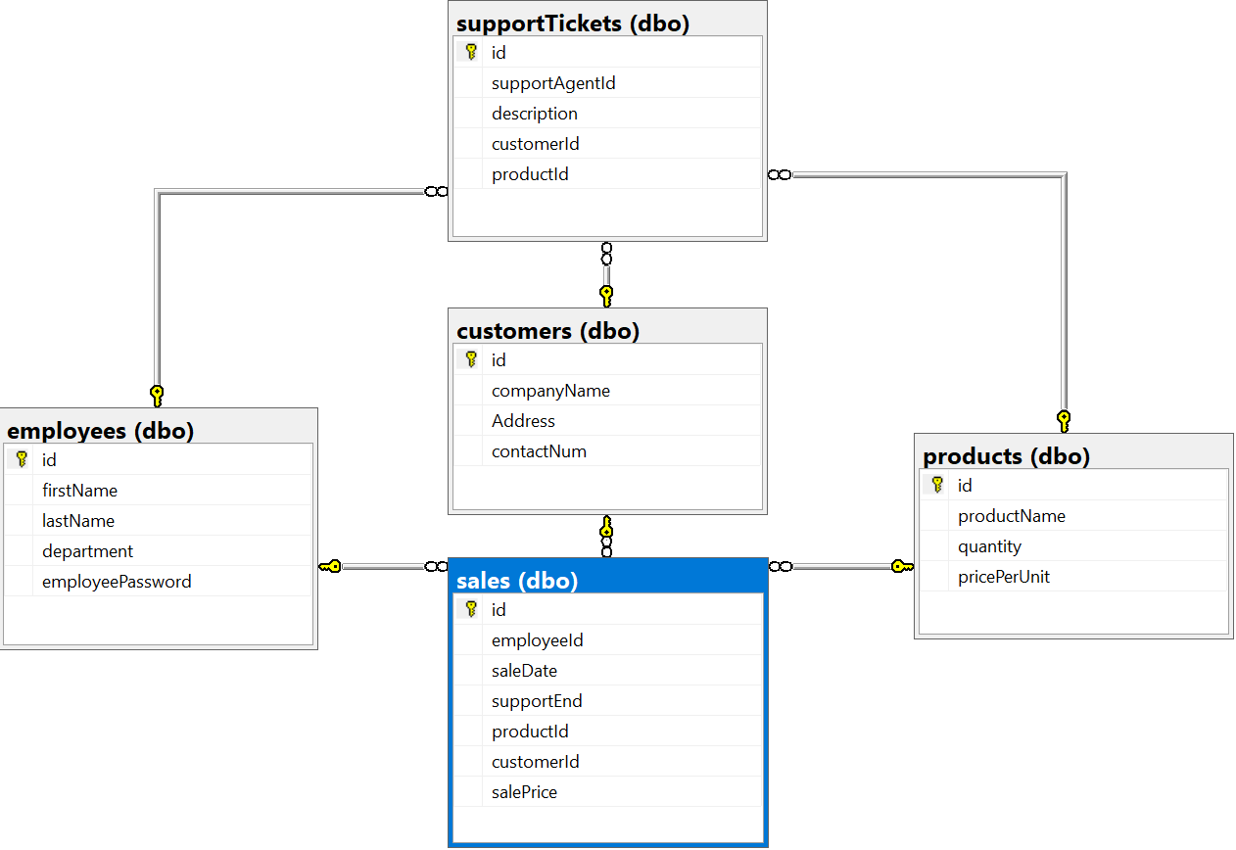
Database Diagram

Slide 4
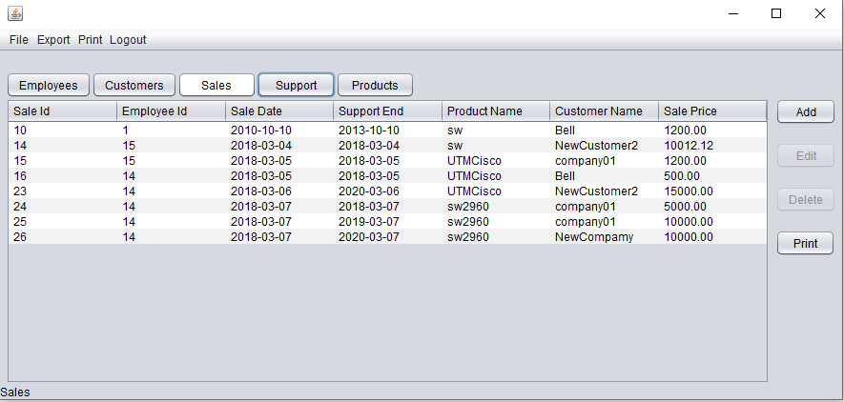
Project Overview
The layout for each of our tabs
A user can view, add, edit, delete, or print the table contents (depending on rights)
Our software is basically a GUI for our database tables

Slide 5
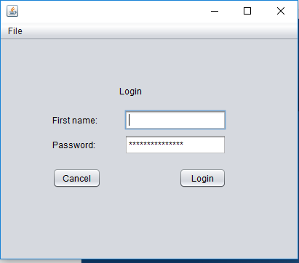
Login
We also added a login feature
Make it more realistic, as well as adding some internal security to the program/database

Slide 6
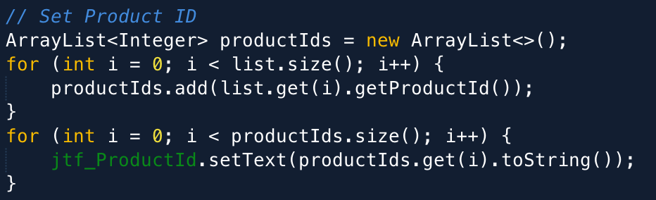
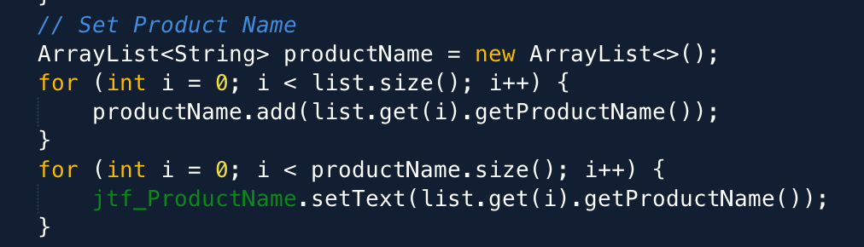
Challenges – p.1(Yasser)
Do not use of id on tables and use name instead of id
Work with FOREIGN KEY

Slide 7
Challenges – p.2(Chris)
Moving data back and forth from the database to the program
Using a table model instead of a list, not quite the same

Slide 8
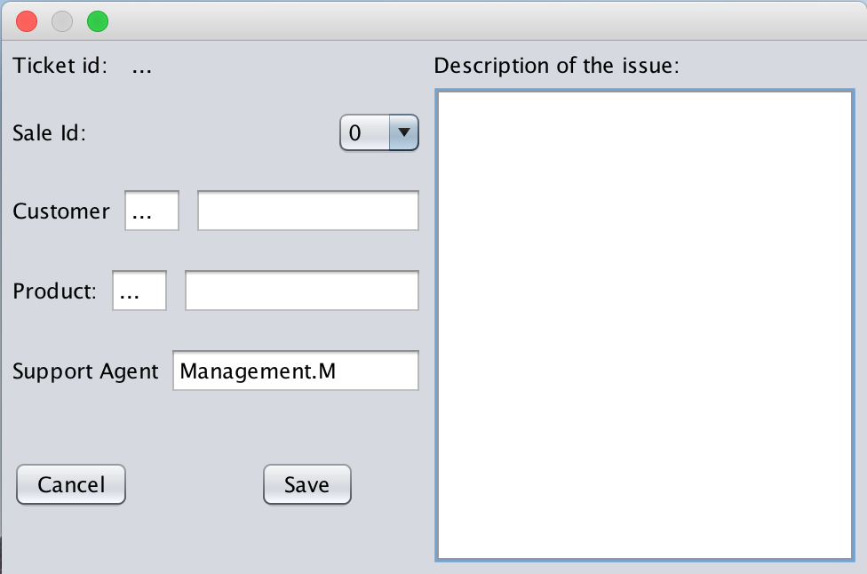
A specific problem (Yasser)
Catch correct FOREIGN KEY and put them to table but on GUI user see just Name
Add Support Ticket

Slide 9
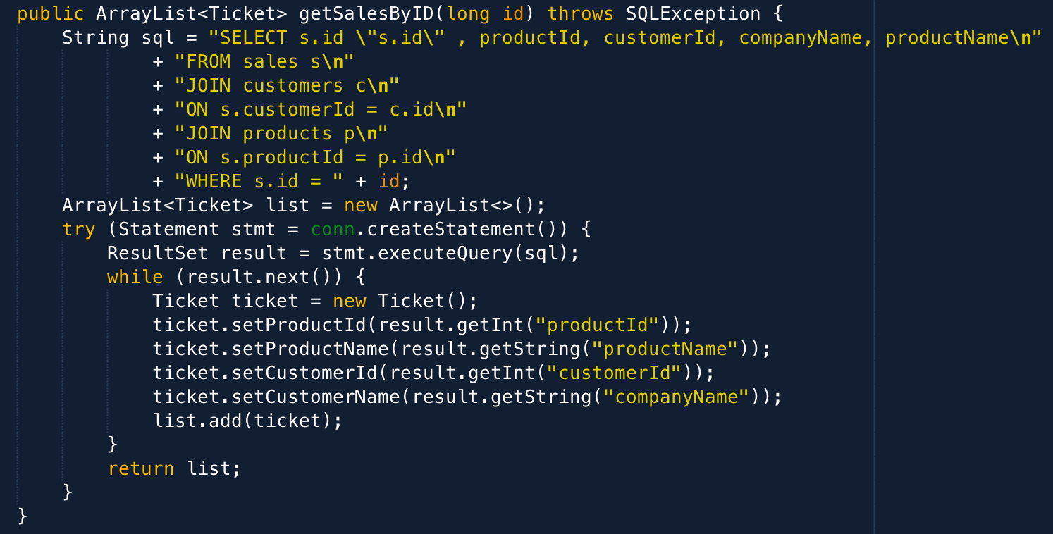
Solution
1- Use sales id on “Sales Id ComboBox”
2- Use join method for catch all require data and put them on right place and then write on database as a id

Slide 10
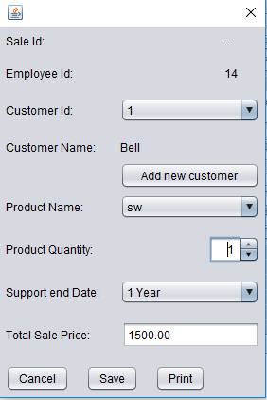
A specific problem (Chris)
Adding a new sale for a product – fetching that product’s price and calculate the total price for that quantity

Slide 11
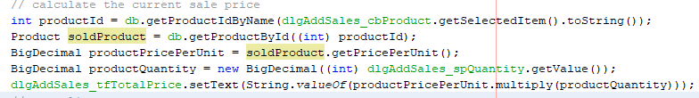
Solution
* First a few lines of code to calculate the total price
* Run this code every time a component’s state is changed ( spinner, product, add dialog)

Slide 12
What else was planned
Export tables to a file
Import of a file (Like import employees list of a Excel file)
Create bill and print it

Slide 13
Summary
What was done: (Surprisingly) exactly what we wanted to do
A basic functioning CRM software using a MSSQL Database to store data
Working user accounts, restrictions, login-logout
A program that doesn’t crash too often

