Slide 1


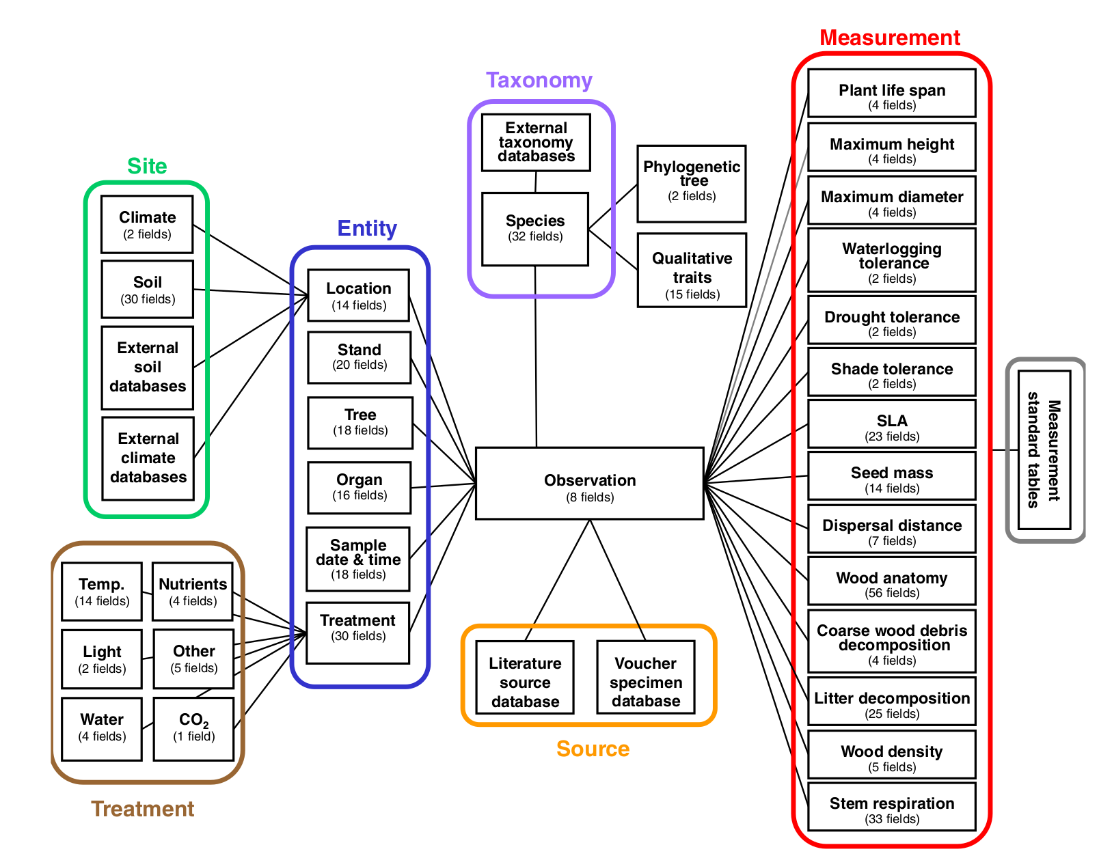
Big Data Ecology
Databases
Christian König
Ecology and Macroecology Lab
Institute for Biochemistry and Biology
University of Potsdam
Source: Kattge et al. (2011): 10.1111/j.2041-210X.2010.00067.x

Slide 2

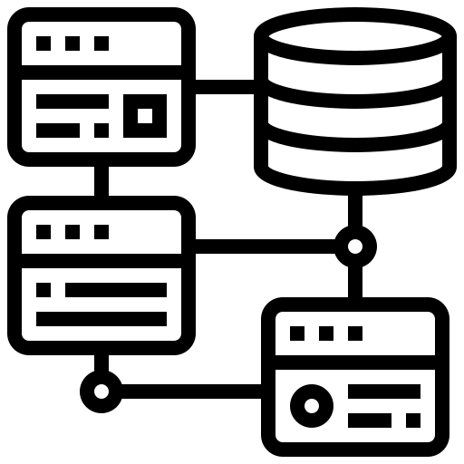

Overview
A database is a collection of electronic data, usually organized for rapid search and retrieval
The software that manages the data organization and interacts with the end user is called a database management system (DBMS)
Different DBMS designs for different applications:
Spreadsheets
Relational DBMS
Non-Relational (NoSQL) DBMS

Slide 3
Spreadsheets
Not a “database” in the traditional sense, but still widely used
Advantages:
Easily accessible and usable, human-readable
better than your field notebook
Drawbacks:
Error-prone
redundant data storage
no user access management
[...]

Slide 4
Relational databases
Data format and relationships are strictly defined
Advantages:
No redundant data storage,
Data consistency due to normalization
good vertical scalability
Fast data search, modification and extraction via SQL
Drawbacks:
Can be complex and inflexible
May incur additional hardware and maintenance costs
does not scale to really large data (PB and beyond)

Slide 5

Relational databases - the database schema
The database schema defines the structure of the data and the relationship among different tables
taxonomy
taxonomy
 | Field name | Data type | [...]
 | species_id | <unsigned int(10)> | [...]
 | species_name | <varchar> | [...]
 | genus | <varchar> | [...]
species_id | species_name | genus
1 | Circus aeruginosus | Circus
2 | Circus cyaneus | Circus
3 | Circus pygargus | Circus
4 | Circus macrourus | Circus
5 | [...] | [...]
Structure
Data

Slide 6
Relational databases - the database schema
The database schema defines the structure of the data and the relationship among different tables
taxonomy
observations
 | Field name | Data type | [...]
 | species_id | <unsigned int(10)> | [...]
 | species_name | <varchar> | [...]
 | genus | <varchar> | [...]
1
 | Field name | Data type | [...]
 | observation_id | <unsigned int(10)> | [...]
 | species_id | <unsigned int(10)> | [...]
 | observer_id | <unsigned int(10)> | [...]
 | date | <datetime> | [...]
 | coord_lon | <double> | [...]
 | coord_lat | <double> | [...]
n
n
observers
 | Field name | Data type | [...]
 | observer_id | <unsigned int(10)> | [...]
 | first_name | <varchar> | [...]
 | last_name | <varchar> | [...]
1

Slide 7
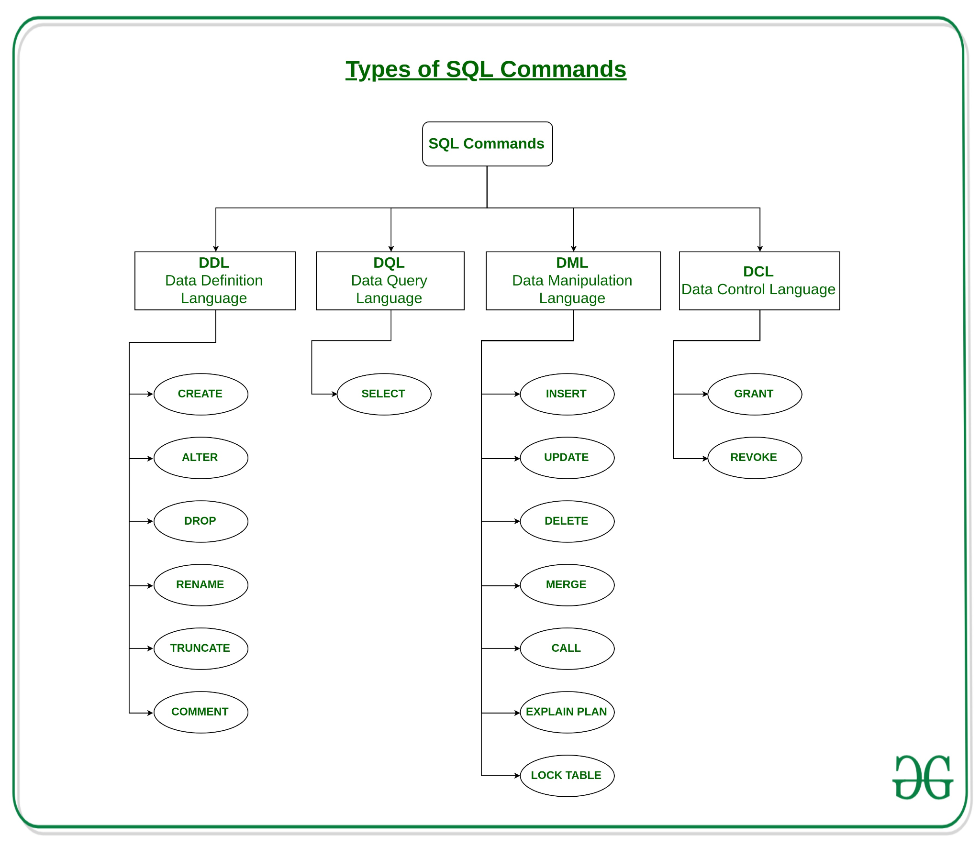
Relational databases - SQL
SQL is a standardized language to interact with relational databases
SQL allows you to:
Modify the database structure
Query the data
Manipulate the data
Manage access to the database
Source: https://www.geeksforgeeks.org/sql-ddl-dql-dml-dcl-tcl-commands/

Slide 8
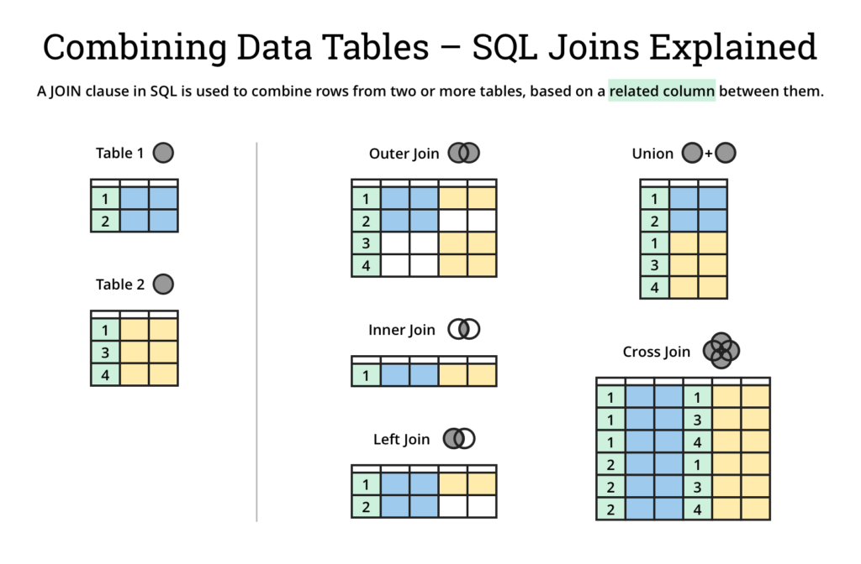
Relational databases - SQL Joins
Source: https://dataschool.com/how-to-teach-people-sql/sql-join-types-explained-visually/

Slide 9
Relational databases - some more SQL keywords
SELECT Select data (entire tables or specific columns)
WHERE Filter by rows
ORDER BY Sort results by column in ASC or DESC order
GROUP BY Group results by column values and apply summary functions (MIN(), MAX(), AVG(),...)
AND, OR, NOT Combine logical statements
see https://www.w3schools.com/sql/ for more

Slide 10
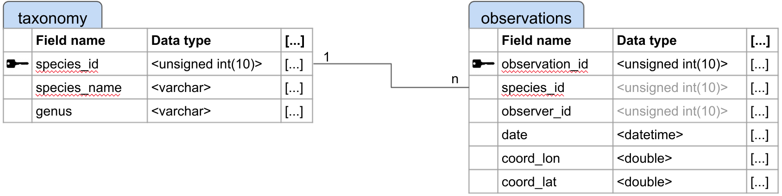
Relational databases - a query example
Aim: From our example database on slide 6, select all observations of Circus above a latitude of 50°
SELECT * FROM observations
LEFT JOIN taxonomy
ON observations.species_id = taxonomy.species_id
WHERE taxonomy.genus = “Circus”
AND observations.latitude > 50;

Slide 11
NoSQL databases
Umbrella term for different DBMS designs with a non-relational approach, e.g. document-based, key-value, graph or wide-column stores
Advantages:
Highly flexible data schemas that can cope with unstructured data
High horizontal scalability
Simple queries can be very fast
Drawbacks:
No standardized querying language
Problems with concurrency

Slide 12
Application programming interfaces (API)
An API allows communication with a database using specified protocols and services
Main benefits are abstraction (APIs offer a stable interface to the database) and isolation (APIs do not expose the database itself to the client)
APIs enable a connected network of database and applications
An example: the GBIF web API
https://api.gbif.org/v1/occurrence/search?taxonKey=2480481
https://api.gbif.org/v1/occurrence/search?continent=EUROPE&country=SE&taxon_key=2480481&year=1900,2021

Slide 13

Where do these different technologies fit into a global biodiversity data landscape?

Slide 14
Practical
Work through the R practical databases.md

Slide 15
Further readings
Publications:
Kattge, J. et al. 2011. A generic structure for plant trait databases. - Methods Ecol Evol 2: 202–213.
McIntosh, A. C. et al. 2007. Database design for ecologists: composing core entities with observations. - Ecological informatics 2: 224–236.
Schulman, L. et al. 2021. The Finnish Biodiversity Information Facility as a best-practice model for biodiversity data infrastructures. - Sci Data 8: 137.
Weigelt, P. et al. 2020. GIFT – A Global Inventory of Floras and Traits for macroecology and biogeography. - J Biogeography 47: 16–43.
List of biodiversity databases:
https://en.wikipedia.org/wiki/List_of_biodiversity_databases
https://ecologicaldata.org/find-data
Technical background:
https://support.microsoft.com/en-us/office/database-design-basics-eb2159cf-1e30-401a-8084-bd4f9c9ca1f5
https://www.ibm.com/cloud/blog/sql-vs-nosql

