Slide 1



Big Data Ecology
Efficiency and performance in R
Christian König
Ecology and Macroecology Lab
Institute for Biochemistry and Biology
University of Potsdam

Slide 2


language design
“To understand computations in R, two slogans are helpful: Everything that exists is an object. Everything that happens is a function call.”
John M. Chambers
R is a multi-paradigm language:
Object-oriented
Everything is an object
Objects are defined by a class and methods
Functional
Functions are “first-class citizens” that can be assigned to variables, passed as arguments, or even returned by a function
Problem solving is centered around functions
Dynamic
Variable types can change
No strict scoping rules
Code is interpreted, not compiled
Notes:
functions: problem solving is centered around functions
first class citizens: you can assign them to variables, store them in lists, pass them as arguments to other functions, create them inside functions, and even return them as the result of a function.
object: specified data structure with a defined set of methods and behaviours
R has a reputation of being slow, especially among people who are not familiar with it

Slide 3
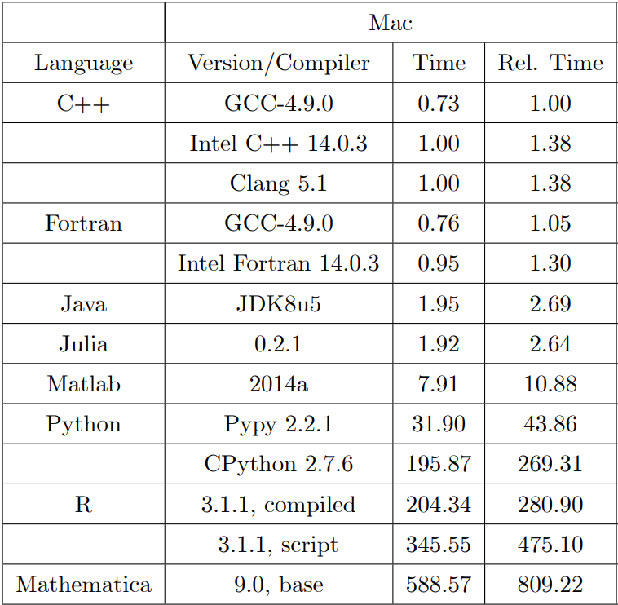
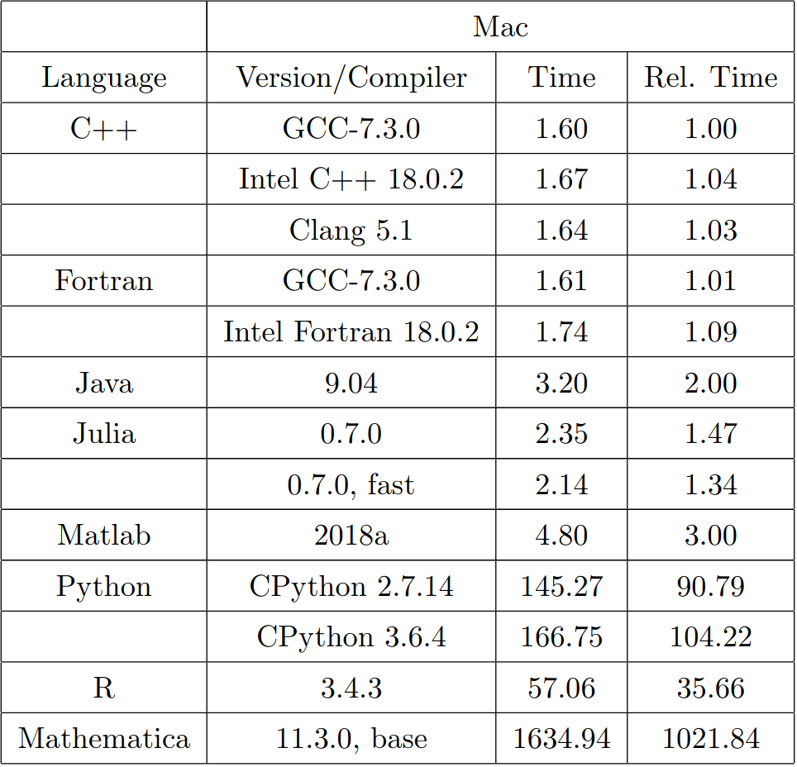
language design
The design of the R language makes it extremely flexible and interactive
This flexibility and ease of use may come at the cost of performance
2014
2018
Arouba & Fernandez-Villaverde (2014): 10.3386/w20263
Notes:
Dynamism is very handy, but also costly
When trying to write efficient code, we need to take the language architecture and implementation into account

Slide 4
General tips - Vectorization
Vectors are the basic data type in R
Many operations and function in R work naturally and intuitively with vectors:
> x = 0:9 # create a vector from 0 to 9
> x + 1 # vector-scalar addition
[1] 1 2 3 4 5 6 7 8 9 10
> x + x # vector-vector addition
[1] 0 2 4 6 8 10 12 14 16 18
Apply functions (including your own!) to each row/columns of a matrix (apply) or each element of a list (lapply, sapply) or vector (sapply, vapply)
> sapply(x, function(x_i){x_i + 1})
[1] 1 2 3 4 5 6 7 8 9 10
! highly optimized
! safer, but usually not faster than loops
Notes:
Vectorization is so fast, because it uses highly optimized algorithms implemented in C.
Apply functions are encapsulated, no side effects, don’t create global variables, manage memory etc.

Slide 5
General tips - Memory-Management
Per default, R
stores objects in memory
copies objects when you add/remove elements
copies objects when another object points to them
Avoid growing objects iteratively (e.g. in for-loops)
> x = c()
> for(i in 1:10){x = c(x, i)} # creates a new copy of x every iteration
> x
[1] 1 2 3 4 5 6 7 8 9 10
If necessary, pre-allocate memory and modify object in-place
> x = vector(mode = “numeric”, length = 10)
> for(i in 1:10){x[i] = i} # modifies elements of x in place
> x
[1] 1 2 3 4 5 6 7 8 9 10
Notes:
Streaming of data from hard disk only in special cases, e.g. raster package

Slide 6
General tips - Use existing digital infrastructure
There is an R-package for almost everything!
Currently there are almost 18000 R-packages in CRAN, many additional packages are hosted on Github
The existence of a package means someone has spent thought, effort and time on a problem that you don’t have to spend (acknowledge that by citing!)
Packages are often implemented in C and thus offer superior performance over self-written solutions
Outsource computations to more efficient tools (e.g. when connected to a database or GIS)
Check for existing solutions on Stackoverflow, Github, Blogs, etc.

Slide 7
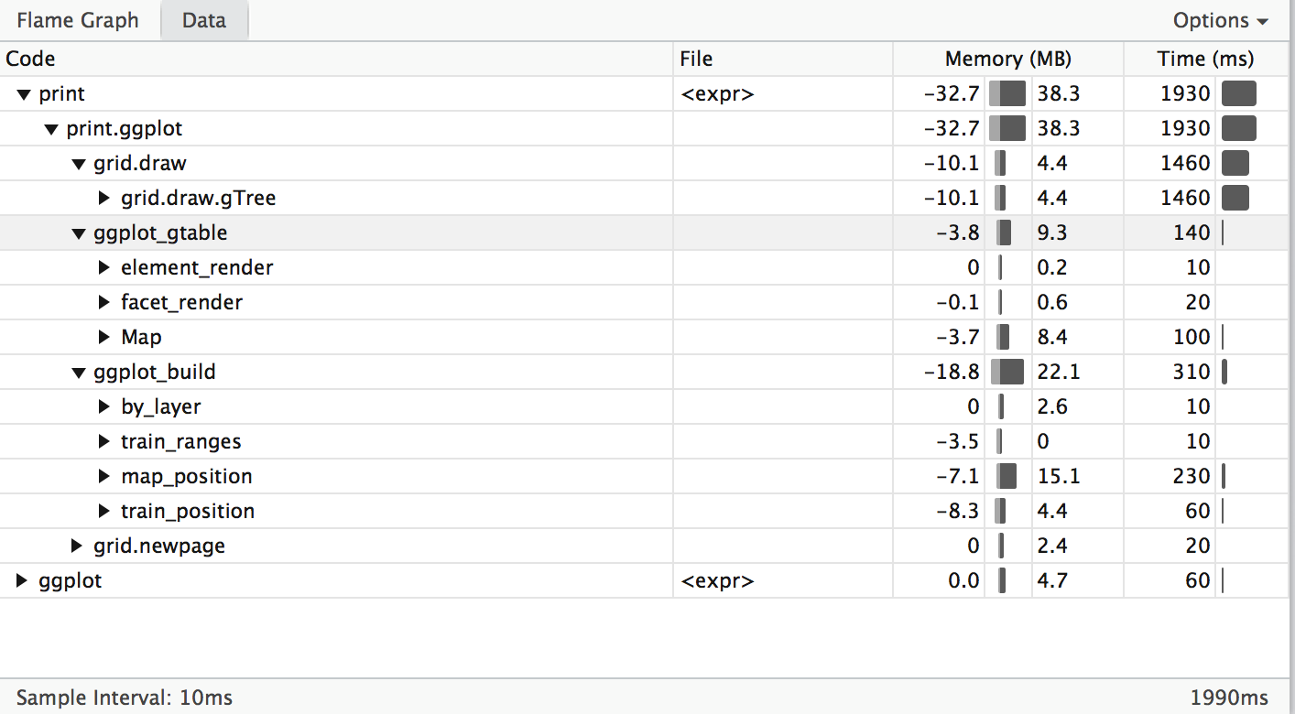
Profiling & benchmarking
To optimize your code, you need to understand which parts are performing poorly
Timing & Benchmarking:
system.time()
bench::mark()
Profiling:
utils::Rprof()
profvis::profvis()

Slide 8
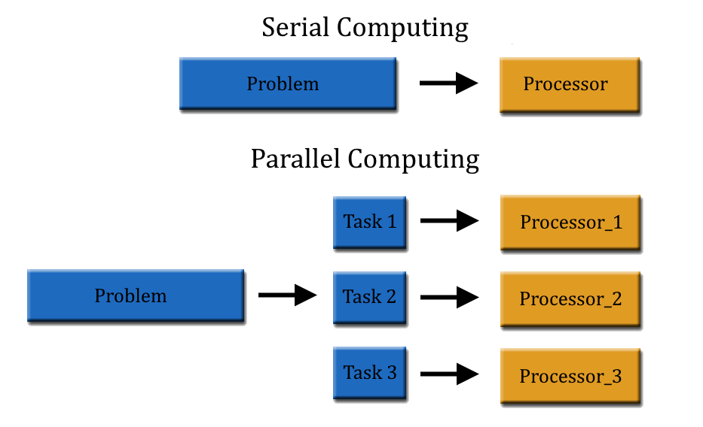
Parallel processing
Split up a complex problem into smaller tasks
Solve these tasks separately (and simultaneously!) on different processors
Core R packages for parallel processing:
parallel: parallel apply family functions, register compute Clusters
foreach + doParallel: parallel for-loops
Source: https://www.teldat.com/blog/en/parallel-computing-bit-instruction-task-level-parallelism-multicore-computers/

Slide 9
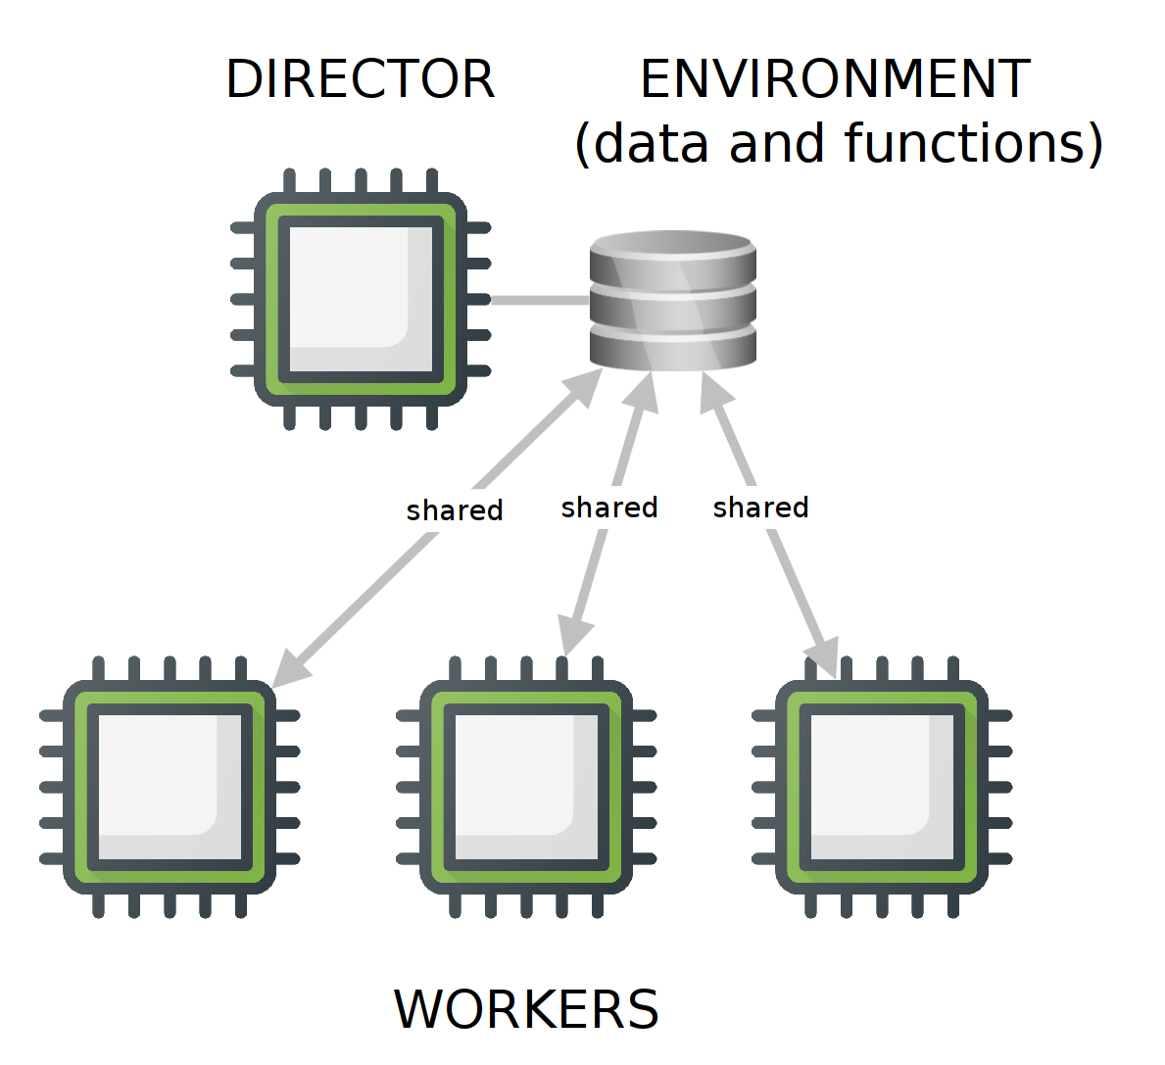
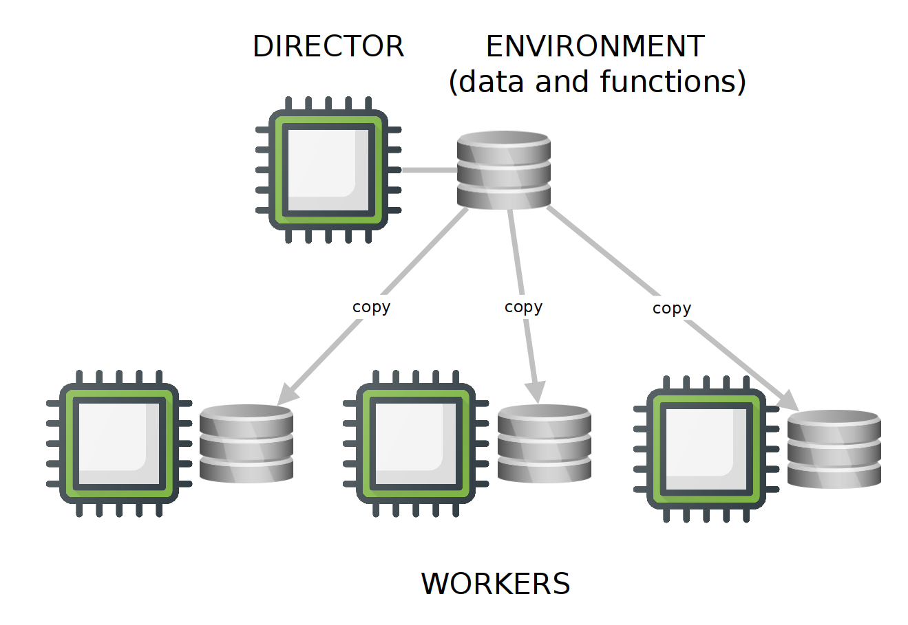
Parallel processing
Parallel workers (CPUs) need to be organized in a parallel backend
Fork:
workers have a shared environment (functions, objects, packages, etc.) → Faster
works only on local machines
works only on machines with UNIX-style OS
Parallel Socket Cluster:
workers get their own copy of the environment
scales easily, works with distributed CPUs
works on UNIX and Windows machines
Fork
PSock Cluster
Source: https://www.blasbenito.com/post/02_parallelizing_loops_with_r/
Notes:
Fork is about 30-40% faster, because there is no communication overhead

Slide 10

It’s not all about computation!
Keep an eye on the bigger picture
Which parts of your code are crucial for performance?
What’s your ratio of coding time vs. runtime?
Know your IDE
Version control
Debugger
Advanced editing features
Manage multiple processes
Access to OS terminal
“The real problem is that programmers have spent far too much time worrying about efficiency in the wrong places and at the wrong times; premature optimization is the root of all evil (or at least most of it) in programming.”
Donald Knuth
Notes:
Switch window to RStudio and show some IDE productivity features

Slide 11
It’s not all about computation!
Organize your work
Plan your project
Split code into separate files, e.g. data_preparation.R, analysis.R, ...
Organize code into logical units within files
Write readable, well-documented code
Use consistent naming conventions
Comment your code liberally but precisely
Don’t repeat yourself

Slide 12

Open discussion
Notes:
Has performance been an issue in your analyses?
Use of HPCs?
Other languages?

Slide 13
Practical
Work through the R practical performance.md

Slide 14
Further readings
E-books and tutorials:
https://csgillespie.github.io/efficientR/index.html
https://adv-r.hadley.nz/techniques.html
https://data-flair.training/blogs/r-performance-tuning-techniques/
Parallel computing:
https://psu-psychology.github.io/r-bootcamp-2018/talks/parallel_r.html
https://www.blasbenito.com/post/02_parallelizing_loops_with_r/
Publications:
Morandat, F. et al. 2012. Evaluating the Design of the R Language (J Noble, Ed.). - ECOOP 2012 – Object-Oriented Programming: 104–131.
Aruoba, S. B. and Fernández-Villaverde, J. 2014. A Comparison of Programming Languages in Economics. National Bureau of Economic Research

