Slide 1


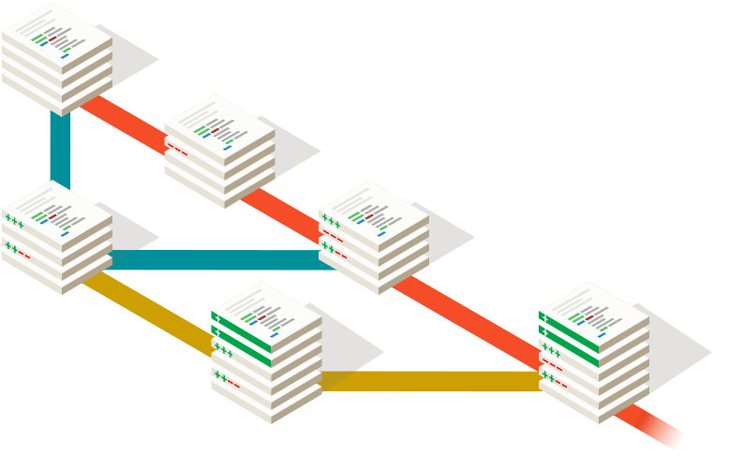
Big Data Ecology
Version Control
Christian König
Ecology and Macroecology Lab
Institute for Biochemistry and Biology
University of Potsdam
Source: https://git-scm.com/

Slide 2
What is version control?
A system for managing changes to files (usually source code) that:
Allows multiple developers to work on the same source files
Stores a complete change history of all tracked files
Provides tools to safely experiment with your code without breaking it
Enables transparent and collaborative code development across the world
Different architectures (centralized vs. distributed), implementations (e.g.: SubVersion, CVS, Git) and online hosters (e.g.: Bitbucket, GitLab, GitHub)

Slide 3


Most powerful and widely used version control system available
Distributed architecture → your local repository is self-contained and includes the full development history
Elegant branching and merging logic
Free web hosting with powerful features, e.g. on GitHub or GitLab

Slide 4
Basics - File organization
Working directory / working tree
Your root project folder
Staging area
Snapshots of files that want to put under git version control
Local repository
Local files under git version control
(Remote repository)
Remote repository of the same project, but with potentially different contents
Working directory
local repository
staging area
remote repository

Slide 5
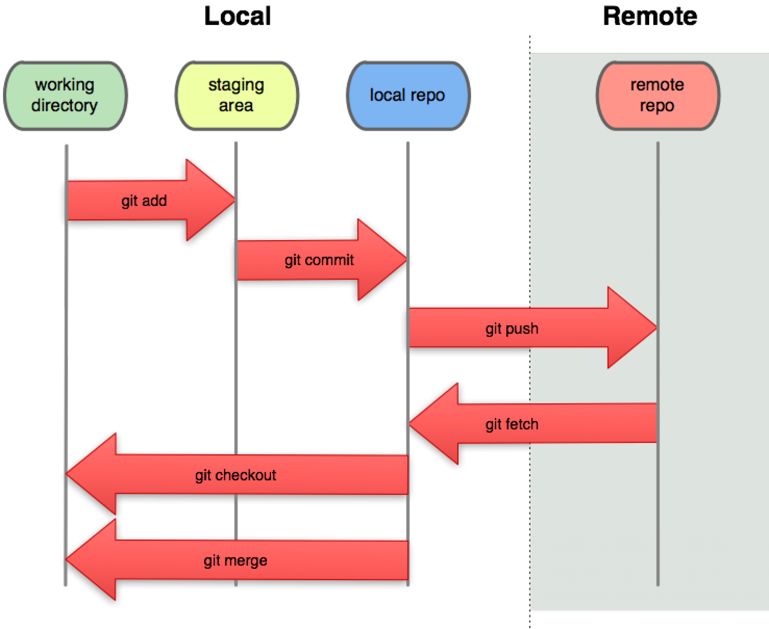
Basics - Workflow overview
Source: https://www.pngwing.com/en/free-png-sazxf

Slide 6
Basics - Branching and Merging
New feature
Master
Bug fix

Slide 7
Web Hosting
Web platforms can host remote repository
They offer a number of additional powerful features such as:
collaboration features, e.g. issue tracking, forks, pull requests
visualization tools, e.g. activity graphs, diffing tools
continuous integration, i.e. automated compilation and unit testing of new code
The most popular git web hosting platform is Github
The University of Potsdam runs its own GitLab-based versioning service: Git.UP

Slide 8
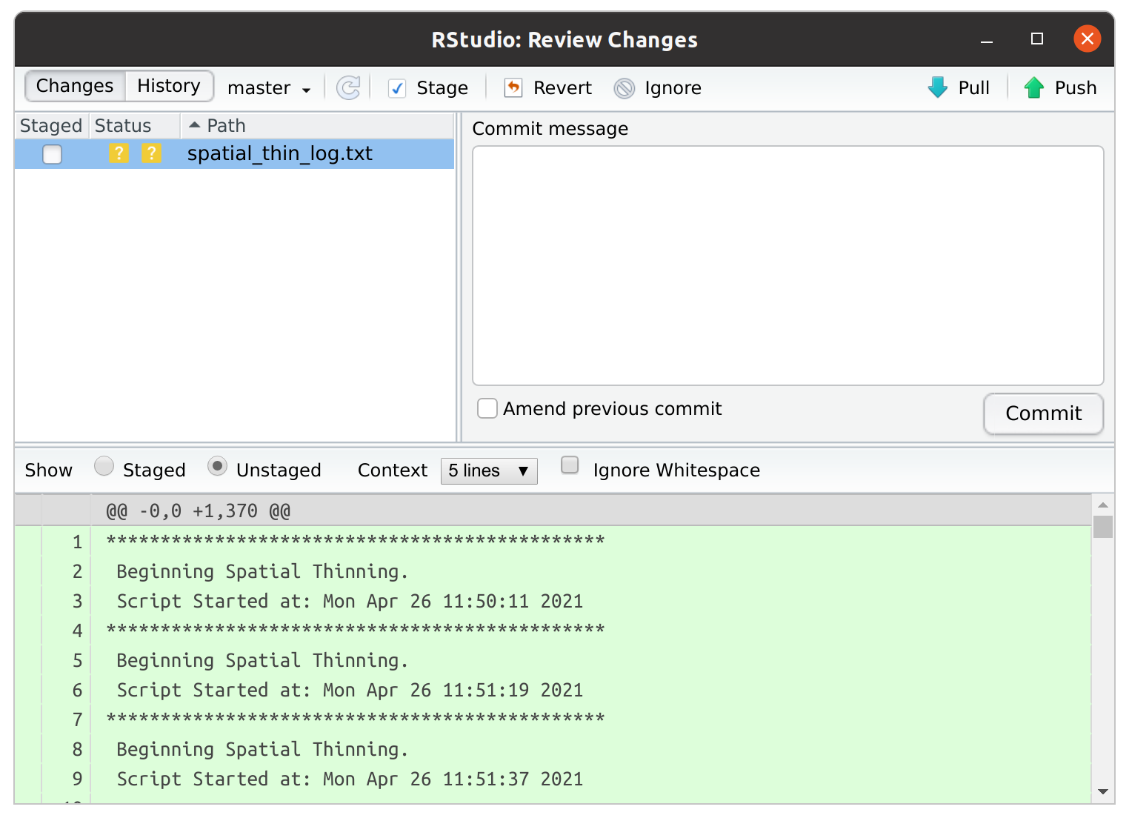
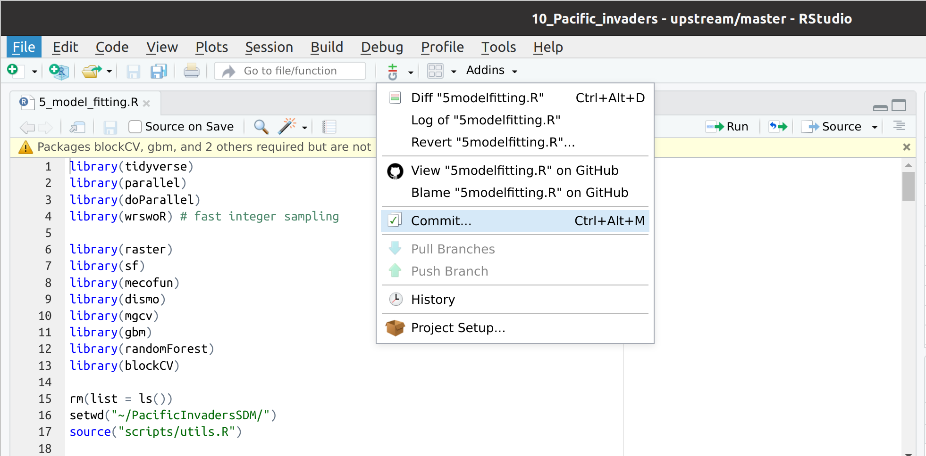
IDE integration
Most modern IDEs have integrated Git support
RStudio has a nice graphical interface for the most common git operations

Slide 9
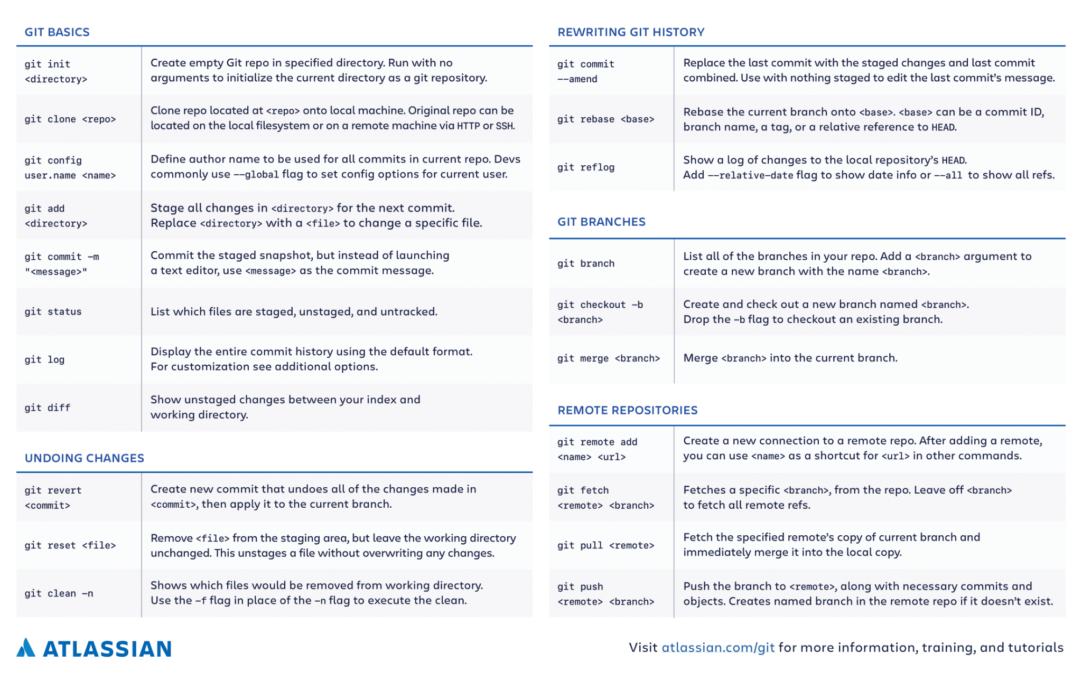
Commands

Slide 10
Practical
Work through the R practical version_control.md

Slide 11
Further readings
Tutorials, Videos & Documentation:
https://git-scm.com/doc
https://www.atlassian.com/git
https://www.youtube.com/watch?v=2sjqTHE0zok
Git & RStudio:
https://support.rstudio.com/hc/en-us/articles/200532077-Version-Control-with-Git-and-SVN
Github:
https://guides.github.com/activities/hello-world/
Troubleshooting:
https://stackoverflow.com/questions/tagged/git?sort=MostVotes&edited=true

