Slide 1

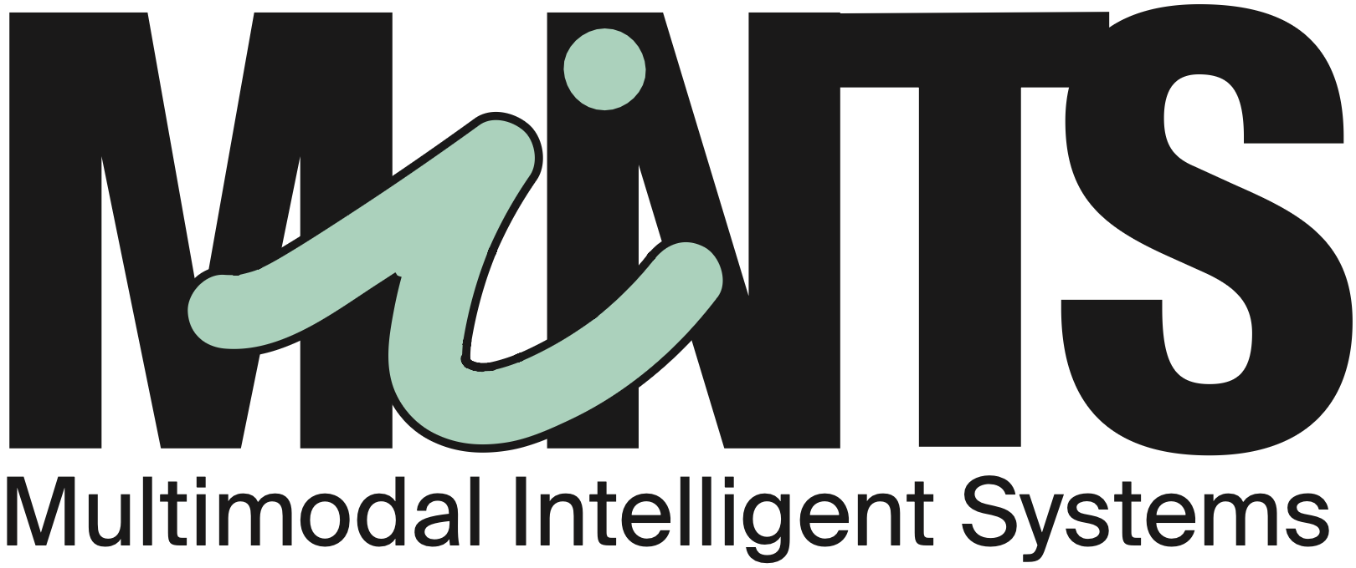
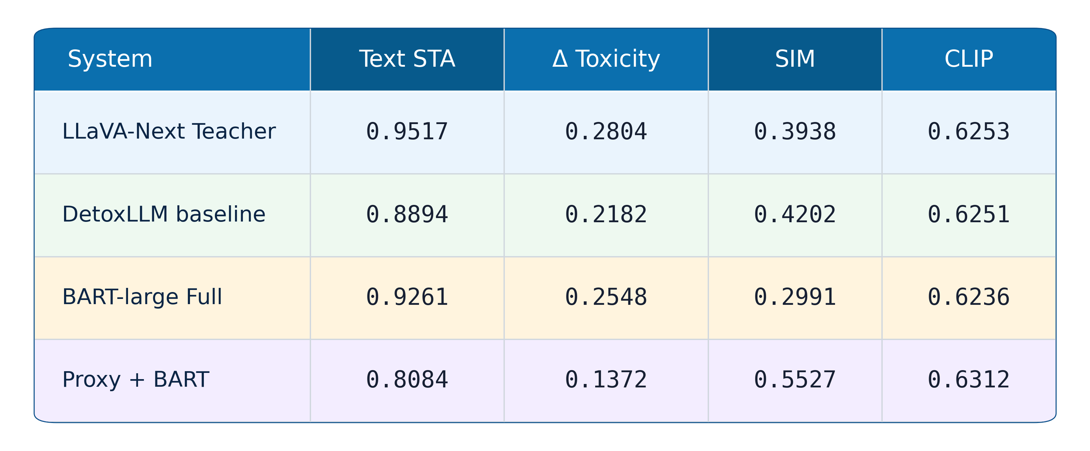
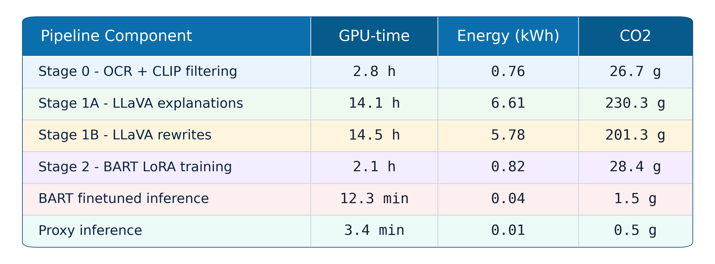
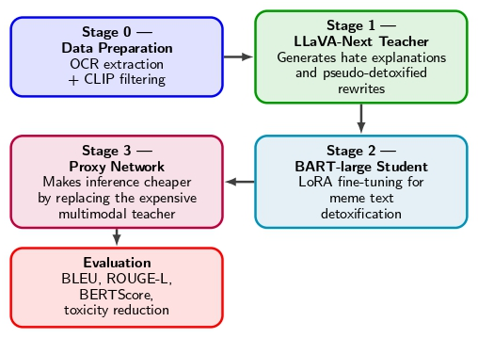
From Censorship to Detoxification:
Rewriting of Harmful Meme
Alex Dell’Orto, Christian Garzone, Dario Liuzzo
Group 31
Problem definition
Validation
Harmful memes combine image and text to spread offensive content across both online platforms and physical spaces. Existing moderation relies on censorship such as blurring or removing content after exposure. This project proposes text detoxification: rewriting harmful meme text in real-time while preserving its meaning and visual coherence, enabling proactive moderation without erasure.
Related works
Hateful meme detection: the dominant line of work frames this as a classification problem: Kiela et al.'s Hateful Memes challenge (2020) showed that multimodal fusion models (VisualBERT, CLIP-based) clearly outperform unimodal baselines. All these approaches detect and remove, while none attempt to preserve meaning.
Text detoxification / style transfer: ParaDetox (Logacheva et al., 2022) formulated toxicity as a style attribute and trained seq2seq models (BART, T5) to rewrite toxic sentences neutrally. However, it operates on plain text only, ignoring the visual context that gives meme text its meaning.
We fill this gap by leveraging LLaVA-Next's multimodal understanding as a teacher to distil detoxification capability into a lightweight BART-large student, enabling context-aware rewriting.
Quantitative results on test set (n = 280):
STA: % non-toxic (RoBERTa) ↑ | SIM: BERTScore ↑ | CLIP: image-text cosine ↑
System STA SIM CLIP
────────────────────────────────────────────────────────────
LLaVA-Next teacher (upper bound) 0.990 +0.472 0.636
BART base (no fine-tuning) 0.973 -0.061 0.622
BART fine-tuned – full context 0.959 +0.339 0.628
BART fine-tuned – target only 0.964 +0.342 0.628
BART + CLIP proxy 0.879 +0.600 0.639
DetoxLLM (baseline) 0.940 +0.443 0.634
BART fine-tuned with full context achieves strong detoxification (STA 0.959) while preserving meaning (SIM 0.339). The CLIP-proxy variant trades STA for best semantic fidelity (SIM 0.600), exposing a clear detoxification–fidelity trade-off.
Method
Limitations
Dataset noise and hetereogenity
Pseudo-label dependence
Limited visual grounding at inference
Partially multimodal evaluation
Unbalanced toxicity-similarity trade-off in proxy model
Conclusion
This project shows that by distilling multimodal supervision from LLaVA-Next into a lightweight BART-large student, the system achieves strong toxicity reduction while preserving semantic alignment with the original meme. Future work should improve dataset quality, strengthen multimodal grounding, and explore integration with OCR and inpainting modules to enable live rewriting of harmful text in video streams, making proactive moderation feasible in real-world physical environments.
Datasets
HarMeme: ~3500 memes related to COVID-19 and US politics, manually labelled as harmful/not-harmful with associated textual claims.
MAMI: 10000 misogynist memes from Twitter.
MMHS150K: ~150000 highly heterogeneous and noisy Twitter image-text.
All filtered to retain meme-like images only. Combining them gives the model exposure to diverse toxicity types and noise levels, improving generalisation.
The combined dataset is split 70/15/15 into train/validation/test. Training data fine-tunes the BART student; validation guides early stopping and hyperparameter selection; the test split is used for all reported metrics.
References
[1]
[2]
[3]
EE-559: Deep Learning, 2026

