Slide 1
Sighted!
„The mobile solution for interactive sighting of
prominent places!“

Slide 2
Content
Concept – The idea behind SIGHTED!
Technologies – Frameworks & Assembling process
Architecture – The MVC-Pattern
Datamanagement – Datastructures & Couch + Pouch Sync
Demo & Outlook – The now and later

Slide 3
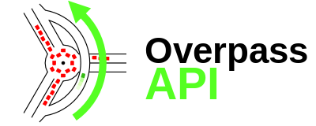

Concept
Mobile app that acquires data of prominent places
- Overpass support (OSM)
Central repository where all data is incorporated
- NoSQL aproach (TU CouchDB-Server)
On- and offline usability
- Multi-User environment with data synchronisation
Mobile solution for interactive acquisition and utilization!

Slide 4

Technologies
Android + Gradle (Build-Management-Tool)
- Arranges dependencies, builds Android-APK
WebView (WebKit rendering engine)
- Rendering web-content
Web-Technologies: Javascript, HTML5, CSS3
- Grunt: Front-End Build-Management-Tool
- Vendor-APIs: jquery (mobile), bootstrap, requireJS, ol3, pouchdb

Slide 5
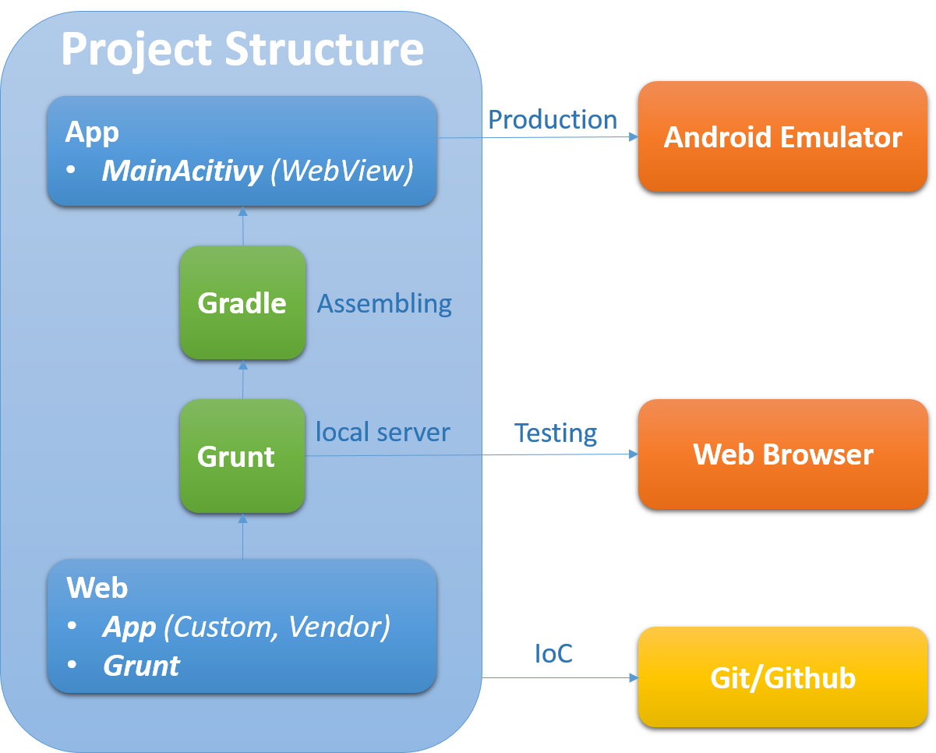

Slide 6

Architecture
Implementation of the Model-View-Controller Pattern
Logical separation to modules (pages)
Using the observer pattern
Model: stores data
View: presentation based on model changes
Controller: updating model & view

Slide 7
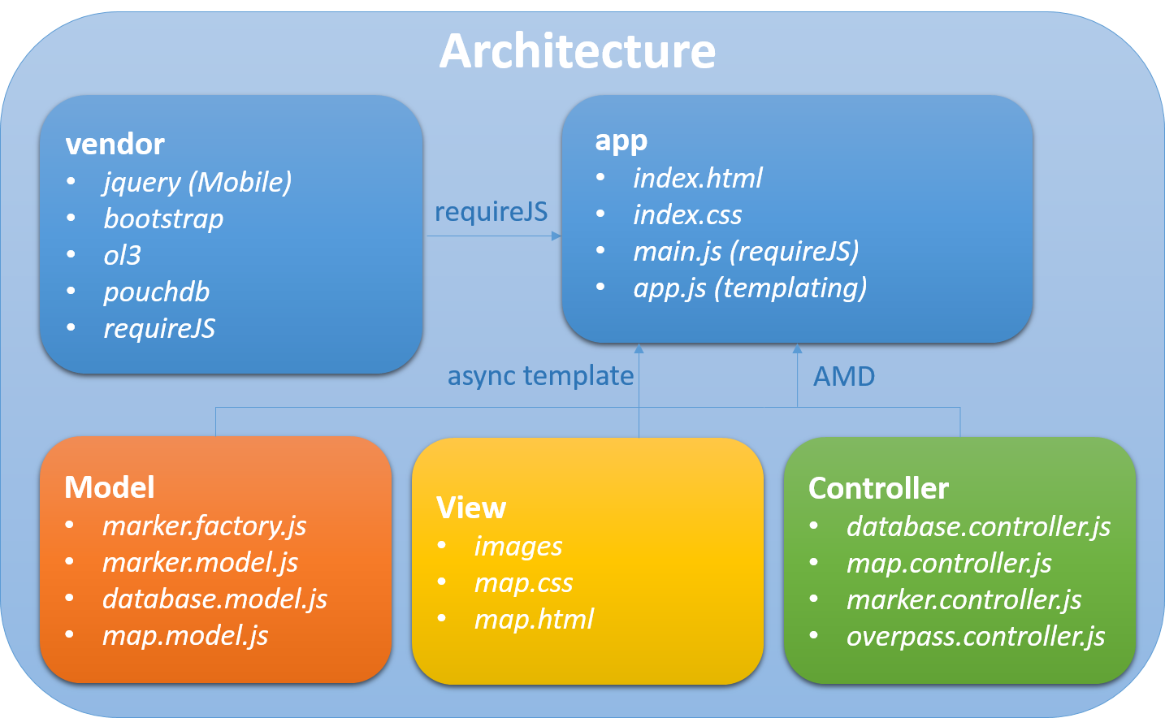

Slide 8
Datamanagement
Things we store
- name, description, location, url, etc…
Fetching data via Overpass API
Editable, stored locally
Identification with UUID

Slide 9
DATAMANAGEMENT
Dataflow
Variation - offline
synchronization via Button
loading tiles into cache
viewing/editing (local DB)
DB sync (when online)
Variation – online
sync via Button
viewing/editing existing data
or request new information
Saving to locally DB, automatic sync with server DB
server DB
request
local DB
view/edit
overpass
new entry

Slide 10
Demo
Test-Environment
- Mozilla, Chrome, etc.
Production-Environment
- Android-APK

Slide 11
Outlook
Login-System for users
Prevention of redundand information
Extension of information
Synchronization based on BBOX
Download of tiles for offline usage (instead of cache)

