Slide 1

CSS Basics

Slide 2


CSS Definition
Cascading Style Sheets (CSS) contain the styling rules used to display HTML pages.
One stylesheet can be used on multiple HTML pages.
Notes:
Hypertext Markup Language (HTML) is a language that specifies the structure and content of hypertext documents, typically viewed via a web browser.
Hypertext is text that is able to relate and link to documents beyond itself.
Markup is a system of elements defined by tags and attributes that define the structure, content, formatting and linking of HTML pages.

Slide 3
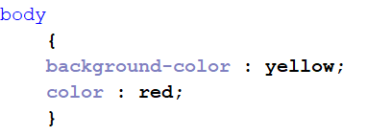
CSS Syntax
CSS rules follow this structure: Example:
selector
{
property: value;
}

Slide 4
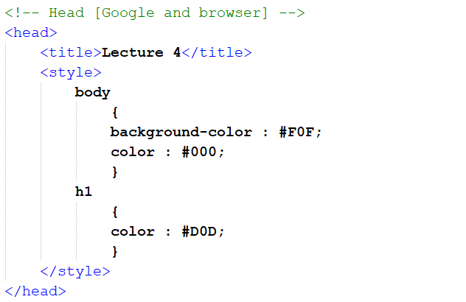
Embedded CSS
It is possible to ‘embed’ a stylesheet in the <head> element of an HTML page.
This is not allowed for the web markup assignments! But why not?
Notes:
An embedded stylesheet
Cannot be reused across multiple pages (copy pasting is not a solution)
Cannot be cached by the browser

Slide 5
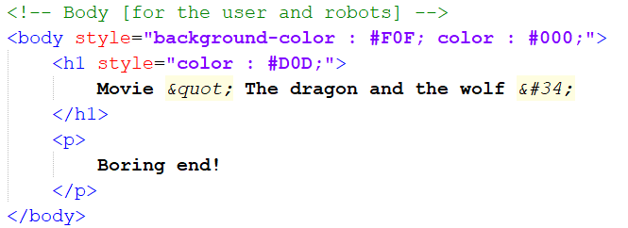
Inline CSS
It is possible to write style rules ‘inline’ in an HTML document.
Again, this is not allowed for the web markup assignments!
Notes:
An embedded stylesheet
Cannot be reused across multiple pages (copy pasting is not a solution)
Cannot be cached by the browser

Slide 6
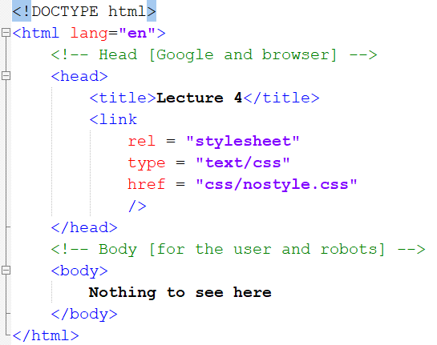
External CSS
Instead, we write our CSS code in separate .css files, which we then link in the <head> element of our HTML pages:

Slide 7
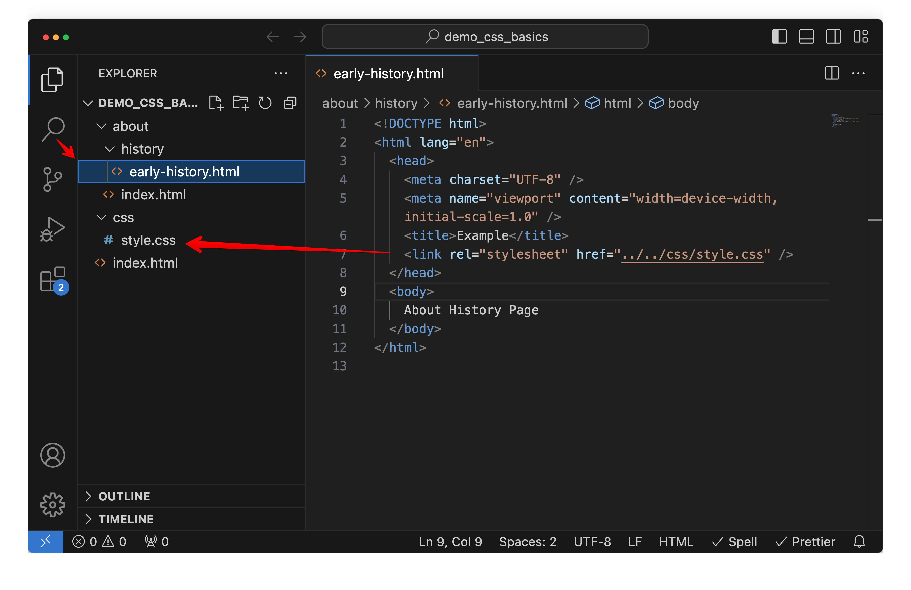
Linking CSS
Asset files can be linked relative to the current directory.
Using “../” navigates up one directory from the current one.
“./” is at the same location in the file hierarchy.
Notes:
- demo: view difference between how stylesheet is linked in demo/about/history/early-history.html and demo/index.html

Slide 8
CSS class selector
h1
{ color: MidnightBlue; }
All of the <h1> elements on the page will be given this color. But what if we want some <h1> elements to have a different color? We can use the ‘class’ attribute in HTML.
<h1 class=“special-heading”>This heading wil look different</h1>
h1.special-heading
{
color: Maroon;
}

Slide 9
CSS id selector
In HTML an element can have an ID selector.
The HTML for a main menu with an id would look like this:
<menu id=“main-menu”></menu>
The CSS to select an id starts with the # symbol.
The main menu id selector would look like this:
#main-menu { font-weight: bold; }
An ID is meant to select a single item. If your selector needs to select multiple items, you should use a class instead.

Slide 10
In-class assignment
Create a folder called ‘css_basics’ in your web markup folder.
Add a file called ‘index.html’ to it with a basic HTML structure.
Add a folder called ‘css’ to the ‘css_basics’ folder
Add a file called ‘style.css’ to the ‘css’ folder and link the stylesheet to the html file.
In the HTML:
Add a H1 element with an article heading
Add a p element with some text
In the CSS:
Change the page background color to a dark gray
Change the page text color to a light grey
Change the H1 text color to white

