Slide 1

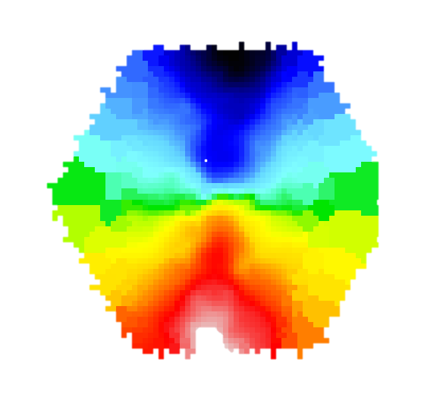

RELAXES TO SUSTAINED
COUNTER-ROTATION
COLD GAS RESERVIOR
RADIATIVE FEEDBACK
ΔPA ≥ 90○
RADIATION DRIVEN OUTFLOW
GAS
STARS
GAS LOSS
MISALIGNMENT RELAXES BUT MORE PRONE TO FUTURE MISALIGNMENT DUE TO RE-ACCRETION & SMALLER GAS CONTENT
HIGH ACCRETION MODE
(DUE TO MERGER?)
ΔPA ≥ 30○
ΔPA < 30○
ΔPA ≥ 30○
ΔPA ≥ 30○
GAS
STARS
GAS
STARS
GAS
STARS
GAS
STARS

