Slide 1
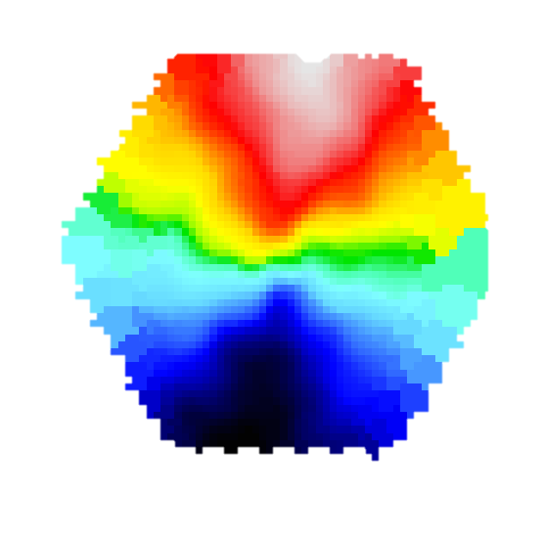
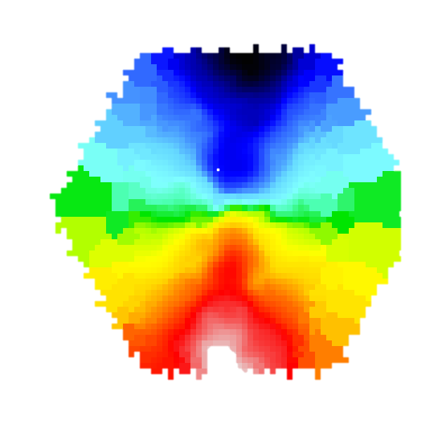

SUSTAINED
COUNTER-ROTATION
COLD GAS RESERVIOR
RADIATIVE FEEDBACK
ΔPA ≥ 150○
GAS
STARS
RADIATION DRIVEN OUTFLOW
GAS LOSS
MISALIGNMENT RELAXES BUT MORE PRONE TO FUTURE MISALIGNMENT DUE TO RE-ACCRETION & SMALLER GAS CONTENT
HIGH ACCRETION MODE
ΔPA ≥ 30○
ΔPA < 30○
ΔPA ≥ 30○
ΔPA ≥ 30○
GAS
STARS
GAS
STARS
GAS
STARS
GAS
STARS

