Slide 1

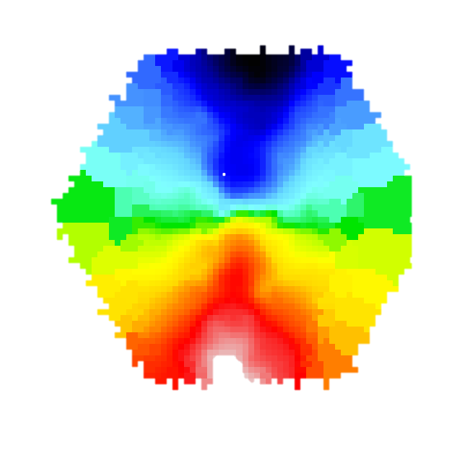

RELAXES TO SUSTAINED
COUNTER-ROTATION
COLD GAS INFLOW
RADIATIVE OUTFLOW
ΔPA ≥ 90○
GAS
STARS
MISALIGNMENT RELAXES BUT MORE PRONE TO FUTURE MISALIGNMENT DUE TO RE-ACCRETION & SMALLER GAS CONTENT
HIGH ACCRETION MODE
ΔPA ≥ 30○
ΔPA < 30○
ΔPA ≥ 30○
ΔPA ≥ 30○
GAS
STARS
GAS
STARS
GAS
STARS
STARS
GAS

