Slide 1

Group 3 Consultants
Recommendations for IronHack

Slide 2

Agenda
Where IronHack is now – Course Quality
Factors Influencing Course Quality
Where IronHack is now - Number of Customers
Factors influencing Number of Customers
Recommendations
Q&A

Slide 3
Where we are now – Course Quality
Using Average Overall Score as proxy for course quality
IronHack has 3rd highest average score, very close to 1st (le-Wagon)
2nd nyc-data-science-academy has around a quarter of IH’s reviews
Suggests course is high quality
Alumni comments are slightly higher

Slide 4
Consistent ratings last 3 Yeats
IronHack is always in top 3 highest rated schools
Second highest this year, up from 3rd in 2018
Our most successful competitor is Le-wagon who are the only school consistently above us in terms of average score

Slide 5
Potential factors influencing average score
No other factors from the dataset are strongly correlated with higher average score
Number of Country locations slightly correlated
Offering more types of courses has no bearing on how much people like the course
Keep course the same

Slide 6
Where we are now – Number of Customers
We are using number of reviews as a proxy for number of customers
Course quality is high Vs other schools – focus should be on expansion
Only Le-wagon & Udacity have more customers

Slide 7
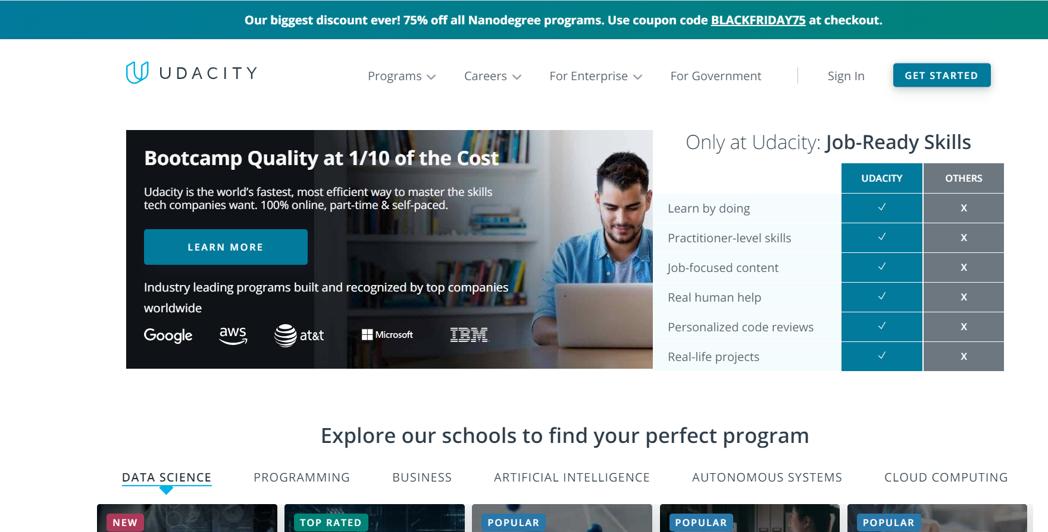
Udacity
Udacity provide online courses ‘Nanodegrees’ that are highly popular
This is a key area IronHack can expand into
Already have a syllabus and skills

Slide 8
Potential factors influencing number of customers
Number of comments is a proxy for the number of customers
Both the number Countries & School influences the number of comments
Therefore operating in more countries and locations will bring in more customers

Slide 9
Areas to expand
Recommend IronHack sets up campuses in London – England, Oslo – Norway, Melbourne – Australia, Stockholm - Sweden, Dubai – UAE as high income countries with high English speaking populations
Web development bootcamp is most popular – so start with that first
Countries Le-wagon operates in that IronHack does not: 'Argentina, Australia’, 'Belgium’, 'Canada’, Chile’, ‘China’, 'Denmark’, England’, 'Indonesia’, 'Israel’, 'Italy’, 'Japan’, 'Morocco’, 'Norway’, 'Singapore’, 'South Korea', 'Sweden’, 'Switzerland', 'Turkey’, 'United Arab Emirates’
Cities Le-wagon operates in that IronHack does not 'Bali', 'Belo Horizonte', 'Bordeaux', 'Brussels', 'Buenos Aires', 'Casablanca',Chengdu', 'Copenhagen', 'Dubai', 'Istanbul', 'Kyoto', 'Lausanne', 'Lille', 'London', 'Lyon', 'Marseille', 'Melbourne', 'Milan', 'Montreal', 'Munich', 'Nantes', 'Oslo', 'Rennes', 'Rio de Janeiro ‘, 'Rome', 'Santiago', 'Seoul', 'Shanghai', 'Shenzhen', 'Singapore', 'Stockholm', 'Tel Aviv', 'Tokyo', 'Toronto'

Slide 10
Courses to expand
Of the top 10 most commented programmes, 3 contain the term “Data Science”
Therefore offering a “Data Science” bootcamp alongside the Data Analytics can be a key area to expand
program | Review
FullStack program - 35+ locations | 1038
Software Engineer Track: In-Person | 731
Full-time Web Development Bootcamp | 362
DATA SCIENCE | 356
FullStack program | 307
Data Science | 262
Web Development Course - Full-Time | 211
Data Science Career Track | 202
AI Programming with Python | 182
Front End Web Developer | 170

Slide 11
Recommendation
Course Quality high – little improvement
Expand into online self-study courses like Udacity
Open more locations in high income, English speaking countries
Offer Data Science Course alongside Analytics

Slide 12
Thank you – Q&A

