Slide 1
NutriMatch
A Hybrid Recipe Recommendation System
with Dietary Constraints and Explainable Recommendations
CS 513 Final Project

Slide 2
Agenda
1. Problem & Motivation
2. Dataset & Preprocessing
3. Exploratory Data Analysis
4. Methodology: Three Parallel Approaches
5. Version A: Content-Based Recommendation
6. Version B: Collaborative Filtering
7. Version C: Hybrid Recommendation
8. Cross-Version Comparison & Analysis
9. Key Findings
10. Practical Implications
11. Conclusion & Future Work

Slide 3
Problem Statement & Motivation
The Challenge:
Recipe discovery is harder than generic search because users have multiple constraints:
taste preferences, available ingredients, cooking time, nutrition goals, dietary restrictions
Why existing approaches fall short:
Popularity-based: ignores personal preferences entirely
Content-based: can't capture 'people like you also liked...' patterns
Collaborative filtering: fails for new users or items with no history (cold start)
Our Research Questions:
Q1. How much does collaborative filtering improve over a popularity baseline?
Q2. How much do metadata features help for sparse users and items?
Q3. Can a hybrid recommender balance precision, coverage, and practicality?

Slide 4
Dataset: Food.com Recipes & Reviews
Metric | Raw Data | After Cleaning | CF Subset
Recipes | 231,637 | 230,543 | 39,844
Interactions | 1,132,367 | 1,067,281 | 533,018
Users | - | 195,468 | 16,973
Sparsity | - | - | 99.92%
Train set | - | - | 507,043
Test set | - | - | 10,069
Features: explicit ratings, ingredients, tags, nutrition, prep time, timestamps
Temporal split: each user's last interaction held out for evaluation
CF subset: users and recipes with >= 5 ratings each
Two data views: full metadata (content) + filtered interactions (CF)
This allows honest study of cold-start and sparsity, not just one preprocessing choice

Slide 5
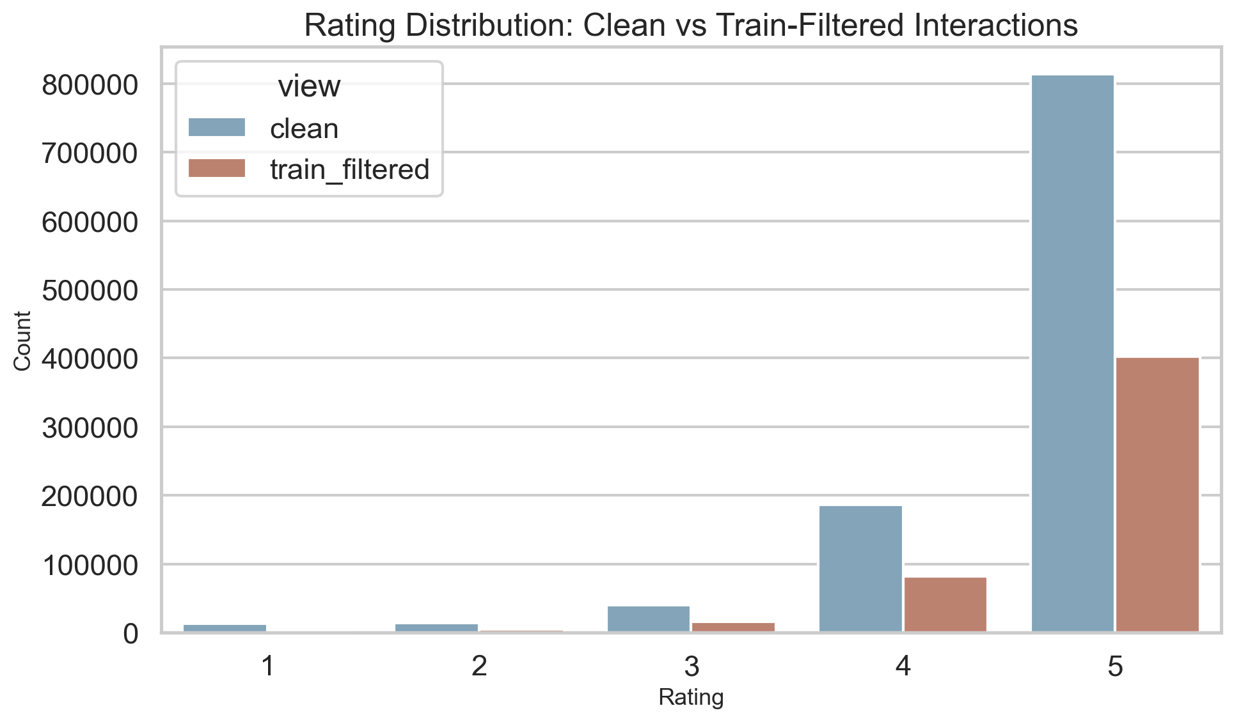
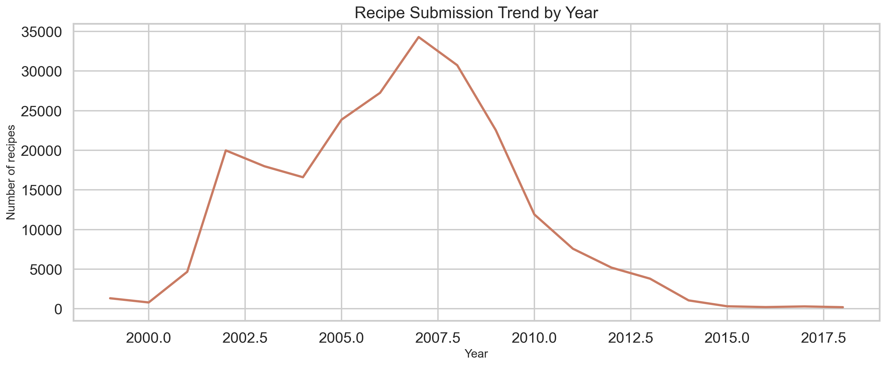
EDA: Rating Distribution & Submission Trends
Understanding the shape of the data before modeling
Left: Ratings are heavily skewed toward 5 stars - most interactions are positive
This means binary positive/negative signal is more useful than fine-grained rating prediction
Right: Recipe submissions peaked around 2008-2010, then declined
Older recipes dominate the catalog; newer recipes may have less history

Slide 6
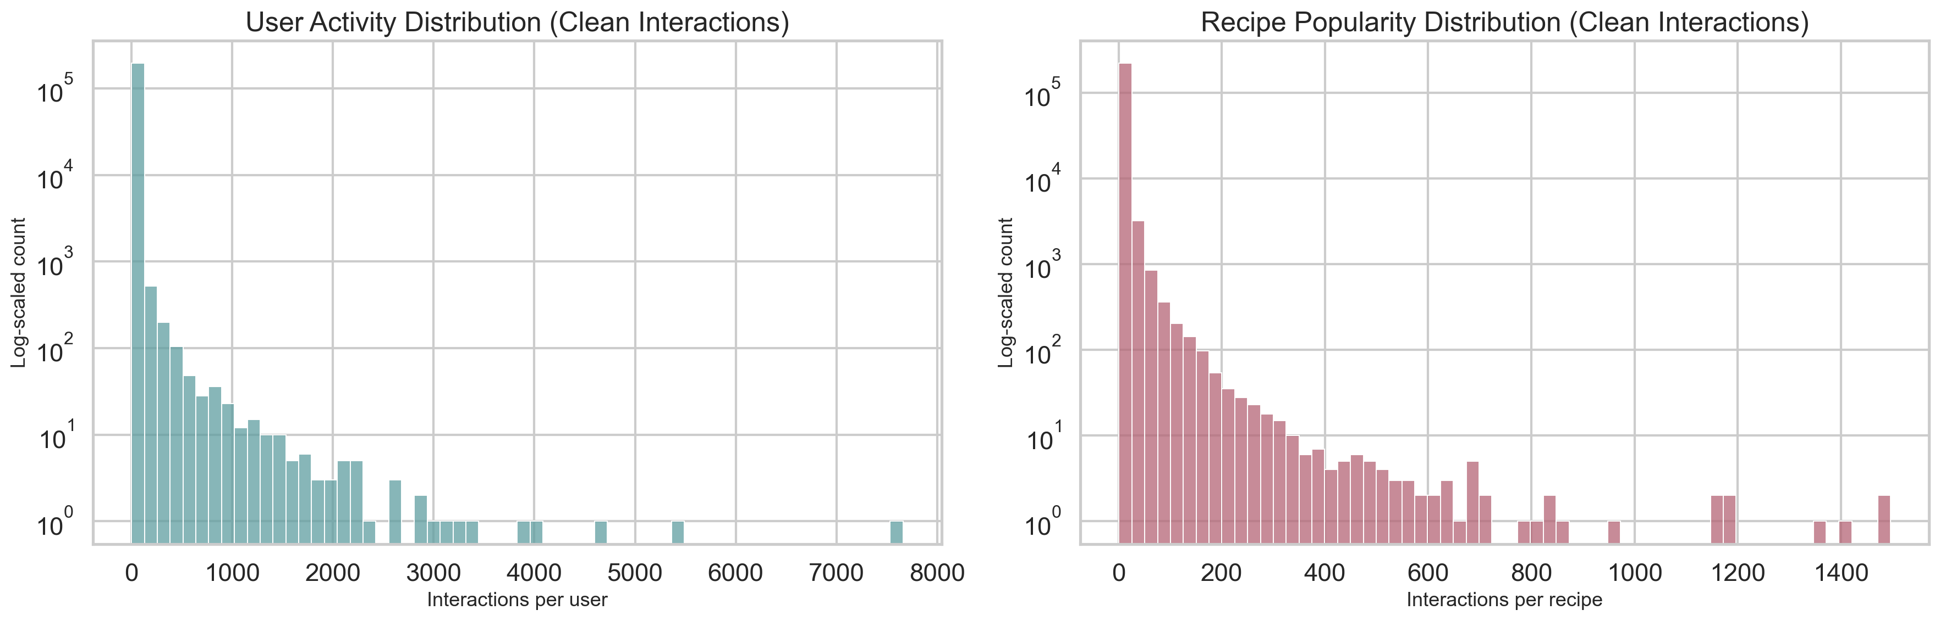
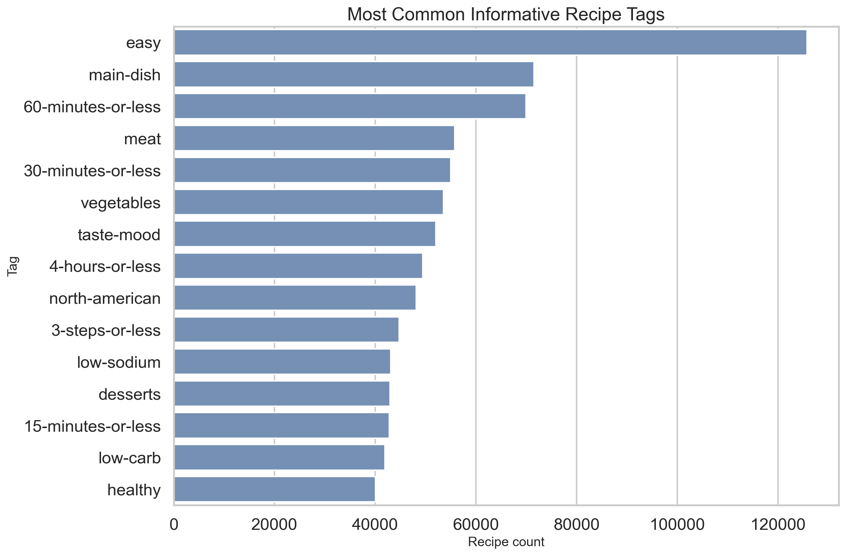
EDA: Interaction Density & Content Features
Identifying sparsity patterns and informative metadata
Left: Long-tail distribution - most users and recipes have very few interactions
This justifies the need for content features to supplement sparse interaction data
Right: Tags like cuisine type, dietary labels, and meal type are highly informative
These features power content-based and hybrid recommendation

Slide 7
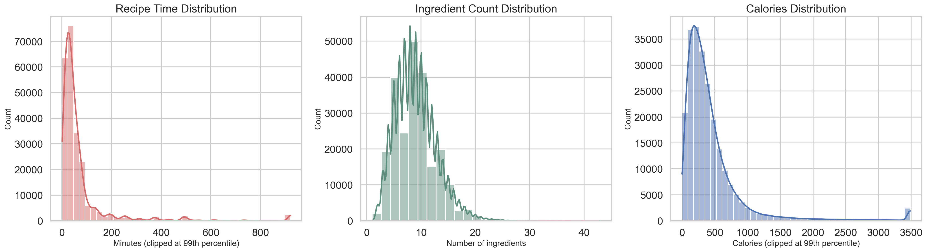
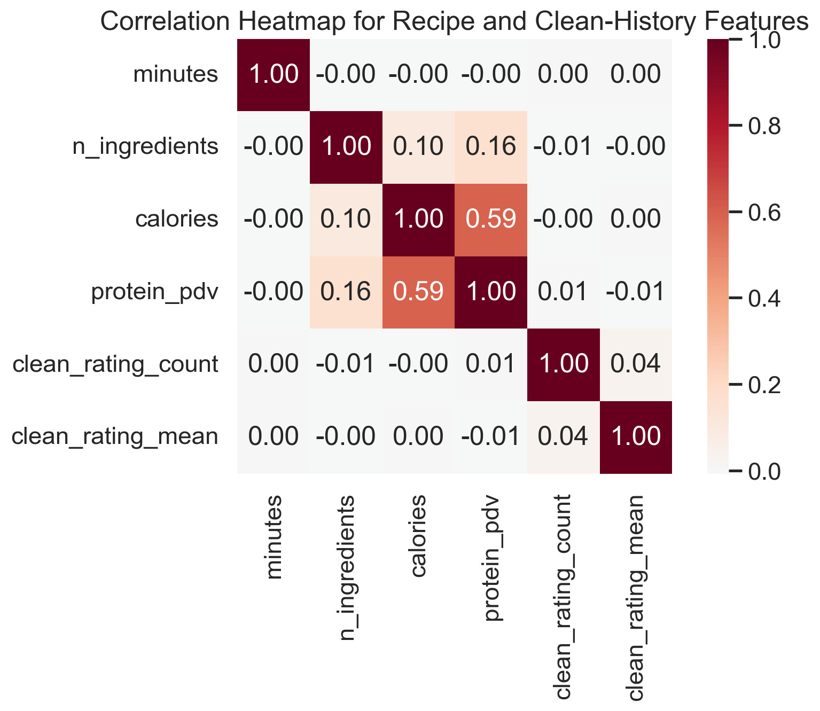
EDA: Recipe Metadata & Feature Correlations
Examining the richness of recipe-level features
Left: Prep time, ingredient count, and step count vary widely across recipes
These features support practical filters (quick meals, simple recipes)
Right: Correlation heatmap shows nutrition features are moderately correlated
Ingredient count and step count correlate with complexity metrics

Slide 8
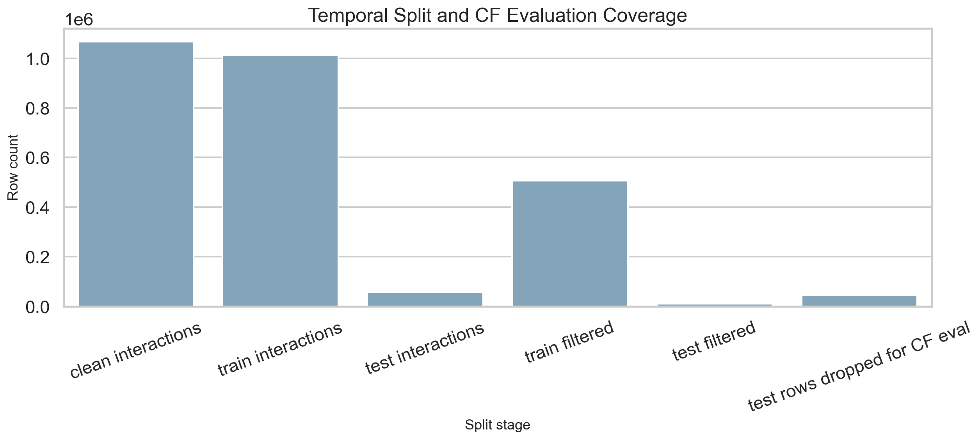
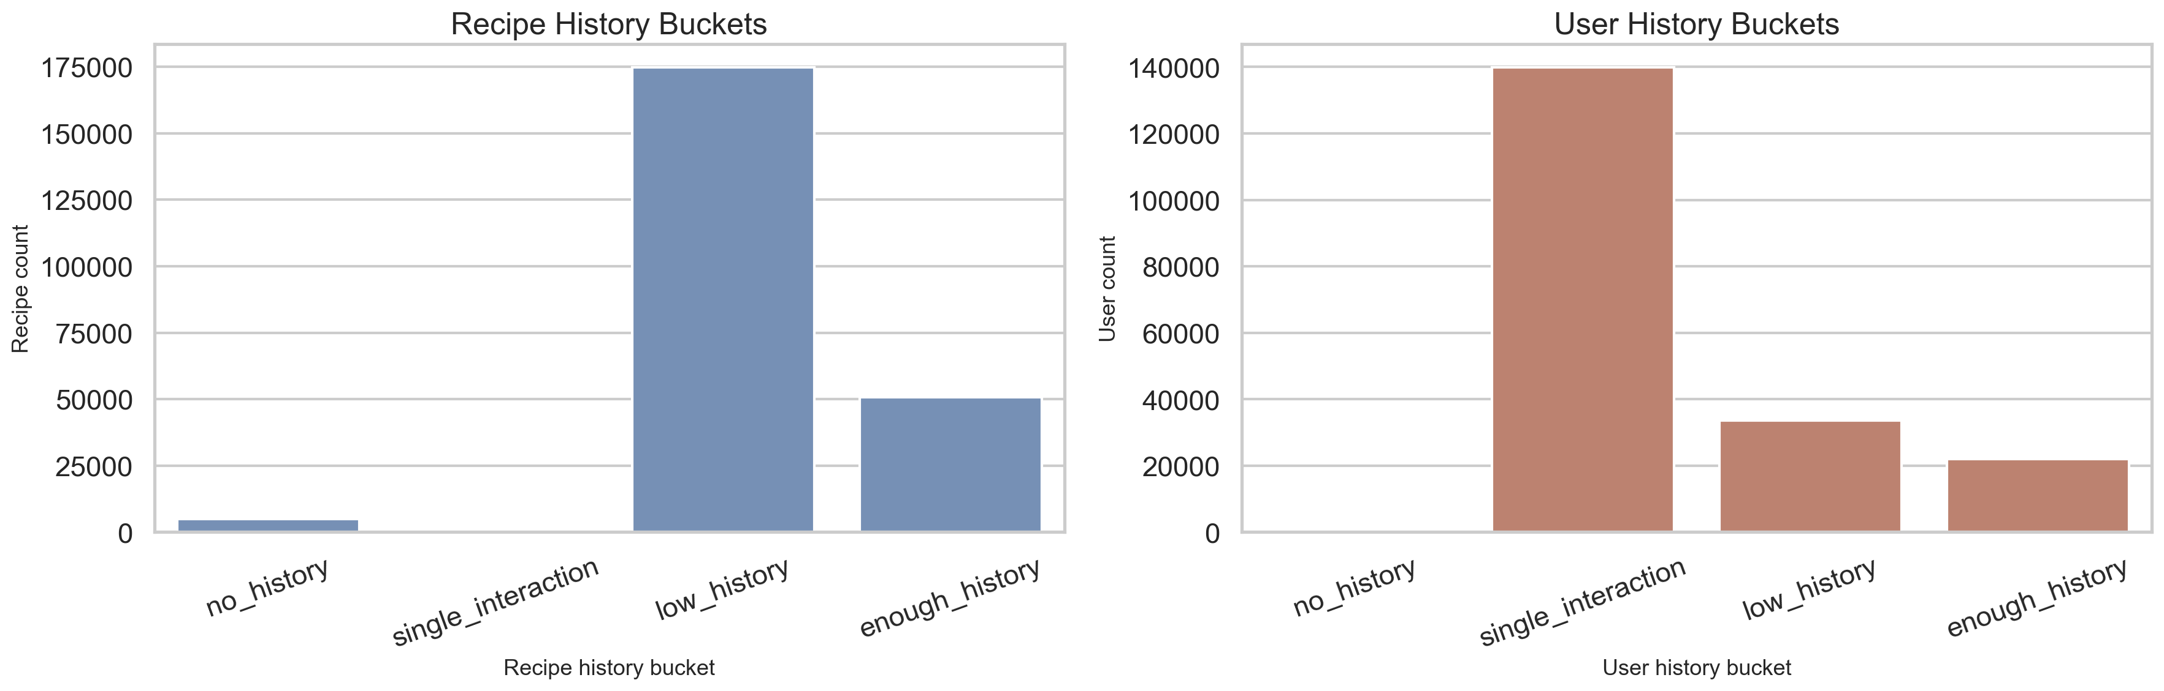
EDA: Temporal Split & User History Buckets
Setting up a realistic evaluation framework
Left: Per-user temporal holdout - each user's last interaction is the test item
This respects chronological order, unlike random splits that cause data leakage
Right: Users grouped by history size - many users have minimal history
This motivates hybrid methods that handle sparse and rich users differently

Slide 9
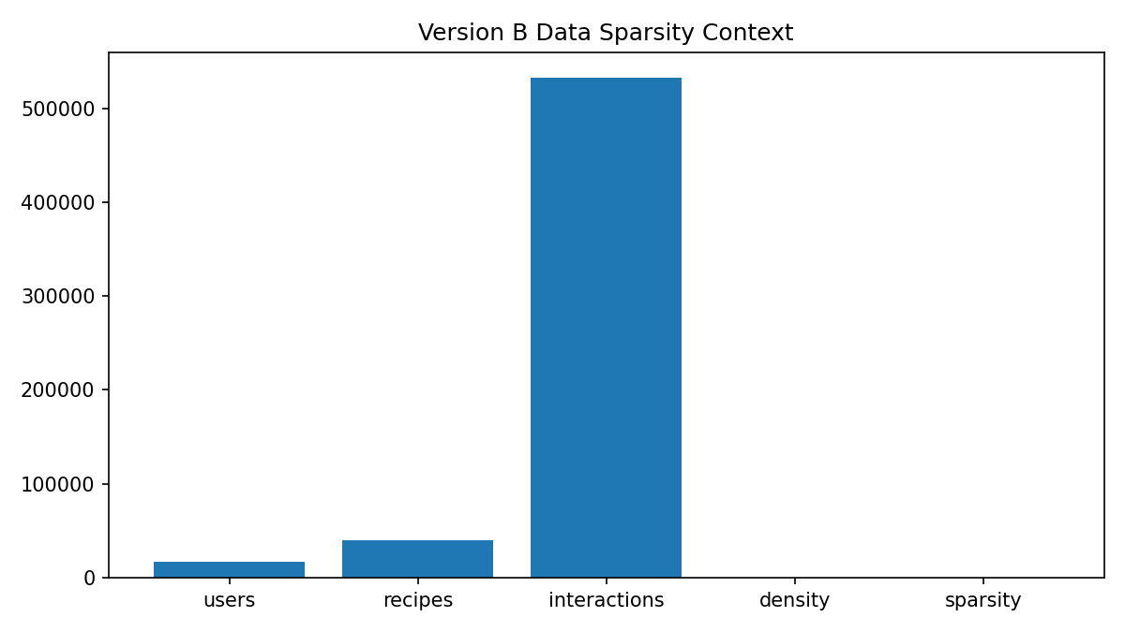
EDA: Data Sparsity for Collaborative Filtering
Why sparsity is the fundamental challenge
16,973 users x 39,844 recipes
533,018 interactions out of 676M possible
Density: 0.079% | Sparsity: 99.92%
Implications for modeling:
Pure CF can only work where history exists
Content features are needed for the 99.9% empty cells
This is the core motivation for hybrid approaches

Slide 10
Methodology: Three Parallel Approaches
Shared data foundation + independent modeling tracks
Version A: Content-Based
Version B: Collaborative Filtering
Version C: Hybrid
A0: Bayesian popularity
A2: TF-IDF item-to-item
A3: User-profile TF-IDF
A4: Content + popularity reranker
A5: SVD semantic content
B0: Bayesian popularity
B1: User-based kNN
B2: Item-based kNN (implicit)
B3: Item-based kNN (weighted)
B4: SVD matrix factorization
C0: SVD CF baseline
C1: TF-IDF content baseline
C2: Weighted hybrid
C3: Switching hybrid
C4: Reciprocal Rank Fusion
Shared Evaluation Protocol
Same temporal train/test split | Same positive threshold (rating >= 4)
Metrics: Precision@10, Recall@10, NDCG@10, Catalog Coverage@10, Hit Rate@10
All models exclude training items from recommendations (no leakage)

Slide 11
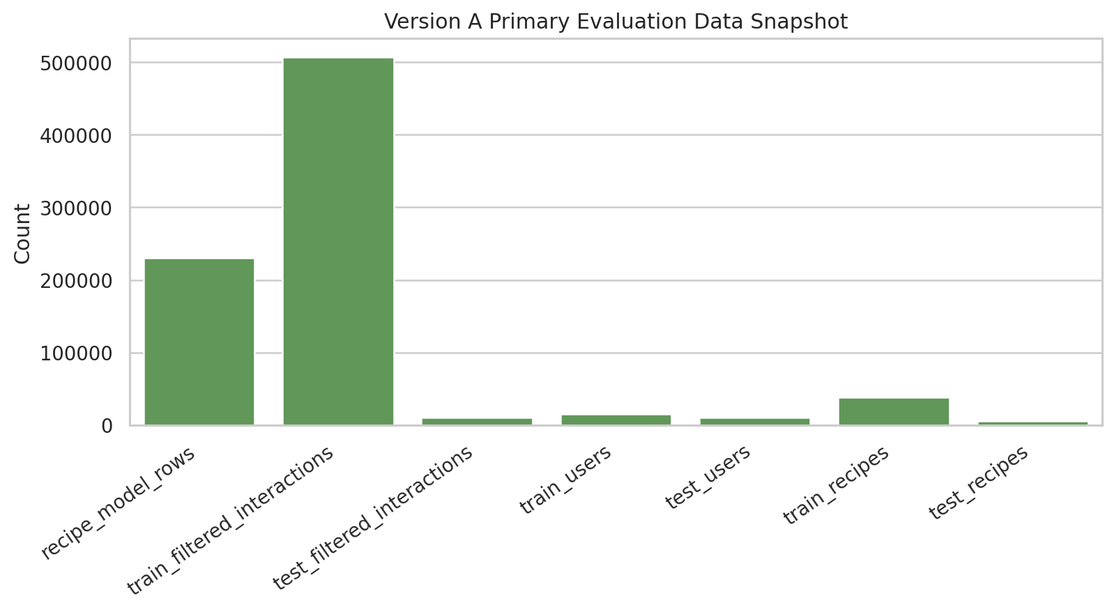
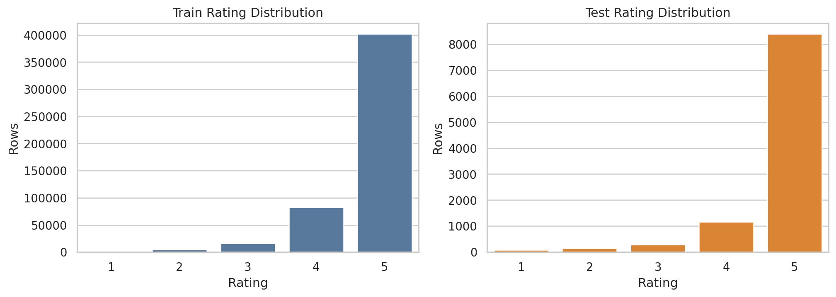
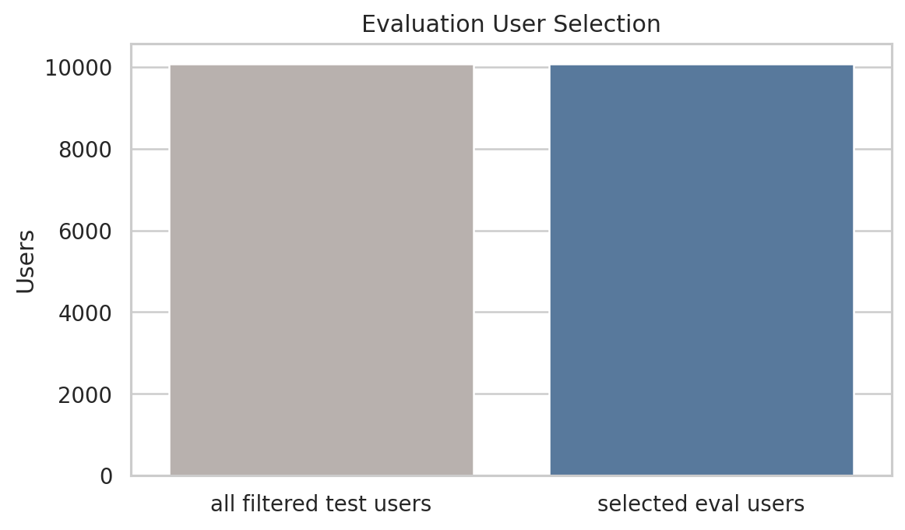
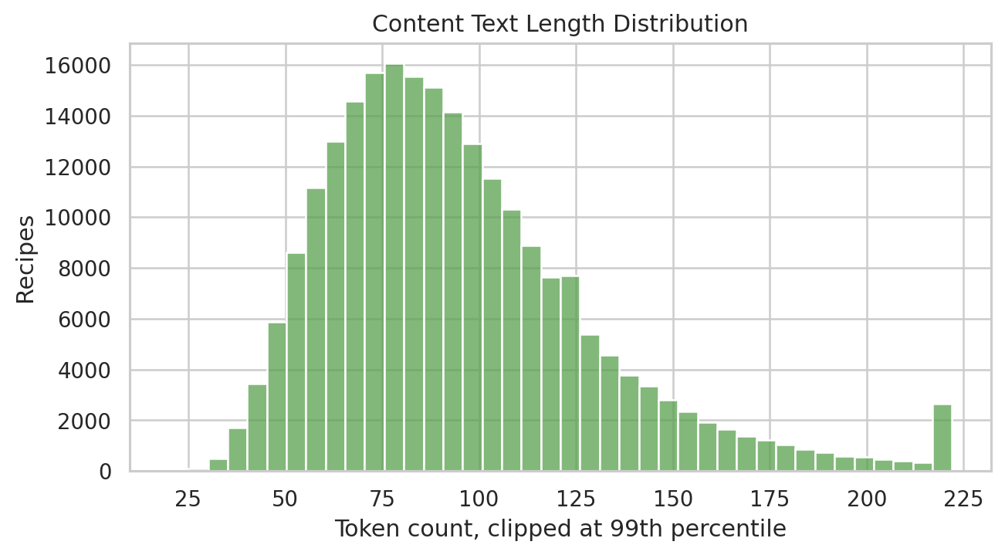
Version A: Data Foundation
Understanding the data before building content models

Slide 12
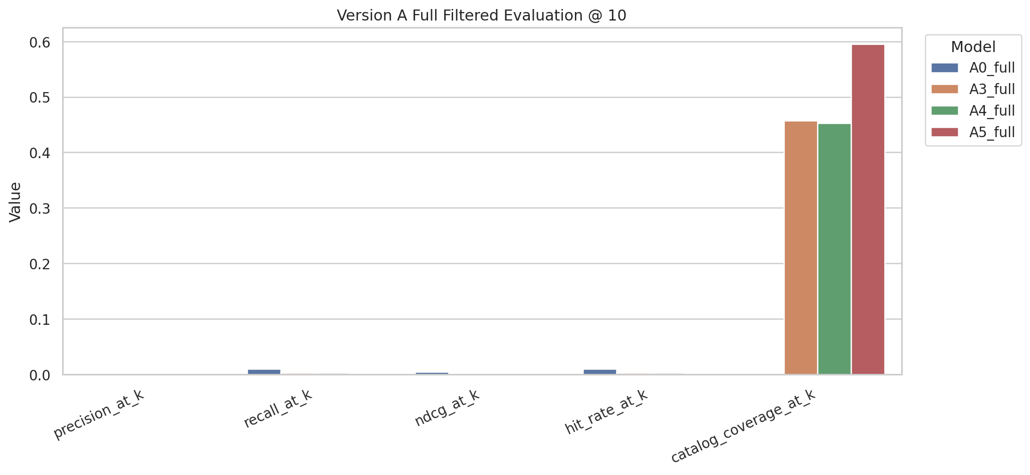
Version A: Content-Based Results
5 models evaluated on the filtered temporal split
Model | Prec@10 | Recall@10 | NDCG@10 | Coverage@10 | Sec/User
A0 Bayesian Pop | 0.00100 | 0.01003 | 0.00462 | 0.06% | 0.0035
A2 TF-IDF item | 0.00022 | 0.00218 | 0.00113 | 44.85% | 0.286
A3 User-profile | 0.00027 | 0.00268 | 0.00132 | 45.74% | 0.058
A4 Content+Pop | 0.00027 | 0.00268 | 0.00134 | 45.30% | 0.061
A5 SVD semantic | 0.00021 | 0.00209 | 0.00096 | 59.51% | 0.016
A4 selected as Version A's best model:
Best NDCG among personalized models
45% coverage (vs 0.06% for popularity)
Lightweight: 0.06 sec/user
Key insight: content models trade precision
for much broader item coverage

Slide 13
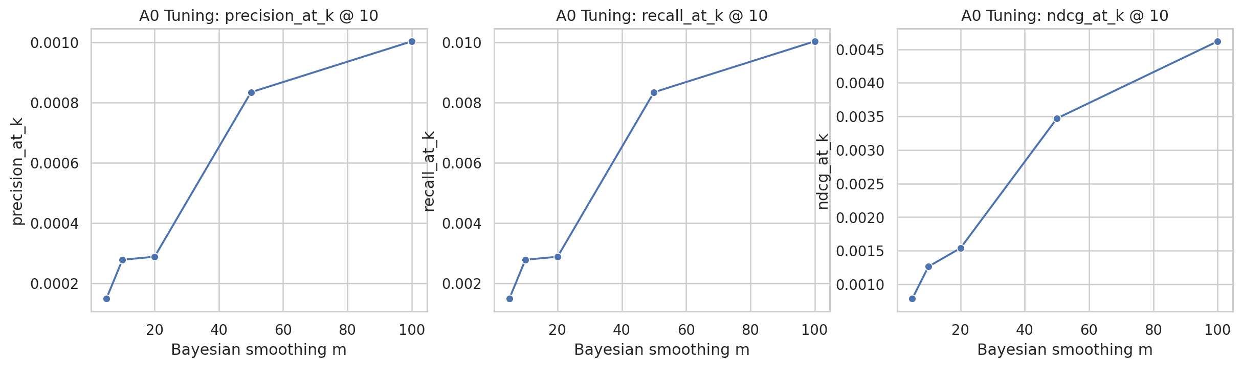
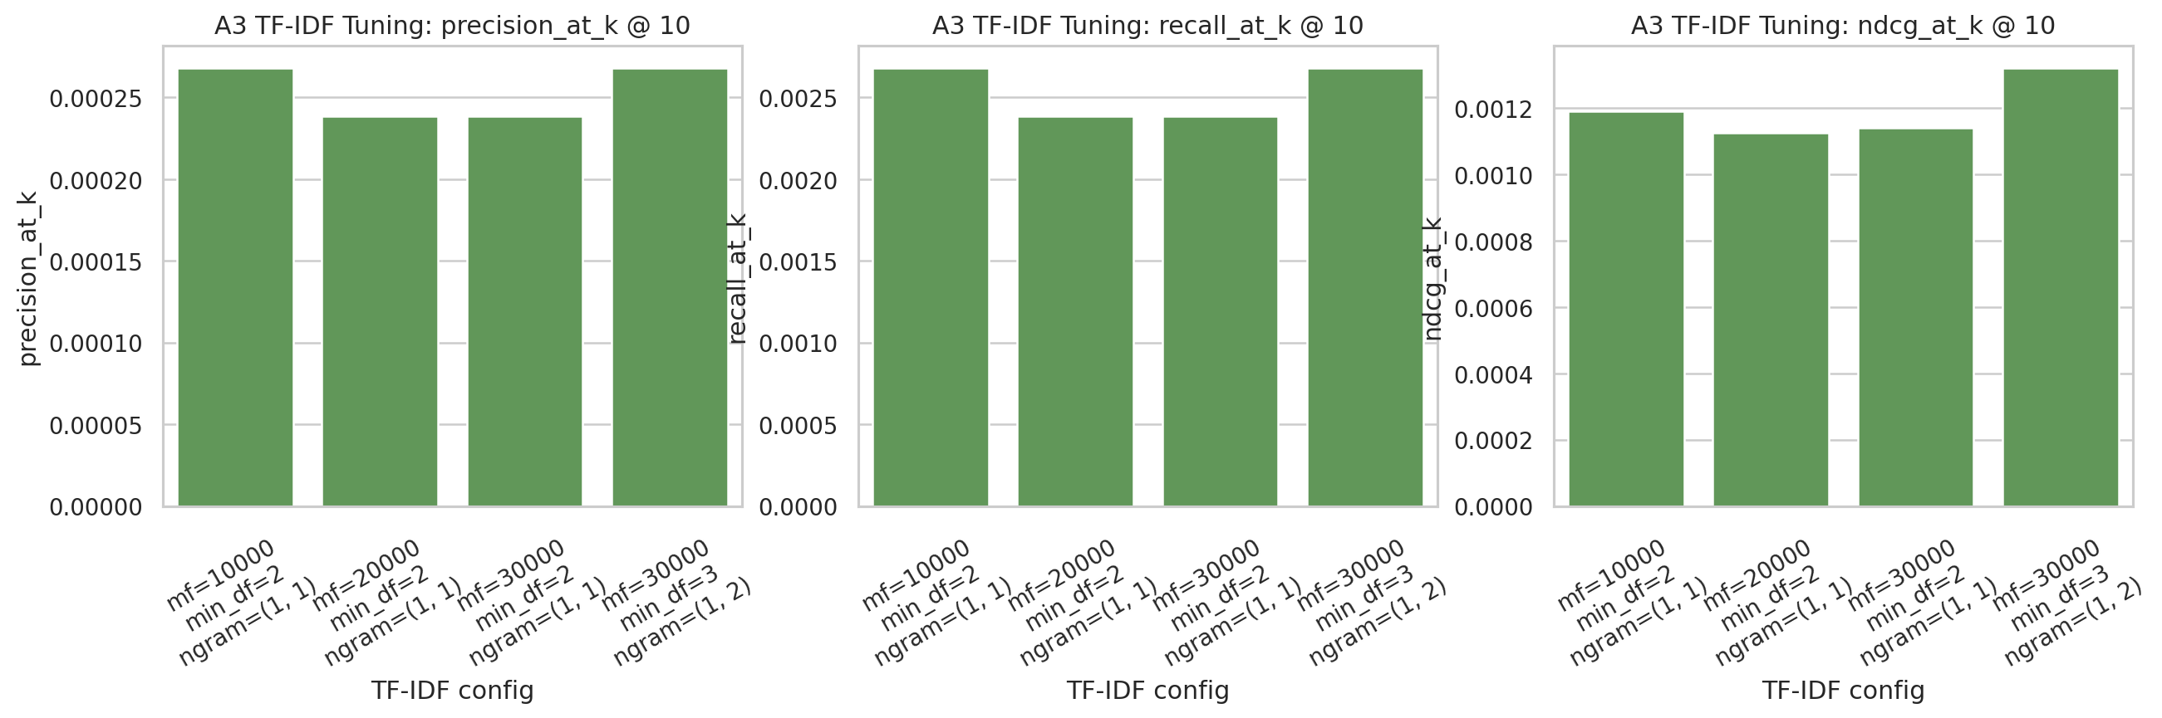
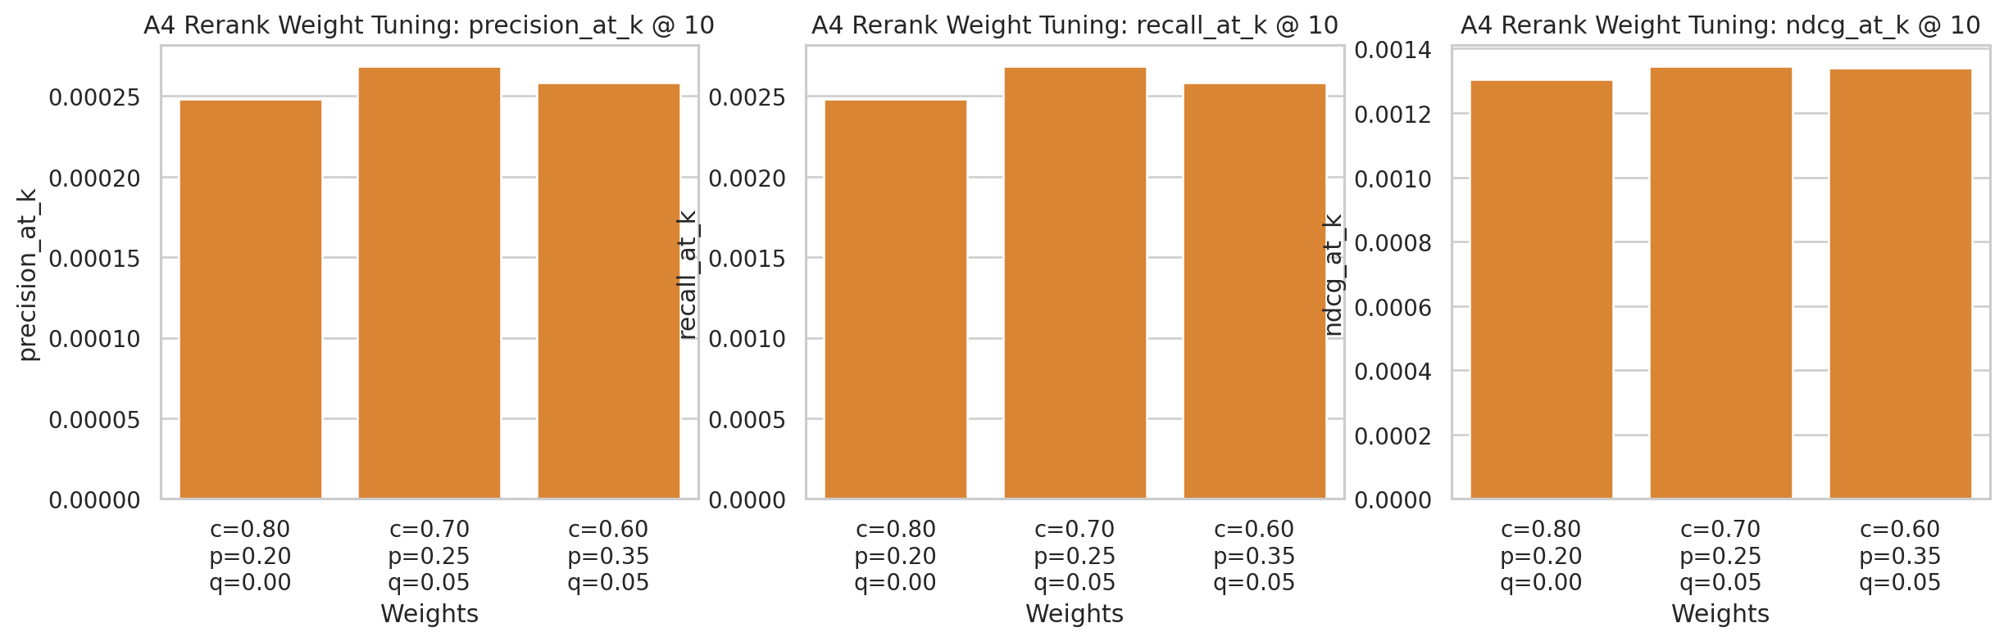
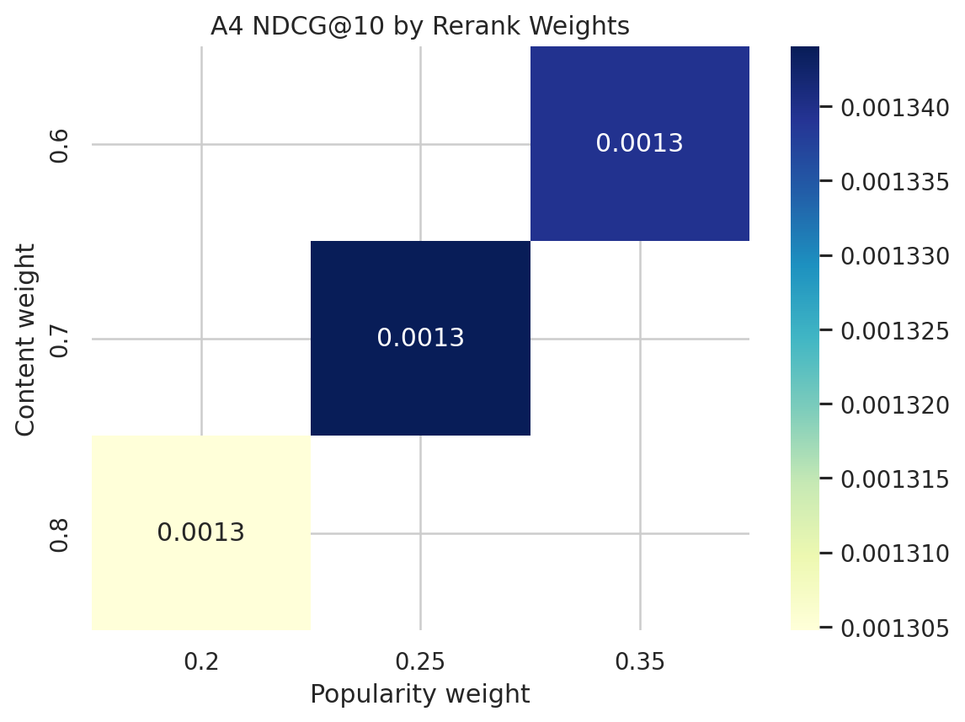
Version A: Hyperparameter Tuning
Finding optimal parameters for each content model

Slide 14
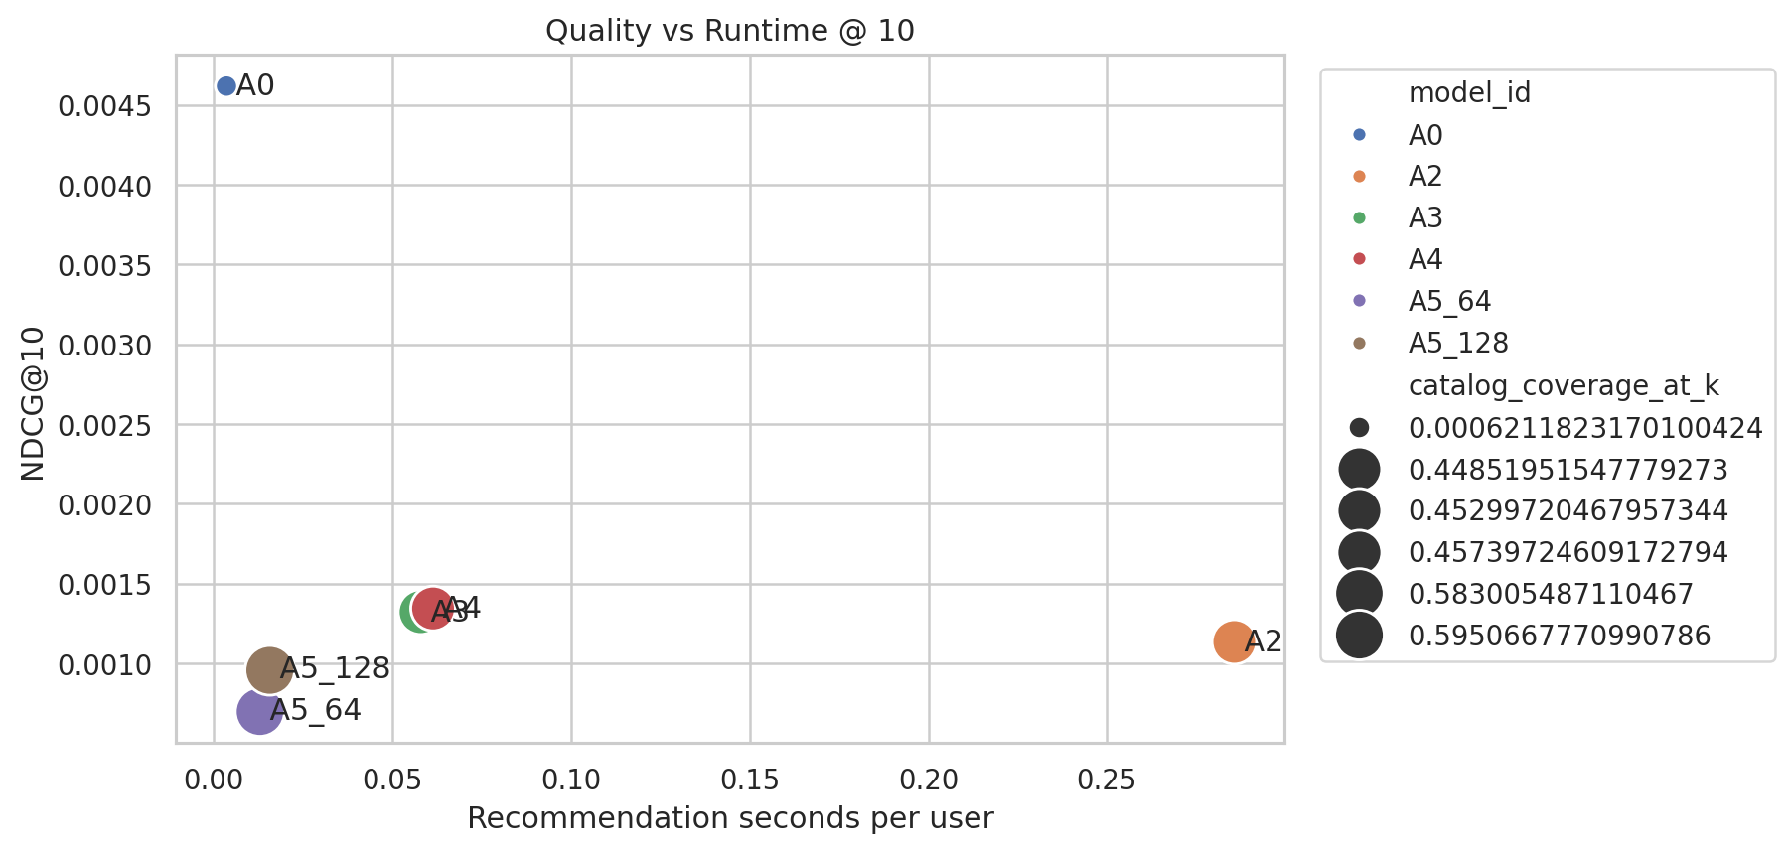
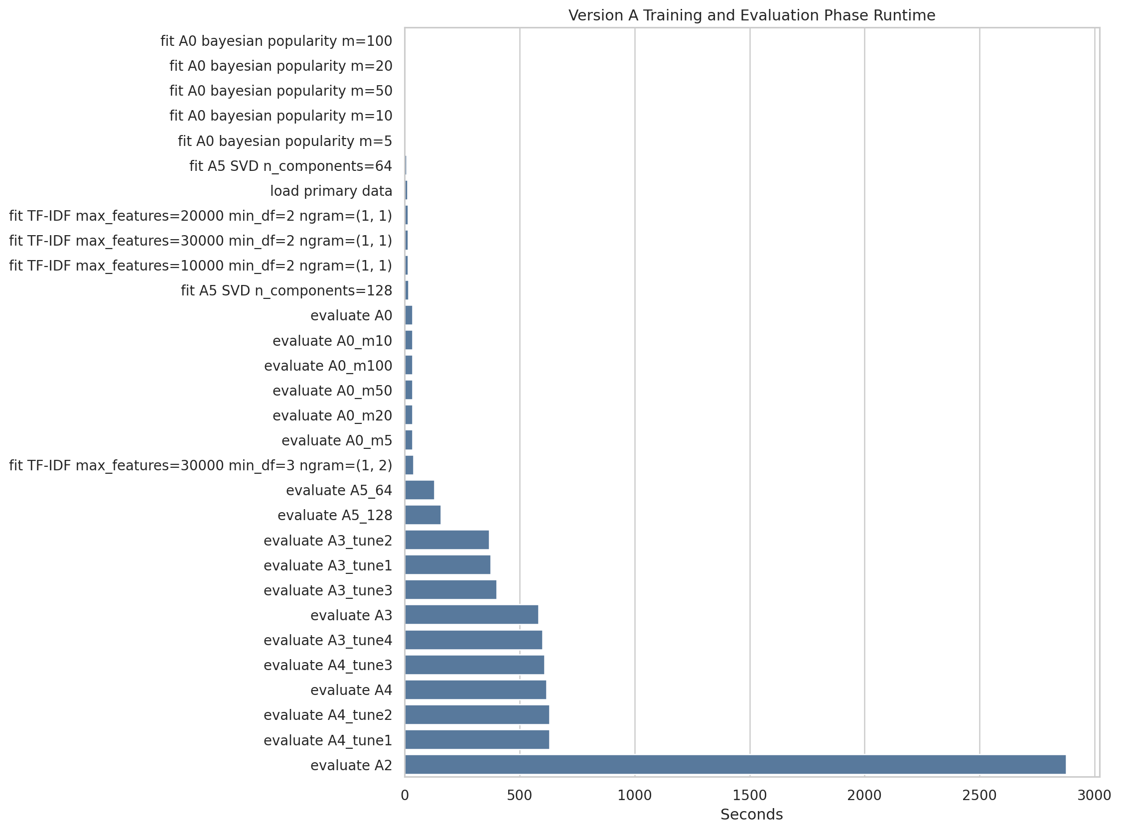
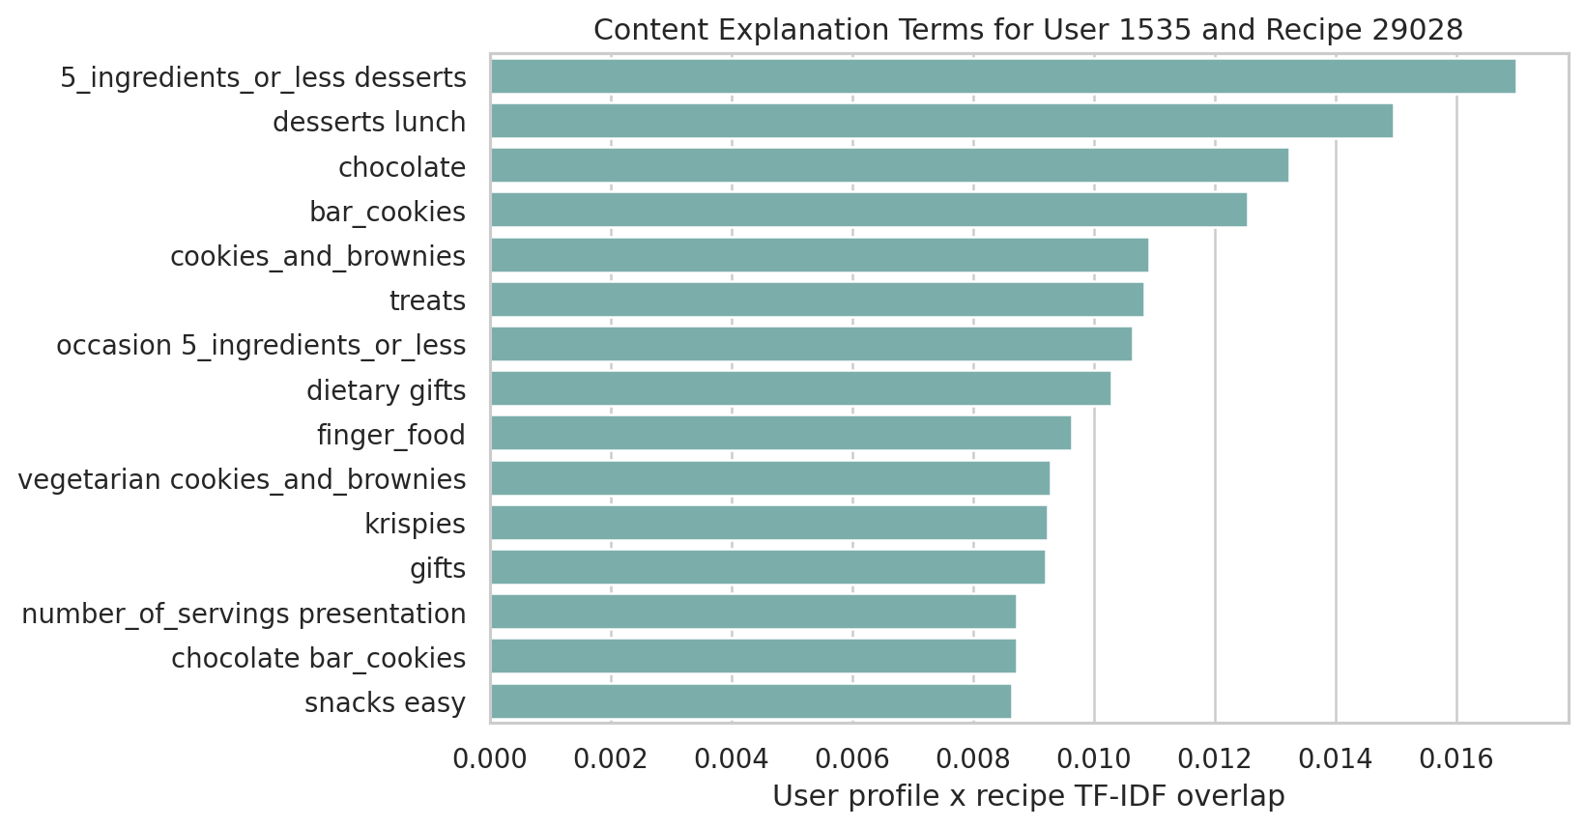
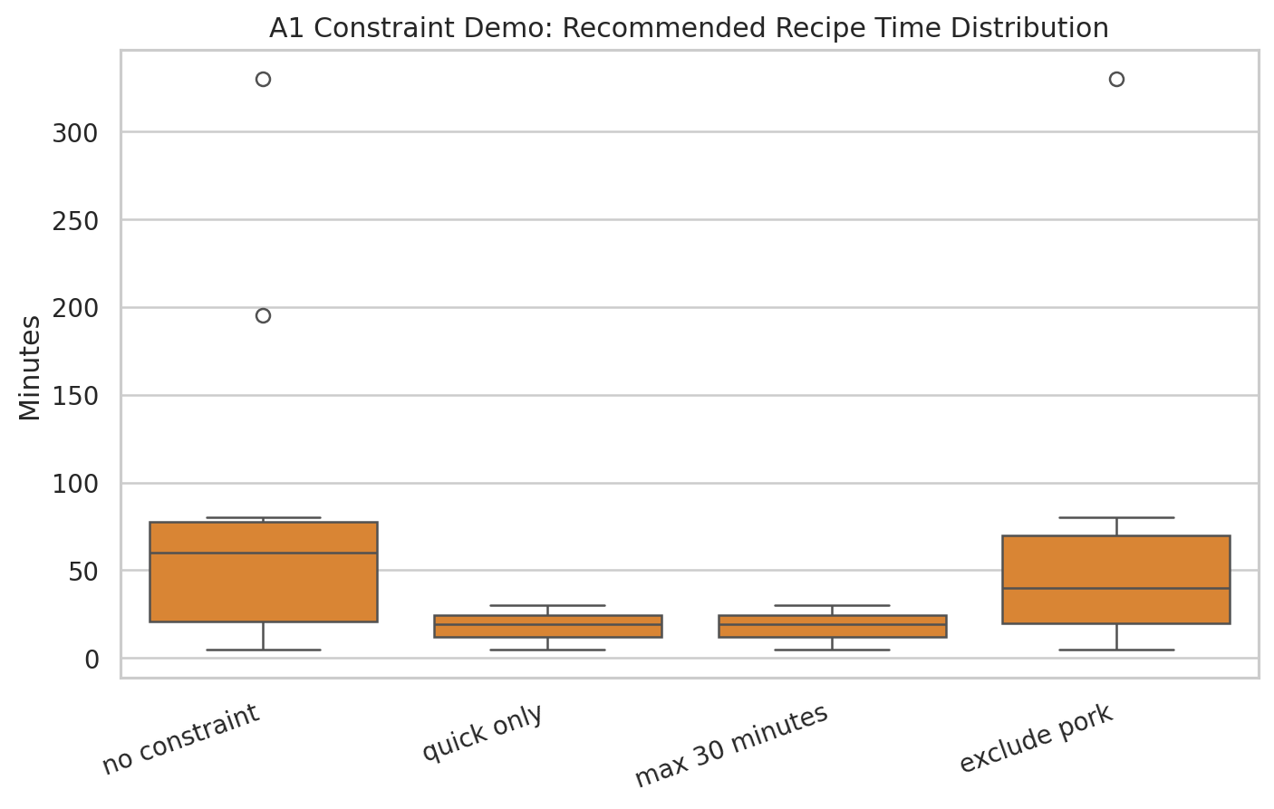
Version A: Quality, Runtime & Explainability
Content models offer interpretability that CF cannot

Slide 15
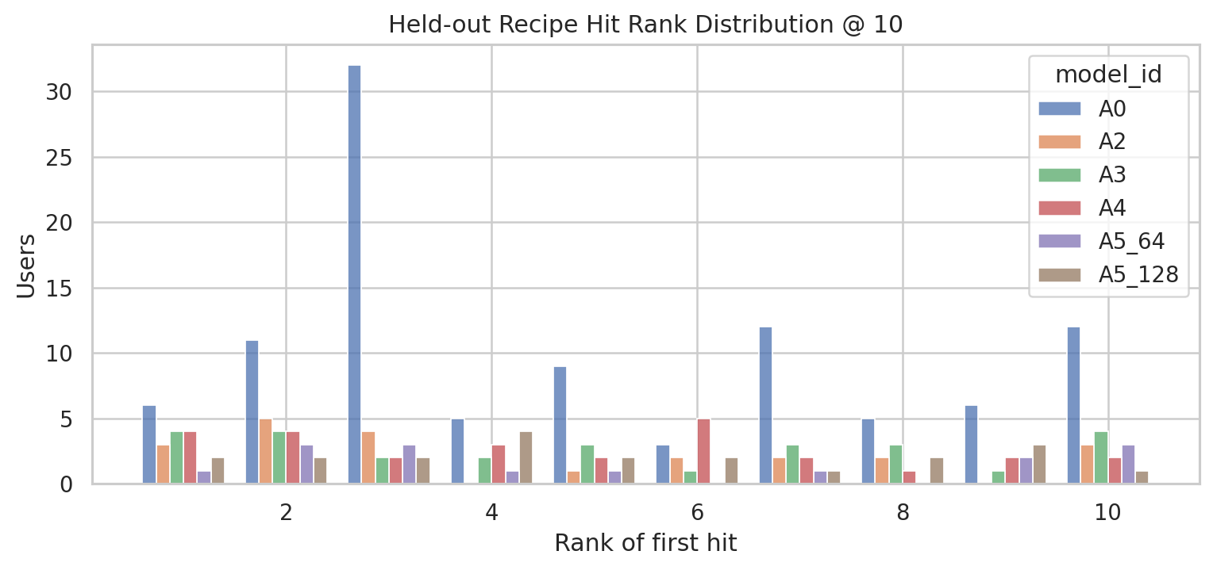
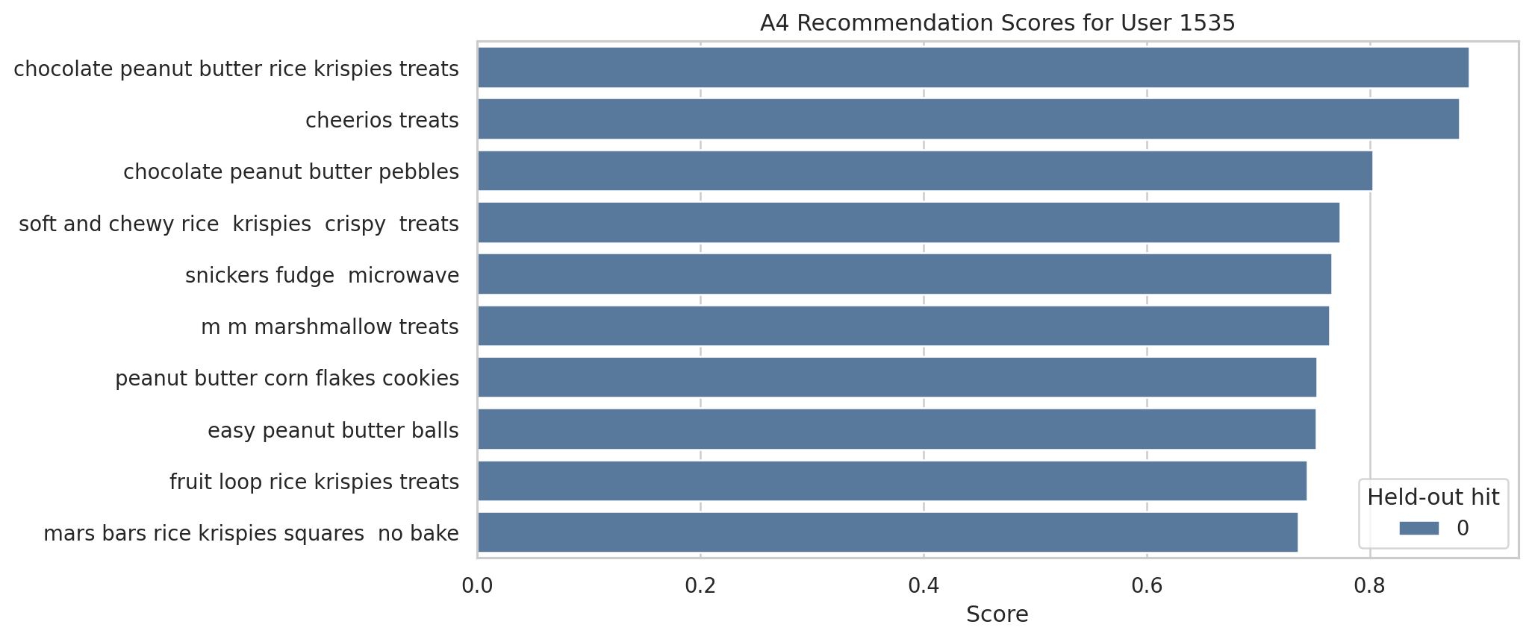
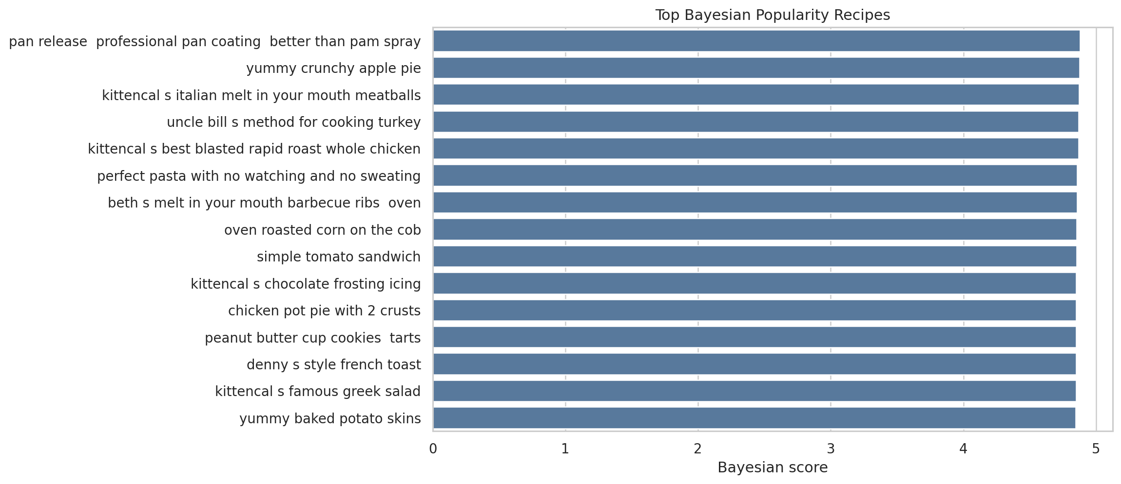
Version A: Hit Distribution & Recommendation Examples
Where content models succeed and where they struggle
Hit rank distribution: A0 (popularity)
concentrates hits at rank 3 - when it
hits, it hits early
Content models hit more uniformly
across all 10 positions
Popularity baseline recommends the
same few recipes to everyone - hence
the 0.06% coverage

Slide 16
Version A: Summary & Transition to Version B
Version A established the content-based baseline:
Strengths:
High catalog coverage (45-60%) - recommends diverse recipes
Interpretable - can explain via shared ingredients, tags, nutrition
Handles cold-start users and items naturally
Supports practical filters (prep time, dietary constraints)
Weaknesses:
Low absolute NDCG (best = 0.00134) - not very accurate
Cannot capture collaborative signals ('people like you also liked...')
Question for Version B:
How much does adding user interaction patterns improve precision?
And what do we lose in return?

Slide 17
Version B: Collaborative Filtering Results
5 models using user-item interaction patterns
Model | Prec@10 | Recall@10 | NDCG@10 | Coverage@10 | Sec/User
B0 Popularity | 0.00103 | 0.01027 | 0.00471 | 0.06% | 0.000005
B1 User-kNN | 0.00193 | 0.01927 | 0.00984 | 15.38% | 0.000614
B2 Item-kNN impl | 0.00088 | 0.00880 | 0.00443 | 46.77% | 0.003000
B3 Item-kNN wgt | 0.00068 | 0.00681 | 0.00387 | 54.50% | 0.001521
B4 SVD (d=64) | 0.00252 | 0.02524 | 0.01309 | 3.26% | 0.000896
B4 SVD is the clear winner: NDCG = 0.01309, roughly 10x better than A4
Matrix factorization captures latent user-item patterns that content features miss
But B4 coverage is only 3.26% - it recommends from a very narrow pool
Item-kNN models (B2/B3) have high coverage but poor precision
Answer to Q1: CF improves dramatically over the popularity baseline

Slide 18
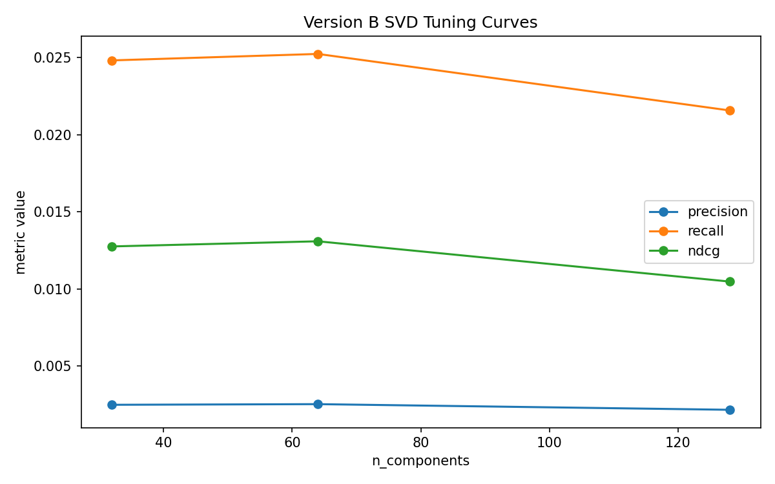
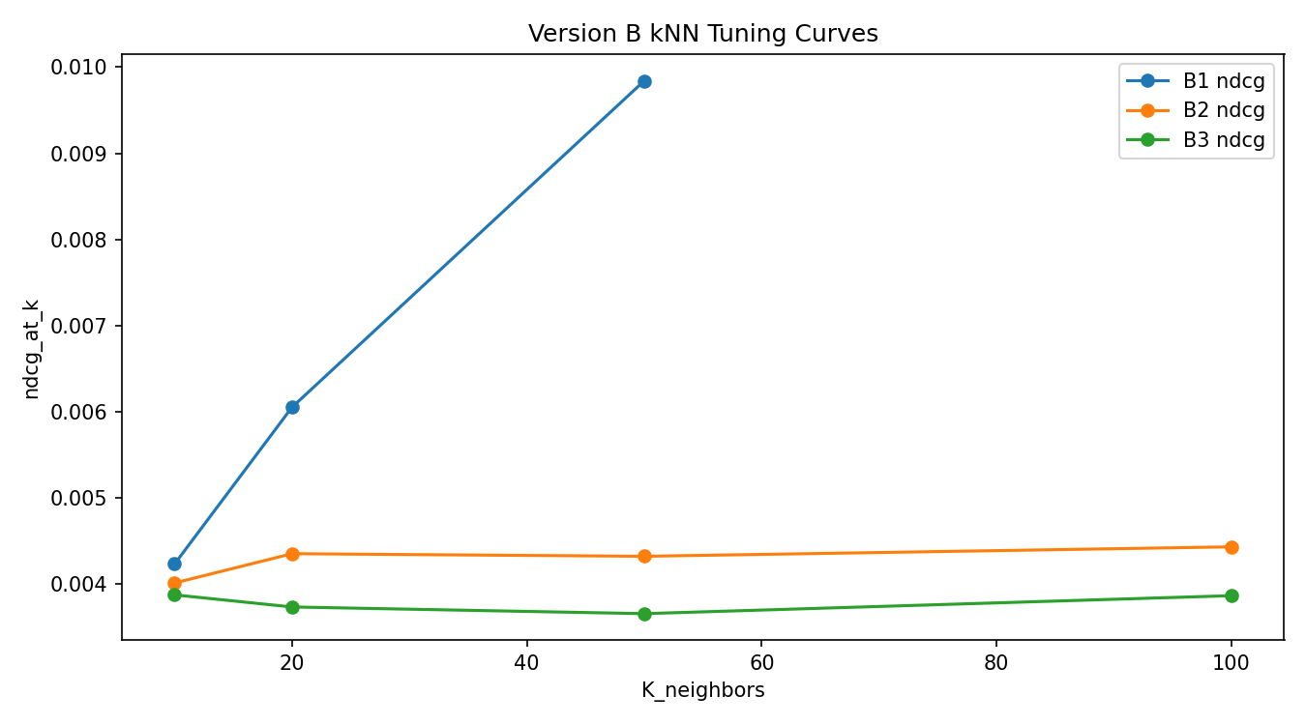
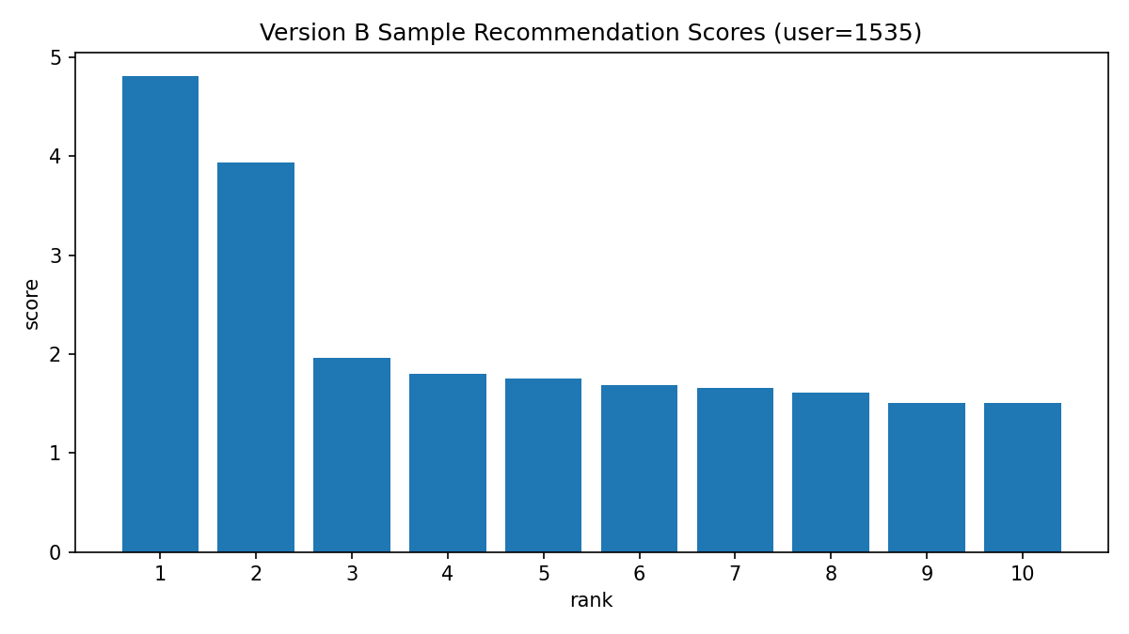
Version B: Hyperparameter Tuning & Analysis
SVD components and kNN neighbor count optimization
SVD tuning (top-left):
64 components is optimal
128 overfits, 32 underfits
kNN tuning (top-right):
User-kNN improves with more
neighbors; item-kNN is stable
Score distribution (bottom-left):
Clear ranking separation between
top-ranked and lower items

Slide 19
Version B: Summary & Transition to Version C
Version B demonstrated the power of collaborative filtering:
Strengths:
B4 SVD achieves NDCG 10x higher than best content model
Fast inference: < 1ms per user recommendation
Captures real user preference patterns from interaction history
Weaknesses:
Very low catalog coverage (3.26%) - echo chamber risk
Cannot handle cold-start users or items with no history
Not interpretable - can't explain why a recipe was recommended
The natural next question:
Can we combine CF's precision with content's coverage?
This is exactly what Version C attempts with hybrid methods

Slide 20
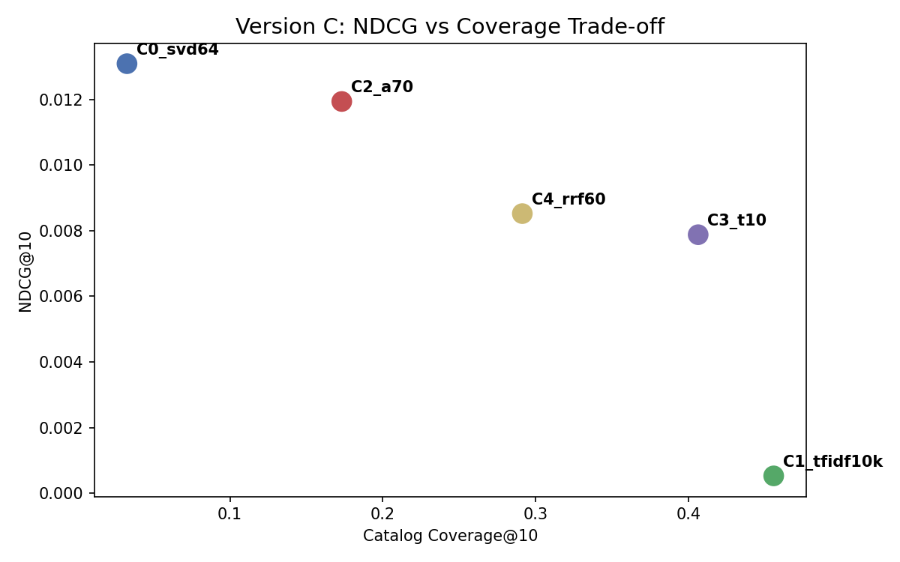
Version C: Hybrid Recommendation Results
Combining the strengths of content and collaborative filtering
Model | Prec@10 | Recall@10 | NDCG@10 | Coverage@10 | Method
C0 SVD CF | 0.00252 | 0.02524 | 0.01309 | 3.26% | Pure CF (baseline)
C1 TF-IDF | 0.00011 | 0.00105 | 0.00053 | 45.57% | Pure content (baseline)
C2 Weighted | 0.00220 | 0.02200 | 0.01194 | 17.31% | 0.7*CF + 0.3*content
C3 Switching | 0.00155 | 0.01550 | 0.00788 | 40.63% | CF or content per user
C4 RRF | 0.00166 | 0.01655 | 0.00852 | 29.12% | Rank fusion
C2 Weighted Hybrid is the best trade-off:
NDCG = 0.01194 (only 9% below pure CF)
Coverage = 17.3% (5x better than pure CF)
C3 Switching: 41% coverage, adapts per user
CF for 57% of users, content for 43%
C4 RRF: 29% coverage, score-scale agnostic

Slide 21
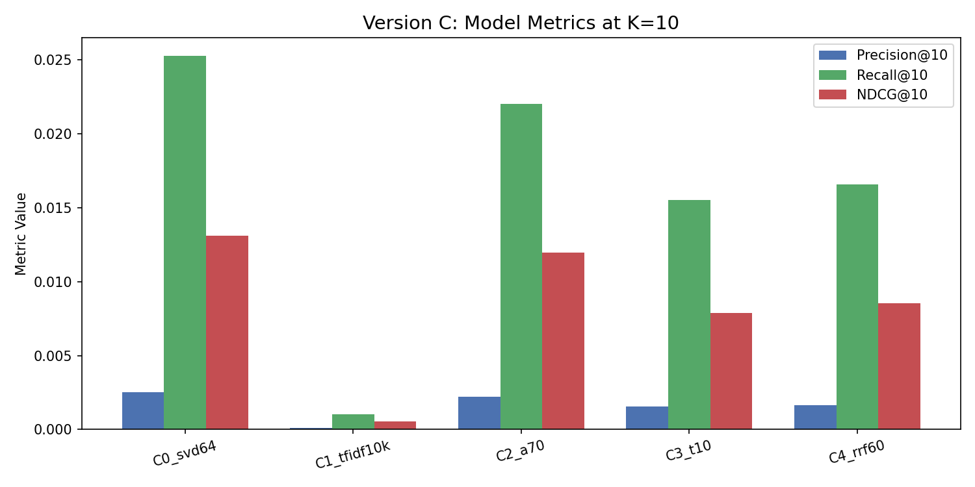
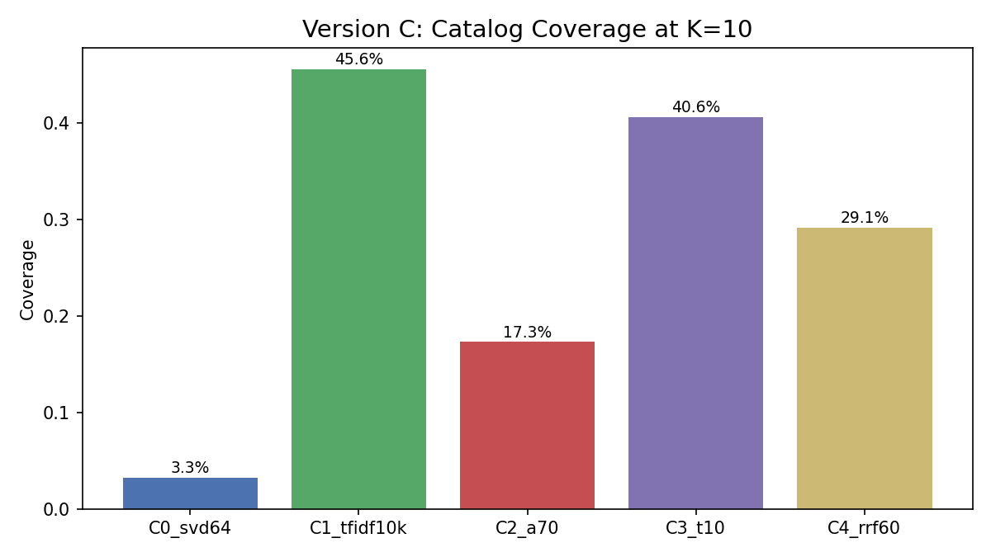
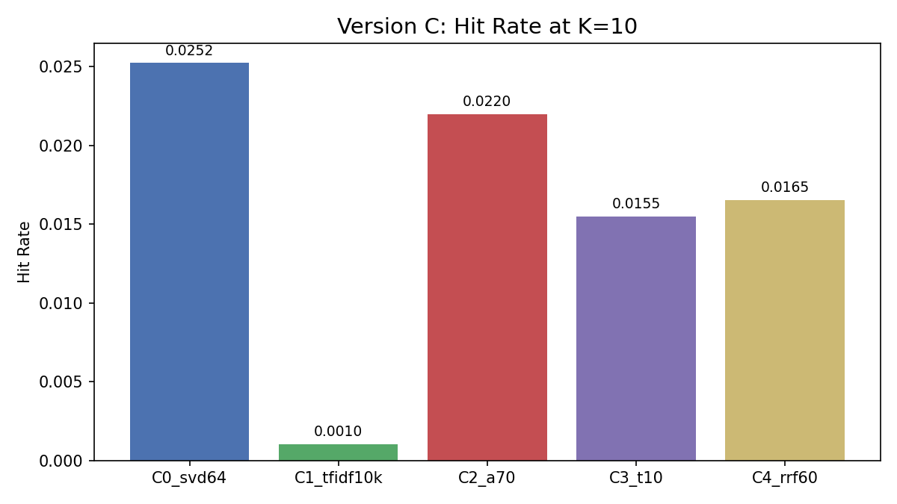
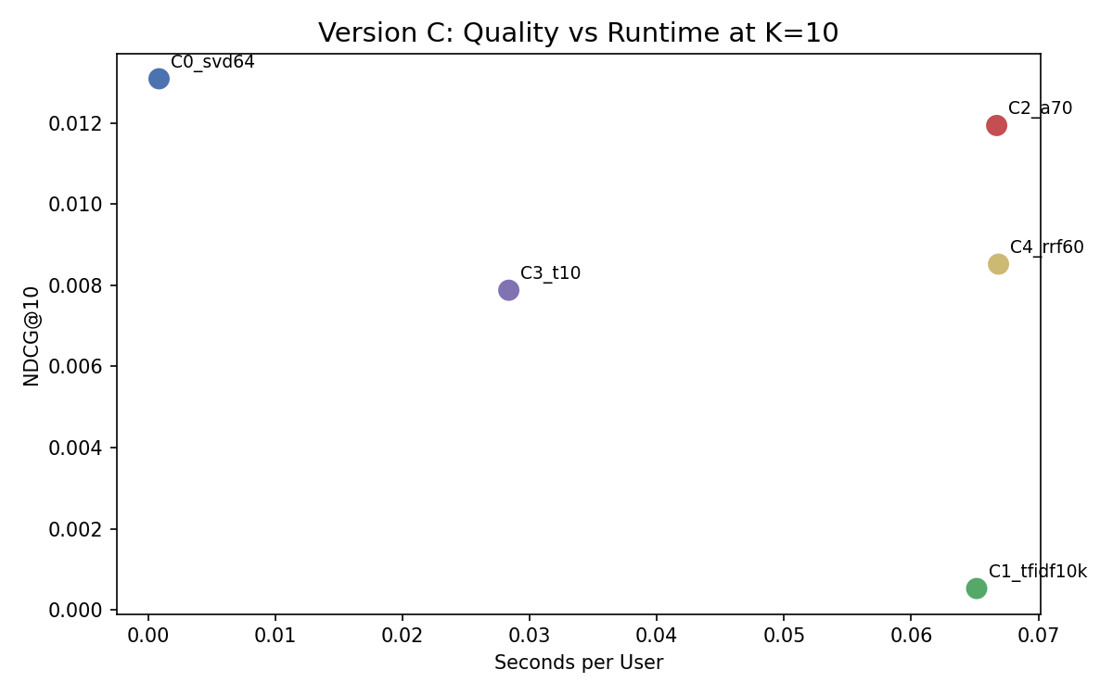
Version C: Model Comparison Visualizations

Slide 22
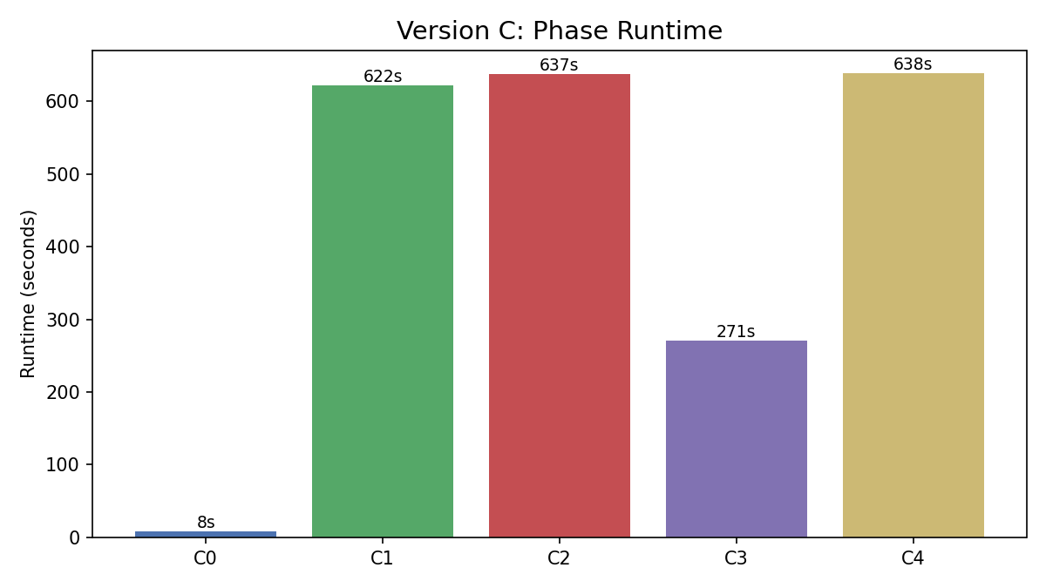
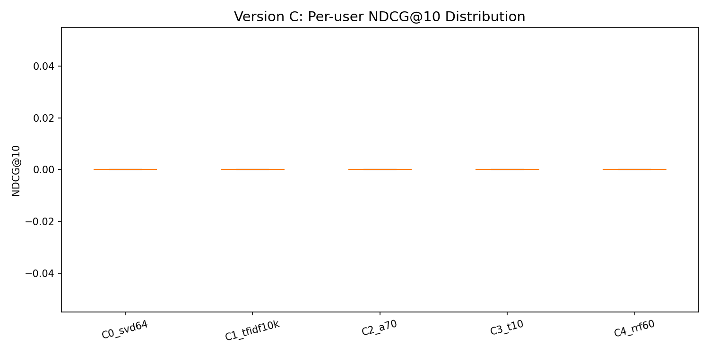
Version C: Runtime & Per-User Distribution
C0 (pure SVD) is fastest: 8 seconds. C1/C2/C4 take ~10 min each (per-user cosine similarity)
C3 switching is faster (4.5 min): 57% of users skip the expensive content computation
Per-user boxplot: most users score 0 (extreme sparsity), but C0/C2 show higher upper-quartile hits
Runtime is acceptable for offline batch recommendation; online serving would need caching

Slide 23
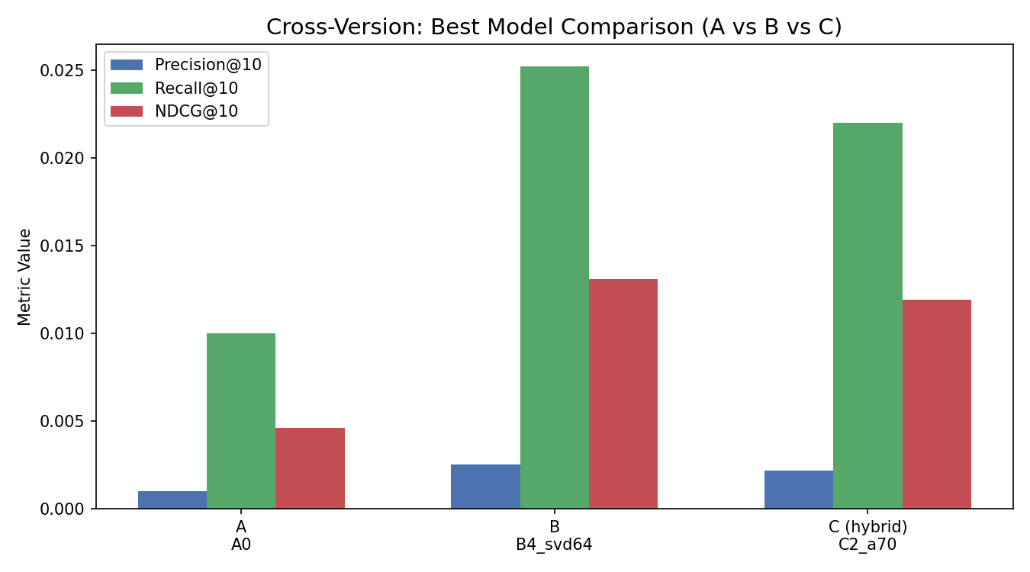
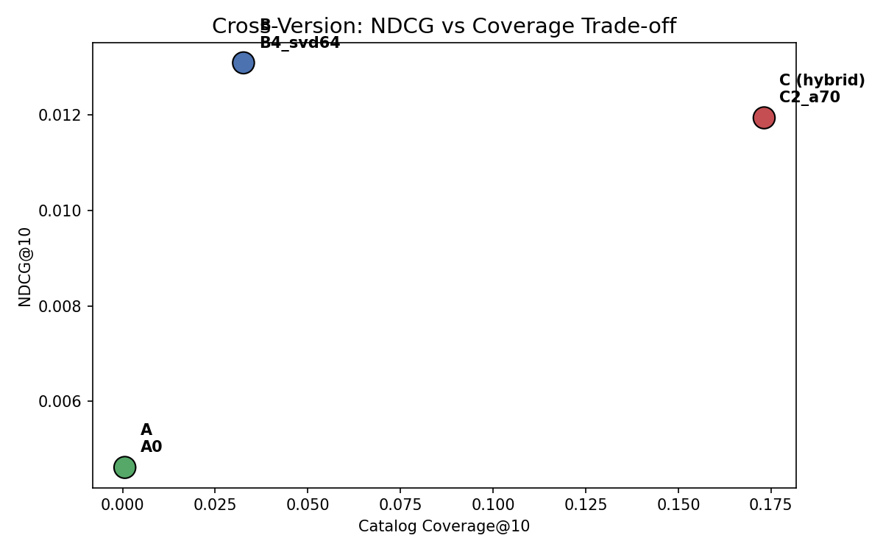
Cross-Version Comparison: A vs B vs C
Which approach wins? It depends on what you optimize for
Version | Best Model | NDCG@10 | Recall@10 | Coverage | Best For
A (Content) | A4 Reranker | 0.00134 | 0.00268 | 45.30% | Cold-start, explainability
B (CF) | B4 SVD | 0.01309 | 0.02524 | 3.26% | Maximum precision
C (Hybrid) | C2 Weighted | 0.01194 | 0.02200 | 17.31% | Balanced trade-off

Slide 24
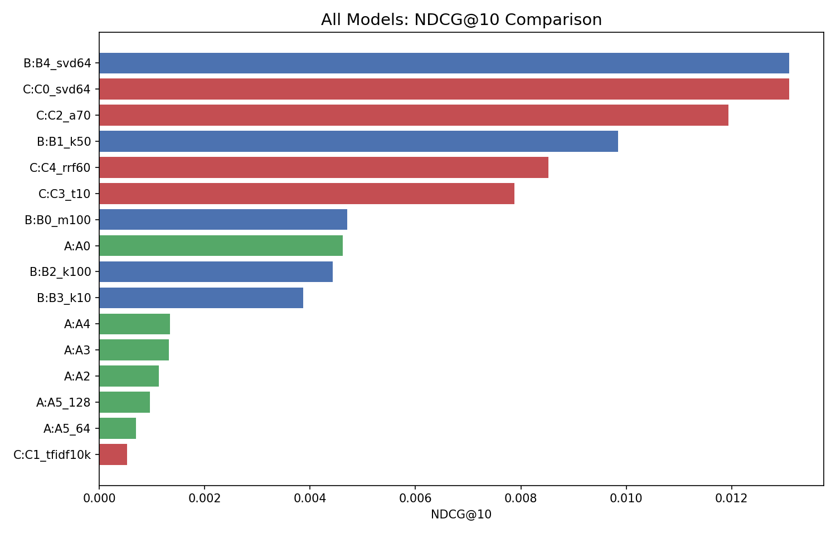
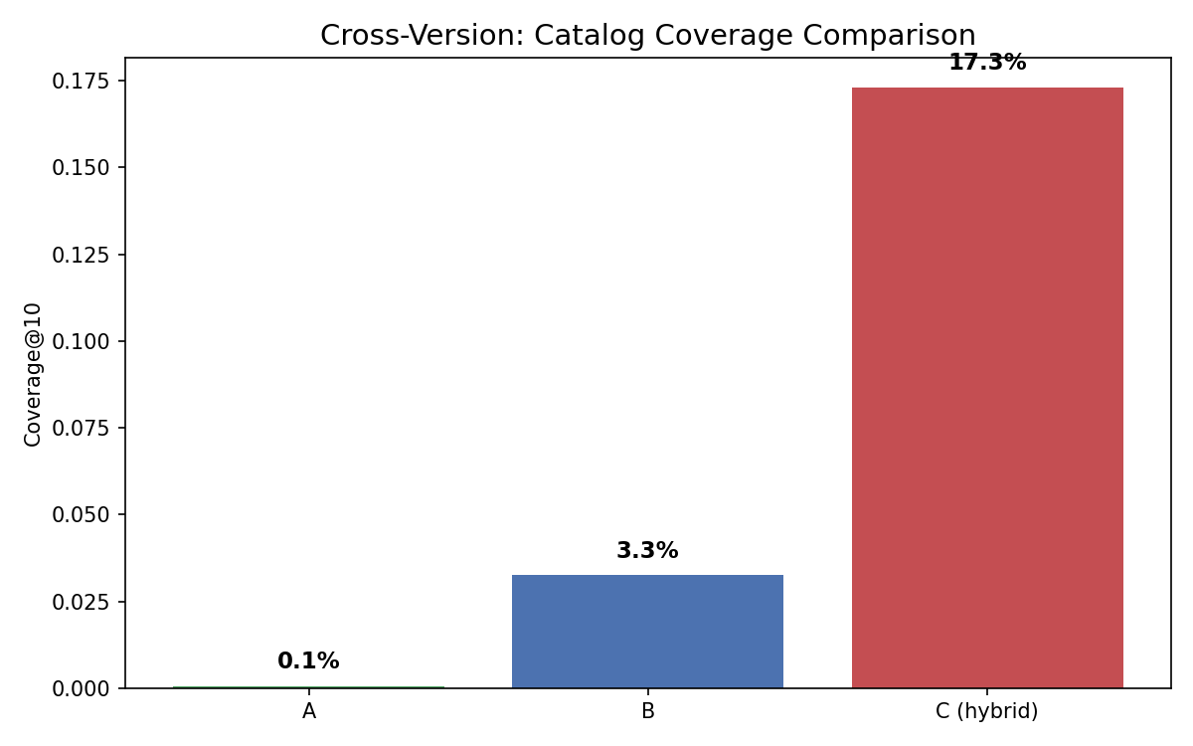
All Models Ranking & Coverage Trade-off
The precision-coverage trade-off is the
central design decision:
A: high coverage, low precision
B: high precision, low coverage
C: controllable balance between both

Slide 25
Key Findings
Finding 1: CF significantly outperforms content-based methods (10x NDCG improvement)
Interaction patterns are far more predictive than metadata similarity alone
Finding 2: Pure CF suffers from critically low coverage (3.26%)
It creates an echo chamber, recommending only well-known items
Finding 3: Hybrid methods successfully balance precision and coverage
C2: only 9% NDCG loss for 5x coverage gain. A strong real-world trade-off
Finding 4: Content-based methods are essential for cold-start scenarios
C3 switching hybrid uses content for 43% of users with sparse history
Finding 5: All metrics are low in absolute terms due to extreme sparsity (99.92%)
This is typical for large-scale recommendation; relative improvements matter more

Slide 26
Practical Implications
For a real recipe recommendation application:
Homepage 'Top Picks for You' (precision-focused):
Use B4/C0 (SVD) for users with >= 10 interactions
'Explore New Recipes' (diversity-focused):
Use C3/C4 hybrid for broader recipe diversity
New user onboarding (cold-start):
Use C1/A4 content-based until enough ratings are collected
Prompt users to rate 5-10 recipes to bootstrap CF
Dietary constraints (practical filters):
Apply post-filters for prep time, ingredients, nutrition
Content methods naturally support constraint-based filtering
Recommended default: C2 Weighted Hybrid (alpha=0.7)

Slide 27
Conclusion & Future Work
Conclusion:
Best overall system: C2 Weighted Hybrid (alpha=0.7)
NDCG = 0.01194 (91% of pure CF), Coverage = 17.3% (5x pure CF)
Lightweight, interpretable, and practical for real deployment
Limitations:
Extreme sparsity limits absolute performance across all methods
Single temporal split; k-fold cross-validation would improve robustness
No deep learning models compared
Future Work:
Neural collaborative filtering (NCF) for better latent representations
LLM-based explanation layer ('We recommend this because...')
Online A/B testing to validate offline improvements with real users
Incorporate recipe images and cooking step sequences as features

Slide 28
Thank You
Questions?
CS 513 | NutriMatch | Hybrid Recipe Recommendation System

