Slide 1
TENNESSEE DATA CENTER RESEARCH PROJECT
Tennessee Data Center
Infrastructure and
Community Tradeoffs
A site-level evidence foundation for energy, water, land use, and community context
University of Tennessee, Knoxville • Research project overview
01

Slide 2
Why Tennessee Needs Site-Level Evidence
Facility growth becomes a research problem when infrastructure and nearby communities enter the same frame.
1
2
3
4
Energy demand
Water use
Land and noise
Communities
Grid load and peak demand
Resource and watershed context
Siting and local externalities
Nearby receptors and equity
The evidence must be geographically specific: a statewide total cannot answer a site-level question.
RESEARCH NEED
02

Slide 3
RESEARCH GAP
Separate records do not yet make decision evidence.
Facility
Infrastructure
Receptors
Decision evidence
Location, status,
Power, water, access,
Communities, land use,
Validated spatial
operator, capacity
availability domains
environmental context
associations and limits
The project supplies the missing analytical connection — without presuming causality.
RESEARCH NEED
03

Slide 4
Research Objective
Build a reproducible Tennessee pilot that documents quality, maps context, and prepares future work.
01
02
03
Document quality
Map exposure context
Prepare extensions
Record identity, sources,
Facilities, infrastructure,
Validated case-study and
coordinates, and uncertainty
and nearby receptors
future research pathways
RESEARCH NEED
04

Slide 5
EXISTING RESEARCH FOUNDATION
The Tennessee workflow starts with a current inventory.
61
16
13
Master records
Candidate sites
Mappable candidates
50 core / interconnection
Tracked separately from
Both latitude and longitude
+ 11 crypto-mining records
confirmed Master records
available for mapping
Snapshot checked: September 4, 2026. Unknown values remain blank rather than estimated.
EXISTING RESEARCH FOUNDATION
05

Slide 6
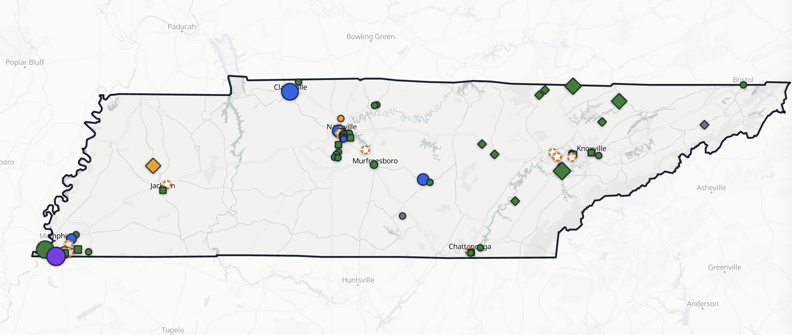
Tennessee Interactive Facility Map
A live research interface for exploring facility records, filters, sources, and data-quality fields.
MAP CONTROLS
Inspect records
Facility details
Evidence links
Source confidence
Coordinate QA
Use the supplied Map folder
for the local HTML demo.
EXISTING RESEARCH FOUNDATION
06

Slide 7
Map Legend and Interpretation
Shape, lifecycle color, candidate styling, and capacity size encode different attributes.
Marker shape
Lifecycle color
Capacity size
Circle — Data center
Green — Operational
Square — Interconnection facility
Amber — Under construction
Blue — Proposed
Larger marker = higher
Diamond — Crypto-mining facility
published MW (log scale)
Purple — Expanding
Dashed circle — Candidate, not confirmed
Gray — Cancelled / inactive
Black — Unknown
Missing capacity means not published, not zero.
Candidates never contribute to confirmed-facility counts; verify coordinate precision before detailed site-level interpretation.
EXISTING RESEARCH FOUNDATION
07

Slide 8
DATA GOVERNANCE
Quality controls remain visible from record to map.
Raw records
Master inventory
Candidate layer
Research map
Public sources
Stable IDs
Separate status
Confidence, QA,
Operator pages
Deduplication
Review required
and evidence links
Retained fields:
source links · verification class · confidence · QA state · coordinate precision
Policy:
unknown values stay blank rather than being estimated.
EXISTING RESEARCH FOUNDATION
08

Slide 9
Spatial Analysis Framework
A reproducible pathway from canonical sites to validated spatial associations.
1
2
3
4
5
Canonical sites
D0 / D1 / D2
Feature table
Point process
Validation
Resolve duplicates
Background controls
Infrastructure + receptors
Association models
Sensitivity checks
Outcome language: descriptive pattern and spatial association — never causal siting conclusions before validation.
ANALYTICAL DESIGN
09

Slide 10
RESEARCH QUESTIONS
Three questions keep the analysis bounded.
RQ1
Where do confirmed Tennessee sites cluster?
RQ2
Which infrastructure and receptor contexts are associated after controls?
RQ3
Which areas merit deeper case-study work?
Interpretation boundary: model results describe association, not causation.
ANALYTICAL DESIGN
10

Slide 11
Work Packages and Deliverables
Each package leaves a reusable research product rather than a one-off analysis.
Work package
Core work
Deliverable
WP1 · Data foundation
Version, deduplicate, and document records
Versioned inventory
WP2 · Spatial workflow
Build canonical sites and feature table
Reproducible workflow
WP3 · Validation
Run diagnostics and sensitivity checks
Validated outputs
WP4 · Case studies
Prioritize places for deeper inquiry
Case-study materials
ANALYTICAL DESIGN
11

Slide 12
Quality Gates and Limitations
Data quality determines the level of inference the project can responsibly make.
GATE 1
GATE 2
GATE 3
GATE 4
Record identity
Coordinate precision
Covariate coverage
Model diagnostics
Duplicate and source checks
Site versus city-level location
Context features available
Sensitivity and validity checks
All gates met → validated spatial association outputs
A gate unmet → descriptive or feasibility output only
ANALYTICAL DESIGN
12

Slide 13
PROJECT OUTPUTS AND USES
A Tennessee-specific evidence base can travel.
Planners
Utilities
Land-use context
Infrastructure context
Transparent
evidence base
Communities
Researchers
Visible evidence limits
Reproducible pathway
CONTRIBUTION
13

Slide 14
RESEARCH CONTRIBUTION
A transparent, reusable
framework for studying
Records
data centers as local
infrastructure.
Validation
Energy · water · land use · community context
Association
The contribution is not a premature conclusion — it is a defensible pathway to one.
CONTRIBUTION
14

