Slide 1
Solitaire
VPE PROJECT 2014-2015
CRISTIAN BULEANDRĂ

Slide 2
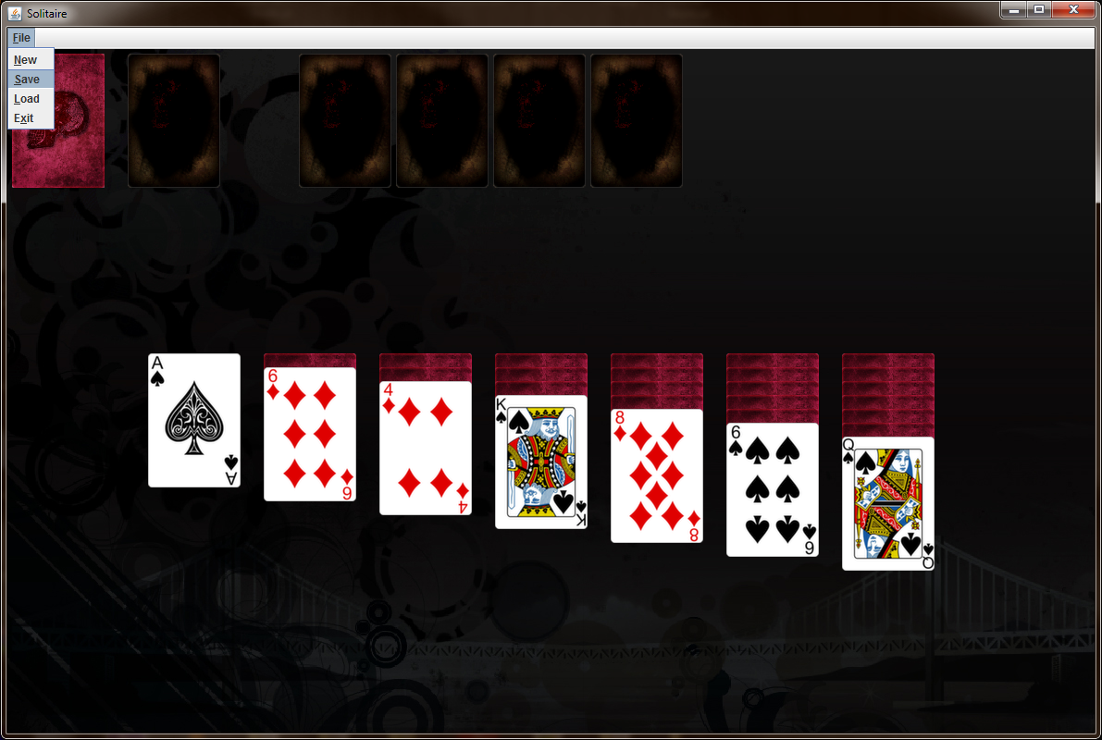
The final outcome

Slide 3
Technical challenges
Create draggable elements. Detect interaction between the draggable elements using Java SWING.
Use Java SWING layouts and absolute positioning in order to display pile of overlapping cards.
Be able to drag an entire pile, not only a card. Also, this pile had to be displayed on top of everything else while being drawn.
Save the state of the game in an XML file.
Load the state of the game in an XML file, without loading any new resources or destroying and re-creating objects.

Slide 4
The design
The face-up card images were taking from a free online sources. There are 52 different face-up images.
The back of the cards, empty piles and background were created by me for this project.
The game can be played on any screen size and resolution, as the design is based on Java SWING BorderLayout and is responsive.

Slide 5
THE PROBLEMS’ Solutions
To see more details about the implementations please consult the autogenerated JavaDoc or the documentation PDF.
The source files are also available. The code is very well structured and well commented but may he hard to understand without a previous Java programming background.

Slide 6

THANK YOU!

