Slide 1
Fantastic 5
“Refreshingly innovative…”
Christopher Mahon: Team Leader
Christopher Jerrard-Dunne: Coder/Designer
Konrad Jedrol: Planner
Jun Hee Jang: Tester
Jake Mulholland: Documenter

Slide 2
Overview
Agile vs. Waterfall
Both considered for our project
Closely related to software development
Distinct

Slide 3
The Waterfall Methodology
Moves through 8 steps as time progresses
Cannot revisit previous steps
Plan must be followed carefully

Slide 4
Why/Why Not?
Advantages:
Stresses meticulous record keeping.
Minimal project impact in case of employee turnover.
Disadvantages:
Once a step has been completed, cannot go back to the previous step to make changes
Does not take into account a client’s ever evolving needs.

Slide 5
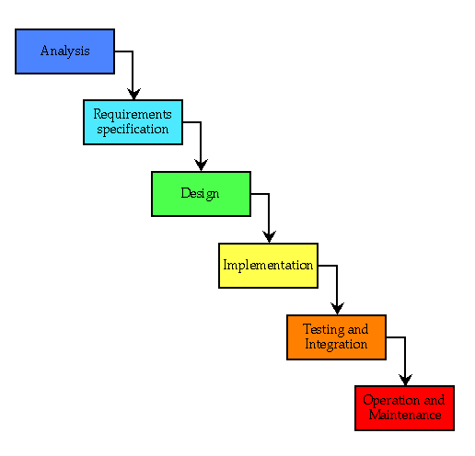
Waterfall Diagram

Slide 6
The Agile Methodology
Developed as a response to waterfall
Works with small modules in sprints
Criticized for its collaborative approach

Slide 7
Why/Why Not?
Advantages:
It allows for changes mid-development.
Testing at the end of each sprint ensures that bugs are found and fixed early.
Disadvantages:
Can become disorganised with less successful project managers.

Slide 8
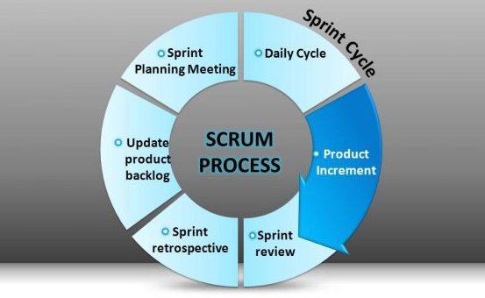
Agile Sprint Cycle

Slide 9
Conclusion
No ‘One size fits all’ approach
Both suit separate environments
Do not need to conform to one approach

Slide 10
Questions?

