Slide 1
Handheld Game Console
Final Year Project -
Christopher Mahon

Slide 2
Introduction
Console created using a Raspberry Pi and integrated into a case
Intended to be an open development platform
Market is lacking in handhelds of this type

Slide 3
Goals
Create a battery powered Raspberry Pi
Create a case to hold the Raspberry Pi, touch screen and controller together
Create a set of drivers to manage communications between the controller and the console
Create a game to test the system

Slide 4
Requirements
Hardware
Usable without a keyboard and mouse
Safe for prolonged use
Software
Speed
Accurate

Slide 5
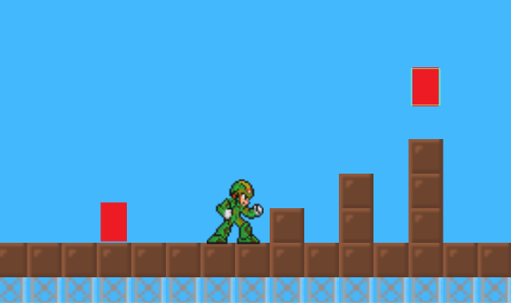
Game Requirements
Platformer
Controllable using as few buttons as
possible
Predictable AI

Slide 6
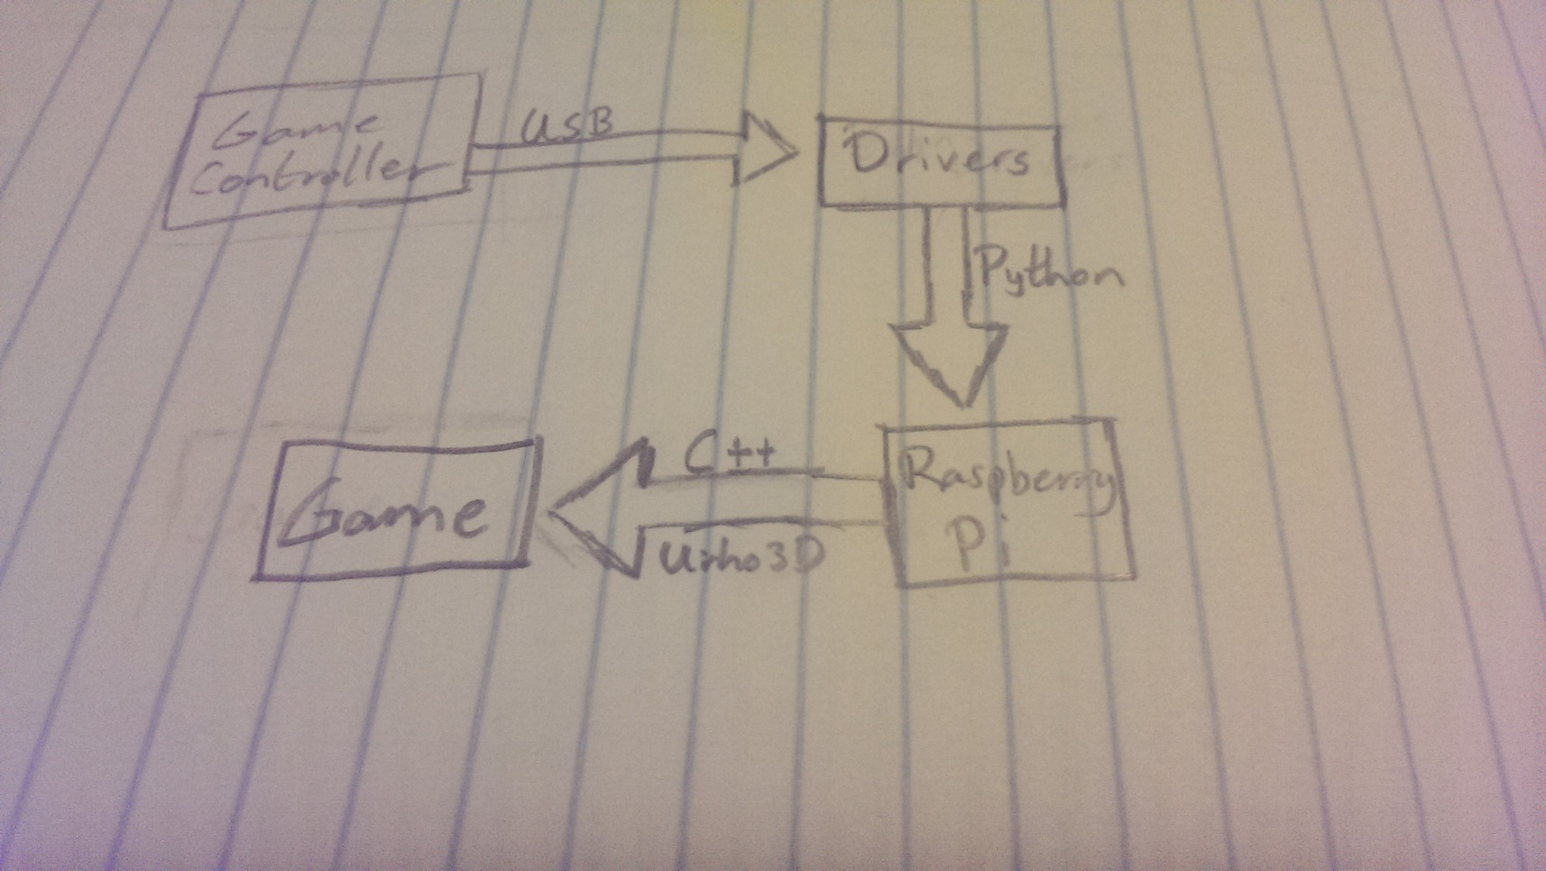
Relational Diagram

Slide 7
Architecture and Technologies
Controller Drivers
Python
PyUSB
Game
C++
Urho3D

Slide 8
Hardware Design Considerations
Injury risks
Comfortable Holding
Lightweight design

Slide 9
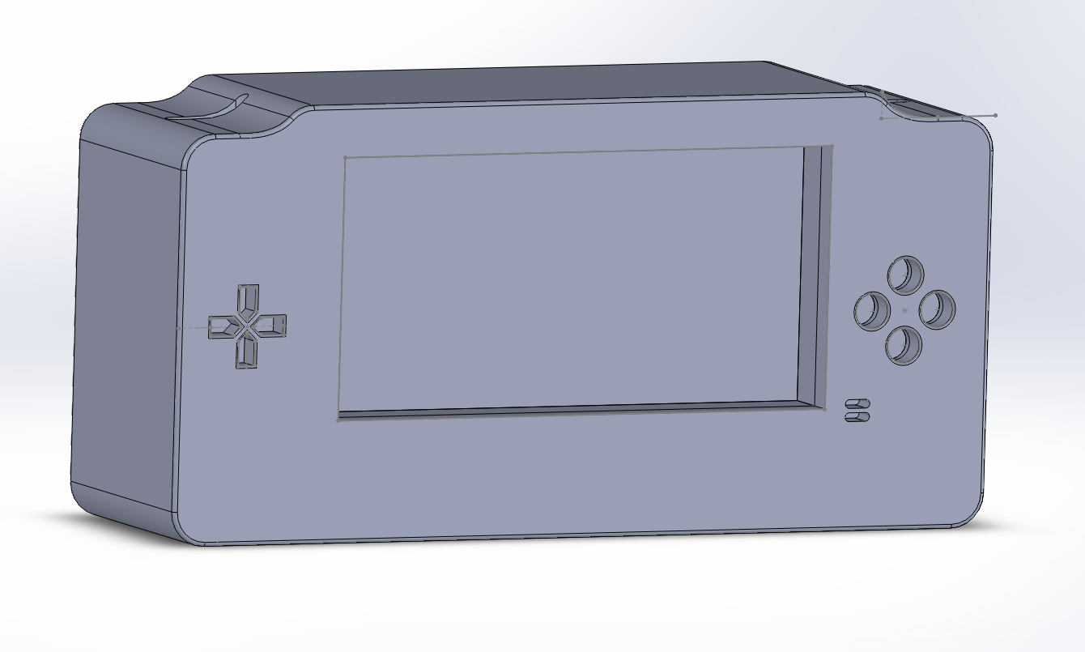
Initial Case Design

Slide 10
Game Design
3 Key Components
Define Game Rules
Define Game Mechanics
Define Game AI
Level Design
Dynamic Environments
Checkpoints
Bosses at the end of each level

Slide 11
Methodologies
2 Methodologies used in tandem
Scrum
Earnest Adams Design Methodology
Implemented the Earnest Adams Methodology during the Design sprints within Scrum

Slide 12
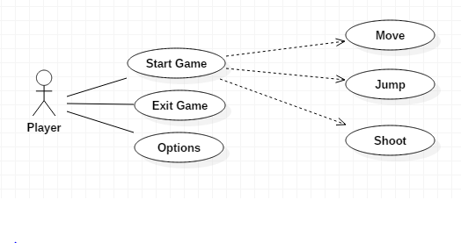
Game Use Case Diagram

Slide 13
Testing
White Box & Black Box testing
Game for Testing
Test cases
User Based Testing
Observational Testing
Recorded Game Play

Slide 14
Prototype
Game Prototype
Movement
Basic combat
Enemy AI
Hardware Prototype
Touch screen connected to Raspberry Pi
Basic circuit for the battery is in testing

Slide 15
Thanks for Listening
Any Questions?

