Slide 1
FINAL PROJECT
CPEN 315
CPU Design
Computer Organization & Architecture
Part A — 16-bit CPU in Logisim-Evolution
MEMBERS
GODFRED SAFO OFORI – 22046644
CHRISTOPHER Y.E. MAWULI – 22071976
Part B — 32-bit MIPS CPU in VHDL
Dept. of Computer Engineering
University of Ghana
First Semester 2025/2026 · Prof. Robert A. Sowah · Raphael Kuayi

Slide 2
PROJECT OVERVIEW
Part A
Part B
16-bit CPU
32-bit MIPS
Logisim-Evolution
VHDL
Learning Objectives
Instruction Set Architecture (ISA)
Control Unit Design
Define the language the CPU understands — opcodes, operands, and instruction formats
Hardwired vs. micro-architected approaches to generating control signals each clock cycle
Datapath Design
Memory Interfacing
Assemble ALU, registers, buses, and Program Counter into a working execution engine
Bridge CPU to RAM via MAR, MBR, and address/data buses for load and store operations

Slide 3
PART A
16-Bit CPU Design
in Logisim-Evolution
7-part implementation · 4 instructions · 16 control signals · Micro-architected control unit

Slide 4
Part A · Part 1: 16-Bit Arithmetic Logic Unit
Arithmetic Operations
Relational Operations
AUSel (4-bit)
RUSel (3-bit)
0
ADD: A + B
0
A > B
1
AND: A & B
1
A == B
2
OR: A | B
3
XOR: A ^ B
2
A >= B
4
DIV: A / B
3
A < B
5
REM: A % B
6
MULT: A × B
4
A <= B
7
SUB: A − B
5
A != B
8
SLL A (×4)
9
SLL B (×4)
Ports
10
SRL A (÷4)
11
SRL B (÷4)
Inputs
A [15:0], B [15:0], AUSel [3:0], RUSel [2:0]
12
NEG A (2's complement)
13
NEG B (2's complement)
Outputs
AUResult [15:0], AUDout [15:0], RUResult [0]

Slide 5
Part A · Part 3: CPU Datapath Design
Instruction Register (IR)
16-bit
Register A
16-bit
Stores current instruction: 8-bit opcode (MSB) + 8-bit address (LSB)
First ALU operand — loaded by the LoadA instruction
Register B
16-bit
Output Register
16-bit
Second ALU operand — loaded by the LoadB instruction
Latches the ALU result before writeback to memory
MAR (Memory Address Register)
8-bit
MBR (Memory Buffer Register)
16-bit
Drives the external address bus to select the RAM location
Staging buffer for data travelling to or from RAM
All registers share a 16-bit internal data bus · MAR drives the 8-bit external address bus · RAM connected via external 16-bit data bus

Slide 6
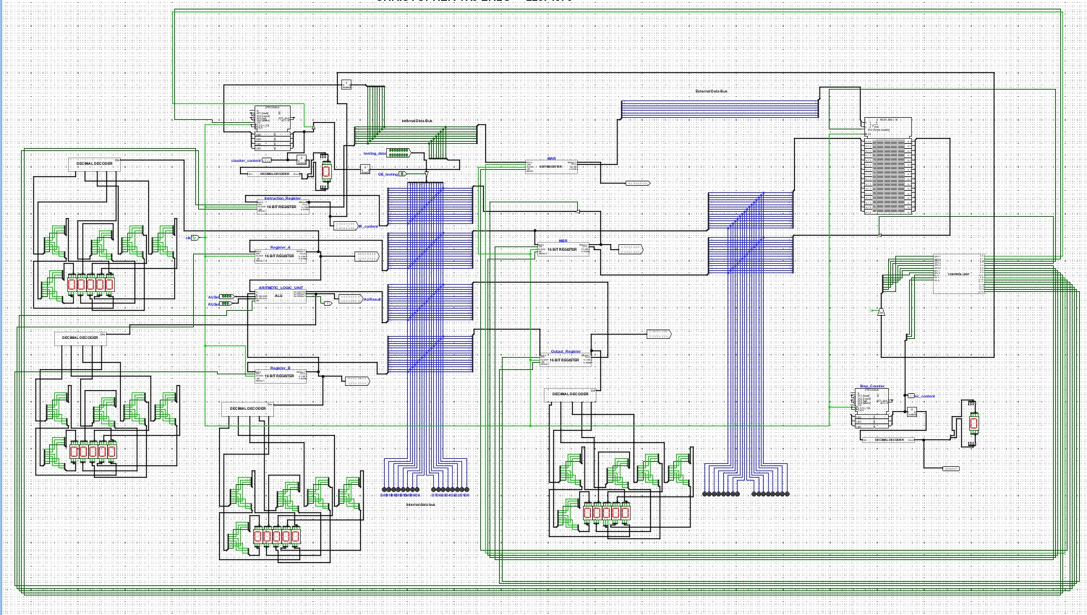
Part A · Logisim-Evolution CPU Circuit
Complete 16-bit CPU implementation — datapath components, buses, control unit, RAM, and 7-segment displays

Slide 7
Part A · Part 5: Instruction Set & RAM Layout
Instruction Format (16-bit): [ 8-bit Opcode | 8-bit Address / Operand ]
Mnemonic
Opcode (Binary)
Hex
Operation
LoadA
00000000
0x00
Load RAM[addr] → Register A
LoadB
00000001
0x01
Load RAM[addr] → Register B
Arithmetic
00000010
0x02
ALU(A, B) → Output Register
Store
00000011
0x03
Output Register → RAM[addr]
Example Program — Compute 10 + 15 and store result
Addr 0
0x000A
LoadA — load value at address 10 into Register A
Addr 1
0x010D
LoadB — load value at address 13 into Register B
Addr 2
0x0200
Arithmetic — ALU performs ADD on A and B
Addr 3
0x030A
Store — write Output Register back to address 10

Slide 8
Part A · Part 6: Control Unit & Step Counter
Control Unit Design Approaches
Hardwired
Micro-Architected
✓ Fast — control signals wired directly in logic gates
✓ Flexible — update microcode to add or modify instructions
✗ Inflexible — modifying ISA requires physical circuit changes
✗ Marginally slower — extra step to fetch microcode from store
This project implements the Micro-Architected approach using Logisim's Combinational Analysis feature to auto-generate the CU circuit from truth tables.
16 Control Signals (C0 – C15) · Inputs: OPC[7:0], SC[2:0]
C0 OE_PC
C1 OE_MAR
C2 WR_RAM
C3 OE_RAM
C4 WE_MBR
C5 OE_MBR_int
C6 CE_PC
C7 WE_IR
C8 OE_IR
C9 WE_MAR
C10 OE_RAM2
C11 OE_ALU
C12 WE_RegA
C13 WE_RegB
C14 OE_OutReg
C15 WE_OutReg
Step counter counts 0–5 per instruction · Output decoded and shown on 7-segment display

Slide 9
PART B
32-Bit MIPS CPU Design
in VHDL
5-stage pipeline · 13 MIPS instructions · 6 VHDL source files · 32-bit datapath

Slide 10
Part B · 5-Stage Pipeline Architecture
IF
ID
EX
MEM
WB
Instruction
Fetch
Instruction
Decode
Execute
Memory
Access
Write
Back
Instruction_Fetch.vhd
Instruction_Decode.vhd
Execute.vhd
Memory_Access.vhd
Write_Back.vhd
PC → 256-entry ROM
Fetch 32-bit instruction
PC advances by 4 each cycle
Decode opcode & fields
Read register file (R0–R7)
Generate all control signals
ALU operation
Branch target calculation
RegDst & ALUSrc MUX select
LW: read data memory
SW: write data memory
ALU result passed through
MemToReg MUX selects
memory data or ALU result
Writes to register file
All five stages are VHDL components instantiated in CPU.vhd · 32-bit STD_LOGIC_VECTOR signals connect each stage

Slide 11
Part B · MIPS Instruction Set & Formats
Instruction Formats
R-Format
op
rs
rt
rd
funct
Arithmetic — ADD, SUB, AND, OR, SLT, JR
I-Format
op
rs
rt
Immediate / Address
Transfer & Branch — LW, SW, BEQ, ADDI, SLTI
J-Format
op
Target Address
Jump — J, JAL
Supported MIPS Instructions
ADD
R[rd] = R[rs] + R[rt]
SUB
R[rd] = R[rs] − R[rt]
AND
R[rd] = R[rs] & R[rt]
OR
R[rd] = R[rs] | R[rt]
SLT
R[rd] = 1 if rs < rt
JR
PC = R[rs]
LW
R[rt] = M[R[rs] + imm]
SW
M[R[rs] + imm] = R[rt]
BEQ
if rs==rt, branch
ADDI
R[rt] = R[rs] + imm
J
PC = JumpAddr
JAL
R[7]=PC+4; jump
SLTI
R[rt] = 1 if rs < imm

Slide 12
Part B · VHDL Components Overview
Instruction_Fetch.vhd
256-entry 32-bit instruction ROM. PC updates on rising clock edge. Outputs instruction at current PC address.
IN: clk, reset, pc_in[31:0] OUT: pc_out[31:0], instruction[31:0]
Instruction_Decode.vhd
8-register file. Decodes R/I/J format. Generates ALUOp, RegDst, ALUSrc, MemRead, MemWrite, MemToReg, Branch, Jump, RegWrite.
IN: instruction, pc+4, write-back OUT: read_data1/2, sign_extend, control signals
Execute.vhd
5-op ALU: ADD(000) SUB(001) AND(010) OR(011) SLT(100). ALUSrc MUX selects register or immediate. RegDst MUX selects rd or rt.
IN: read_data1/2, sign_extend, rt, rd, control OUT: alu_result[31:0], write_data, zero
Memory_Access.vhd
256×32-bit synchronous RAM. Write on rising clock edge (mem_write=1). Read synchronously (mem_read=1). ALU result passed through for non-memory ops.
IN: alu_result, write_data, mem_read, mem_write OUT: read_data[31:0], passes write_reg
Write_Back.vhd
MemToReg MUX: selects memory data (1) or ALU result (0). Result written back to the register file destination port in ID stage.
IN: read_data, alu_result, write_reg, mem_to_reg, reg_write OUT: result, write_reg_out

Slide 13
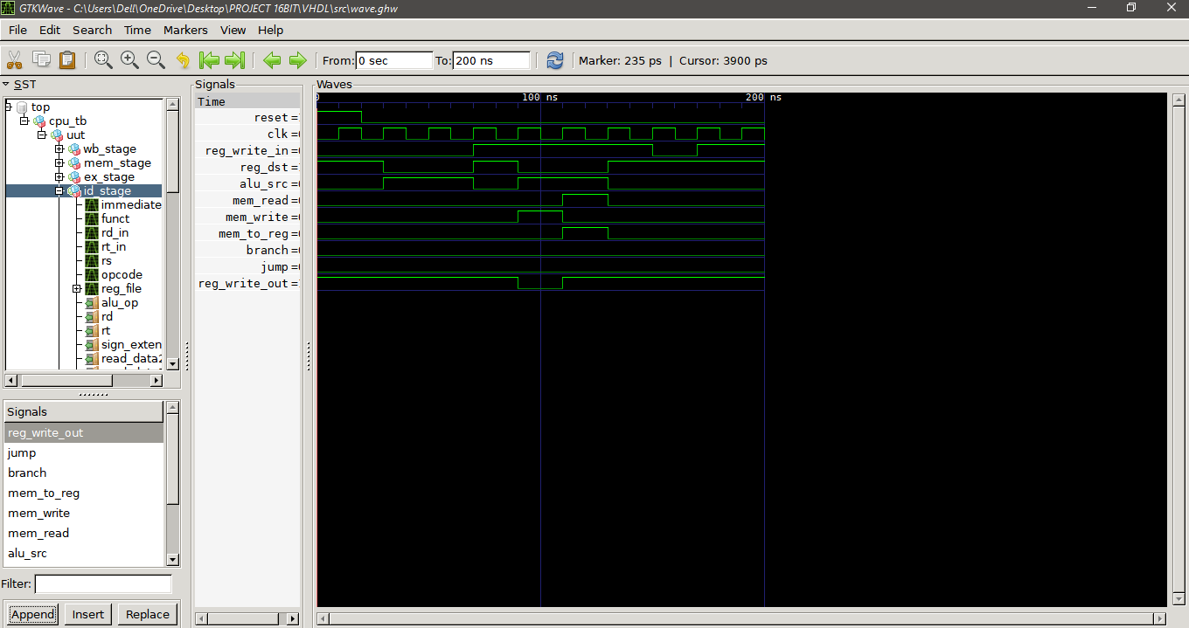
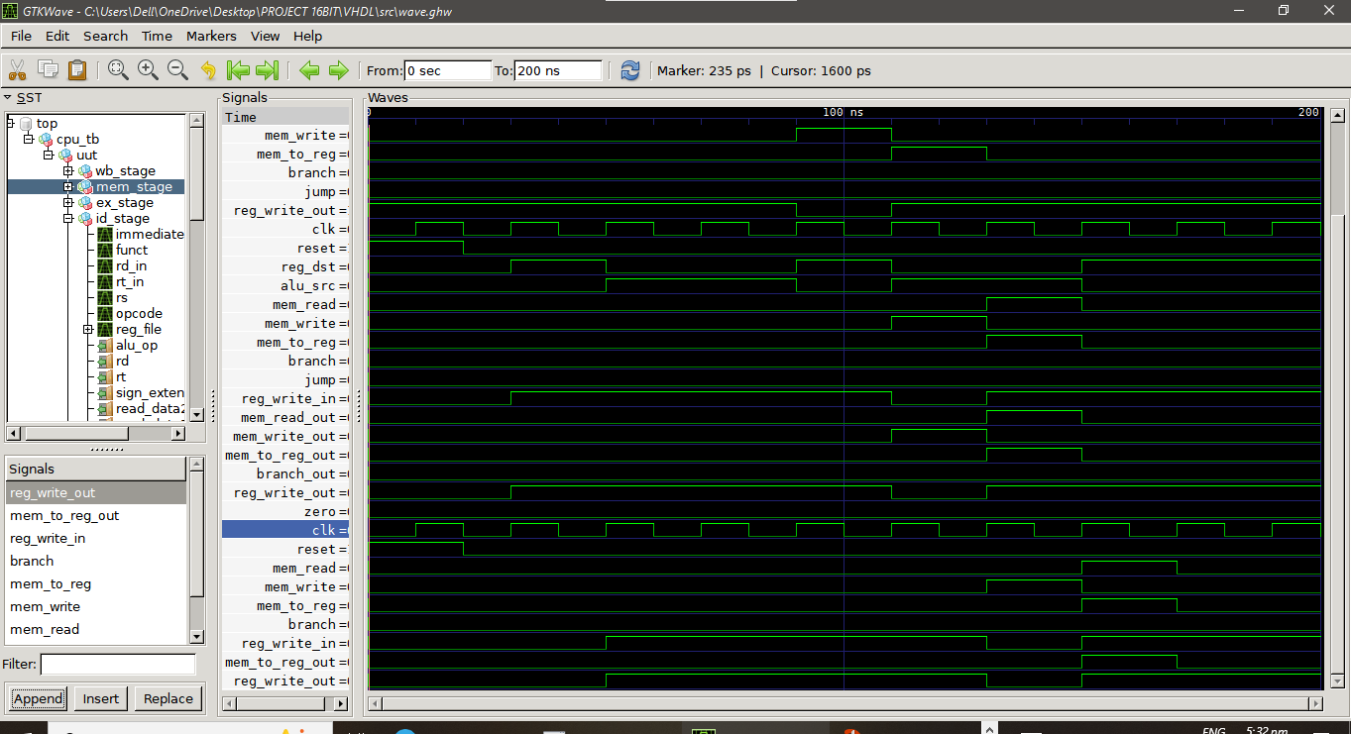
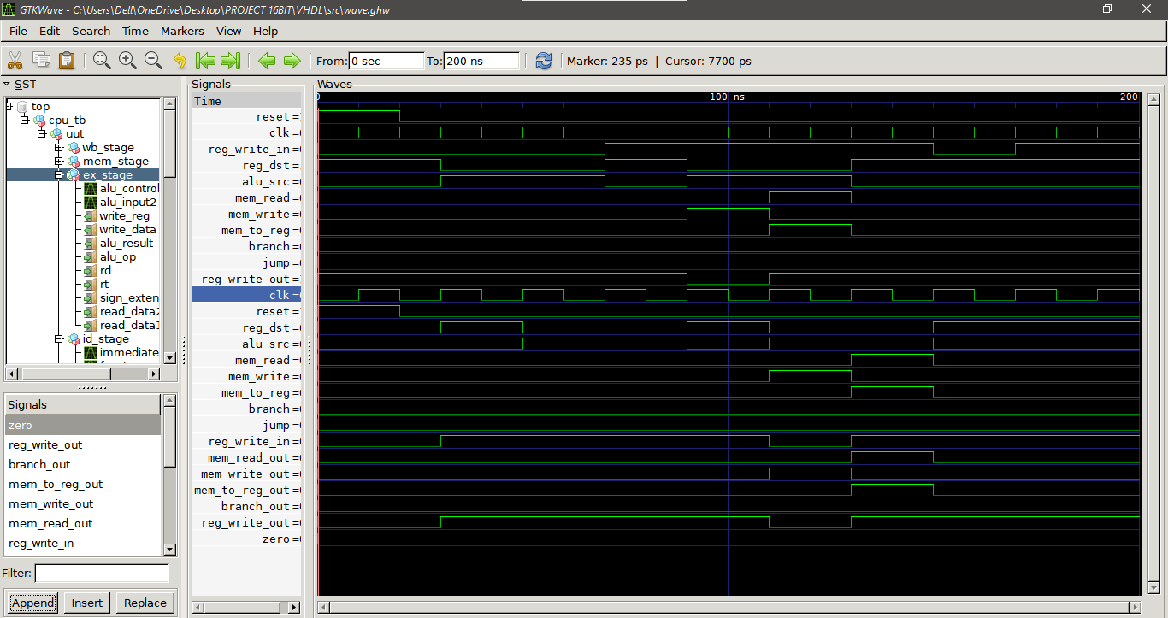
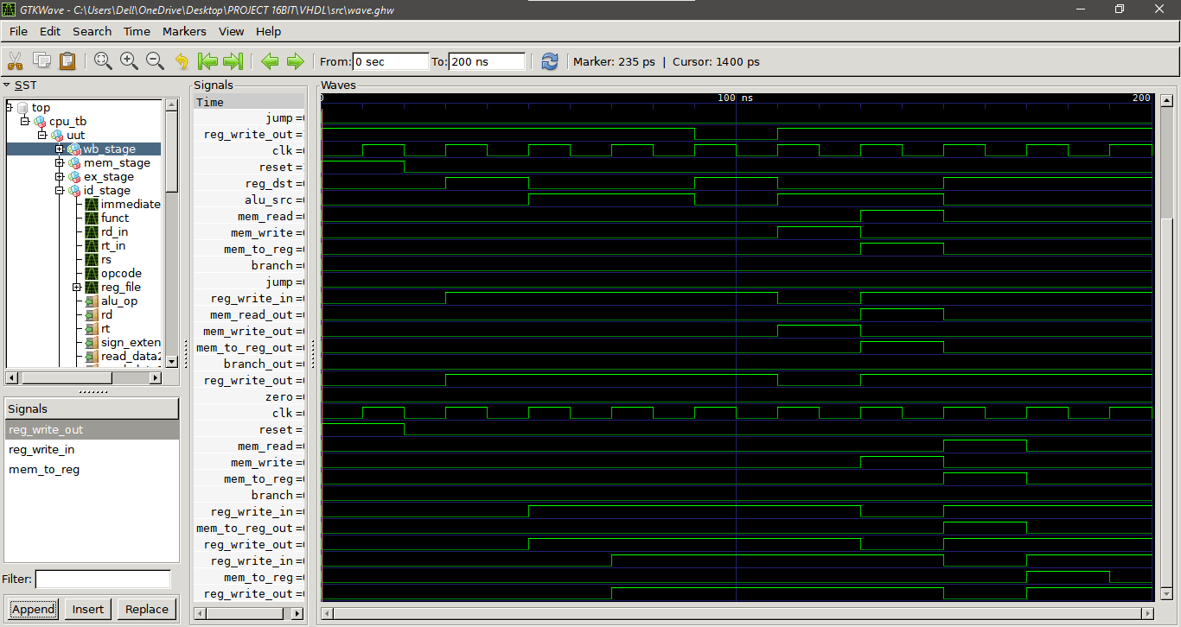
Part B · SIMULATION AND RESULTS

Slide 14
16-bit Logisim CPU vs 32-bit VHDL CPU
Feature
16-bit CPU (Logisim)
32-bit CPU (VHDL)
Data Width
16-bit
32-bit
Design Tool
Logisim-Evolution (graphical)
VHDL / ModelSim (HDL)
Architecture
Single-cycle, custom ISA
5-stage pipeline, MIPS
Instructions
4 (LoadA, LoadB, Arith, Store)
13 standard MIPS instructions
Register File
IR, A, B, Output, MAR, MBR
8 general-purpose (R0 – R7)
Memory
16-entry RAM (8 instr + 8 data)
256-entry instruction + data RAM
Control Design
Micro-architected (C0 – C15)
Hardwired decode from opcode
Program Counter
4-bit, loops 0 → 3
32-bit, increments by 4 bytes
ISA Encoding
16-bit: 8-op | 8-addr
R / I / J formats (16-bit fields)

Slide 15
Conclusions & Key Takeaways
From Theory to Silicon
Logisim as Foundation
Both CPUs translate abstract COA concepts — ISA, datapath, control unit — into real, functioning digital systems.
The 16-bit CPU provides a visual, interactive sandbox: every wire, signal, and clock cycle is observable and debuggable.
VHDL for Scale
Control is Everything
The 32-bit MIPS pipeline demonstrates how the same principles extend into professional hardware description and synthesis.
The control unit — whether hardwired or micro-architected — orchestrates every micro-operation across each clock cycle.
Continuity of Concepts
CPEN 315 Outcomes
A 16-bit custom CPU scales naturally to 32-bit MIPS by widening the datapath, formalising the ISA, and adding pipeline stages.
Hands-on mastery of: ISA design, ALU construction, register files, memory hierarchy, pipelining, and hardware description.
CPEN 315 · University of Ghana · First Semester 2025/2026

