Slide 1
Resources

Slide 2

Sql Server

Slide 3

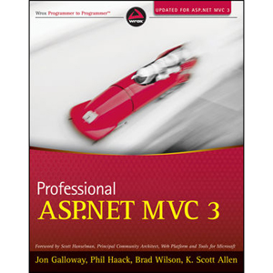
ASP.NET MVC

Slide 4


Html and Css

Slide 5



(more) Html and Css

Slide 6

Javascript
(probably)

