Slide 1
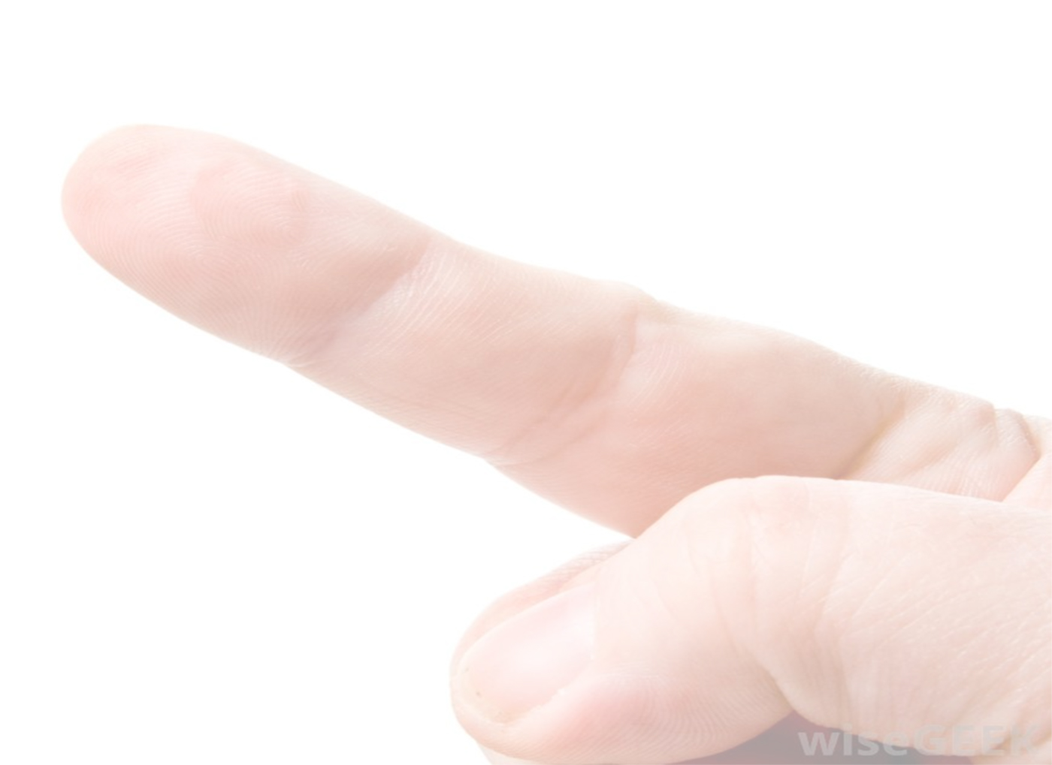
Touchy Browser
Applications
Eric B. Sowell
Mobile Web Dude
at Match.com
eric.sowell@gmail.com
@mallioch

Slide 2
Goals
Some examples
Basic apis and browser differences
How to build something that works across devices
Libraries

Slide 3
Examples

Slide 4
The Basic Apis
Go here: http://ericsowell.com/touch/

Slide 5
click
var canvas = document.getElementById('click');
canvas.addEventListener('click',
function (evt) {
//Do something cool
},
false
);

Slide 6
About click
Supported by every browser everywhere. Yay!
300ms delay on pretty much every mobile browser. Boo!

Slide 7
MouseEvent
clientX/clientY
layerX/layerY
offsetX/offsetY
pageX/pageY
screenX/screenY
target

Slide 8
mouse* events
mousedown
mousemove
mouseup

Slide 9
mousedown, mousemove, mouseup
mousedown/mouseup has mediocre support on all handsets and good support on desktop browsers
Don’t use mousemove if you want to support mobile.

Slide 10
touch* events
touchstart
touchmove
touchend

Slide 11
touchstart, touchmove, touchend
evt.touches holds a collection of touches, so multi-touch is obviously supported. Yay!
The values you get in each touch object are similar but different than the things you get in the mouse event object.
These are webkit events, so Chrome, Android, iOS and Kindle devices are covered well. Windows devices are hosed.

Slide 12
gesture* events
gesturestart
gesturechange
gestureend

Slide 13
gesturestart, gesturechange, gestureend
You use gesture* events primarily to get rotation and scale properties.
Only available on iOS ☹

Slide 14
mouse* events (another kind)
mouseenter
mouseleave

Slide 15
mouseenter, mouseleave
Useful for knowing when the mouse leaves a control.
Not very useful on mobile devices for obvious reasons.
Only works in Internet Explorer.

Slide 16
MSPointer events
MSPointerDown
MSPointerMove
MSPointerUp
MSPointerOver
MSPointerOut
MSPointerHover

Slide 17
MSPointer*
Works only on Internet Explorer 10, so Windows 8 and Windows Phone 8 are covered.
Unifies all interaction (mouse, touch, pen)
Similar but obviously different event type than both Mouse, Gesture and Touch.

Slide 18
MSGesture*
MSGestureTap
MSGestureHold
MSGestureStart
MSGestureChange
MSGestureEnd
MSInertiaStart

Slide 19
MSGesture*
Also works only on Internet Explorer 10, so Windows 8 and Windows Phone 8 are covered.

Slide 20


Slide 21
Less Awesome Things
There are numerous browser differences.
You get offset location differently depending on the event type.
Firefox won’t even give you this info.

Slide 22
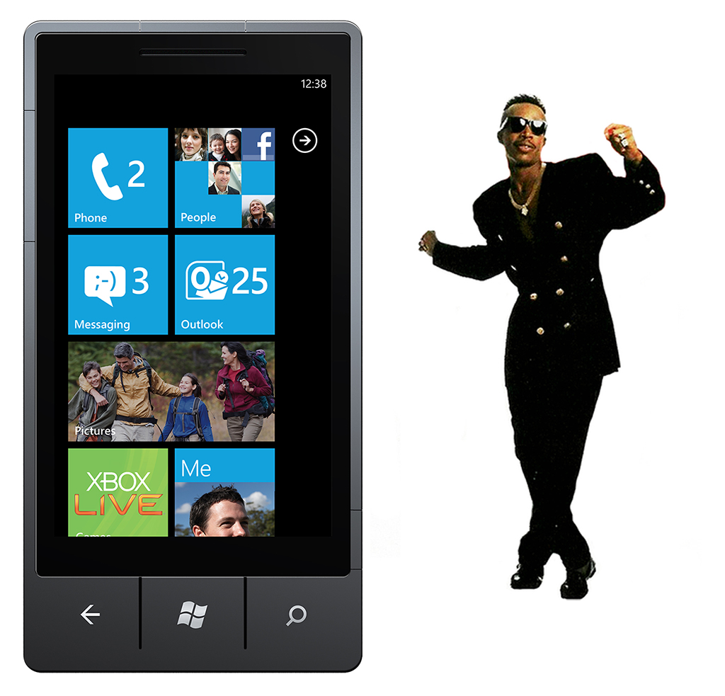

Slide 23


Slide 24


Slide 25


Slide 26
Reasonable
iOS (I’ve tested back to v4)
Android (I’ve tested back to 2.2 – usually ok)
Kindle (actually Android)
Windows Phone 8
Windows 8
Blackberry 10 (webkit)

Slide 27
Let’s see something simple but real

Slide 28
Preventing Default Behavior
evt.preventDefault() is your friend.
-ms-touch-action: none is also your friend.

Slide 29
Random Thoughts
Don’t forget mice.
On a multi-device web, don’t use any type of hover/mouseover event.
Make things of a nice touchable size

Slide 30
Libraries can help you

Slide 31
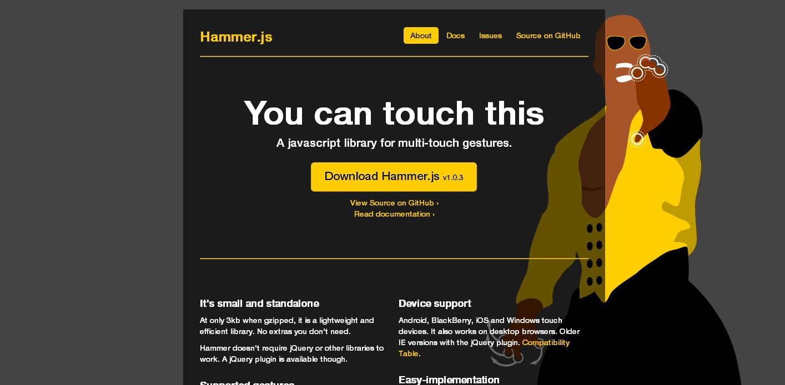

Slide 32
Hammer.js demo

Slide 33

http://spkr8.com/t/20751

