Slide 1
Responsive Web Design
Eric B. Sowell
Mobile Web Development Lead, Match.com
@mallioch
eric.sowell@gmail.com
ericsowell.com

Slide 2

I am not a designer

Slide 3


Slide 4
Css does not belong (only) to the designers

Slide 5
It isn’t all that hard to make sites readable on mobile devices

Slide 6
Different markup/mobile site is not always (usually?) necessary

Slide 7
You often don’t need a mobile framework

Slide 8
So What Is Responsive Design?
Using fluid grids,
fluid images
and media queries
to adapt to different media sizes.

Slide 9
mediaqueri.es

Slide 10
A Media Query
@media screen and (max-width: 320px) {
/* cool css goes here */
p
{
color: red;
}
}

Slide 11
The Viewport Meta Tag
<meta name="viewport“
content="width=device-width;
initial-scale=1.0">

Slide 12
This works well on all modern mobile browsers

Slide 13
Project Caleb

Slide 14
Tips

Slide 15
It helps to start a design with responsive principles in mind

Slide 16
As a general rule, things like “width: 960px;” are a bad idea.

Slide 17
As a general rule, min-width is usually not your friend.

Slide 18
Floating elements for layout is still cool, but you will need to do this less often.

Slide 19
If you are (still, despite years of people saying it is a bad idea), you will fail at making a site responsive.

Slide 20
max-width works very well with responsive design. So does percentage-based widths.

Slide 21
Expect to use more than one media query if you want to support multiple screen sizes.

Slide 22
Images can be problematic.

Slide 23
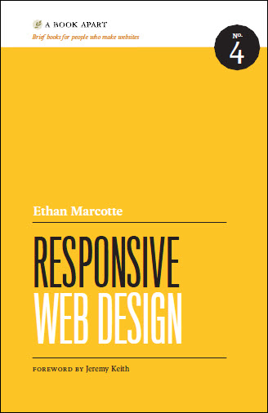
Buy this book

Slide 24
On my tech blog (http://thecodinghumanist.com/blog) I have a series on mobile web development going on.

Slide 25
Responsive Web Design
Eric B. Sowell
Mobile Web Development Lead, Match.com
@mallioch
eric.sowell@gmail.com
ericsowell.com

