Slide 1
Brewing 101
How to make beer, from grain to glass

Slide 2
Overview
How I got started
The process of brewing
SCIENCE!
Equipment
Our setup
Have a taste!

Slide 3
My background
Played in a band

Slide 4
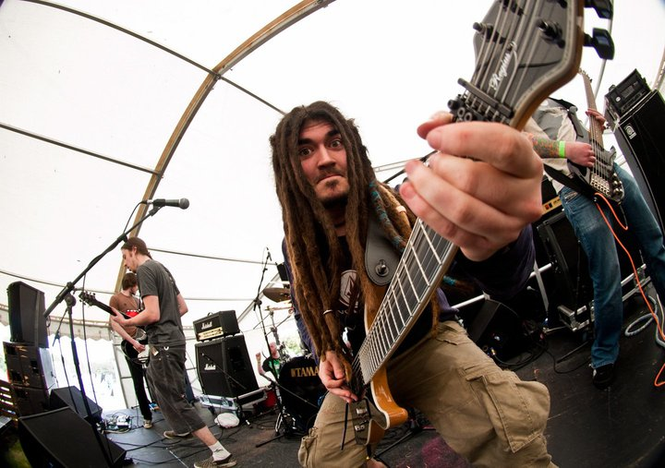

Slide 5
My background
Played in a band
Went to Belgium

Slide 6
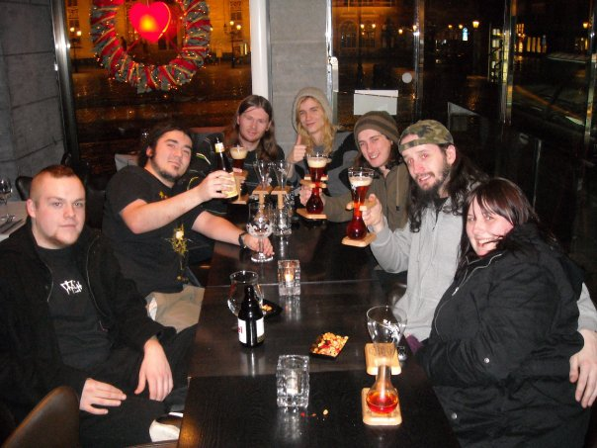

Slide 7
My background
Played in a band
Went to Belgium
Realised when I came home that NI was not Belgium.

Slide 8
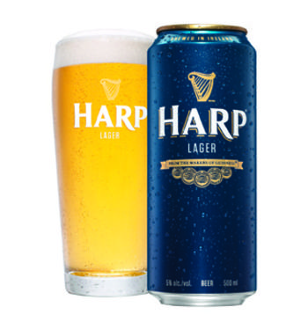
Crap

Slide 9
My background
Played in a band
Went to Belgium
Realised when I came home that NI was not Belgium.
How hard can it be?

Slide 10
The brewing process
4 main ingredients in beer:
  Water
  Malted barley
  Hops
  Yeast

Slide 11
3 stage process
The mash
  Steep grain in hot water – Temp is very important!
  Run wort off and sparge
The Boil
  Boil wort for an hour, add hops along the way
Fermentation
  Crash cool wort, rack to fermenter, pitch yeast
  Yeast consumes sugars, converts to alcohol & CO₂
  Wait!

Slide 12
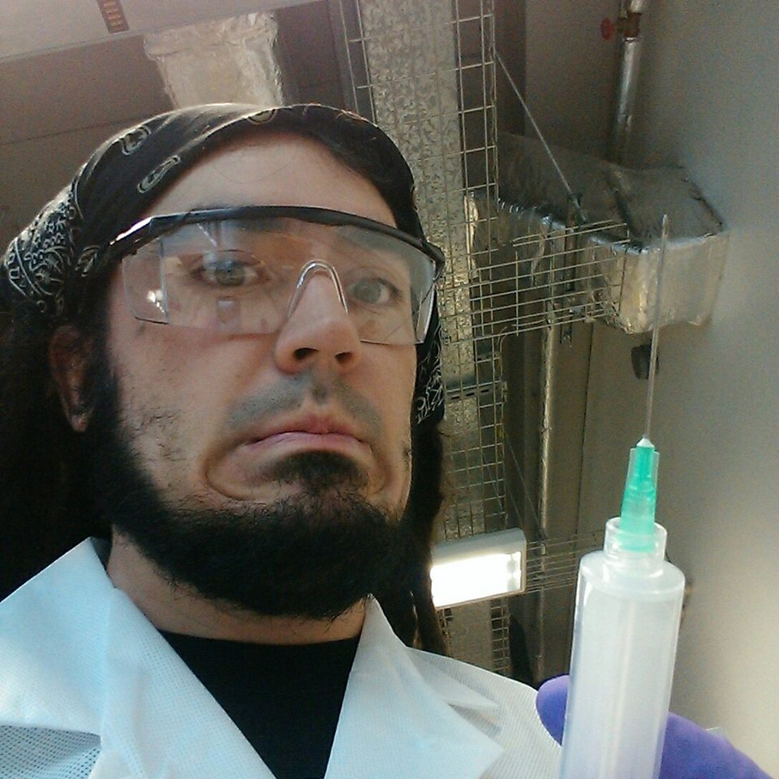
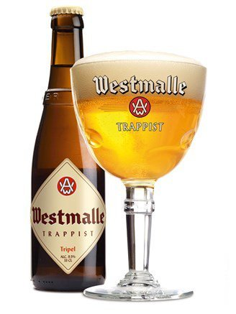


SCIENCE!
How to make beer more better:

Slide 13
Ingredients!
Different malts give different results!
Different hops also give different results!
Different yeasts also also give different results!
  Wild yeasts – whole ‘nuther ballgame.
Bonkers ingredients like wheat, oats, lactose, fruit, odd sugars, vanilla, coriander, coffee, marshmallows, bovril, coconut (?!) etc.

Slide 14
Mash Temperature
Starches are extracted from the grain during the mash.
Starch – long branched polymer chains made up of sugars.
Yeast is capable of consuming short sugar molecules (fermentable), and will leave longer complex chains (unfermentable dextrins).
Enzymes also released from grain during mash.

Slide 15
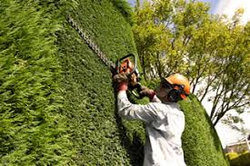
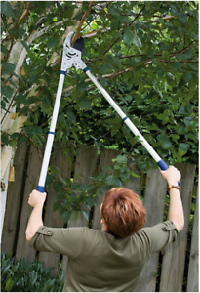
An allegory – trimming a hedge
Hedge trimmers – efficacious, but only really effective on twig ends
Clippers – Slower and more useful for larger branches

Slide 16
Enzymes & Saccharification
Alpha- & Beta-amylase are the main players
  Alpha – clippers
  Beta – hedge trimmers
Starch is converted to maltose (sugars) by these enzymes, but each performs a different role – both are necessary for a full conversion.

Slide 17
Beta-amylase (trimmers) will set to work on the ‘twig’ ends of the starch polymers, and work along the chain.
  Unable to break ‘branch’ bonds.
Alpha-amylase (clippers) targets junctions in the starch, exposing more ends for the beta-amylase to convert.
Both active at different temperatures, thus a compromise must be reached for optimal activation of both.

Slide 18
Lower mash temperature (in the optimal beta-amylase range) will result in a crisp, thinner bodied dry beer.
Higher mash temperature will give a heavier, sweeter beer (due to excess of complex unfermentable sugars).
Step mashes are possible, but usually not necessary.
Important that mash is kept at a consistent temperature throughout.

Slide 19
Post-fermentation
Dry-hopping – IPAs…
Barrel aging
Wild/Brettanomyces fermentation (not quite ‘post’)
Nitro tap
Ice distillation
etc...

Slide 20
Equipment
Video of us setting up rig

Slide 21
Equipment
Mash Tun
  Must be thermally insulated to maintain temperature
  Must have filter and tap
Boiling vessel
  Heating element
  Filter or ‘hop spider’
Fermenter
  Airtight, with airlock to vent CO₂
Thermostatic Fridge
  To maintain fermentation/conditioning temperature

Slide 22
Mash Tun

Slide 23
Boiler

Slide 24
Fermenter

Slide 25
Fridge

Slide 26
Electronics

Slide 27
Software layout

Slide 28
Try some!

