Slide 1
Using Code Inspection to Detect Security Vulnerabilities and Manage Potential Ones
A Case Study With ASP.NET and Custom FxCop Rules
Chris Shaffer
Director of Engineering, Relationship Science

Slide 2
We’ll be addressing…
Cross-Site Request Forgery
Cross-Site Scripting
JSON Request Hijacking
SQL Injection
Management and inventory of application’s attack surface
Enforcing organization-specific best practices

Slide 3

static code analysis
Back up … What is it, anyway?

Slide 4

Static Code Analysis
FxCop is a static analysis program used to find design and usage flaws, and failure to adhere to best practices.
It’s code reading other code and then criticizing it.
FxCop is just one of many.
Your code is great … for me to poop on.
Notes:
.NET: CodeRush, Ndepend, StyleCop
JSLint

Slide 5
When Testing Happens
Compiler
Unit Test
FxCop
Code Review
Integration Test
Burp Suite, etc.
Manual Test
Notes:
A compiler is kind of like a shitty unit test …
The key point here is that most security tools you think of look at actively running applications, and static analysis happens at an earlier stage, before code has to be deployed at all.

Slide 6
Advantages to Static Analysis
Runs at earlier stage of life cycle
Can run scans much faster
Can detect unsafe functions before code that calls them is even written, poor design that doesn’t leave external evidence
Of course, it works best in parallel, not as a replacement
Notes:
We’re all familiar with the exponential cost increases to finding a bug later in the lifecycle…
FxCop takes less than 5 minutes to run on our whole code base. It’s as quick as the compilation.

Slide 7
Some Examples of Rules Microsoft Gives Us
Declare Types in Namespaces
Do Not Catch General Exception Types
URI Properties Should Not Be Strings
Avoid Uncalled Private Code
Review Unused Parameters
And many more …

Slide 8
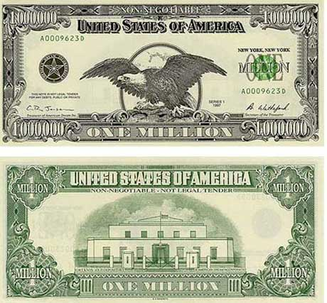
Cross-site request forgery
First, let’s review how CRSF attacks work

Slide 9
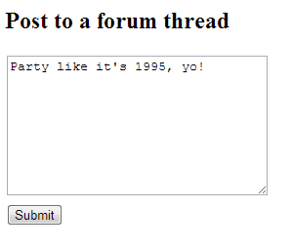
So, a victim is logged into a site …
For this example, let’s pretend the authentication of this site is secure …

Slide 10
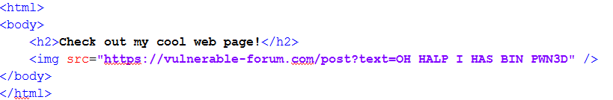
An attacker tricks them into clicking a link …
… or maybe they use a cross-site scripting vulnerability on a trusted site to stick that image in an ad on a news site …
If the victim user is logged into that site, and opens this link in the same browser, it’s going to use their login cookie and execute as if they clicked the ‘post a message’ button themselves.
Notes:
A trusted site like NYT, NYPost, Twitter, Buzzfeed, whatever else you may read …
And of course, this can be any action you’d take that you’d want to be protected, like changing your email address, transferring money, etc.

Slide 11
Or maybe the attacker is even more brazen …
“Hey, click this link!”
https://nostalgia-forum.com/post?somecrap=look-nontechnical-users-arent-even-going-to-read-this-seriously-its-techie-computer-nerd-stuff&nonsense=30ijrf3j09fij3ef09j3f0i3j2390fj30i4h4309u3409hf30f9h340&text=O%20HALP%20I%20STILL%20HAS%20BIN%20PWN3D
“Oh, I use the Nostalgia Forum all the time, of course I can trust a link to an article on it.”
Notes:
Lots of people that know better than to click a link in an email to chase.stealmymoney.com won’t think twice about a link that says chase.com?abunchofstuff

Slide 12
CSRF Mitigation
An application-wide solution to not being that guy

Slide 13
Generate a token, and add it to every form
Require that the token be submitted with any form.
This will ensure that a form submission to your site came from your site.
Fortunately, the .NET Framework gives us a built-in method for this …

Slide 14

Built-In Anti-Forgery in .NET
To add a token to the page’s markup:
@Html.AntiForgeryToken()
To check the token’s validity:
AntiForgery.Validate();
That’s It!
Sort of.

Slide 15
You’d still have to add that code to every sensitive form post …
That’s a pain.
Let’s not do that.
Add that token to our _Layout file
Have JavaScript append to it every form post
Have an HttpModule that runs on every request
If the request is a POST and is from a logged-in user, look for a token
If the token is missing, throw an error, otherwise validate it
Add [HttpPost] attributes to those sensitive form posts to make sure an attacker can’t hit them with a GET request (which would bypass the above)
Notes:
All your tokens, same-origin policies, URL referrer checks, etc. can’t protect you from this …

Slide 16
We’re Done!
Hold up.
Do you have any idea how fast you were going, son?
public class DerpDerpImNewAtWebDevelopmentController : Controller
{
[HttpGet]
public ActionResult TransferAllOfMyMonies(int destinationAccount)
{
//didn't plan for me, didja, punk?
}
}

Slide 17

how code analysis fits in
FxCop to the rescue!

Slide 18
First Rule
First rule of CSRF: Don’t talk about CSRF
Looks for any Action without [HttpPost]
If the name of the Action contains any words that indicate editing of data…
Such as … Save, Update, Edit, Delete, etc.
Or if it calls any functions named like that
Flag it as a violation

Slide 19
Second Rule
We flag anything that’s missing an [HttpGet] or [HttpPost] tag.
FxCop allows us to differentiate between “warnings” and “errors”, so we can treat these as a lower priority.
To catch cases in which a data-altering function doesn’t contain one of those keywords
Maybe we didn’t think of a keyword we should have
Maybe someone made a typo
Basically, this ends up being a way of making sure new code that adds to our attack surface is tracked and code reviewed.

Slide 20

JSON Hijacking
If you have to support crappy browsers…

Slide 21
JSON Hijacking
It’s similar to CSRF, except it uses JSON GETs to eavesdrop on the contents of those requests or even convince your browser to forward your session cookie to the attacker.
Details: http://haacked.com/archive/2009/06/25/json-hijacking.aspx
Fixed in most modern browsers.
But, it’s a great example.
Notes:
There’s a good blog post, it’s also the first Google result, I’m not going to go into the details, it’s similar to CSRF.

Slide 22
public class JSONAllowGetRule : BaseIntrospectionRule
{
public JSONAllowGetRule()
: base("JSONAllowGetRule", "RelSciCustomRules.RelSciCustomRules", typeof(RelSciBaseRule).Assembly) {}
public override TargetVisibilities TargetVisibility { get { return TargetVisibilities.All; } }
public override ProblemCollection Check(Member member)
{
var m = member as Method;
if (m != null)
{
VisitStatements(m.Body.Statements);
}
return Problems;
}
public override void VisitMethodCall(MethodCall call)
{
if (call.Method() != null)
{
if (call.Method().Parameters.Any(a => a.Type.FullName == "System.Web.Mvc.JsonRequestBehavior"))
{
this.Problems.Add(new Problem(this.GetResolution(), (Node)call));
}
}
base.VisitMethodCall(call);
}
}
Notes:
It’s a great example because the code is small enough to fit on a PowerPoint slide.
There’s also an XML file that has the message(s) for each rule, the priority, stuff like that…

Slide 23

The point of the next few rules is to identify high-risk code to make sure it’s first in line to be code reviewed.
Notes:
Whatever code review policy you’ve got, it’s probably pretty useful to be able to quickly and reliably identify the stuff that’s most likely to be risky right off the bat.

Slide 24

Authentication and Authorization
Policing to ensure the proper checks are in place.

Slide 25
Authentication
Our setup: Any request is required to be authenticated by default; any action that a developer wants to be accessed by an un-authenticated user has to be marked with a [SkipAuthorize] attribute
To ensure it’s being used correctly, we have FxCop generate a warning for any new [SkipAuthorize] to be code reviewed.

Slide 26
Authorization
.NET provides attributes:
[Authorize(Roles, Users, etc.)]
We use these to control access to premium features, and also administrative functions.
If it’s missing, any authenticated user could hit this page.
FxCop rule: Flag any Controller that doesn’t have this attribute specified.

Slide 27

Cross-Site Scripting
What happens when code bypasses the framework’s protections?
Notes:
If you just do @myString, you don’t have to worry about XSS

Slide 28
XSS
Flags functions that return an IHtmlString for code review.
We haven’t tried it, yet, but an approach similar to the next one (SQL injection) might work, here.

Slide 29
XSS (side note)
Replace this:
public class AViewModel
{
public IHtmlString AHyperlink { get; set; }
// ... elsewhere
AHyperlink = new HtmlString("<a href='" + Url.Action("doinit") + "'>clicky</a>");
With this:
public class AViewModel
{
public UrlHelper Url { get; set; }
public IHtmlString Ahyperlink {
get {
return new HtmlString("<a href='" + Url.Action("doinit") + "'>clicky</a>");
Also, use a TagBuilder.
Notes:
The idea here is that you only have to review and ensure the safety in one place. With the first approach, any time the property is used is a potential for a new XSS vulnerability.

Slide 30

SQL injection
The final frontier.
Notes:
Not because it’s the end of the talk, but because it’s freakin’ hard

Slide 31
SQL Injection – Attempt 1
Having a strictly enforced 3-layer architecture allows us to limit checks to just libraries with database access.
Follow “string-ish” method parameters
string, StringBuilder, IEnumerable<string>, user-defined types with public string properties, string cheese.
Flag unsafe concatenations, appends, etc. – anything with non-numeric arguments

Slide 32
SQL Injection – Failures of Attempt 1
False alarm: String concatenation for display logic in the data layer.
This:
And this:
This is bad practice, but it’s not SQL injection …
//the procedure comes from a value in a drop-down
public IEnumerable<int> RunSomeSelect(string procedureName) {
It’s not part of a dangerous concatenation…
var uhOh = repo.Query<string>(
"select Value from SomeCrapTheUserTypedIn;").Single();
string sql = string.Format(
"select * from SomeTable where Name = '{0}';", uhOh);

Slide 33
SQL Injection – Attempt 2
Every declared or assigned variable…
Mark parameters “dirty”
Mark constants and literals “clean”
Mark the target “clean” if all of the components in a format or concatenation are “clean”
Otherwise, mark it “dirty”
If the source is unknown, it’s “dirty”
If a SQL-executing function is called, and the SQL parameter is dirty, throw an error

Slide 34
SQL Injection – Attempt 2
Fixes the issues with the first one
Still has weaknesses:
It’s hard (false alarms)
Functions like these give errors that aren’t particularly informative; we can mitigate that with attributes.
[ExecutesSql]
private void RunMySQLAndDoSomethingWithTheResults(string sql)
{
var data = Query<int>(BuildCrazySearchSQL());
//... elsewhere
[BuildsDynamicSql]
private string BuildCrazySearchSQL()
Notes:
It’s hard to backtrack every variable and make sure it’s coming from clean sources. Often things that are clean are incorrectly marked dirty because the code can’t figure it out.
The first one will just tell you it’s untrusted because the parameter is dangerous. Really, what we want in this case is to flag when dangerous things go into this function.
The second one will tell you that it’s untrusted from the moment you call the Build function. Really, what you want is to go inside that function and find dangerous return values.

Slide 35
SQL Injection – Other Ideas
SafeSQLBuilder class – prevent string inputs, flag any SQL call that doesn’t use it
The obvious …
Use procedures
Use parameters
Use enums when databases, tables, and/or structural pieces of queries are determined by parameters
Notes:
But, realistically, applications just need dynamic SQL sometimes.
Parameters and enums are easy ones, and pretty foolproof - dynamic SQL should really be stuff you couldn’t make as SQL parameters, where the structure of the query changes
- but it’s really about enforcing that rule and catching it when people slip up.

Slide 36
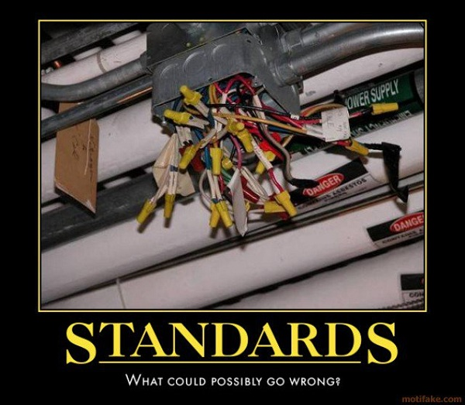
Enforcing best practices
Insert witty subtitle here.

Slide 37
Rules to Enforce Best Practices
Declaring a static IDisposable
Emails sent directly through the system library rather than our company’s library
Using a .Context property on the data layer
Lots of possibilities for more rules
Notes:
#1 – IDisposables are intended to be disposed when you’re done with them, so having a static one is just shady. We had a lot of problems with EntityFramework data contexts, and weird issues cropping up in test/production because multiple users/web pages were accessing the same one simultaneously.
#2 – The RelSci Email library has cool features like checking what environment you’re in and not emailing external addresses outside of production. We totally didn’t come up with that the hard way.
#3 – Using a .Context on the data layer could mess up caching – you’re depending on something that’s not going to be part of the cache key.

Slide 38

Putting it all together
Integrating it into our build process.

Slide 39
Integrating Into a Build Process
TeamCity: Fail if the number of warnings and/or errors reaches a certain threshold.
FxCop projects live in a repository that everyone has read access to, but only a few people have write access to.
Command-line utility: Add every DLL in a ….…… given directory to an FxCop project file.
So punks can’t whitelist their own stuff.
No forgetting to set up scanning for new code.
Notes:
TeamCity has a built-in option for an FxCop build step, other CI systems have it too. Or you can write a PowerShell script that runs it on the command line.

Slide 40
Next Steps
Code that’s not complied into an assembly …
Html.Raw() in .cshtml files
Dynamic SQL inside stored procedures
JavaScript
Example: Find code that makes a GET request to one of the actions turned up by the CSRF or JSON rules.
(so they don’t turn into page breaks when you fix the vulnerability)
Mass Assignment attacks
Make that SQL injection rule actually work
And many more …
Notes:
Html.Raw in .cshtml files: We can probably still point FxCop at precompiled assemblies, but will need different rules and standards for those
JavaScript: You should never rely on client-side code for security, but there is potential for static analysis here

Slide 41

Questions
Ask them.
TEH CODEZ: https://github.com/DrShaffopolis/FxCop

